Slide 2
THIS
IS
Jeopardy

Slide 3
With
Your
Host...
Mr. Riley

Slide 4
Jeopardy
Maps
Definitions
Physical Geography
The region today
Human Geography
100
100
100
100
100
200
200
200
200
200
300
300
300
300
300
400
400
400
400
400
500
500
500
500
500

Slide 5
What country is highlighted below?
A 100

Slide 6
Egypt
A 100

Slide 7
What country is highlighted below?
A 200

Slide 8
Iraq
A 200

Slide 9
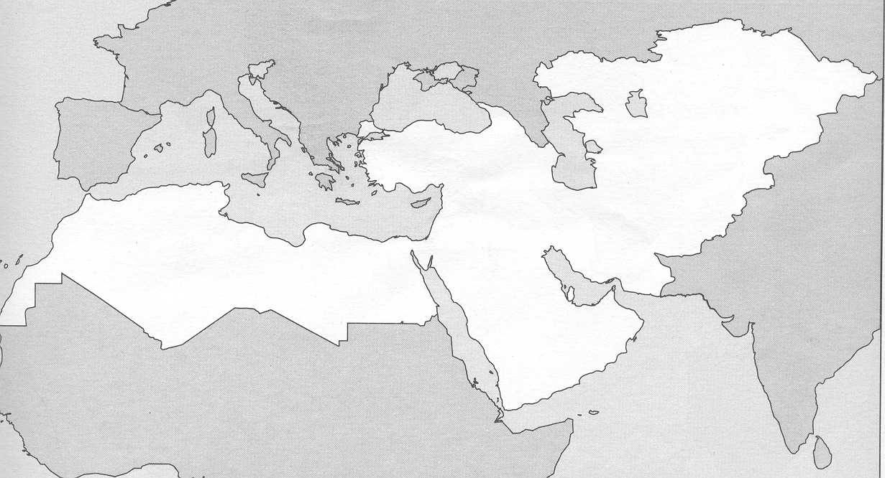
What mountain range is highlighted below?
A 300

Slide 10
Atlas Mountains
A 300

Slide 11
What body of water is highlighted below?
A 400

Slide 12
Caspian Sea
A 400

Slide 13
What landform is highlighted below?
A 500

Slide 14
Rub’ Al Khali
A 500

Slide 15
The belief in one god.
B 100

Slide 16
Monotheism
B 100

Slide 17
The banning of trade with a country.
B 200

Slide 18
Embargo
B 200

Slide 19
The basic urban necessities like streets, running water, sewer systems, and electricity.
B 300

Slide 20
Infrastructure
B 300

Slide 21
Define Hieroglyphics and Cuneiform.
B 400

Slide 22
Hieroglyphics are a writing system used by the ancient Egyptians using pictures as words.
Cuneiform is a writing system of the Sumarians that used wedged shapes symbols as words.
B 400

Slide 23
Define the terms Alluvial Soil and Arable.
B 500

Slide 24
B 500

Slide 25
The longest river in the world is partially located in this region.
C 100

Slide 26
Nile
C 100

Slide 27
Desert covers approximately what % of the region. (Within 10%)
C 200

Slide 28
50%
C 200

Slide 29
What is a Wadis?
C 300

Slide 30
A river bed that remains dry until it rains.
C 300

Slide 31
DAILY DOUBLE
DAILY DOUBLE
Place A Wager
C 400

Slide 32
What landform connects the Middle East to Africa?
C 400

Slide 33
The Sinai Peninsula
C 400

Slide 34
Describe the 2 other types of climate/vegetation regions that are found in the Middle East/North Africa.
C 500

Slide 35
Steppe- Grasslands region that receives about 10-20 inches of rain a year. Mostly used to raise livestock.
Mediterranean- Hot dry summers, mild wet winters. Most of the agriculture of the region is grown here.
C 500

Slide 36
What natural resource provides most of the income for the region?
D 100

Slide 37
OIL
D 100

Slide 38
Limited water supplies has resulted in some countries to build facilities that turn salt water into fresh water called…
D 200

Slide 39
Desalination plants
D 200

Slide 40
Hundreds of oil wells were set on fire by Iraqi forces, threatening birds and fish, during what war?
D 300

Slide 41
Persian Gulf War
D 300

Slide 42
What 2 business areas are some countries in the region trying to transition too?
D 400

Slide 43
Tourism and Bankig
D 400

Slide 44
Describe several differences between Shia and Sunni Muslims.
D 500

Slide 45
Shia- More strict following of the Koran. Religious leaders must be a descendant of Mohammad. Women have fewer rights. Gov’t and religion often the same.
Sunni- Less strict following of the Koran. Anyone can be a religious leader. Women have more rights. Gov’t often separate from the religion.
D 500

Slide 46
The most common language spoken in the region is…
E 100

Slide 47
Arabic
E 100

Slide 48
This religion is believed to be the worlds first monotheistic religion.
E 200

Slide 49
Judaism
E 200

Slide 50
What is the most important religious site for Muslims?
E 300

Slide 51
Mecca
E 300

Slide 52
Explain how the country of Israel was created.
E 400

Slide 53
In 1947, the United Nations separated Israel into Jewish and Palestinian states. In 1948, the British withdrew from the region and the Jews proclaimed Israel an Independent nation.
E 400

Slide 54
Describe 3 of the 5 “Pillars of Islam.”
E 500

Slide 55
Profess and spread the faith in God.
Pray five times a day.
Help the poor and needy.
Fast during the daylight hours of the holy month of Ramadan.
Make a pilgrimage to Macca.
E 500

Slide 56
The classification of Mammals with pouches
F 100

Slide 57
What are Maruspials?
F 100

Slide 58
This second largest bird in the world is native to Australia
F 200

Slide 59
What is the ostrich?
F 200

Slide 60
Australia’s wild dogs
F 300

Slide 61
What are dingos?
F 300

Slide 62
This Australian island is the home of a devil and a wolf
F 400

Slide 63
What is Tasmania?
F 400

Slide 64
Although the National Bird of New Zealand, it is also indigenous to Australia
F 500

Slide 65
What is the Kiwi?
F 500

Slide 66
The Final Jeopardy Category is:
Early Civilizations
Please record your wager.
Click on screen to begin

Slide 67
Identify 2 early civilization of the region. Describe 2 accomplishments of each civilization.
Click on screen to continue

Slide 68
Correct Final Jeopardy Response
Click on screen to continue

Slide 69
Thank You for Playing Jeopardy!
Game Designed By C. Harr-MAIT

