Slide 1
Glycolysis & The Metabolic Pathway
Topic 2 Group A

Slide 2
Metabolic Pathway
Breakdown of glucose in mammalian cells
Most commonly found in skeletal muscle a.k.a. glycolytic tissue
Usually pale or white skeletal muscle (white especially during exercise)
Which contain large quantities of glycolytic enzymes
Process is a multistep pathway (much more than phosphogen system
Two forms: (1) Anaerobic and (2) Aerobic

Slide 3
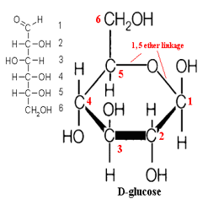
Structure of Glucose

Slide 4
Glycolytic Pathway (1) Anaerobic
Glucose → Glucose 6-Phosphate (G6P) via Hexokinase
G6P→ Fructose 6-Phosphate (F6P) via Phosphohexoisomerase
F6P→ Fructose 1, 6 diphosphate (F1,6DP) via Phosphofructokinase (PFK)
F1,6DP→Dihydroxyacetone Phosphate & Glyceraldehyde 3-Phosphate (G3P) via Aldolase
-Key: last step is where glucose (6-C) splits into two 3-C structures.
-G3P continues while Triose Isomerase catalyzes the reversible interconversion of the isomers dihydroxyacetone phosphate and G3P

Slide 5
Glycolytic Pathway cont….
G3P→Diphosphoglycerate (1,3-DPG) via Glyceraldehyde 3-phosphate dehydrogenase
1,3-DPG→3-Phosphoglycerate (3-PG) via 3-Phospoglycerate kinase
3-PG→2-Phosphoglycerate (2-PG) via Phosphoglyceromutase
2-PG→ Phosphoenolpyruvate (PEP) via Enolase
PEP→ Pyruvate via Pyruvate kinase
-Key: “end” result pyruvate either reduces to lactate or enters the mitochondria for complete oxidation.
Pyruvate → Lactate via Lactate dehydrogenase

Slide 6
Glycogen
Composed of hundreds of glucose molecules, joined end to end, with prevalent branches.
Stored in the liver or skeletal muscle.
In resting muscle, little glycogen is broken down, however, during exercise, glycogen breakdown is accelerated.
With exercise, glycogen not glucose is the main precursor for glycolysis.

Slide 7
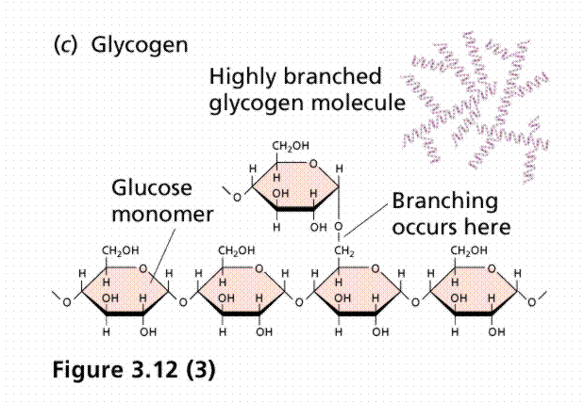
Structure of Glycogen

Slide 8
Glycogenolysis
Glycogen (n units) + Pi ← → Glycogen (n-1 units) + Glucose 1-Phosphate (G1P) via Glycogen phosphorylase
Glucose 1-Phosphate ← → Glucose 6-phosphate (G6P) via Phosphoglucomutase
G6P continues in the glycolytic pathway

Slide 9
(2) Aerobic
Aerobic or slow glycolysis
In step 6 NAD+ (adding of hydrogen and electrons) reduces to yield NADH
NADH “shuttles” the hydrogen and electron to the mitochondria
The end result of slow glycolysis is pyruvate, which is consumed by the mitochondria.

