Slide 1
ACS 560 Project
Microblog 911
Kassie M. Bowman
December 6, 2011

Slide 2
Project Overview
Emergency detection using microblog data
Benefits
  Real-time information
  Instant notification to relevant parties
Challenges
  Timeliness without false alarms

Slide 3
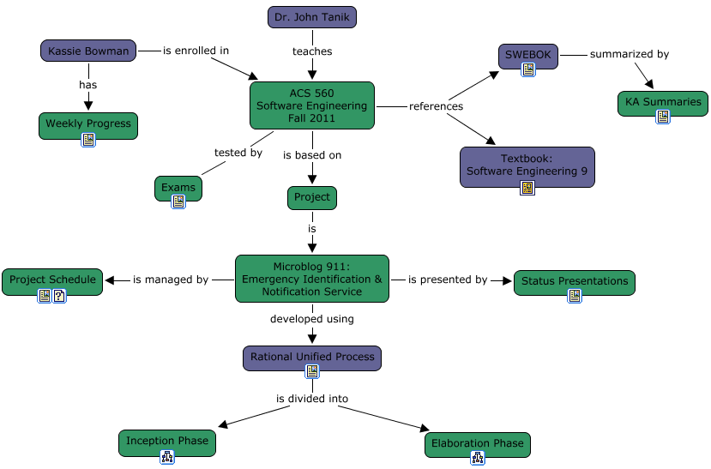
Main Cmap

Slide 4
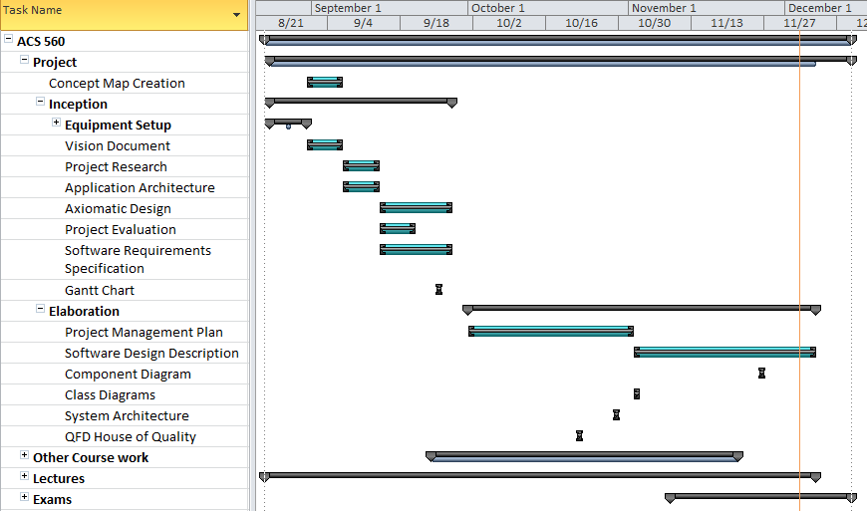
Project Schedule

Slide 5
Inception Phase

Slide 6
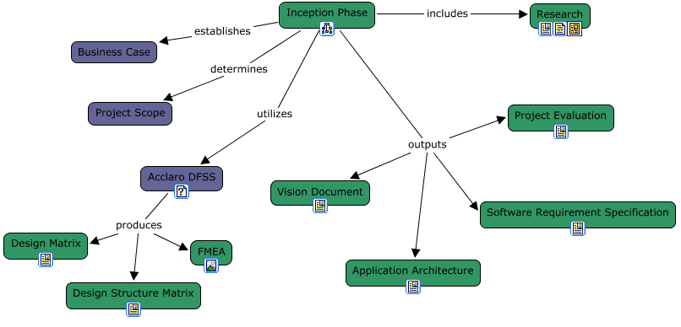
Inception Cmap

Slide 7
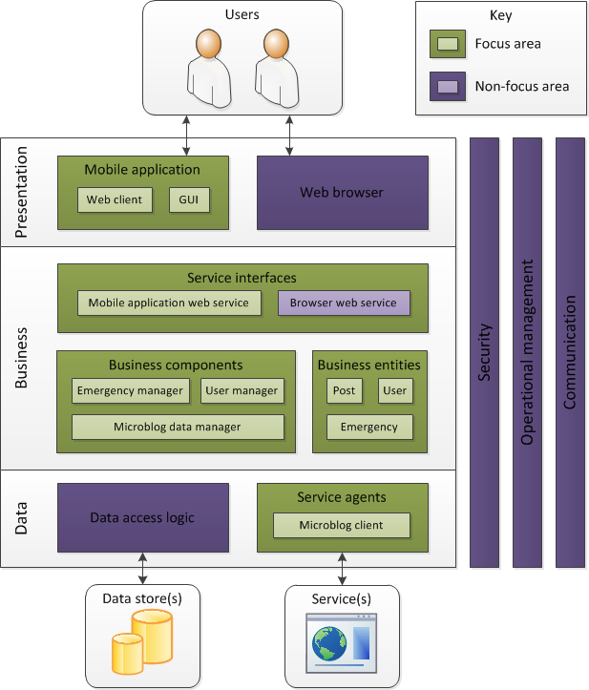
Application Architecture

Slide 8
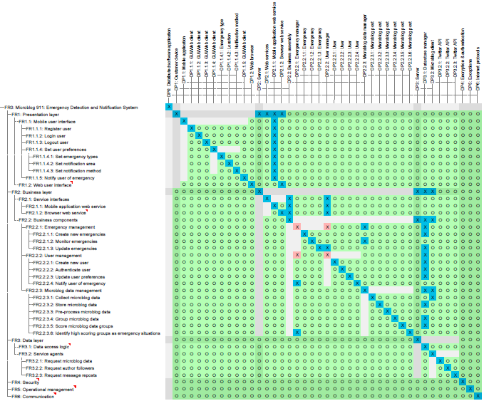
Design Matrix

Slide 9
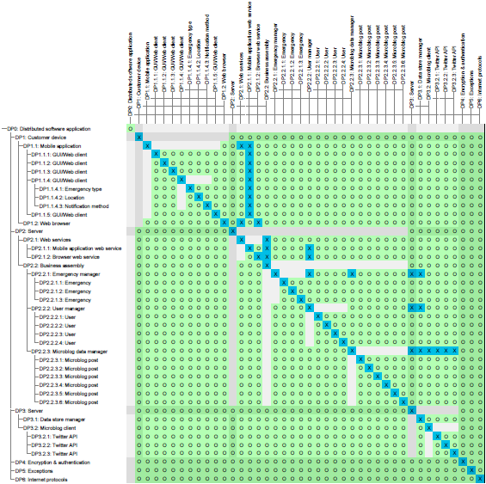
Design Structure Matrix

Slide 10
Elaboration Phase

Slide 11
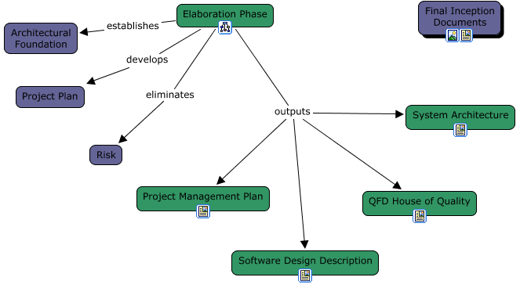
Elaboration Cmap

Slide 12
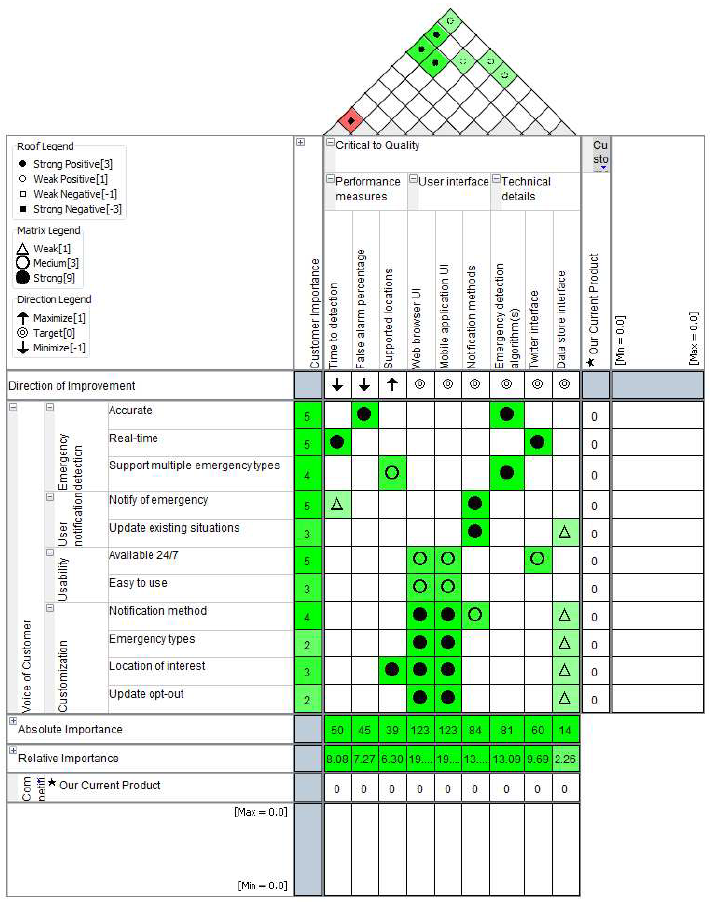
QFD House of Quality

Slide 13
UML - Component Diagram

Slide 14
UML – Class Diagrams

Slide 15
UML – Activity Diagram
Emergency detection algorithm
  Process posts
  Group similar posts
  Score groups
    Cumulative followers
    Cumulative reposts
  Create emergency

Slide 16
Project Summary

Slide 17
Deliverables – Inception Phase
Vision Document (v2)
Application Architecture (v2)
Software Requirement Specification (v4)
FMEA (v1)
Design Matrix (v2)
Design Structure Matrix (v2)

Slide 18
Deliverables – Elaboration Phase
Project Management Plan (v5)
QFD House of Quality (v1)
System Architecture (v2)
Software Design Description (v3)
Project Schedule (v3)

Slide 19
Thank You.
Any questions?

