Slide 1
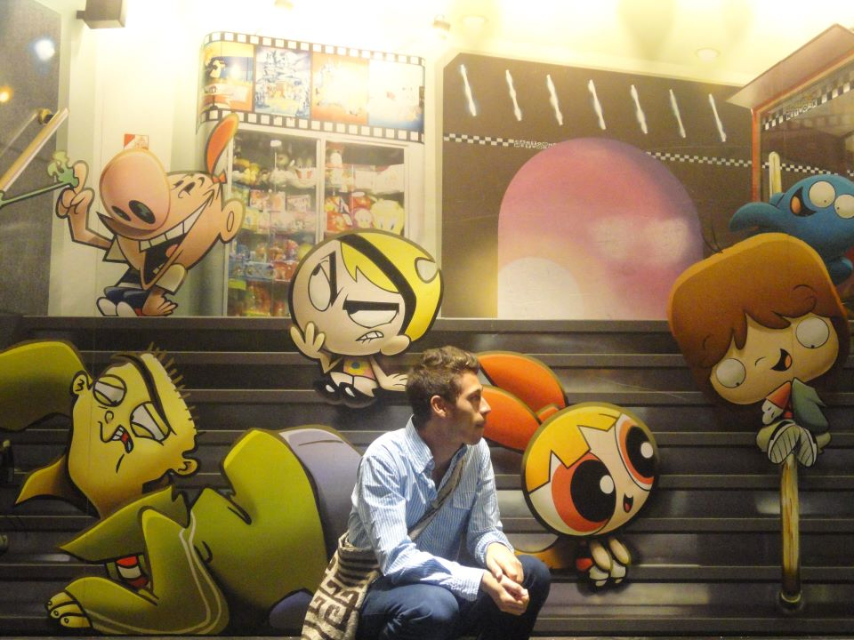
Bitacora zero
Miguel Andrés Díaz Cortés

Slide 2
What do I expect from this course?
I expect from this course to give me pedagogical tools that I could put into practice once I start my practicum.
I also expect myself to come up with pedagogical points of view towards the use of technology and relate it to what I currently learn in other pedagogy classes.

Slide 3
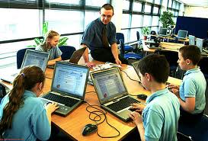
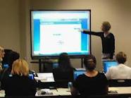
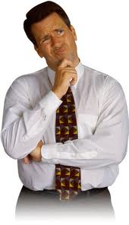

Slide 4
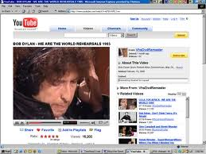
My experience as a teacher
My experience as a teacher is quite short. I have only given private lessons to no more than 3 people.
I always liked Youtube. It is a source full of music, academic information and also ESL material. Never did I use so sophisticated technological tools or softwares since I did not have the chance to know them, nor was I curious about them.

Slide 5
Technology in L2 teaching
Techonology has shown development in the past decades. It is so controversial sometimes: when it comes to ethics, mankind and technology.
L2 teachers must have asked themselves (and they still do, I guess) how to use technology in order to improve our learners’ L2 proficiency.

Slide 6
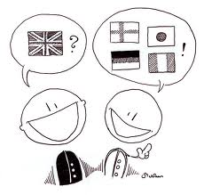
+
?
<?

Slide 7
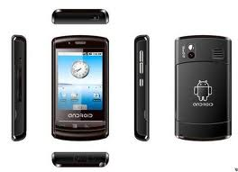
To that extent, I believe that technology keeps offering teachers tools to be applied in the L2 classroom, as it keeps developing and innovating. Our challenge, as teachers, is to adapt those devices, softwares and virtual experiences in favor of a proficiency in a foreign language.

Slide 8
All in all, techonology is important in L2 teaching as it challenges teachers’ adaptive skills. Furthermore, it is something to which mankind has attached itself. Instead of avoiding it, we should use it to our own benefit, which means, our learners’ benefit.

Slide 9
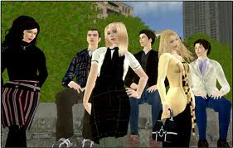
Bitacora 1
Second Life experience

Slide 10
In general, it was a good experience (once it became possible to work).
The first hour everything was crazy. I barely could handle my avatar and I seriously doubted that I could fulfill with the tasks. In other terms, I really thought I would not make it.

Slide 11
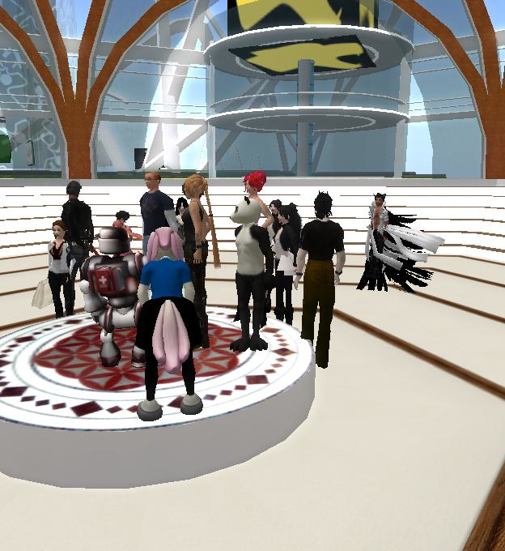
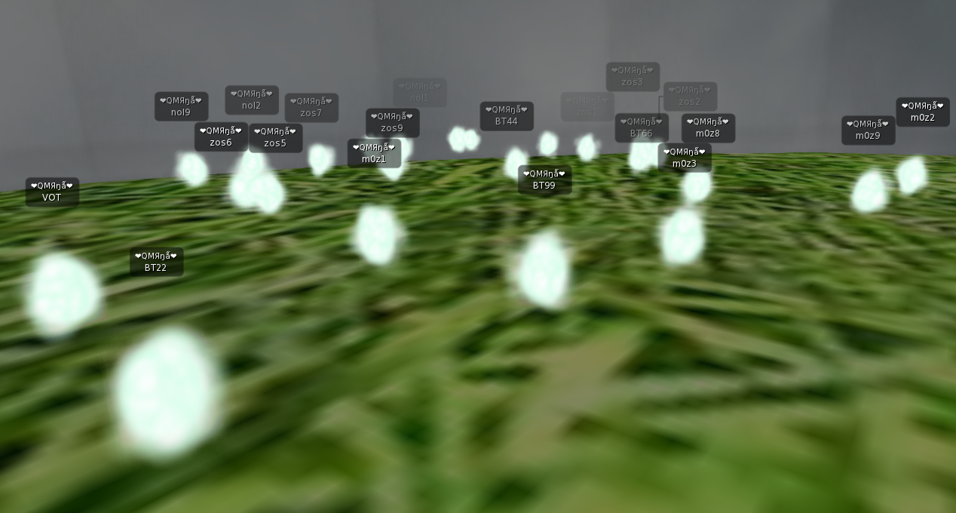
Something similar to what I saw.
What my classmates saw

Slide 12
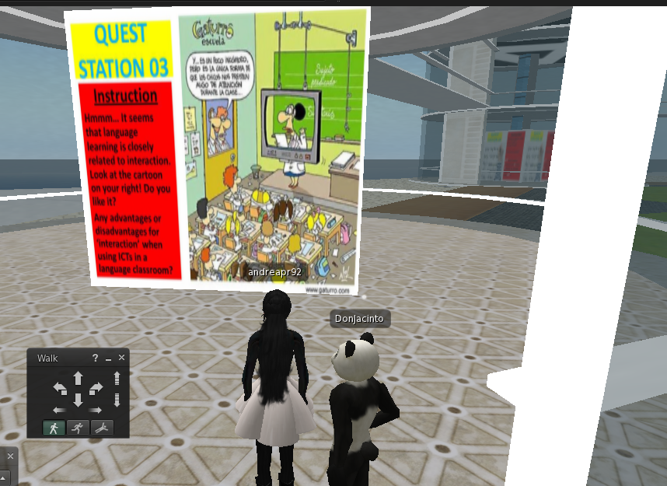
I considered it very challenging to organize this kind of activities. It requires a lot of logistics (in terms of audio, checking on students’ proper use of the program, students who arrive late, students who got lost easily, and so on).

Slide 13
I felt comfortable in this group work. We had enough time to discuss the questions and we were all very supportive. If somebody was lost, somebody else would be asked to track him/her down and lead him/her.
This was also evidenced when new people got in and had no idea about the instructions. In general, we all had at least one problem, but we were always supported. By the end of the activity, it could be felt how proud we all were of having done it and having experienced something new.

Slide 14
I am curious about the next Second Life immersion.

