Slide 1
M113 APC

Slide 2
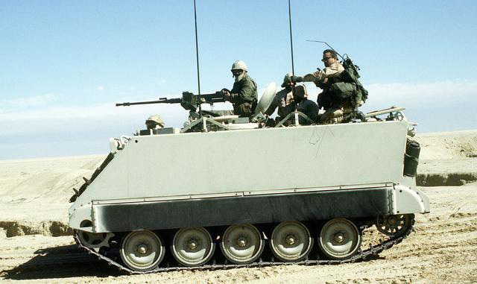
Characteristics of M113 APC
A fully tracked 5 road wheels armored personnel carrier.
Boxy in shape, often mounted with small arms weapons.
Transport troops to battle front.

Slide 3
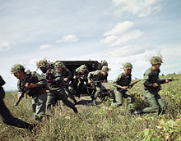
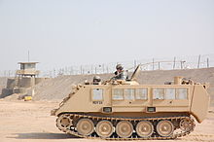
M113 APC Facts
The M113 is a fully tracked armored personnel carrier that has formed the backbone of the United States Army’s mechanized infantry units from the time of its first fielding in Vietnam in April 1962. Most widely used armored vehicle of the U.S. Army in the Vietnam War, earning the nickname 'Green Dragon' by some people, but largely known as an APC and ACAV (armored cavalry assault vehicle) by the allied forces, as it was used to break through heavy thickets in the midst of the jungle to attack and overrun enemy positions.

