Slide 1
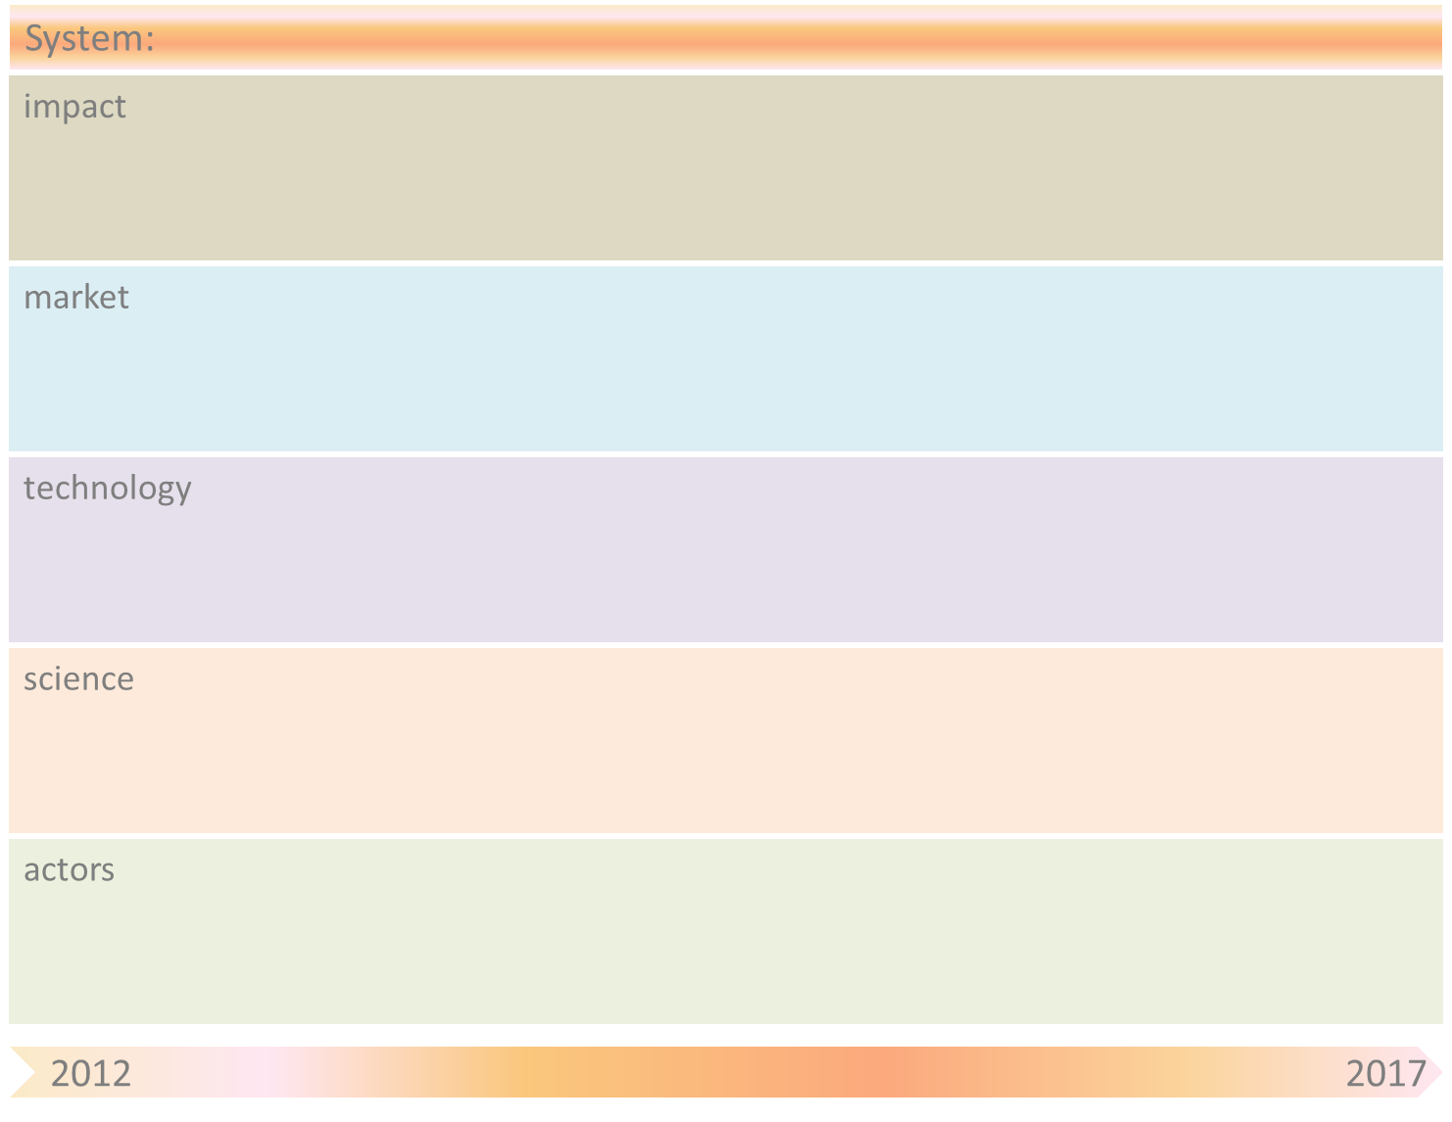
Communication networks: Fixed and mobile networks & Wireless Ad-hoc Networks
Rapid growth in supply and demand of different communication services
Further increase of society’s dependency on communication networks.
Need for new regulations (e.g. net neutrality, network availability/robustness,..)
Lower prices for communication services due to higher efficiency and less human involvement in the network operations.
Boost to the economy because of the ability of rapid introduction of new communication services.
Operator companies will offer less operational jobs, because of reducing human involvement.
Currently: The level of self-organization in Ad-hoc and sensor networks is already quite high.
In mobile networks only very first formed self-organization is present, for example in LTE. In fixed data networks some functionalitie (e.g. routing) can be considered to be self-organizing.
2020: Mobile networks, in particular LTE, are fully self-organizing. The concept of Cognitive Radio in heterogeneous wireless and mobile networks is fully exploited: the systems selects the communication technology that fits best the usage at that moment.
Fixed data networks are largely self-managed.
1 step further: In the ideal case, the operator needs to feed the self-organizing network only with a set of policy aspects.
Currently: In mobile networks some self-learning algorithms are already developed for different functionalities (e.g. handover optimization). The level of self-learningness is limited. , mostly, based on a priori chosen space of possible environmental and network changes.
2020: Level of self-organization is increased for a large number of functionalities. Interaction between the self-organizing functionalities is captured. Translation of the operator into different sub-goals. In the ideal case, the system itself translates the operator policies into different sub goals for the various self-organizing functionalities.
1 step further: In the ideal situation, the system adapts to the need and desires of the users (in terms of service quality, communication speed,..). This requires an enhanced form of self-learning by interpreting the human desires and human experience. This is a big challenge.
Actors: Network operators, Network vendors (manufactures), government (policy, regulation), Consultancy companies, universities and other research institutes.
2020: The traditional role of the operator will be superfluous. Like the energy and railway infrastructure, the communication infrastructure will be controlled by the government.

Slide 2
System-name
: Communication Networks
Drivers/ Breakthroughs | Mitigation by SOAS principle(s)
Robustness | The increasing dependency on communication networks requires a robust and sustainable network system. There is a need for flexible redundancy.
Complexity of operations (growing scale and diversity of services). | Manual operations becomes impossible. Self-manament principles are needed.
Cost efficiency | Due to the strong competitions there is an urge to decrease the costs, and to make the network system as efficient as possible.

