Slide 1
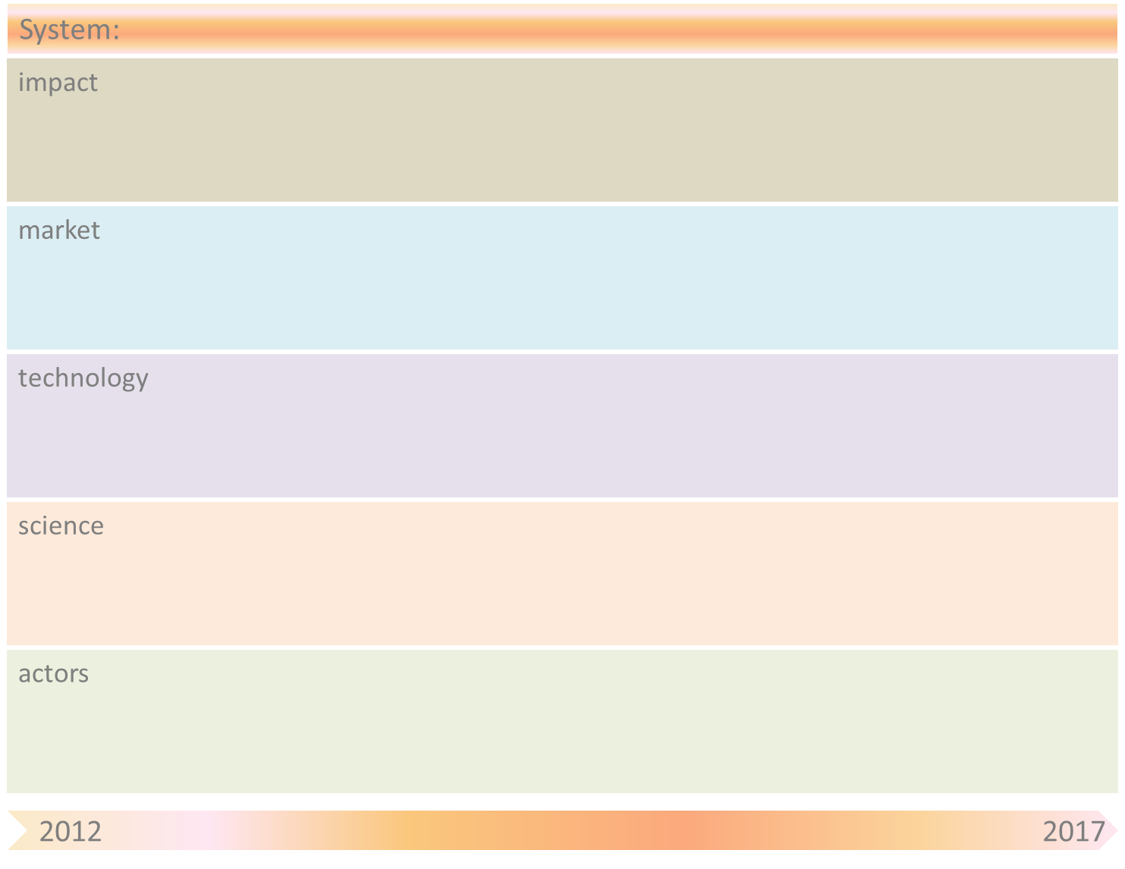
Internet of Services: Emergence of Cloud Services & Service Oriented Architectures (SOA)
Service creation becomes a ‘commodity’ (both for companies and individuals).
Enablers for “Het Nieuwe Werken”; organizational changes in companies etc. (e.g. reduced role of ICT departments).
Growing privacy issues
Further increase of society’s dependency on the Internet
Extreme flexibility in creation of new services and businesses (faster, cheaper, etc.)
Completely new business models and roles (e.g. role of brokers)
Overall: boost service economy by enabling more flexibility and more efficiency.
Currently: Cloud/service usage (by customers) and management (by providers) is handled largely ‘manually’. Actions are taken at relatively large time scales and based on rough, static guidelines.
2020: Cloud/service usage and management are largely self-organising. Automated actions can be taken at small time scales quickly adapting to fluctuations in available resources, demand, prices etc. (i.e. increased flexibility and (hence) increased efficiency and robustness). New business parties play an important role (service brokers, federation of providers, federation of users, etc.). Tactical and strategic decisions are still made by humans possibly supported by ‘intelligent’ suggestions from the system.
1 step further: Full self-organising service creation and ‘implementation’ only based on high-level specifications of service providers. Similar developments regarding service usage. In fact, service creation and usage becoming convertging.
Introduction of initial forms of self-organisation in cloud/service managmement is currently investigated. But still also quite some efforts needed on functional aspects (architectures, protocols) and their standardization.
Realization of the 2020 goals (see above) requires, in particular, further research on large scale system monitoring and self-learning decision algorithms. This are highly complex tasks due to the large system scale, the multitude of interrelated parameters and the highly fluctuating demands together with the strong requirements regarding system performance, robustness, etc.
The ‘ultimate’ form of self-organization (see above, under 2030) requires, in particular, additional research on ontologies etc. The integration of technical and human aspects is also of great importance!
Service developers, service providers, cloud providers, users (companies, individual persons), service brokers, technology manufacturers (IBM, HP, Alcatel-Lucent), integrators (IBM, Getronics). Legal parties, government.
2020: The role of service brokers is becoming more and more important.

Slide 2
System-name
Internet of Services: Emergence of Cloud Services & Service Oriented Architectures
Drivers/ Breakthroughs | Mitigation by SOAS principle(s)
Manual operations and usage becomes too complex due to the growing scale and diversity of cloud services (→ inefficiency, system failures, etc.).

