Slide 1
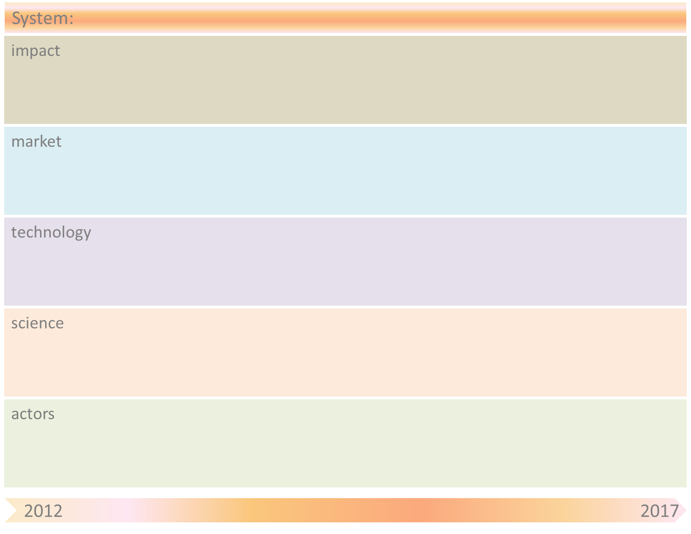
Smart ICT & Open Energy
Sustainable Energy System
obstacle
Trust in network tech
Platform dependency
Constant Energy Awareness
item
Growing Importance
of local/smart energy
Risk of Platform lock-in
Ecological impact
Energy Policy hurdle
obstacle
Facebook as an energy provider
Single Europe Energy Market?
Energy App Store
Single Europe Energy Market
Personal energy management
Energy eBay
Piracy
Smart Energy Pilots
Privacy issues
Quadruple Play
Privileges of incumbents
Free energy market
Radically new business models
Energy On the Go
Interoperability
Smart Grid
Energy OS/API
Ubiquitous Energy
PET
Energy Apps
Cloud comp
Energy Valuation
Hyperlocal Energy Production
Network tech
Tariff Modelling
Wearable Energy Production Tech
Computer science
Privacy law
Social Sciences: User Participation
Data science
Energy harvesting
Multi disciplinarity
SNA
Nano
Sensor
Graphene
Users
Legacy companies revolt
Hardware developers
Energy Network Operators
App developers
VCs
ISPs as ESPs
Ownership Utility Data
Independent Energy Producers
Energy Utility Companies
Energy Data intermediaries
Energy Pirates
Government
Billing Providers
Local Energy Communities

Slide 2
Smart ICT & Open Energy
Obstacle | Mitigation by SOAS principle(s)
Energy Policy Hurdle | ?
Platform dependency | Community control/restrictions, inhibiting extremes…
Privacy Issues | Personal data management services (bottom up)
Privileges of incumbents | ?
Single Europe Energy Market? | New market mechanisms
Energy Valuation | Free market mechanism (in kind possible, better in currency)
Privacy law | Organizing adapted networks of users and producers
Energy harvesting | Choice for sustainability ipv economy
Legacy companies revolt | ?
Ownership Utility Data
Interoperability | Central agreement on standard, consequence ….

