Slide 1
Hybrid freight market: storyline
E-markets for freight capacity now rely mostly on volume information and are rather static (function within the existing regime of pre-planned tours). Auctions can be used for allocating spot freight to planned tours.

Slide 2
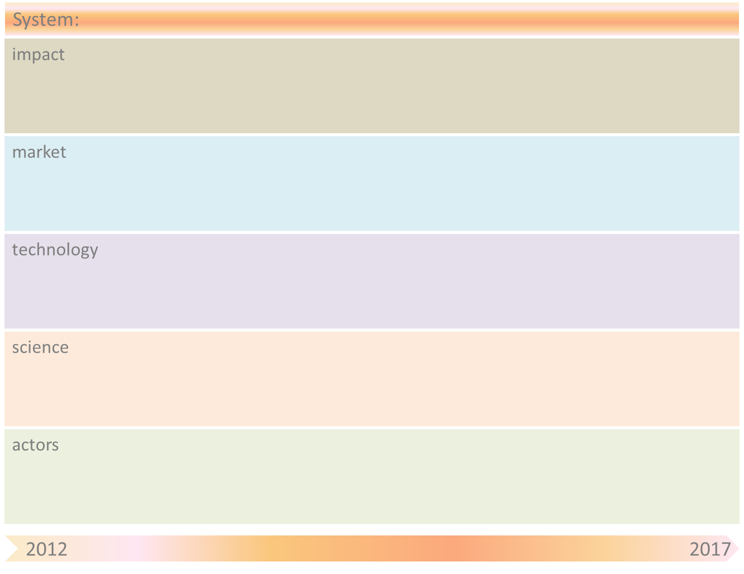
Hybrid freight market
Improved capacity utilization
Increased flexibility for freight market
Flexible (time&price)
customized delivery
Freight auctions
Shipping market
Freight carriers (‘ collectives)
Home delivery
Dynamic pricing
Auction technology
Dynamic planning
Pricing strategies
Artificial Intelligence
Economics
Shippers
Carriers
Universities (e.g, ?)
& Research Institutes (e.g., TNO/?)
Transport Marketplace
Customers
AH

Slide 3
Hybrid freight market
Obstacle | Mitigation by SOAS principle(s)
Unwillingness to share information about excess capacity | Auctioning based on actual prices
Overview of available capacity in market is lacking | “

