Slide 1
SOAS Roadmaps Template (in English please)
Instructions:
Collect existing roadmaps in ‘your’ domain (logistics, biology, com-networks, organization-work, organization-collaboration, ict -people)
Choose relevant existing roadmap
Make a copy of slide#2 and slide#3 and insert
Define the system-name and system-goal the roadmap is about
For each horizontal bar (actors, science, technology, market, impact) formulate the development in terms of keywords (use copies of the “item” [ctrl+d]) see also explanation of the dimensions
After all keywords are in place, add key obstacles (use copies of “obstacle” [ctrl+d])
When done, return to step 2 until all relevant roadmaps are made
Save file with domain name in the file name (eg. logistics zoas rm v01.pptx)
Place in following folder \\tsn.tno.nl\data\Projects\041\0\01077\ZOAS knowledge\roadmaps
Think ‘hallelujah’
Explanation of the dimensions:
Actors:
For this dimension name the relevant actors involved with the system and how they are linked and how this network develops through time.
Science:
Name the actual and expected scientific principles involved.
Technology:
Describe the technological development , the actual practical application of science now and expected.
Market:
Name the relationships between producers and consumers (a-b) that benefit from the system, now and expected
Impact:
Name the consequences of the emergent system behavior, positive and negative

Slide 2
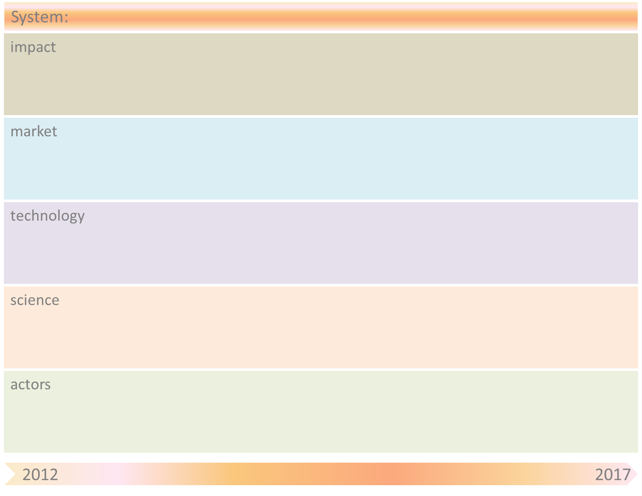
system-name & system-goal
item
obstacle

Slide 3
System-name
Obstacle | Mitigation by SOAS principle(s)

