Slide 1
Trade management
Inventory management
Modes
Fleet assignment
Scheduling
Routing
Delivery
1
SOAS focus:
Transport Logistics
Selforganized
TRANSPORT
LOGISTICS
?
Relation between
Systems (logistics soas roadmap)
Selforganized
multimodal
Routing
Collaborative
Capacity management
Hybrid
Markets / auctions
Exists within LSP’s
Experiments e.g. PAT, Nabuurs & Bakker
Various freight market places e.g. vozeeme
But not yet integrated with adaptive tour planning
Adaptive tour planning

Slide 2
Self-Organizing
Transport Logistics (SOTL)
Will individual and collective eventually converge?
2.
Individual
SOTL
3.
Collaborative
SOTL
4.
SOTL
market
Stream A: global integrators/individual
1.
Adaptive tour planning
Stream B: regional providers/collective

Slide 3
Selforganized routing
Collaborative capacity management //
Hybrid freight markets
Adaptive tour planning
Consumer
Shipper (CocaCola)
LSP (DHL/UPS, K+N)
Carrier collective (Transmission, Nabuurs&Bakker)
Transport firm (Vos Logistics)
Infra network

Slide 4
Individual
Collective
2
Modes
Fleet assignment
Scheduling
Routing
Delivery
3
4
1
SOTL
3: asset based
4: market based

Slide 5
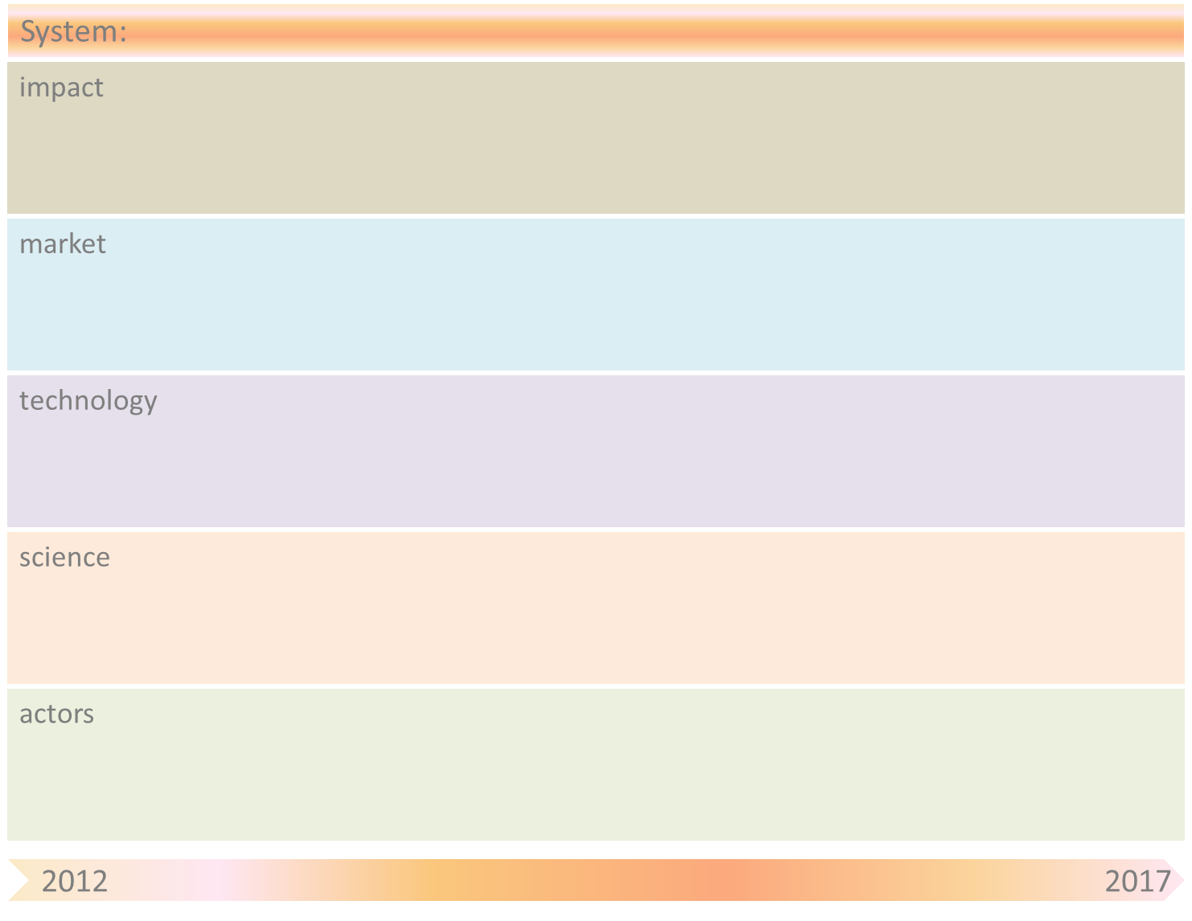
Adaptive tour planning system
Shorter delivery times for consumers
Increased responsiveness & flexibility of tours for (individual) carriers
Better vehicle capacity utilization for (individual) carriers
Reduction of waiting times for (individual) carriers
Planning tools for tour planning providers
On-board systems for carriers
Dynamic planning
Agent-based technology for carriers
Cloud computing
Artificial Intelligence
Web 2.0 technologies
Universities (e.g., TUDelft, Utwente, Uni Bremen)
& Research Institutes (e.g., TNO, CRC637)
Regional logistics providers /individual
On-board systems providers
Global Integrators/individual
(e.g., DHL, K&N, UPS)
Planning systems providers

Slide 6
Adaptive tour planning system
Obstacle | Mitigation by SOAS principle(s)
Interoperability issues | Availability of information to improve real time decision making and governance models to coordinate the level and amount of data sharing, based on pre-specified agreements
Costs | High transaction costs, difficulty of coordination and risk of information leakage with central planning
Data sharing | Willingness to share information
Agent-based technology | Distribution of intelligence to nodes (moving nodes and nodes at fixed locations)
Sensors issues | On board computers (or apps on smart devices) acting as sensors for creating location awareness

Slide 7
Self-organizing parcel delivery system
Customised parcel delivery for customers
Increased robustness for (individual) global integrators
Increased responsiveness and flexibility for (individual) global integrators
Container services
E-commerce (B2B & B2C)
Parcel services
Quality control & security for customs
RFID technology for parcels
URI & semantic web technologies
Algorithms for agent-based parcel routing
Cloud computing
Sensors & sensor networks
Ubiquitous computing
Distributed computing
Artificial Intelligence
Sensors suppliers (e.g., ASML, TNO)
& sensor applications developers
Global Integrators/individual
(e.g., DHL, K&N, UPS)
Universities (e.g., TUDelft, UTwente, Uni Bremen)
& Research Institutes (e.g., TNO, CRC637)

Slide 8
Self-organizing parcel delivery system
Obstacle | Mitigation by SOAS principle(s)
Sensors and RFID technology costs | We aim at providing eventually even the smallest parcels with smart sensors in order to store/process information. Costs of sensors and RFID technology are still too high.
Scalability of agent technology | Agents are necessary in a decentralized architecture to process locally the relevant information coming from RFID tags, and take decisions based on this information. Are agent-based solutions scalable for huge amounts of parcels to be delivered?
Granularity level of agent-based solutions | Where the agents should be for optimal and scalable solutions? E.g., (ordered from low to high granularity) parcels, packages, containers, vehicles, hubs, etc.
Reusability of technological solutions | To what extent can technological solutions, such as sensors and agents, be reused? E.g., products (no reusability), packages (low reusability), containers (good reusability) , vehicles (high reusability)

Slide 9
Container capacity management system
Shorter delivery times for customers
Optimized costs and movements for carrier collectives
Planning systems for carrier collectives
Container carriers
Agent-based technology,
Dynamic planning
RFID technology
Collaborative planning tools
Computer Supported Collaboration
Sensor networks
Artificial Intelligence
Sensors suppliers (e.g., ASML, TNO)
& sensor applications developers
Regional providers /collectives
(e.g., PAT-Planning Apart Together, TransMission, Nabuurs & Bakker)
Universities (e.g., TUDelft, Utwente, Uni Bremen)
& Research Institutes (e.g., TNO, CRC637)
Planning systems providers

Slide 10
Container capacity management system
Obstacle | Mitigation by SOAS principle(s)
Data sharing | Availability of information to improve real time decision making and willingness to share the information. We can provide IT solutions to improve communication and information sharing using web technologies and so forth, but are stakeholders willing to provide and share this info?
Interoperabiltiy issues | Availability of inter-operable decentralized/distributed tour planning systems able to effectively coordinate among multiple partners for which it produces a tour planning in order to allow regional logistics providers to collaborate with each other in the execution of logistical services.
Costs | Sensor and RFID costs for containers, communication costs, costs of facilities to construct a network (e.g. GSM, wireless sensor networks with detection mechanisms in inland waterways, satellite)
Decision making complexity | Only parts of the network are known, how does optimization of these parts affect the total network? Is it only feasible if these parts are loosely coupled, e.g. via vessels or other transport means with fixed schedules?
Scalability of agent technology | Agents are necessary in a decentralized architecture to process locally the relevant information coming from RFID tags, and take decisions based on this information. Are agent-based solutions scalable for huge amounts of container movements?

Slide 11
Hybrid freight market
Customised (in price and time) delivery for consumers
Flexible pricing mechanisms for carrier collectives
Increased responsiveness for freight market
Electronic hybrid freight market (integrated platform for freight market and auctions)
Electronic freight auctions
Electronic freight market
Dynamic pricing,
Collaborative planning tools
Auction technology
Dynamic planning
Computer
Supported Collaboration
Pricing strategies
Artificial Intelligence
Universities (e.g., TUDelft, UTwente, Uni Bremen) &
Research Institutes (e.g., TNO, CRC637)
Regional providers /collectives in hybrid freight market (integrated platform for freight market and auctions)
Regional providers /collectives
in electronic freight auctions
Planning systems providers
Regional providers /collectives in freight market places
(e.g. vozeeme, Transport Marketplace)

Slide 12
Hybrid freight market
Obstacle | Mitigation by SOAS principle(s)
Data sharing | Unwillingness to share information about excess capacity
Lacking information | Overview of available capacity in market is lacking
Interoperability issuses | Lack of interoperability and general ‘digitalization’ among IT solutions of regional providers/collective

Slide 13
TNO input & impact
Sensors
Sensors, machines that make sensors
(software solutions for) sensor networks
System integration - R&D/ evaluation/ architecture design/ living labs
traffic management and logistics functions, emergent properties
software - architecture, middleware, agents
Right to play
Links with academia: UT, TUD, Tilburg …. (int’l?)
links with industry: ASML, DHL, Ports, K+N, SAP ….

