Slide 1
SOAS: Self Organizing & Autonomous Systems
from controlling the predictable to managing the unpredictable
Research funded by ETP AMSN (200 KEURO phase 1)
SOAS-team
Vliet, A.J. (Tony) van [pl]
Huis in 't Veld, M.A.A. (Mirjam)
Ouboter, T.M. (Tanneke)
Daniele, L.M. (Laura)
Keijser, B.J.F. (Bart)
Oeij, P.R.A. (Peter)
SOAS-commission
Essens, P.J.M.D. (Peter), [chair]
Berg, J.L. (Hans) van den
Tavasszy, L.A. (Lori)
Frissen, V.A.J. (Valerie)
Greef, J. (Jan) van der
Bongers, P.M. (Paulien)
For detailed information and documentation click: CMap ZOAS overview

Slide 2
SOAS
from controlling the predictable to managing the unpredictable
Issue
Strengths: rich assets, multi-sector, multi-domain, multi-disciplinary, multiple applicable technologies
Weakness: fragmented, ‘bewust onbekwaam’
Opportunities: complex (wicked) problems (Grand Challenges, TopSectoren, BigSociety,….)
Threats: losing ‘right to play’
(expected) Results
Targeted sensor development (AMSN)
Control Rooms (interaction design)
Multi-stakeholder collaboration (goal setting)
(Cyber)security (anomaly detection)
E-freight systems (autonomous parcels)
Smart Grids (distributed power generation)
Living Labs (evidence based CD&E)
………………………..
Approach
ETP SOAS roadmaps with stakeholders network thinking and representation system dynamics & agent based modelling anomaly detection & pattern recognition self learning algorithms meta data architecture
Community building within and between stakeholders and disciplines goal synchronization, shared values, appreciation of diversity, crowd sourcing
R&D enhancement in ETP’s & VP’s awareness of ‘adaption, robustness & learning’ system behavior is emergent in complex systems
Impact
External
Enhancing competiveness Facilitating fair and sustainable societies Combining people and knowledge
Internal Satisfaction & Productivity Creativity & Innovation Adaption, Robustness & Learning Trust & Prosperity

Slide 3
Overview
Issue
Research agenda for SOAS
Approach (iterative)
What is self organization
Business opportunities with SOAS
Sensible approach
Results
No Holy Grail
Business opportunities
TNO state of the SOAS art
Connecting Stakeholder and Researcher networks
Validation approach
Consequences
Controlling Entities ►Managing Relationships
What can TNO do
From: Transportation networks in termite nests Andrea Perna, Sergi Valverde, Guy Theraulaz, Christian Jost

Slide 4
Issue: Research Agenda
Primair doel van het onderzoek (2012) is om een heldere, goed onderbouwde visie op de potentie en (toekomstige) rol van zelforganiserende-autonome systemen te ontwikkelen, resulterend in een TNO-brede research & innovatie agenda. Deze agenda moet duidelijk maken waar TNO onderscheidend kan zijn en de kansen liggen.
Hiertoe identificeren we de leidende principes van zelforganisatie in de verschillende domeinen – technische, biologische, sociale domeinen – en brengen deze bij elkaar door gebruikmaking van verschillende use cases.
Afhankelijk van de uitkomst van dit eerste deel van het onderzoek zal tevens een meerjarenplan voor de opzet van een ETP op het terrein van zelforganiserende-autonome systemen worden opgesteld.
De lange termijn ambitie is om als TNO (waar nodig met externe partners) de onderliggende technologieën zodanig te laten samenwerken, en mogelijk ook zelf verder te ontwikkelen, dat er binnen 2-5 jaar toepassingen op alle TNO thema’s met grote maatschappelijke impact gerealiseerd worden. Hiervoor lijkt een meerjarig ETP een goed instrument.
Source (KIP ZOAS v1.4)

Slide 5
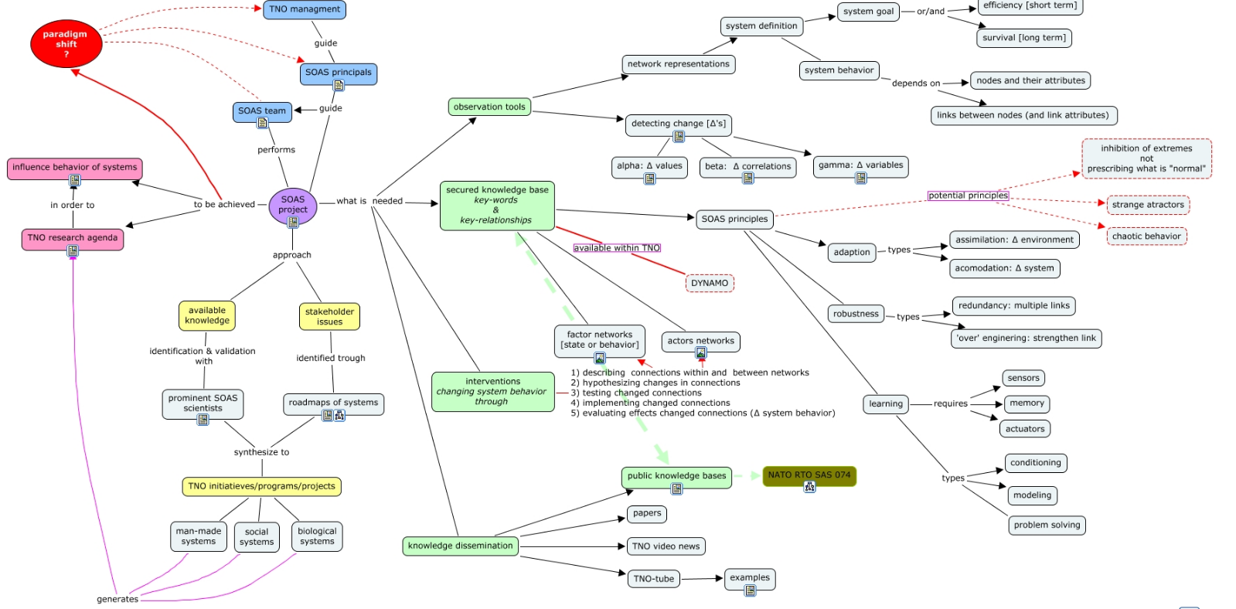
Approach: Iterative
Point-paper, CMaps…orientation
Roadmaps of complex stakeholder issues (systems and tipping points)
Validation of Approach with ‘SOAS’ scientists
Feedback of insights
Phase 2 Go or No-Go

Slide 6
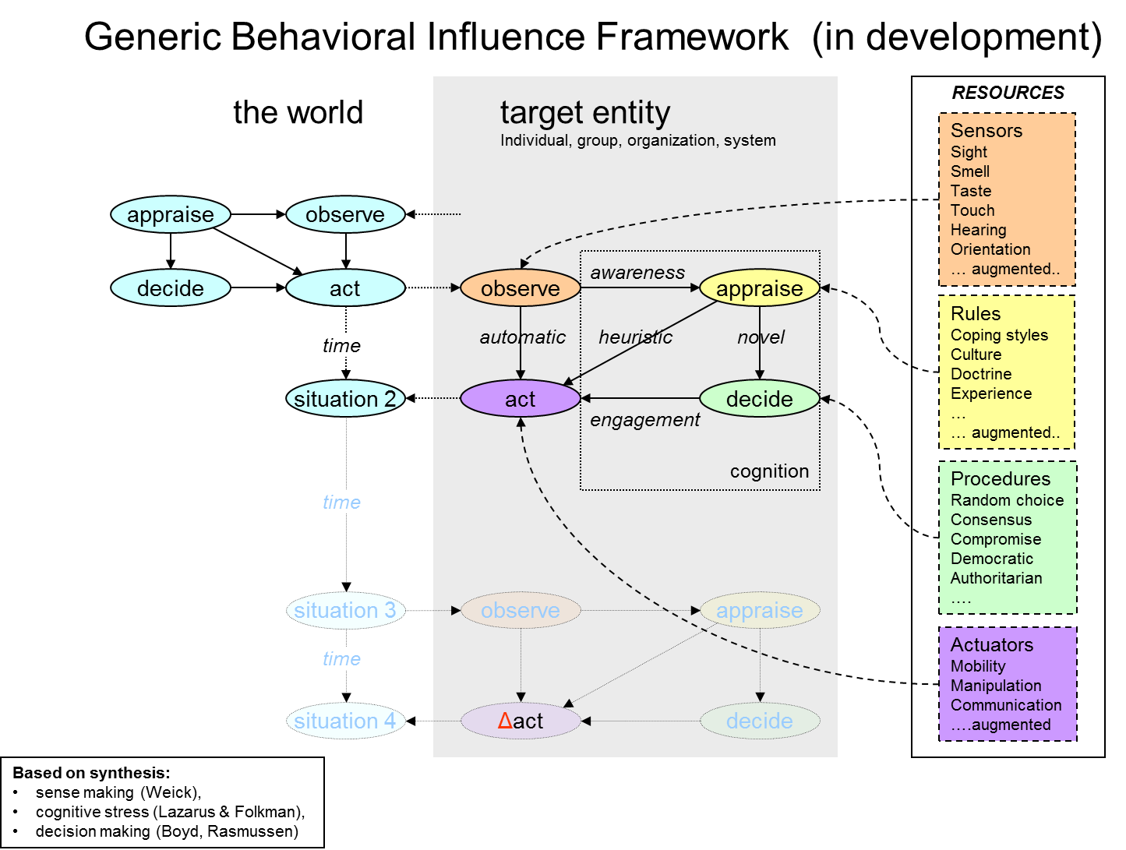
Results: no holy grail
Wikipedia defines self-organization as the process where a structure or pattern appears in a system without a central authority or external element imposing it through planning. This globally coherent pattern appears from the local interaction of the elements that make up the system, thus the organization is achieved in a way that is parallel (all the elements act at the same time) and distributed (no element is a central coordinator).
http://en.wikipedia.org/wiki/Self-organization
Identified SOAS principles
Adaption through assimilation (environment) and/or accommodation (system)
Robustness through ‘over engineering’ and/or multiple links
Learning
Hard wiring (conditioning)
Heuristics (if-then rules)
Problem solving (out of the box)

Slide 7
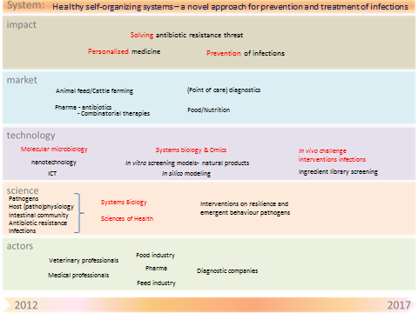
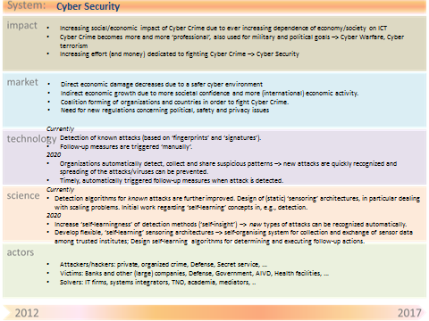
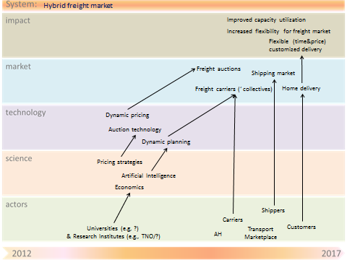
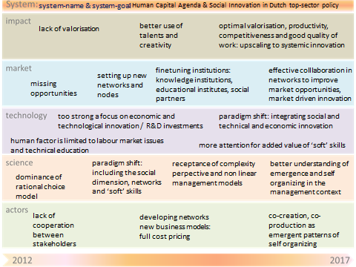
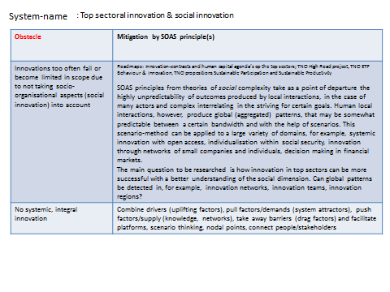
Results: Business Opportunities
System RoadMaps
Ecological
Biological Systems
Social
Work Organization
Organization of Collaboration
ICT & citizens
Man Made
Communication networks
Logistical systems
Summary
Man made systems are ripe for application of self organization to achieve efficiency whilst enhancing effectiveness
Social systems are in part self organizing, but how to manage/influence these, knowing that control is not possible
Ecological systems are self organizing, but how can we exploit these without disruptions

Slide 8
Results: Business Opportunities from RoadMaps (note, the table can be seen in full, but not in the ppt presentation mode)
Domain | Roadmap | Obstacle | Mitigation by SOAS principle(s)
bio systems | [bio sys] 01 bacterial systems and human health.pptx - Shortcut | Integrated description of ‘system’ | Integration of host physiology, pathogenic pressure and vulnerability in network model enables identification is essential to understand emergence of pathogens and antibiotic treatment. This is a shift from the current and failing “wait and cure” approach.
bio systems | [bio sys] 01 bacterial systems and human health.pptx - Shortcut | (In silico) selection biofunctional agents | Pre-selection of bio-functional ingredients is essential for cost-effective development of novel treatments. Since antibiotic development pipelines have dried out, a systems biology network approach enables identification of weak spots and allows development of solutions that sustain biological network complexity and resilience.
bio systems | [bio sys] 01 bacterial systems and human health.pptx - Shortcut | diagnostics | Better diagnostics based on the whole biological system is essential to evaluate interventions but also to link status to cure or prevention. These novel diagnostics integrate multiple levels of data, including lifestyle, genetic predisposition and infectious pressure from environment. Diagnostics are not aiming at identification of threats but also aiming at identification of intrinsic resilience. These are based on integrated predictive network models with understanding of emergent behaviour derived from zoas principles
bio systems | [bio sys] 01 bacterial systems and human health.pptx - Shortcut | ICT infrastructure | Linking appropriate data and sensory information in risk profile to safeguard health of the population
collaboration | [Collaboration] 01 mitigation pandemics .pptx - Shortcut | Nu verkeerd beeld: ik ben voorbereid | Informatie geven: inclusief handelingsperspectieven (risico- & crisiscommunicatie) => zodat burgers zichzelf kunnen prepareren
collaboration | [Collaboration] 01 mitigation pandemics .pptx - Shortcut | Conflict sub-systemen | In geval er een grote pandemie uit breekt is het mogelijk dat er maatregelen worden getroffen (of dat mensen uit zichzelf) die minder gebruik van infrastructuur tot gevolg heeft. Susbsystemen raken geisoleerd en kunnen op die manier elkaars concurrent zijn. Dit scenario moet worden doorgedacht met zoas principes.
collaboration | [Collaboration] 01 mitigation pandemics .pptx - Shortcut | awareness | Zie ook 1, er is geen awareness van de omvang een epidemie echt zou kunnen hebben. (dus er is geen beeld, of er is het beeld dat men voorbereid is op een pandemie) = > informatie geven zodat burgers zichszelf kunnen prepareren
collaboration | [Collaboration] 01 mitigation pandemics .pptx - Shortcut | Law | Wetgeving moet mogelijk worden aangepast.
collaboration | [Collaboration] 01 mitigation pandemics .pptx - Shortcut | Isolement | Subsystemen komen mogelijk in een isolement (wijken, dorpen, steden’; hoe dan maatregelen door te voeren? Dit scenario moet worden doorgedacht met zoas principes.
collaboration | [Collaboration] 01 mitigation pandemics .pptx - Shortcut | Early detectie | Het is lastig om snel veel vaccins te ontwikkelen en andere preventieve maatregelen adequaat uit te rollen. Early detectie van een virus die mogelijk een pandemie kan veroorzaken geeft meer ruimte. Dit kan bijvoorbeeld door mensen zichzelf te laten checken (voorbeeld tools van Philips).
com net | [com net] 01 communication networks.pptx - Shortcut | Robustness | The increasing dependency on communication networks requires a robust and sustainable network system. There is a need for flexible redundancy.
com net | [com net] 01 communication networks.pptx - Shortcut | Complexity of operations (growing scale and diversity of services). | Manual operations becomes impossible. Self-manament principles are needed.
com net | [com net] 01 communication networks.pptx - Shortcut | Cost efficiency | Due to the strong competitions there is an urge to decrease the costs, and to make the network system as efficient as possible.
com net | [com net] 03 Cyber Security.pptx - Shortcut | Increasing complexity of control (due to increasing complexity and scale of attacks and increasing complexity of the involved networks/systems). Manual control is no longer good enough (and becomes too expensive). | •Faster and more adequate detection and resolution of cyber attacks.
com net | [com net] 03 Cyber Security.pptx - Shortcut |  | •Cost reduction in fighting cyber crime through reduced need for human involvement.
ict people | [ict people] 01 value generation on open webplatforms.pptx - Shortcut | Trust in providers | Mobilization through a new network (community)
ict people | [ict people] 01 value generation on open webplatforms.pptx - Shortcut | Energy harvesting | Choice for sustainability ipv economy
ict people | [ict people] 01 value generation on open webplatforms.pptx - Shortcut | interoperability | Central agreement on standard, consequence ….
ict people | [ict people] 01 value generation on open webplatforms.pptx - Shortcut | Privacy Law | Organizing adapted networks of users and producers
ict people | [ict people] 01 value generation on open webplatforms.pptx - Shortcut | Privacy issues | Personal data management services (bottom up)
ict people | [ict people] 01 value generation on open webplatforms.pptx - Shortcut | Platform dependency | Community control/restrictions, inhibiting extremes…
ict people | [ict people] 01 value generation on open webplatforms.pptx - Shortcut | Digital Labour Divide | New ways of organising learning and working
logistics | Self-organizing parcel delivery system | Interoperability issues | Availability of information to improve real time decision making and governance models to coordinate the level and amount of data sharing, based on pre-specified agreements
logistics | Adaptive tour planning system | Interoperability issues | Availability of information to improve real time decision making and governance models to coordinate the level and amount of data sharing, based on pre-specified agreements
logistics | Adaptive tour planning system | Costs | High transaction costs, difficulty of coordination and risk of information leakage with central planning
logistics | Adaptive tour planning system | Data sharing | Willingness to share information
logistics | Adaptive tour planning system | Agent-based technology | Distribution of intelligence to nodes (moving nodes and nodes at fixed locations)
logistics | Adaptive tour planning system | Sensors issues | On board computers (or apps on smart devices) acting as sensors for creating location awareness
logistics | Self-organizing parcel delivery system | Sensors and RFID technology costs | We aim at providing eventually even the smallest parcels with smart sensors in order to store/process information. Costs of sensors and RFID technology are still too high.
logistics | Self-organizing parcel delivery system | Scalability of agent technology | Agents are necessary in a decentralized architecture to process locally the relevant information coming from RFID tags, and take decisions based on this information. Are agent-based solutions scalable for huge amounts of parcels to be delivered?
logistics | Self-organizing parcel delivery system | Granularity level of agent-based solutions | Where the agents should be for optimal and scalable solutions? E.g., (ordered from low to high granularity) parcels, packages, containers, vehicles, hubs, etc.
logistics | Self-organizing parcel delivery system | Reusability of technological solutions | To what extent can technological solutions, such as sensors and agents, be reused? E.g., products (no reusability), packages (low reusability), containers (good reusability) , vehicles (high reusability)
logistics | Container capacity management system | Data sharing | Availability of information to improve real time decision making and willingness to share the information. We can provide IT solutions to improve communication and information sharing using web technologies and so forth, but are stakeholders willing to provide and share this info?
logistics | Container capacity management system | Interoperabiltiy issues | Availability of inter-operable decentralized/distributed tour planning systems able to effectively coordinate among multiple partners for which it produces a tour planning in order to allow regional logistics providers to collaborate with each other in the execution of logistical services.
logistics | Container capacity management system | Costs | Sensor and RFID costs for containers, communication costs, costs of facilities to construct a network (e.g. GSM, wireless sensor networks with detection mechanisms in inland waterways, satellite)
logistics | Container capacity management system | Decision making complexity | Only parts of the network are known, how does optimization of these parts affect the total network? Is it only feasible if these parts are loosely coupled, e.g. via vessels or other transport means with fixed schedules?
logistics | Container capacity management system | Scalability of agent technology | Agents are necessary in a decentralized architecture to process locally the relevant information coming from RFID tags, and take decisions based on this information. Are agent-based solutions scalable for huge amounts of container movements?
logistics | Hybrid freight market | Data sharing | Unwillingness to share information about excess capacity
logistics | Hybrid freight market | Lacking information | Overview of available capacity in market is lacking
logistics | Hybrid freight market | Interoperability issuses | Lack of interoperability and general ‘digitalization’ among IT solutions of regional providers/collective

Slide 9
Results: TNO state of the SOAS art
SOAS principles are applied, but….
Disjoint researcher networks
Disjoint stakeholder networks
Disjoint knowledge networks
Technology is available but…not used to its fullest potential
Domain knowledge is high, particularly when combined (in comparison to others)
Multitude of disciplines in one system (TNO)
Multitude of technologies in one system (TNO)
Transfer of insights across disciplines limited
Complexity is too often reduced to linearity
….

Slide 10
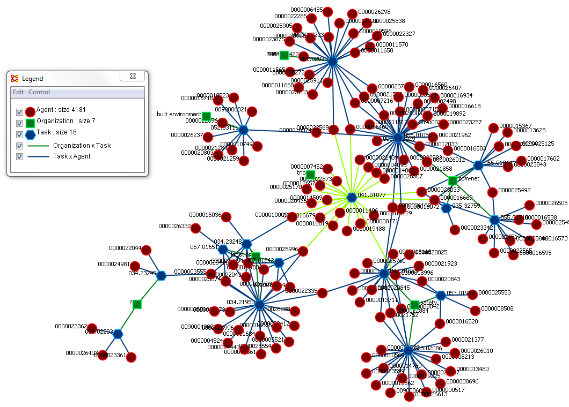
Results: SOAS like projects @TNO (SAP data week 1-22)

Slide 11
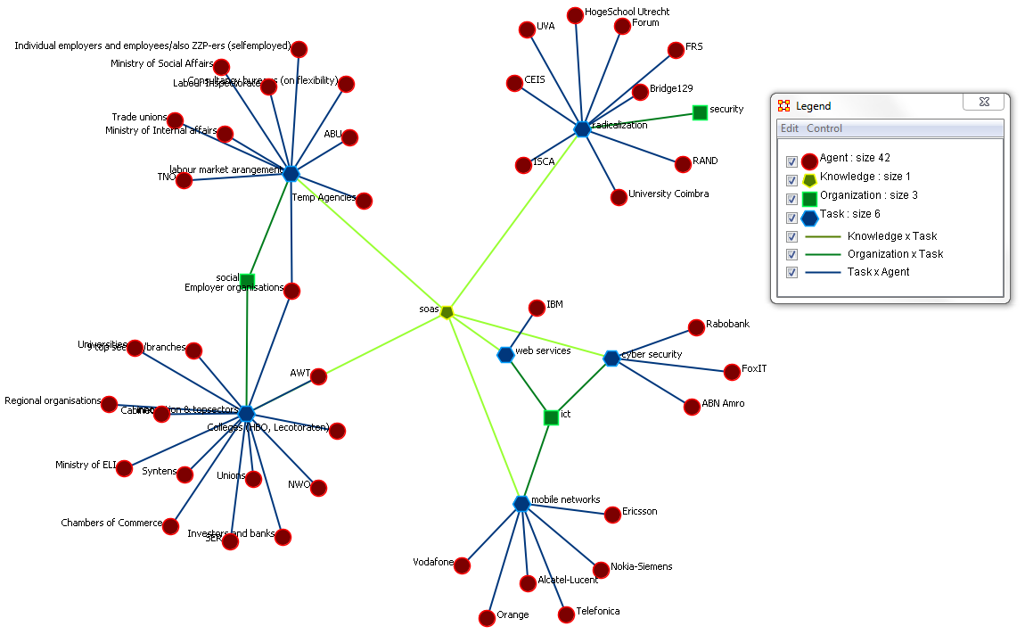
Results: SOAS issues and their Stakeholders

Slide 12
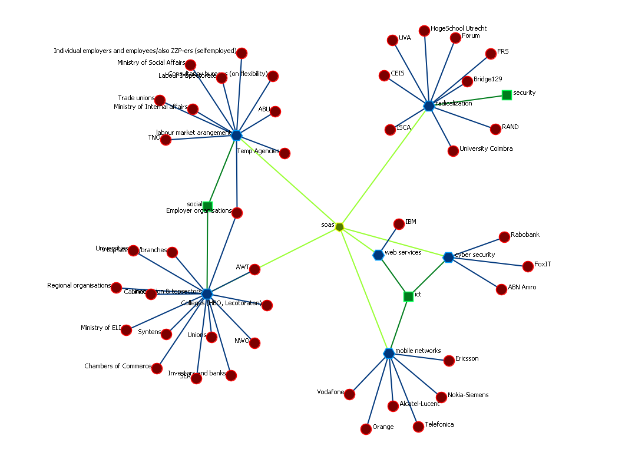
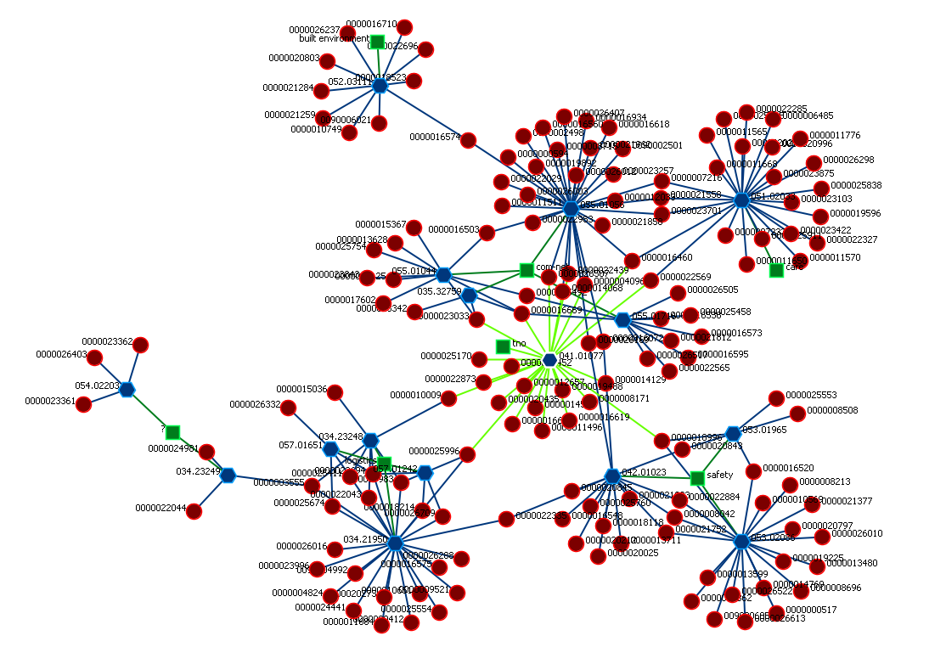
Results: Connecting Stakeholder networks and Researcher networks through SOAS
SOAS issues and their stakeholders
SOAS
SOAS like projects @TNO

Slide 13
Results: Validation SOAS approach with ‘SOAS’ scientists
Wander Jager [director GCSCS] (supports/validates approach)
Maarten van Steen [chairman NWO theme complexity] (SOAS is inevitable)
Santa Fe (contact established, appointment not yet realized)
Stichting Zelforganisatie (SOAS is inevitable)
prof dr Ralph Stacey (SOAS is inevitable)
H. van den Berg (invited speaker at International Workshop on Self-managing and Autonomous Networks (SAN 2012)
The topics in the call for papers of SASO the “IEEE International Conference on Self-Adaptive and Self-Organizing Systems” http://www.saso-conference.org/ can be seen as confirmation of SOAS approach.

Slide 14
Consequences: of SOAS for TNO
Managing relationships instead of controlling entities
Develop, formulate and up-date ‘system’ RoadMaps (standardized) with stakeholders
System(Network) approach as SOP
System behavior is emergent,
Use system dynamics to identify ‘targeted’ system behaviors
Use agent based models to make sense of underlying mechanisms and validate with empirical evidence
Use intended system behavior change as departing point, reduces problem space, total system description is not possible / feasible / 42
Visualize networks (these represent states and relationships)
Facilitate links between and within knowledge networks
Facilitate links between and within actor networks
Detect change, not only α-changes, but also β-changes and γ-changes
Dissemination strategy (multi modal: papers, wiki, CMaps, video, demo,…)
Setup a program to achieve the above suggestions

Slide 15
SOAS
from controlling the predictable to managing the unpredictable
Issue
Strengths: rich assets, multi-sector, multi-domain, multi-disciplinary, multiple applicable technologies
Weakness: fragmented, ‘bewust onbekwaam’
Opportunities: complex (wicked) problems (Grand Challenges, TopSectoren, BigSociety,….)
Threats: losing ‘right to play’
to be continued…
(expected) Results
Targeted sensor development (AMSN)
Control Rooms (interaction design)
Multi-stakeholder collaboration (goal setting)
(Cyber)security (anomaly detection)
E-freight systems (autonomous parcels)
Smart Grids (distributed power generation)
Living Labs (evidence based CD&E)
………………………..
Approach
ETP SOAS roadmaps with stakeholders network thinking and representation system dynamics & agent based modelling anomaly detection & pattern recognition self learning algorithms meta data architecture
Community building within and between stakeholders and disciplines goal synchronization, shared values, appreciation of diversity, crowd sourcing
R&D enhancement in ETP’s & VP’s awareness of ‘adaption, robustness & learning’ system behavior is emergent in complex systems
Impact
External
Enhancing competiveness Facilitating fair and sustainable societies Combining people and knowledge
Internal Satisfaction & Productivity Creativity & Innovation Adaption, Robustness & Learning Trust & Prosperity

