Slide 1
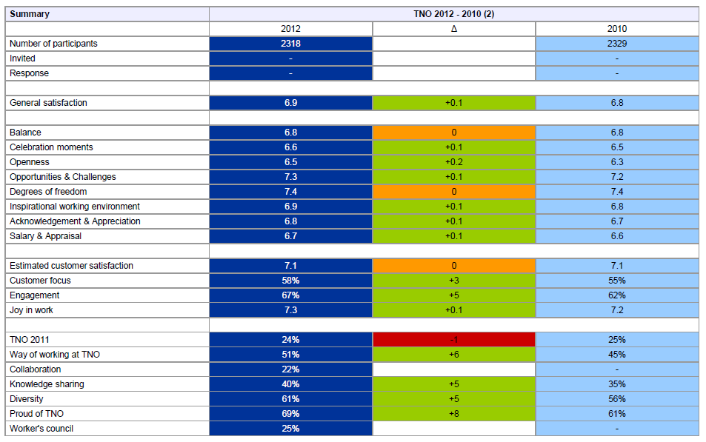
α changes (Δ₂₀₁₂₋₂₀₁₀ in MBO data)

Slide 2
The added value of relationships β and γ changes ! fake data ! for illustration purposes only !
directly actionable
+Δ₂₀₁₂₋₂₀₁₀
emergent
=Δ₂₀₁₂₋₂₀₁₀
correlation
-Δ₂₀₁₂₋₂₀₁₀
Celebration moments [6.6]
Estimated customer satisfaction [7,1]
Openness [6.5]
Customer focus [58%]
Opportunities & Challenges [7.3]
Balance [6.8]
Engagement [67%]
Degrees of freedom [7.4]
Inspirational working environment [6.9]
Joy in work [7.3]
Acknowledgement & Appreciation [6.8]
Salary & Appraisal [6.7]
% direct [??%]
Sustainability [?.?]

