Slide 1
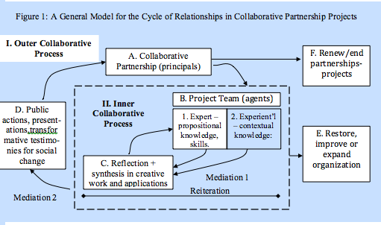
Organizations and Organizing

Slide 2
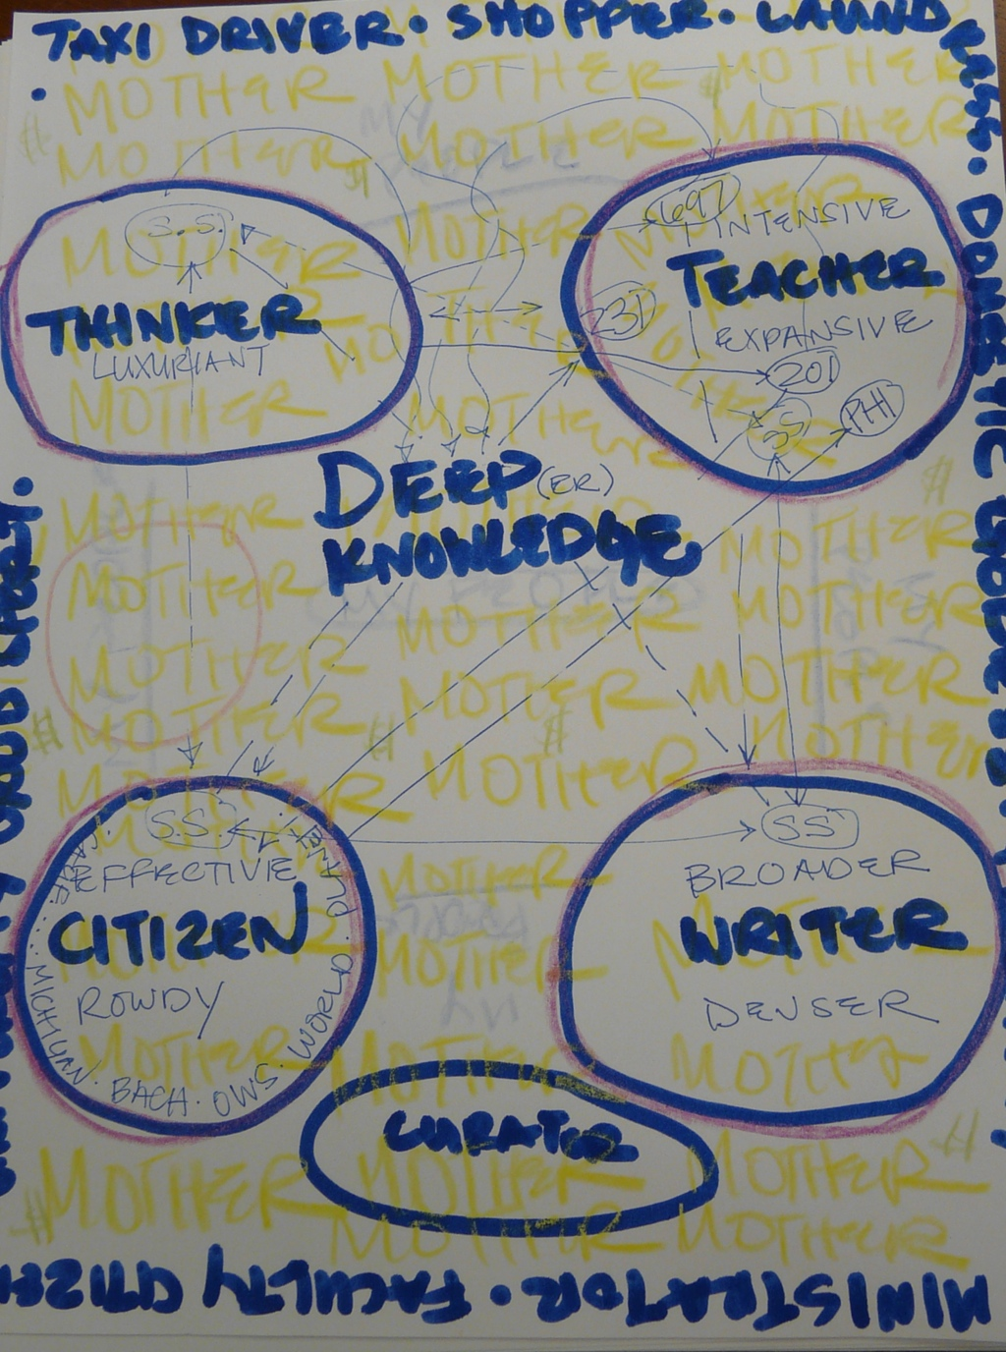
“In the center of your piece of unlined blank paper, put the thing you are for.”
Sylvia Gale

Slide 3
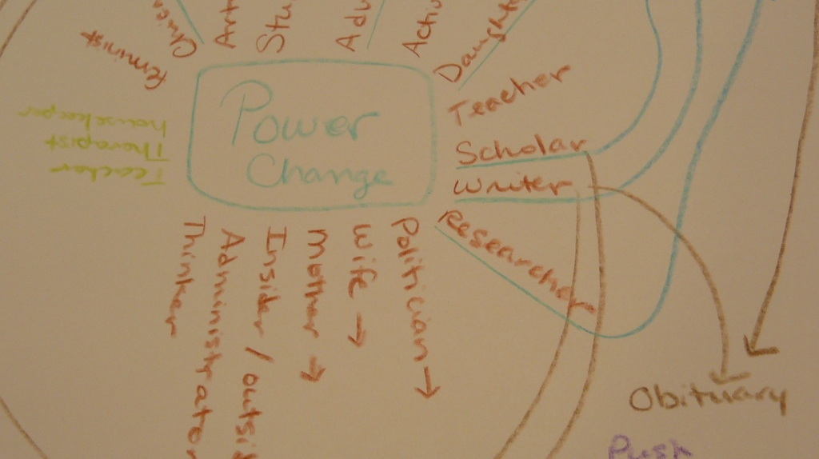
“Now my roles are driving my projects.”

Slide 4
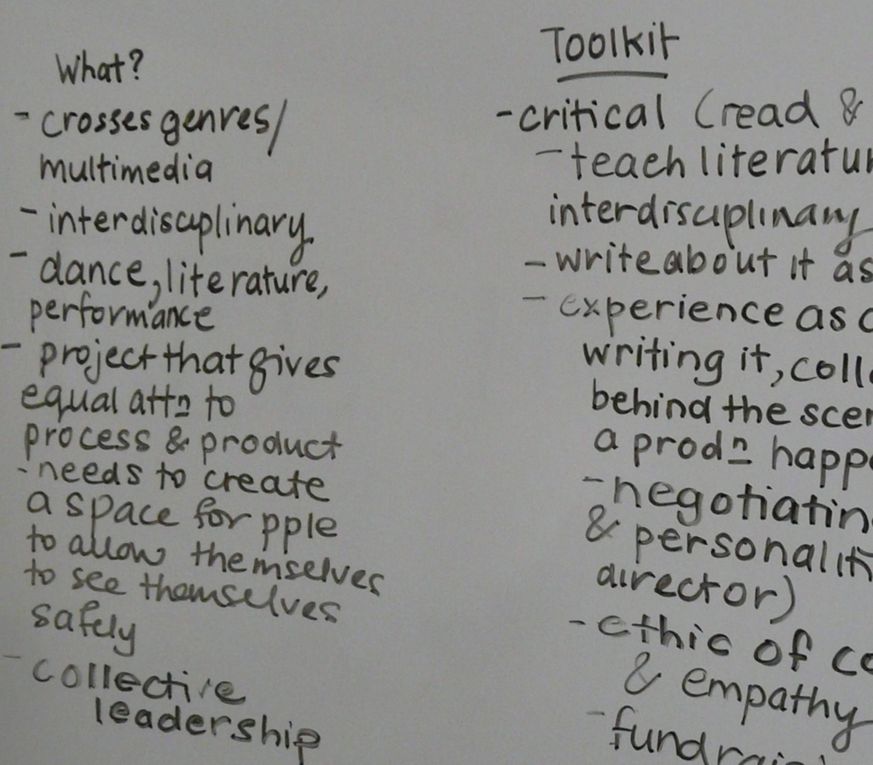
“In motion between... not bound.”

