Slide 1
Hind-limb Nerve Block

Slide 2
Technique
Place tourniquet proximal to the tarsus
Allow adequate time for venous engorgement
Clean the area of injection with alcohol (this area maybe shaven)
Inject 5ml of solution of 2.5ml 2% lidocaine and 2.5ml saline into lateral saphenous vein (see Figure 6-6)
Remove the needle and apply pressure at the insertion point to reduce leak back of the anaesthetic
Massage the injected area (well after) to help prevent haematoma formation
Release tourniquet after completing the required procedure

Slide 3
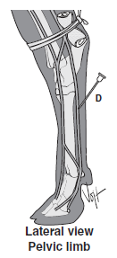
Figure 6-6 Intravenous regional anesthesia of the distal hind-limb in the bovine. The suggested sites are only for reference; any visible or palpable vessel may be used.
(From Muir WW, Hubbell JAE, Skarda RT, Bednarski R: Handbook of
veterinary anesthesia, ed 3, St Louis, 2000, Mosby.) (edited)

