Slide 1
Hoof Trimming
For Horses

Slide 2
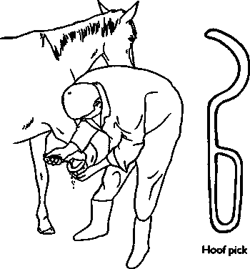
Step 1
Clean any debris from under the hoof with a hoof pick.

Slide 3
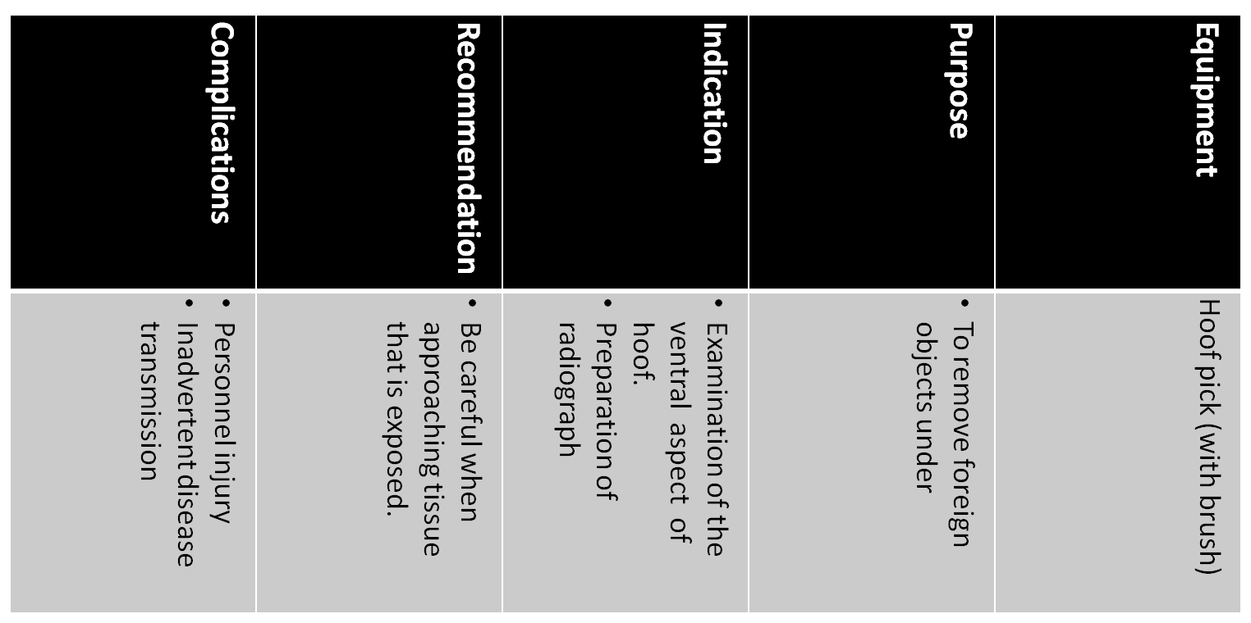
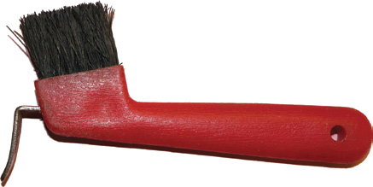

Slide 4
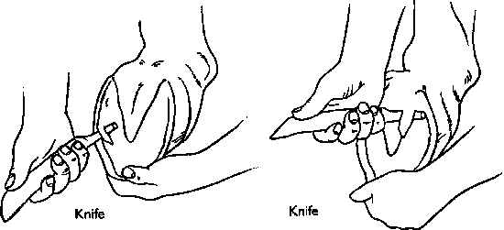
Step 2
Remove loose flakes of sole with the knife.

Slide 5
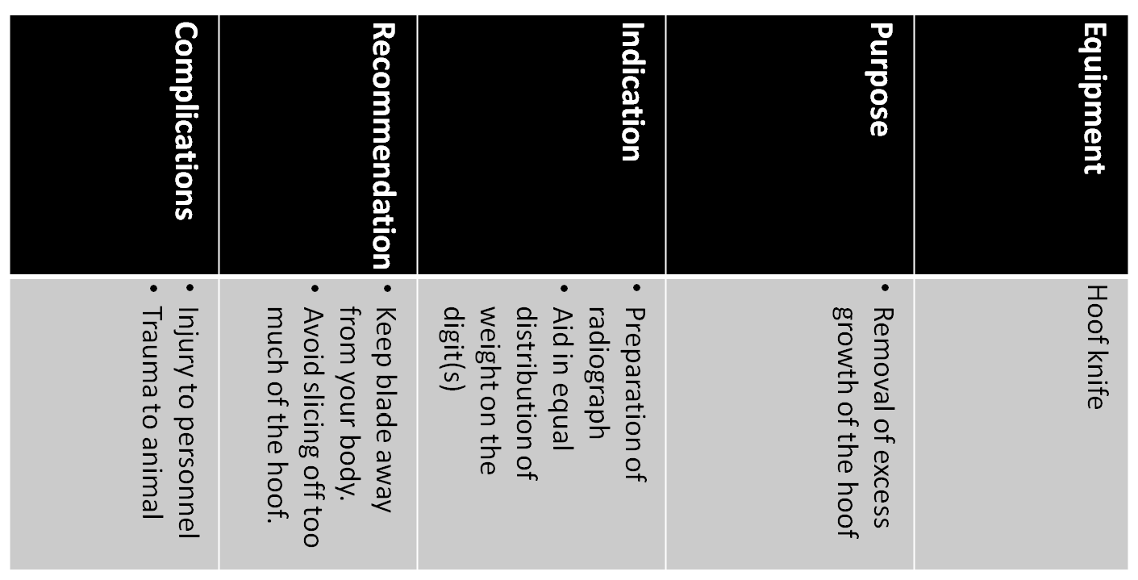
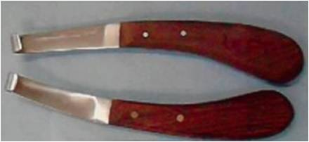

Slide 6
Step 3
Trim the edges of the frog with the knife.

Slide 7
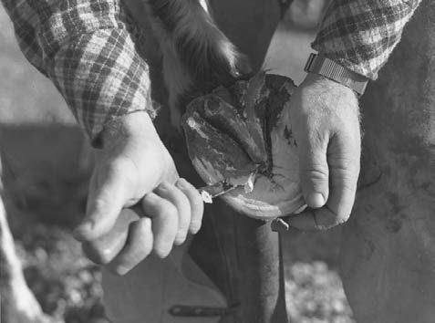
Step 4
Cut back the sole around the white line to the depth of the hoof wall that is to be removed with the knife.

Slide 8
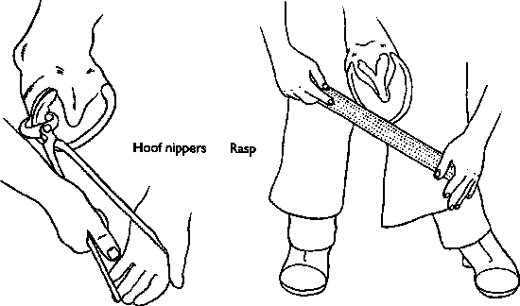
Step 5
Starting at one heel, cut round the hoof wall with hoof nippers to shorten the foot.

Slide 9
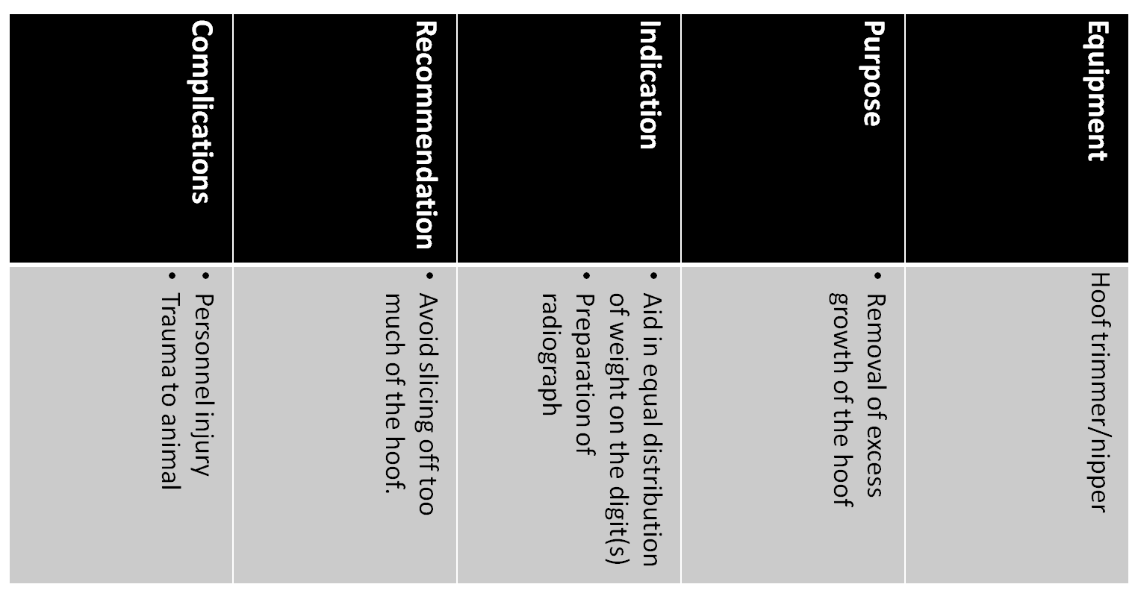
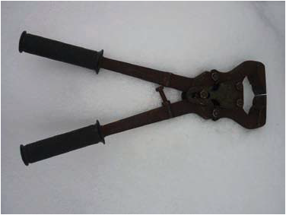

Slide 10
Step 6
Rasp the sole flat and even.

Slide 11
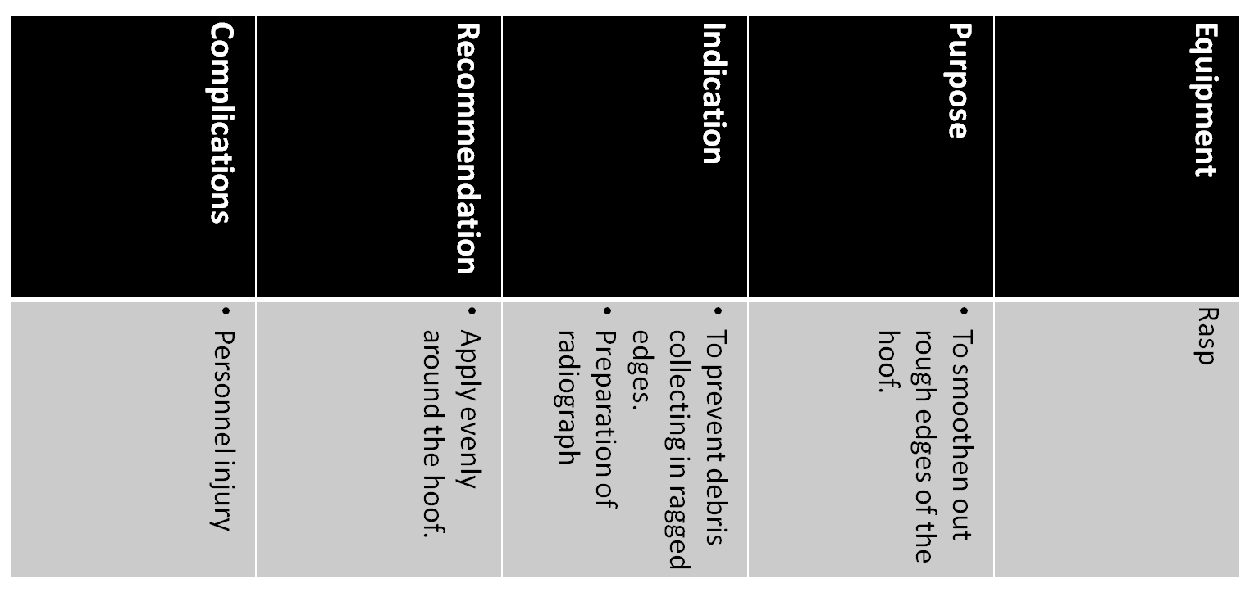
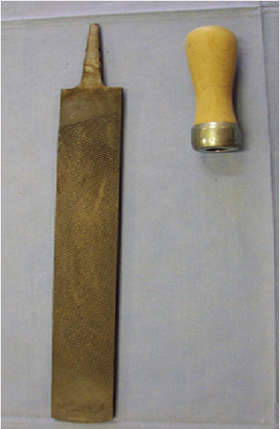

Slide 12
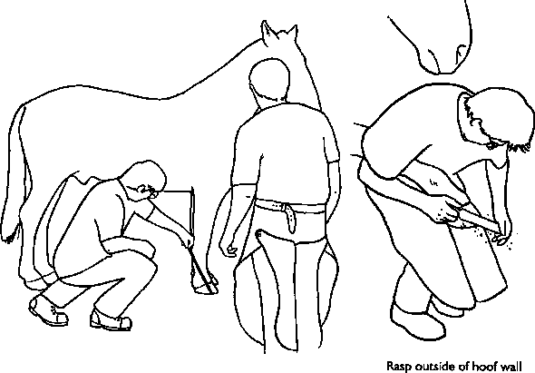
Step 7
Rasp the outside edge so the wall has even thickness at the ground. Do not rasp the shiny outside of the wall high up the hoof.

Slide 13
References
Veterinary Medical Terminology Guide and Workbook - Angela Taibo
Horse Healthcare - A Manual for Animal Health Workers and Owners - David Hadrill
Veterinary Treatment of Pigs – G. R. Duncanson

