Slide 1
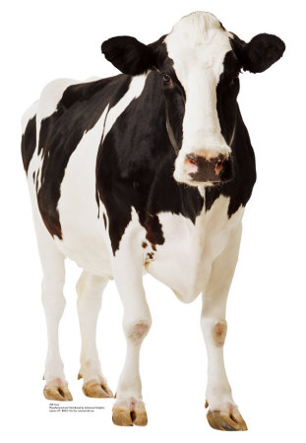

Physical Exams of Cattle
By C Kohn
Agricultural Sciences
Waterford, WI

Slide 2
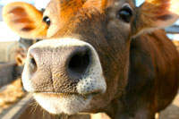
Physical Exams
A physical exam is a routine medical procedure in which the physical symptoms of a patient are measured in order to determine if those symptoms fall within the normal range of that animal.
  Physical exams should always follow a consistent routine – in most cases, every examination should follow the same order of steps.
  Even if you find a suspicious
  symptom, you should not stop
  the examination – there may
  be more symptoms to discover!
Source: itsthelittlethings.info

Slide 3
Steps of a Physical Exam
The first step of an animal physical exam is to speak with the owner in order to get a history of the patient.
The following 8 questions should always be asked:
  What is the problem? Why did you call?
  What symptoms have you observed?
  When did this problem start?
  Has this affected her
  feed consumption?
?

Slide 4
Questions (cont.)
?
  Has this affected her milk
  production or rate of gain?
  How long ago did she calve?
  How old is she?
  Do any other animals have
  similar symptoms?
Follow-up questions should also be asked to get all needed details.

Slide 5
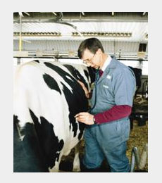
Steps of a Physical Exam
After you’ve taken the patient history, you should begin to examine the animal’s head and neck.
You should assess the following:
  Ears – erect or drooping?
  Hot or cold?
  Eyes – sunken or normal?
  Emotional status?
  Nose – does she have any
  mucus discharge?
  Mouth – is she grinding her
  teeth? Circulation?
  Jaw – does she have any
  swelling?
  Neck – does she have
  swollen lymph nodes?
  Skin – is she dehydrated?
Source: cdfa.ca.gov

Slide 6
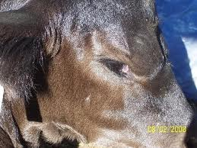
Ears & Eyes
Ears are a quick indicator of the cow’s physical well-being.
  If her ears are cold, there is a problem. If her ears are warm, there might still be a problem.
Eyes are a quick indicator of both hydration and of her emotional status.
  Are her eyes normal or are
  they sunken?
    If they are sunken, the
    animal is dehydrated.
  Do her eyes indicate if the
  animal is scared or in pain?
    Emotion can be read most
    easily from the eyes.
Source: cattletoday.com

Slide 7
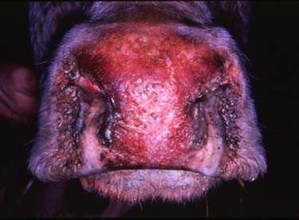
Nose & Teeth
When examining the nose, look for mucus (i.e. a runny nose)
  Is it clear (good) or
  solid-colored
  (typically bad)
  Is it clean (good) or
  bloody (bad)
After checking the nose, listen near her mouth.
  Is she chewing her cud (very good)?
  Do you hear a high-pitched grinding noise (bad)? If so, this is a sign that the cow is in pain.
  Is she compulsively licking or chewing, or are there any other signs of emotional/nervous problems?
Source vet.uga.edu

Slide 8
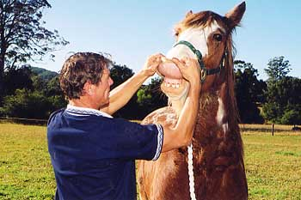
Capillary Refill Time
When checking the mouth, you should also check the capillary refill time of the animal.
  Capillaries are the smallest blood vessels that link arteries to veins.
  They line the surface of the skin.
To perform the Capillary Refill Time (CRT) test, gently and carefully lift the lip of the animal (make sure the animal is properly restrained!)
  Gently push on the animal’s
  gums and release.
  The color of the gums should
  go from a whitish color to its
  normal pink in 1-2 seconds.
  A slower time indicates shock
  or dehydration.
  A time under 1 second indicates
  heat stroke or shock.
Source: eqmusclerelease.com
Yes – I know this is a horse…I couldn’t find one with a cow ☺

Slide 9
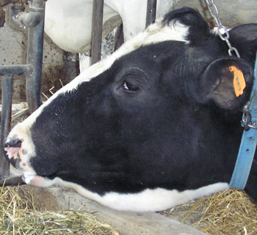
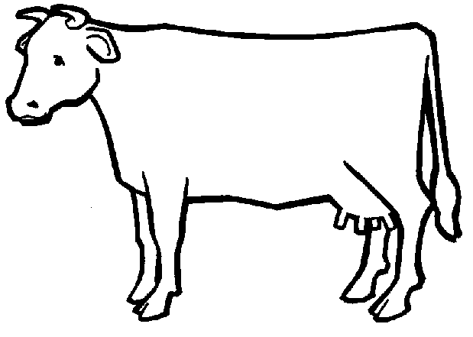
Jaw and Neck
Check her jaw – is
there any swelling or
fluid build-up (bad)?
  If so, this could be a
  sign of poor circulation
  or low electrolytes.
Neck – check the lymph nodes (they can be found along the jaw-line below the ears).
  Lymph nodes are glands full of
  white blood cells; they move
  lymphatic fluid (immune
  system-fluid) throughout the body
  If the lymph nodes are swollen,
  this is a clear sign that the animal
  is fighting an infection or injury.
    ☆ = Lymph node
Source: nodpa.com

Slide 10
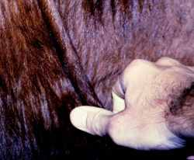
Skin & Dehydration
To check for dehydration, you should perform a pinch test on the skin.
  To perform the pinch test, firmly but gently grab skin between your thumb and forefinger.
  Pull the skin gently and then immediately release.
Under normal conditions, the skin should immediately snap back to its original position.
    The return to its normal state should be instantaneous.
If the animal is dehydrated,
the skin will slowly return to
its original state.
    It will behave sort of like
    cold bread dough
medical-dictionary.thefreedictionary.com

Slide 11
Symptoms & Diseases
Common symptoms include…
  Cold ears ➔ hypocalcemia (milk fever, or dangerously low levels of calcium in the blood)
  Sunken eyes ➔ dehydration
  Swollen jaw (bottle jaw) ➔ low electrolytes or blood protein levels; possible heart failure
  Swollen lymph nodes ➔ infection, illness, or injury
  Nasal discharge ➔ infection or illness
  Chewing her cud ➔ she is feeling ok

Slide 12
Steps of a Physical Exam
After examining the head, you move to the left-hand side of the animal and examine their chest.
At the chest, you will
examine the….
  Heart Rate – should
  be 60-80 bpm
  Respiration Rate –
  should be 10-40 bpm
Source: UW-Madison Dept of Dairy Science

Slide 13
Heart Rate
To measure the heart rate, you would use a stethoscope and place it behind the animal’s left elbow.
  It may take a couple tries to find a good-sounding heart rate – move around until you find a good beat.
When you check the heart rate,
you will check for 2 things:
  Rate – the rate should be 60-80 bpm
  Quality – the heart should be a
  “lub-dub” sound.
    ‘Woosh’ or ‘Whistle’ sounds are
    signs of other problems – these are
    called heart-murmurs.
Source: UW-Madison Dept of Dairy Science

Slide 14
Respiration Rate
To measure the respiration rate, you would use a stethoscope and place it above the animal’s left elbow.
  Like the heart rate, it may take a few tries to find a quality-sounding respiration rate.
When you check the respiration rate,
you will check for 2 things:
  Rate – the rate should be 10-40 bpm
  Quality – the breathing should sound
  clear; it should not sound raspy or
  obstructed (dyspnea)
Source: UW-Madison Dept of Dairy Science

Slide 15
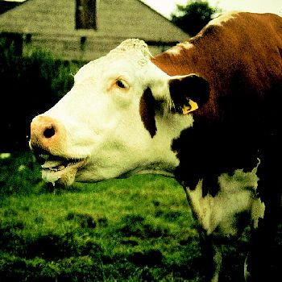
Symptoms and Diseases
The following are common symptoms you may encounter when examining the left side of the chest:
  High heart rate (rate above 80 bpm) – high heart rates can be a sign of a wide-range of problems, including infection, heat stroke, injury, nervousness, etc.
    The same is true for high breathing-rate (above 40 bpm)
  Heart murmurs – if the heart beat does not have a ‘lub-dub’ sound (i.e. if you hear a woosh or whistle), this is a sign of an injury or infection in the heart.
  Raspy breathing – the lungs should
  sound clear and open during breathing;
  raspy or obstructed breathing can be a sign
  of a respiratory infection.
Source: answers.com

Slide 16
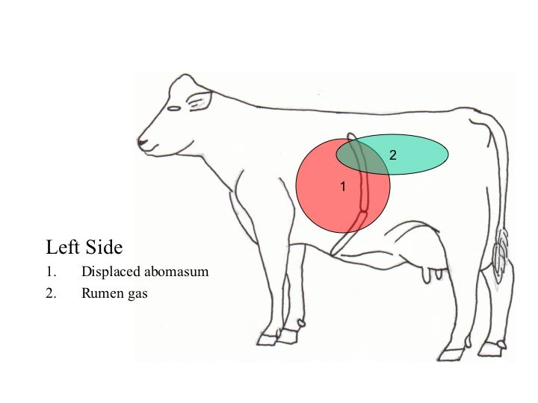
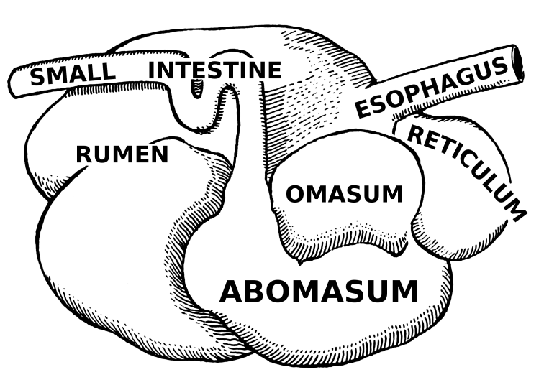
Steps of a Physical Exam
After examining the left chest, you would move to the left abdomen (stomach area).
  In the left abdomen, you would examine the following:
    Rumen Contractions – does she haved 1-2 contractions per minute.
    Abomasum placement - does she have a displaced (twisted) abomasum?

Slide 17
Rumen Contractions
The rumen is the first chamber of the four-chambered stomach of a cow.
  The rumen has to contract at least 1-2 times per minute to sufficiently mix and break down the feed she has consumed.
To measure rumen contractions, place the stethoscope over the center of her body (where the red circle is below).
  Listen for what sounds like
  low rumbles of thunder
  while watching for a minute
  to pass.
  Low rumen contractions
  is a symptom of digestive
  problems.
Source: UW-Madison Dept of Dairy Science

Slide 18
Abomasum Placement
The abomasum is the fourth stomach chamber of a cow.
  It operates in the same way your stomach works.
If a cow stops eating, or has other problems, the abomasum can fill up with gas and twist over itself.
  The abomasum will swell with gas like a balloon.
Source: UW-Madison Dept of Dairy Science

Slide 19
Abomasum Placement
If the cow has a displaced abomasum, or twisted stomach, you will be able to detect this by ‘pinging’ the cow.
Place your stethoscope over what is the green area on cow below and flick repeatedly with your finger and thumb.
If the stomach has twisted, it will sound like a banjo through the stethoscope
when you flick the area.
Source: UW-Madison Dept of Dairy Science

Slide 20
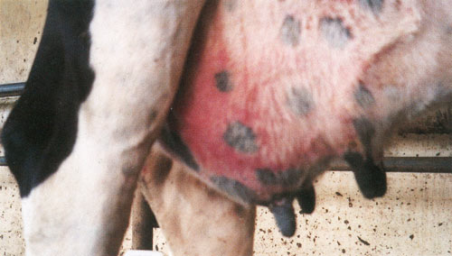
Udder
After you check for rumen contractions and for a twisted stomach, you will move onto the udder.
At the udder, you will check for the following:
  Edema, or swelling
  Redness, heat or coolness.
    A hot quarter may indicate an infection (mastitis)
    A cool quarter may indicate dying tissue or obstructed
    circulation due to injury or frostbite.
      This could become
      gangrenous
  Examine her milk using a
  mastitis test such as the
  California Mastitis Test
  (CMT) paddle.
Source: teara.govt.nz

Slide 21
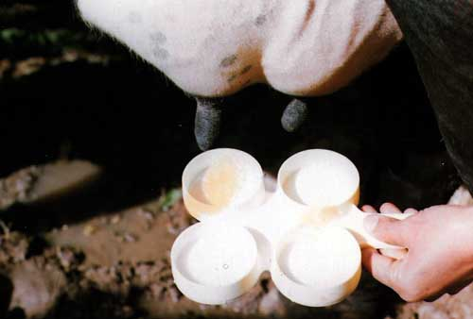
Mastitis
Mastitis is an infection of the udder.
  It is the most costly disorder in the dairy industry.
Mastitis can cause any of the following:
  Reddened or hot udder
  Swelling in the udder
  Chunky or flaky milk
  Watery milk
  Fever and increased
  heart/respiration rate
If there are symptoms
that indicate mastitis,
a test should be performed to confirm this.
  CMT and MECS are commonly-used tests
Source: vetscan.co.in

Slide 22
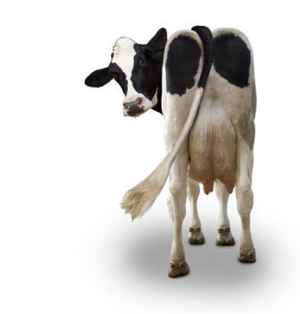
Rear Examination
After examining the udder, you would move onto examining the rear of the cow.
Here you will check the following:
  Rectal Temperature
  Urine Ketones
  Rear feet and legs
  Stool (manure sample)
Source: johnlund.com

Slide 23
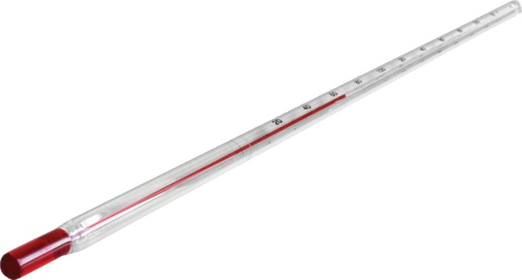
Rectal Temperature
To take an animal’s temperature, you will need a clean, lubricated rectal thermometer.
To take the animal’s rectal temperature, have an assistant lift the tail and gently raise it as high as it will safely and humanely go.
  This will help to partially paralyze the cow’s rear, reducing her likelihood of kicking while humanely restraining her
    If done correctly, it should not cause pain.
Gently insert the thermometer into the rectum using a twisting motion.
  Leave in place for at least 1 minute.
  A cow’s temperature should be 101.5º F
  A higher temp (above 103⁰) indicates an infection or injury.
Source: lightlabsusa.com

Slide 24
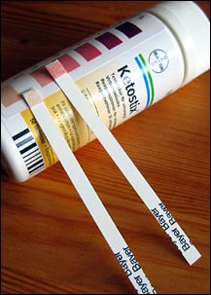
Urine Ketones
Ketones are by-products of breaking down bodily fat for energy.
  If a cow is breaking down fat too rapidly, the ketone levels in her blood will rise too rapidly, causing the equivalent of a “metabolic hangover”.
    Abnormally high levels of ketones result in ketosis.
  This will cause internal discomfort to the animal and reduce her feed intake
    This can lead to a displaced
    abomasum (DA).
To test for ketosis, dip a Keto-stick
into the urine stream of the animal.
  Urination can be stimulated by
  gently but firmly pushing upward on
  the vulva of the animal.
Source: livinlavidalocarb.blogspot.com

Slide 25
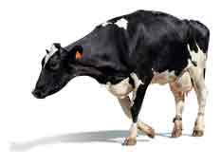
Rear Feet and Legs
When examining the front and rear legs of the animal, check for the following:
  Is she favoring one foot over the other?
  Does she limp when walking?
  Are there any noticeable signs of injury, infection, or swelling?
  Is there any deformity?
Source: nwnyteam.org

Slide 26
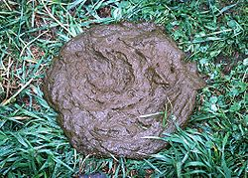
Stool (manure)
Manure is one of the most revealing and helpful symptoms of an animal.
When examining the manure, look for the following:
  Amount – does she have diarrhea or is she constipated?
  Color – is it a normal brown, or does it have red or black streaks in it?
  Smell – does it smell like
  normal manure or does it
  have an especially-foul
  or –sour smell?
  Consistency – is it runny,
  tarry, or extra stiff?
Source: en.wikipedia.org

Slide 27
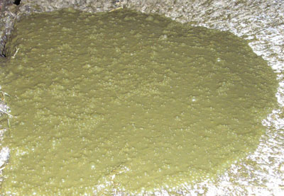
Symptoms in Manure
Brown, frosting-like consistency - normal
Runny – diarrhea
Green & Watery – Johnnes disease (see photo)
Sour-smelling – Salmonella infection or acidosis
Slimy – excess fiber or protein
Too little – twisted or obstructed colon or other digestive problem
Black or red streaks –
internal bleeding (the
redder the streaks, the
later the injury in the
digestive tract)
Too stiff – excess fiber
Source: nodpa.com

Slide 28
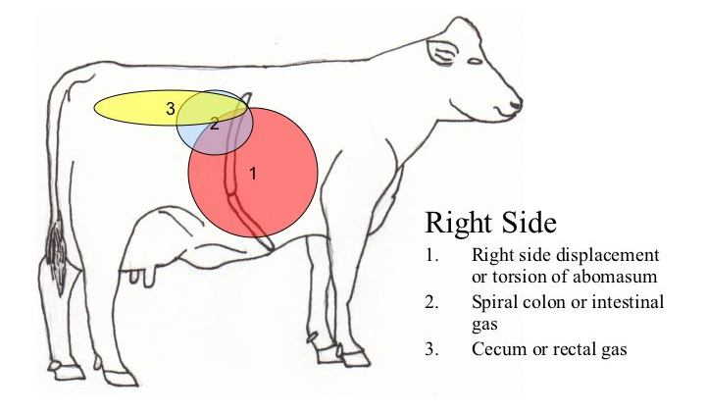
Right Side
Most of the symptoms that you will check would be found on the head or left-side of the animal.
On the right hand side, you will check…
  Right displaced abomasum
  Digestive obstruction
  Withers pinch

Slide 29
Right Displaced Abomasum
Checking for a displaced abomasum (DA, or twisted stomach) on the right hand side is the same as checking it on the left-hand side.
Place your stethoscope over what is the green area on cow (but on the right-hand side) and flick repeatedly with your finger and thumb.
If the stomach has twisted, it will sound like a banjo through the stethoscope
when you flick the area.
A Right DA is much more
serious and requires
immediate attention.
Source: UW-Madison Dept of Dairy Science

Slide 30
Digestive Obstruction
To check for a digestive obstruction (such as a blocked or twisted colon), locate the hip of the cow (this is the bony part that juts out at the rear of the cow).
Check for ‘pings’ just like you would check for a DA.
  If you hear a ping right
  around the hip, it is a
  sign of rectal gas (#3).
  If you hear a ping to the
  right of the hip, it is a sign
  of a twisted intestine
  or intestinal gas (#2).
Hip Bone
Source: UW-Madison Dept of Dairy Science

Slide 31
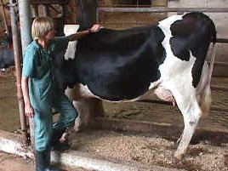
Withers Pinch
The withers is area consistency of the spine of the animal above the front feet.
If you gently pinch along the spine, the animal should have a reflex that resembles a “shrug” – the animals spine should dip and their head should arch slightly.
  This is called a “dorsiflex”.
If the cow does not respond to repeated withers pinches, it may have a internal
pain or hardware disease.
  Hardware disease occurs
  when the animal accidentally
  consumes a piece of metal or
  other indigestible substance.
  The hardware will remain in the
  cow’s reticulum (2nd stomach
  chamber).

Slide 32
Summary of Steps
Questions: ask 8 questions to determine what the owner already knows.
Head and neck: examine the…
  Ears – are they warm or cold?
  Eyes – are they normal or sunk?
  Nose – is there mucus discharge?
  Mouth – is she grinding her teeth?
  CRT – how is her circulation?
  Jaw – is her jaw swollen (bottle jaw)? Does she have swollen lymph nodes.
  Skin – is she dehydrated (pinch test)?

Slide 33
Summary
Left Chest
  How is her heart rate? Is it 60-80 bpm?
  Does she have a heart murmur?
  How is her respiration rate? Is it 10-40 bpm?
  Does she have dyspnea?
Left Abdomen?
  Does she have 1-2 rumen contractions per minute?
  Does she have a displaced abomasum?
Udder
  Is it red/hot/swollen/cold/chunky/watery?

Slide 34
Summary
Rear
  Is the cow’s temperature 101.5º?
  Does she have Ketosis (High Urine Ketones)
  Are her rear feet and legs healthy?
  Does her manure have the right color/consistency/odor?
Right Side
  Does she have a right displaced abomasum
  Dose she have a digestive obstruction
  Does she dorsiflex during a withers pinch

