Slide 1
Types of Watches
Digital
Analog
Basic
Functional
Smart
Quartz
Manual
Automatic

Slide 2
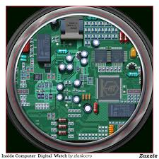
What is digital technology?
Digital is entirely different. Instead of storing words, pictures, and sounds as representations on things like plastic film or magnetic tape, we first convert the information into numbers (digits) and display or store the numbers instead.

Slide 3
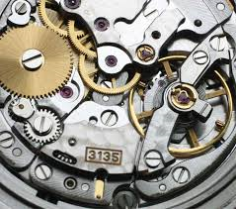
What is analog technology?
People accept digital things easily enough, often by thinking of them as electronic, computerized, and perhaps not even worth trying to understand. But the concept of analog technology often seems more baffling—especially when people try to explain it in pages like this! So what's it all about?

