Slide 1
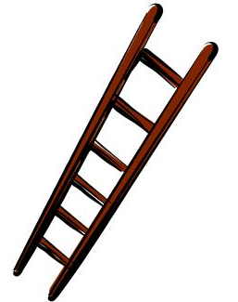
Laddering
A technique that makes you look at the problem through different lenses and explore the problem space more creatively and more thoroughly
How else could we see this problem?
Is there another angle?
“A redefinition technique which generates alternative problem definitions by moving through progressively higher levels of problem abstraction until a satisfactory definition is achieved
When a problem is systematically enlarged in this way, new definitions emerge that can be evaluated for their usefulness and feasibility.”²
1 Isaksen, S, Dorval, B & Treffinger, D. (2011). Creative Approaches To Problem Solving (3rd Edition). SAGE Publications, Thousand Oaks, CA
2 Couger J.D, Flynn P. and Hellyer D., 1-01-30 Creativity Training for IS, http://www.ittoday.info/AIMS/Information_Management/1-01-30.pdf accessed 13/09/2013
Notes:
How often have you been in the situation, either where your customer or your colleagues have said “this is the problem so this is what we need to do” and you have seen the problem differently and thought it ought to be tackled a different way. Or worse when you have a stakeholder group that are all seeing it differently – they all have different views of what needs to be done and how.

Slide 2
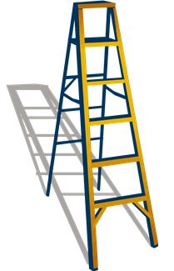
Broader problem statements
Different perspectives
Higher level of abstraction –
asking “why”?
Lower level of abstraction –
asking “how”?
Sub-problem space – evaluate new “hows”
1 Isaksen, S, Dorval, B & Treffinger, D. (2011). Creative Approaches To Problem Solving (3rd Edition). SAGE Publications, Thousand Oaks, CA
Notes:
Take any particular perspective of a problem and imagine it is on the rung of a ladder. The other rungs of the ladder are different perspectives that are more or less abstract than the original. Asking “why?” moves up the ladder to a higher level of abstraction, asking “how?” moves down the ladder to a lower one.
Moving up the ladder enables broader problem statements to be identified; moving down the ladder narrows the problem statement into smaller, more task based sub-problems. New definitions are evaluated for applicability.
Establish an invitational stem that encourages many possible responses to the problem statement (e.g. other examples: “how to…?”, “how might…?”)
Couger J.D, Flynn P. and Hellyer D., 1-01-30 Creativity Training for IS, http://www.ittoday.info/AIMS/Information_Management/1-01-30.pdf accessed 13/09/2013

Slide 3
Action
verb
Invitational stem
In what ways might Niki reduce her energy bills?
An objective
Problem
owner
1 Isaksen, S, Dorval, B & Treffinger, D. (2011). Creative Approaches To Problem Solving (3rd Edition). SAGE Publications, Thousand Oaks, CA
Notes:
Take any particular perspective of a problem and imagine it is on the rung of a ladder. The other rungs of the ladder are different perspectives that are more or less abstract than the original. Asking “why?” moves up the ladder to a higher level of abstraction, asking “how?” moves down the ladder to a lower one.
Moving up the ladder enables broader problem statements to be identified; moving down the ladder narrows the problem statement into smaller, more task based sub-problems. New definitions are evaluated for applicability.
Establish an invitational stem that encourages many possible responses to the problem statement (e.g. other examples: “how to…?”, “how might…?”)
Couger J.D, Flynn P. and Hellyer D., 1-01-30 Creativity Training for IS, http://www.ittoday.info/AIMS/Information_Management/1-01-30.pdf accessed 13/09/2013

Slide 4
New stem :
In what ways might we save for a holiday?
New stem:
In what ways might we reduce spending?
New stem:
In what ways could the environment be saved?
To save for a holiday
To save the environment
To reduce spending
Why?
Why else?
Stem:
In what ways might Niki reduce her energy bills?
Why else?
How?
How else?
How else?
Turn thermostat to low overnight
Change supplier
Prevent heat loss
New stem:
How might we change supplier?
New stem:
How might we turn the thermostat down?
New stem:
How do we prevent heat loss?

