Slide 1
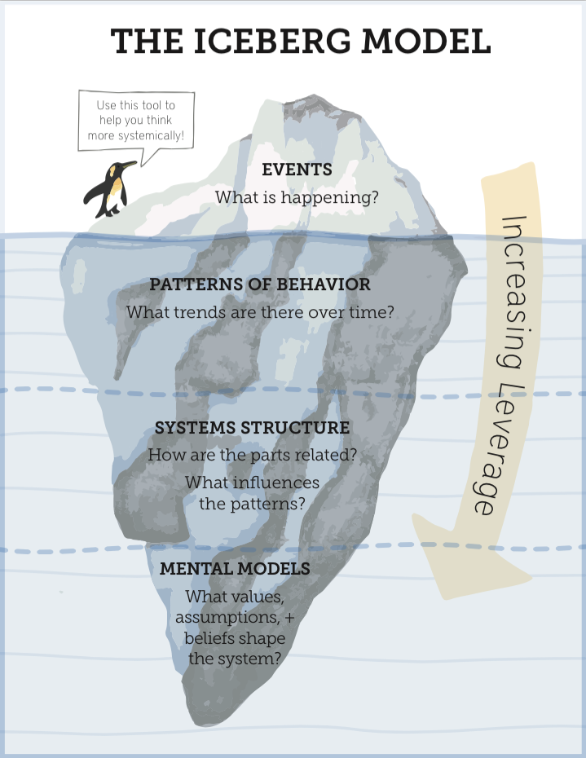
Focus of inquiry at each level of thinking
Individual events
Patterns of events:
  What has been happening?
  What are the trends over time?
  What changes have occurred?
Physical things
Organisations
Rules/policies/regulations
Rituals
Cause of patterns being observed:
  How are the parts/events related?
  What influences the patterns?
The attitudes, beliefs, morals, expectations, and values that give rise to stable structures
  What thoughts and reasoning is causing the structure?
http://donellameadows.org/systems-thinking-resources/
https://nwei.org/resources/iceberg/

Slide 2
Focus of inquiry at each level of thinking
The framework of thought that shapes and constrains mental models
  What values and beliefs are so core to the individual/group/society that they are seldom brought to the surface to be challenged?
Container
Systems Thinking, the iceberg theory of
Daniel Kim explained for YEBISU by André Huigens
http://www.fusbp.com/wp-content/uploads/2010/07/systems_thinking-explained.pdf

Slide 3
Increasing complexity
Container
Systems Thinking, the iceberg theory of
Daniel Kim explained for YEBISU by André Huigens
http://www.fusbp.com/wp-content/uploads/2010/07/systems_thinking-explained.pdf

Slide 4
Utility of thinking style
Can address the symptoms of the single event
Can forecast events
Can understand what is giving rise to events and patterns through time
Can understand the underlying values and beliefs that are giving rise to structures and patterns of behaviour
Container
Can understand the underlying culture/mindsets and value and belief systems that shape how we develop mental models
http://donellameadows.org/systems-thinking-resources/
https://nwei.org/resources/iceberg/

Slide 5
Example: the common cold
React to catching a cold – treat symptoms
Anticipate – I keep on catching colds when stressed and run down
Design – stressed as a result of working long hours due to insufficient staffing levels, overly complicated processes, headcount cap…..
Transform - working long hours culture, fire fighters are heroes, if you can’t stand the heat keep out of the kitchen…..
Container
Transform – Western worldview/capitalist culture
Adapted from https://nwei.org/resources/iceberg/

