Slide 1
The Pig Model
Dr Niki Jobson

Slide 2
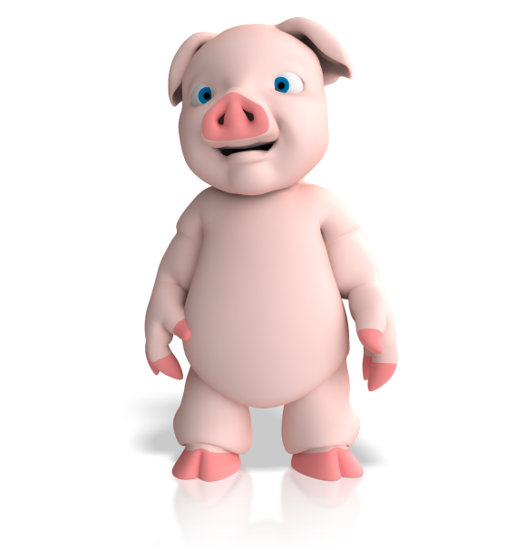
Pig in the middle model
Stakeholder X
Stakeholder A
System of
interest
Stakeholder Y
Stakeholder B
Stakeholder Z
Stakeholder C
Gareth Morgan. Imaginization: New Mindsets for Seeing, Organizing and Managing, (new management edition) San Francisco: Berrett-Koehler, 1997
Notes:
Simple technique used to explore different perspectives in a problem situation. Name arises from the original model developed by Gareth Morgan who demonstrated the model’s concepts by considering a pig as the focus.
Draw the system in focus or problem in the centre (so you need to decide what the pig is, encouraging discussion on the system boundary). Then identify each stakeholder in the system/problem and add them around the pig (text or cartoon), linking them with a line. Annotate the link with the perspective of the stakeholder.

Slide 3
Pig in the middle model
Stakeholder X
Stakeholder A
System of
interest
Stakeholder Y
Stakeholder B
Deciding what the pig is can be surprisingly difficult but it encourages discussion on system boundary
Stakeholder Z
Stakeholder C
Gareth Morgan. Imaginization: New Mindsets for Seeing, Organizing and Managing, (new management edition) San Francisco: Berrett-Koehler, 1997
Notes:
Simple technique used to explore different perspectives in a problem situation. Name arises from the original model developed by Gareth Morgan who demonstrated the model’s concepts by considering a pig as the focus.
Draw the system in focus or problem in the centre (so you need to decide what the pig is, encouraging discussion on the system boundary). Then identify each stakeholder in the system/problem and add them around the pig (text or cartoon), linking them with a line. Annotate the link with the perspective of the stakeholder.

Slide 4

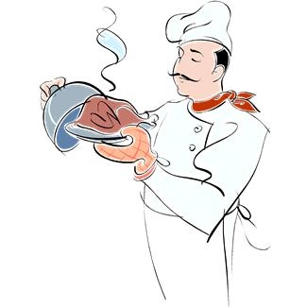
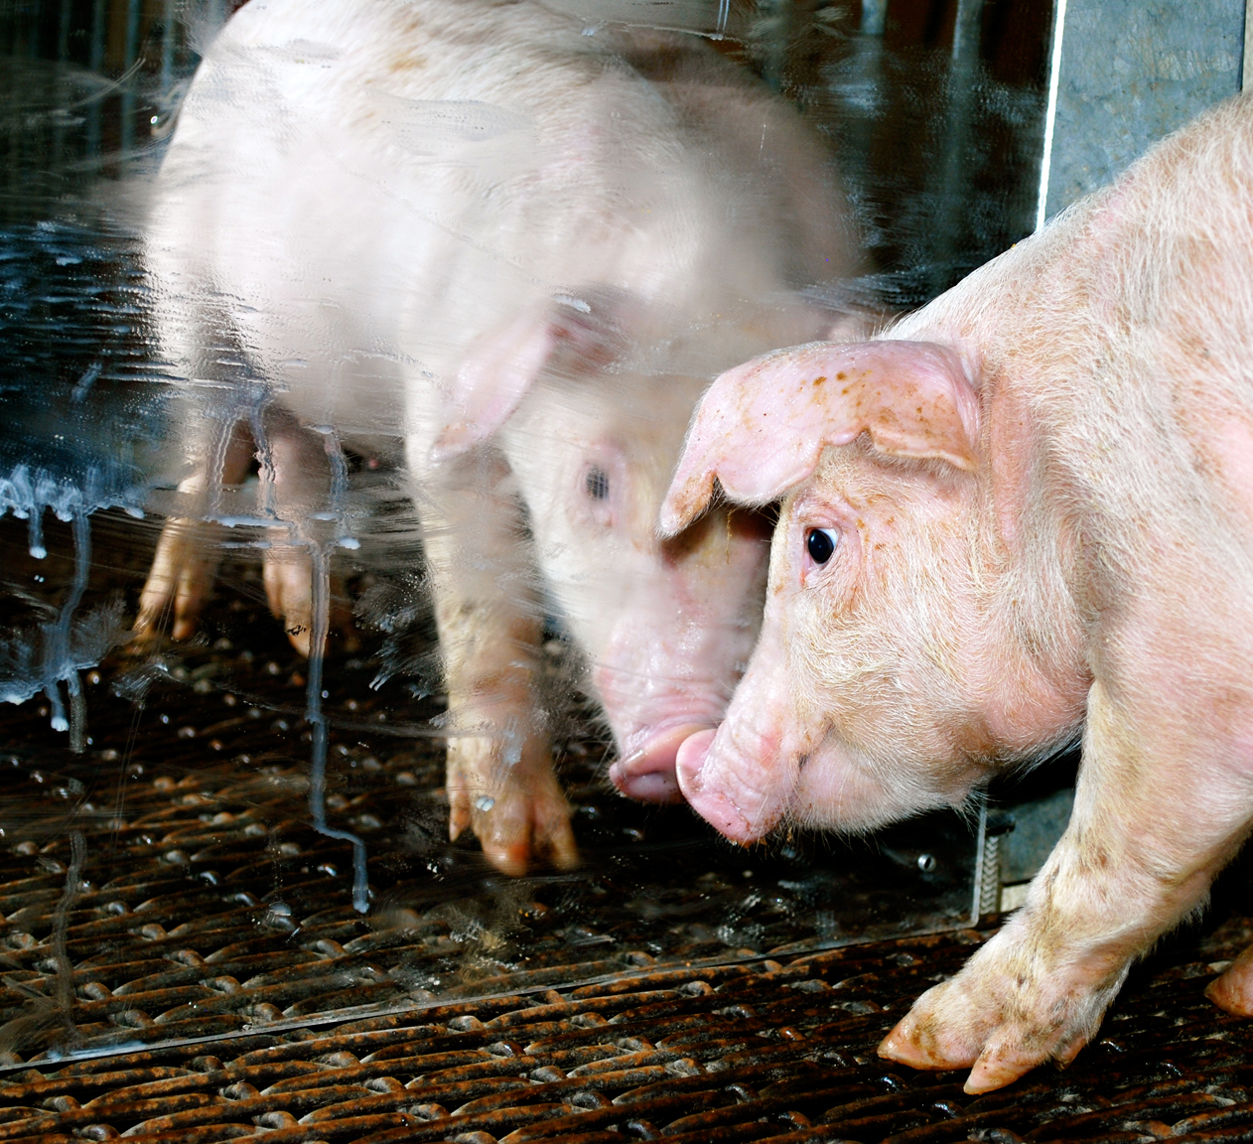



What does a pig mean to you?
Ingredient
Livestock
What the stakeholder sees the pig as (line of perspective)
Story character
Money
Food

Slide 5
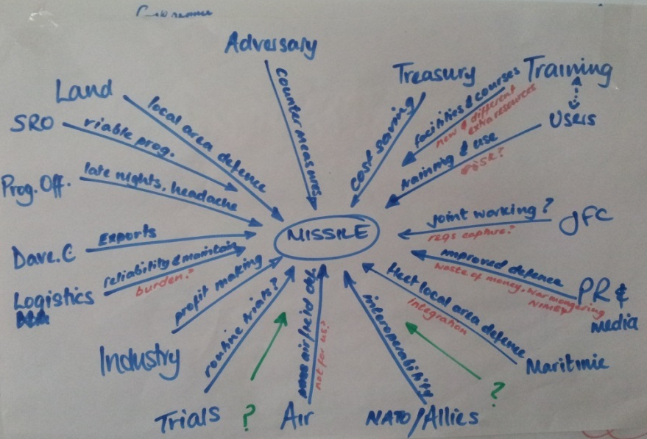
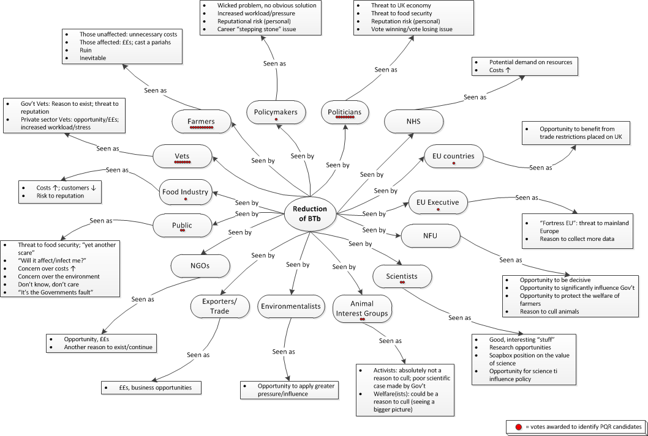
Examples

