Slide 1
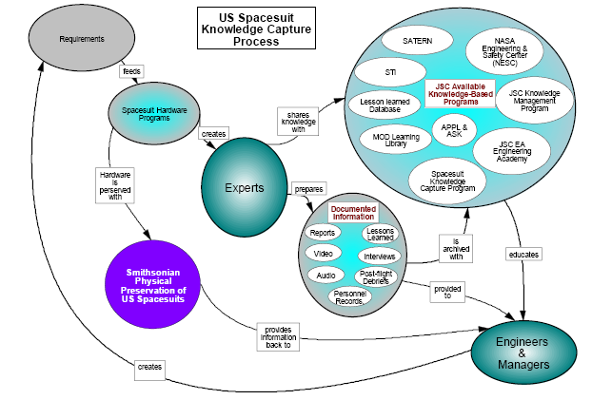
Example of Knowledge Capture Process for US Spacesuit

Slide 2
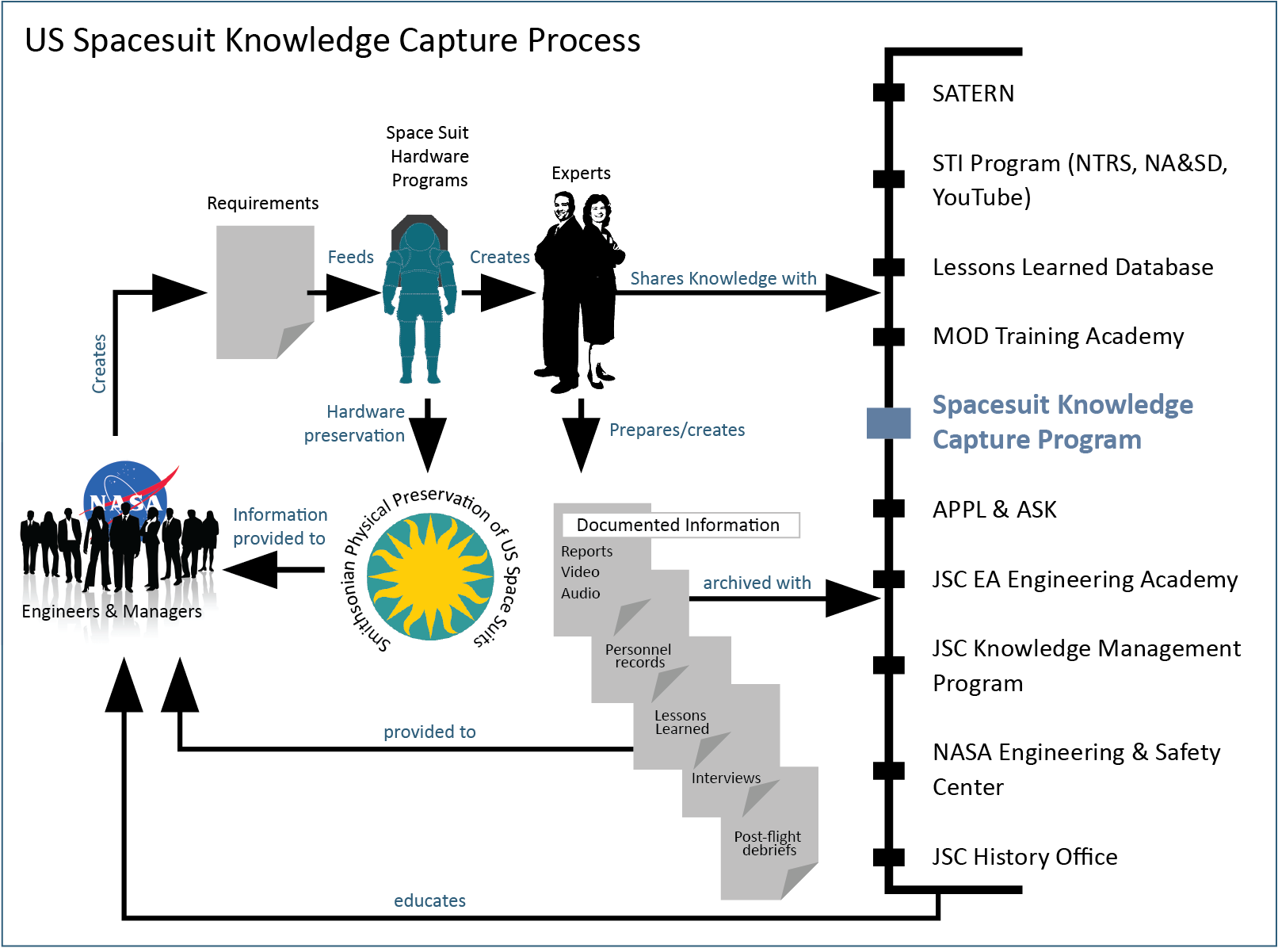

Slide 3
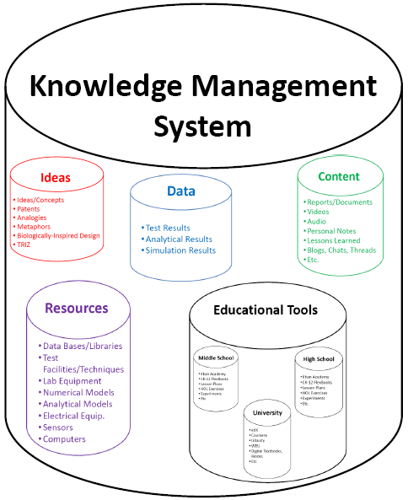
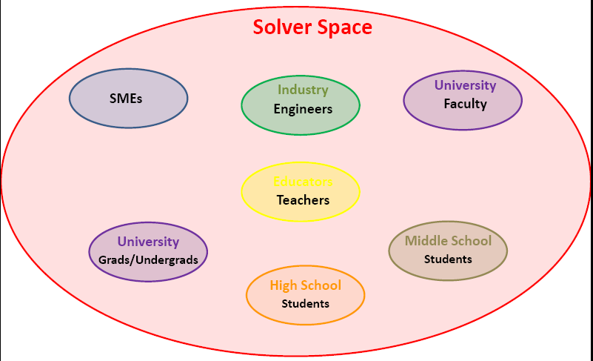
Design Challenge Space
Epic Challenge

Slide 4
Background

Slide 5
Design Challenge Space
Epic Challenge

Slide 6
Solver Space
Industry
Engineers
University
Faculty
SMEs
Educators
Teachers
University
Grads/Undergrads
Middle School
Students
High School
Students

Slide 7
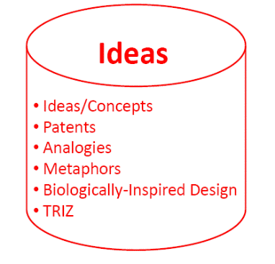
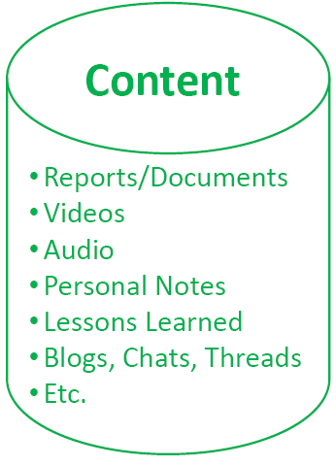
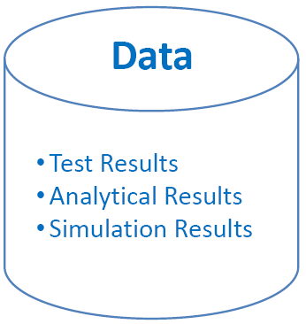
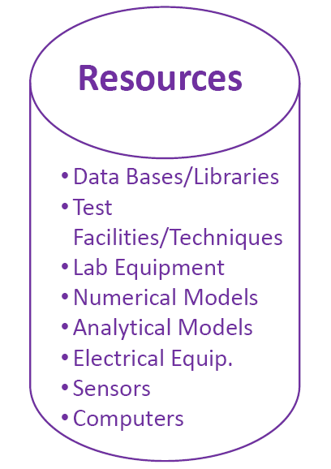
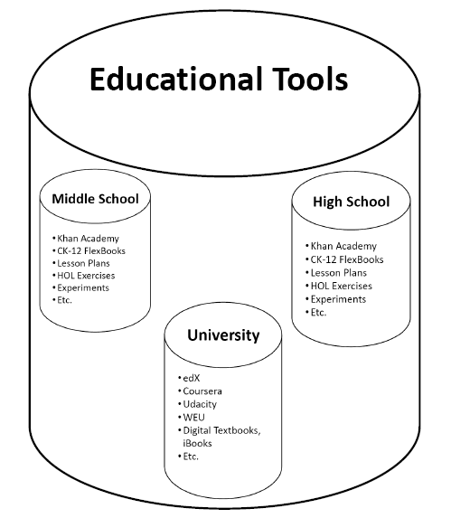
Knowledge Management System

Slide 8
Content
Reports/Documents
Videos
Audio
Personal Notes
Lessons Learned
Blogs, Chats, Threads
Etc.

Slide 9
Data
Test Results
Analytical Results
Simulation Results

Slide 10
Resources
Data Bases/Libraries
Test Facilities/Techniques
Lab Equipment
Numerical Models
Analytical Models
Electrical Equip.
Sensors
Computers

Slide 11
Ideas
Ideas/Concepts
Patents
Analogies
Metaphors
Biologically-Inspired Design
TRIZ

Slide 12
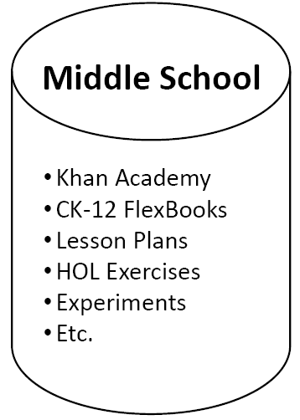
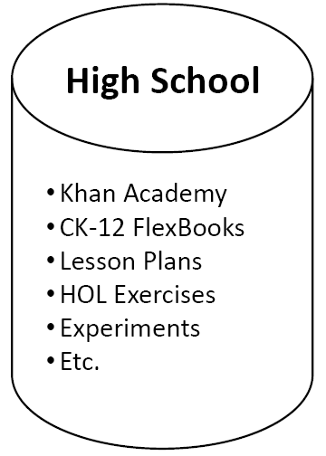
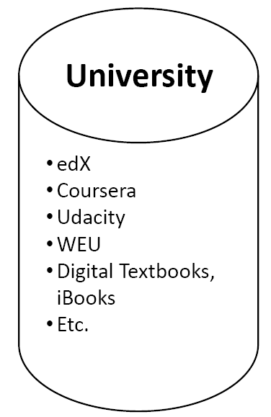
Educational Tools

Slide 13
University
edX
Coursera
Udacity
WEU
Digital Textbooks, iBooks
Etc.

Slide 14
Middle School
Khan Academy
CK-12 FlexBooks
Lesson Plans
HOL Exercises
Experiments
Etc.

Slide 15
High School
Khan Academy
CK-12 FlexBooks
Lesson Plans
HOL Exercises
Experiments
Etc.

