Slide 1
Project 3
Vamsi Kalakuntla
50152777

Slide 2
Student Background Sheet
Name Vamsi Kalakuntla Course # CSCI 524 Analysis/Design
Wix: https://vkalakuntla.wixsite.com/vamsikalakuntla
Undergrad/grad Computer Science
Contact info Vkalakuntla@leomail.tamuc.edu
9034565168
Graduation date May 2017
Textbook available date
Any questions on syllabus
Reason to take this course : Learn more about product or project management and get into more insights about software development
Expectations for this course Smart learning which I can later implement in my carrier
Personal Background : I am from Hyderabad,India.
Professional Radio and Jockey
Marketing Expert
Degrees/Certifications:Bachelors Engineering Degree in Computer Science
Goals after graduation :I would like to work as a leading Software Developer and Product Manager in the Industry.
Work experience :Eighteen Months of work experience at the marketing and communications department of Texas A&M University-Commerce as a content producer and Student Marketing Relations Individual for 88.9 KETR
Extra-curricular interests (may help in project)

Slide 3
I am looking forward to work in the industry as a software developer and programmer.
I would like to focus on Java and Devops technologies.
Also I would like to be equally useful to the company as a resource which can be relied on for overall developement

Slide 4
SWEBOK-Areas of Interest
Software maintenance :It is the modification of a software product after delivery to correct faults, to improve performance or other attributes.
Sub topic-software maintenance processes -It is the modification of a software product after delivery to correct faults, to improve performance or other attributes. A common perception of maintenance is that it merely involves fixing defects.
Software construction:It is the detailed creation of working meaningful software through a combination of coding, verification, unit testing, integration testing, and debugging
Sub topic: Coding is the process of programming the code.
Engineering foundations: This Engineering Foundations knowledge area (KA) is concerned with the engineering foundations that apply to software engineering and other engineering disciplines

Slide 5
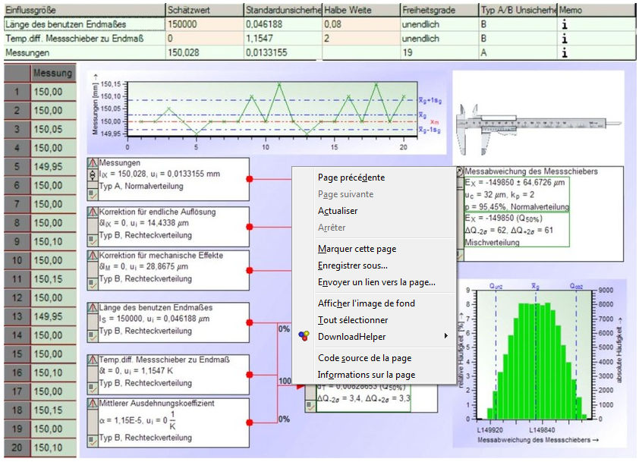
Measurement of System Analysis Software

Slide 6
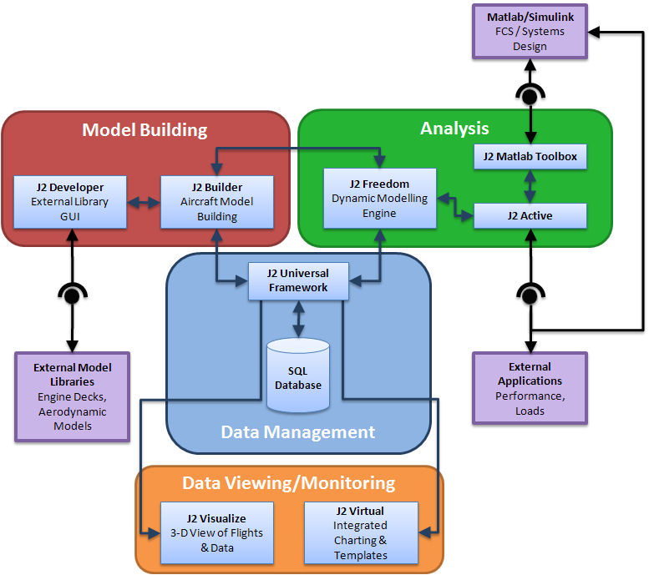
Design of Software System

Slide 7
CONCLUSION
ngoing analyses in order to modify components of the system that do not prove efficient and to upgrade designs also improves the quality of a business as outdated methods are discontinued and new procedures implemented.
System analysis and design can be used to improve procedures in handling accounts receivable, in preparing and implementing a budget and in scheduling regular or one-time projects.
System analysis and design also can be used to identify, develop and market new products as well as identify and enter new markets with existing and new products.

