Slide 1
DRUGS COMMONLY USED
IN
NERVE & JOINT BLOCK
IN
EQUINE LAMENESS

Slide 2
Regional anesthesia is a valuable diagnostic aid used to localize lameness when, after a thorough clinical examination, the site of pain remains uncertain. Localizing pain allows other diagnostic procedures, such as anesthesia of a joint, radiography, ultrasonography, CT, scintigraphy, or MRI to be used more effectively and economically to identify the cause of lameness. Additionally, use of regional anesthesia allows some surgical procedures to be performed without the need for general anesthesia, and it can be used to provide temporary, humane relief of pain.
Lidocaine HCl (2%) and mepivacaine HCl (2%) are the local anesthetic agents most commonly used to induce regional anesthesia during the lameness examination. Mepivacaine HCl is preferred by most clinicians, because it causes less tissue reaction than lidocaine HCl. Bupivacaine HCl is used to induce regional anesthesia for humane relief of pain, because it provides anesthesia that lasts 4–6 hr.
Vasoconstrictors (epinephrine) are occasionally incorporated with or added to Lidocaine to increase the intensity of effect and prolong anesthetic activity.
Adding the hyaluronidase increases tissue penetration in the region of infiltration and hasten the analgesic activity.

Slide 3
Mechanism of action of Local Anesthesia (LA).
It acts by interference with transmission of impulses by preventing the increase in membrane permeability of the nerve cell to sodium ions.
LAs block nerve conduction by inhibiting influx of sodium ions through ion selective sodium channels in nerve membrane leading to impairment of the generation of action potential.
The sodium channel itself is a specific receptor for local anesthetic molecules.
LAs are membrane stabilizing agents which prevent depolarization and stop or retard conduction of impulses.

Slide 4
General considerations
Use sterile solutions, equipment and techniques
Avoid injection into inflamed area (if possible)
Use as small a gauge needle as practical
Aspirate for blood before injecting
Use the lowest effective concentration of LA drug to produce the desired effect
Wait for onset of analgesia before proceeding

Slide 5
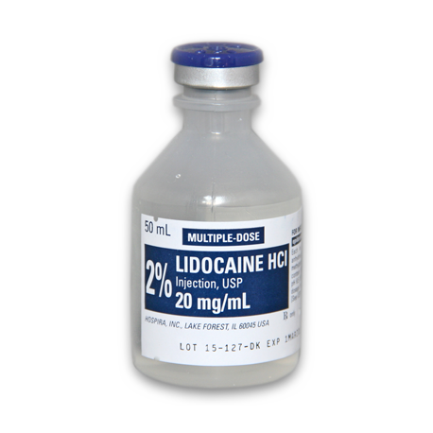
AGENT: Lidocaine HCL 2%
TRADE NAME: Xylocaine
CHEMICAL NAME: Diethylaminoacet -2,6 xylidiide
ONSET: Rapid (5-10 minutes)
DURATION: Intermediate (60-90 minutes)
INDICATIONS:
Lidocaine HCl with Epinephrine is a local anesthetic agent which can be used for infiltration or conduction (nerve blocking) anesthesia. It is twice as potent as procaine hydrochloride and produces more prompt, longer lasting and more extensive anesthesia than the latter preparation.
Lidocaine HCl is stable and non-irritating and although it is highly effective without an accompanying vaso-constrictor, epinephrine (1:100,000) has been included to lengthen the duration of anesthesia.
It is compatible with most commonly used IV infusion solutions. Compatibility is dependent upon factors, such as pH, concentration, temperature, and dilutants used. It is considered to be a class IB (membrane-stabilizing) anti-dysrhythmic agent. It is use as a local and topical anesthetic, lidocaine is used to treat ventricular arrhythmias.

Slide 6
CONTRAINDICATIONS:
Epinephrine may compromise circulation if injected into areas with end artery blood flow (e.g. Ears, digits, tail) and therefore, this product should not be used in these areas.
Do not administer intravenously. Convulsions and shock may occur in sensitive animals if large doses of the drug are given intravenously (inadvertently) or intrathecally. This may be treated by injecting a short acting barbiturate intravenously to control central nervous system stimulation and immediately administering artificial respiration or oxygen.

Slide 7
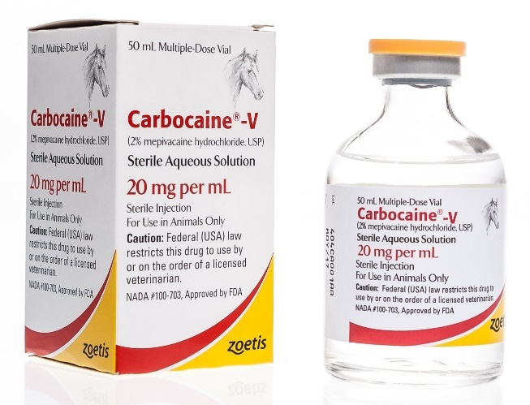
AGENT: Mepivacaine HCL
TRADE NAME: Carbocaine
CHEMICAL NAME: 1- methyl-2’,6’-pipecoloxylidide
monohydrochloride
ONSET: Rapid (5-10 minutes)
DURATION: 120-180 minutes
INDICATIONS:
Mepivacaine Hydrochloride 2% solution is used as a local anesthetic for infiltration around a surgical site, nerve blocks and joint anesthesia (typically used in lameness examinations), epidural (spinal) anesthesia, and topical and/or infiltration anesthesia of the lining of the throat and larynx prior to laryngeal surgery in equines. It is used in a similar manner to Lidocaine hydrochloride, but has a longer-lasting effect. It is often used to anesthetize portions of the hoof or lower leg for surgical procedures and is less effective than Lidocaine for topical anesthesia.

Slide 8
DOSAGE & ADMINISTRATION:
Nerve block (diagnosis of lameness, firing, pain relief in osteoarthritis, navicular disease) 3-15ml
Epidural anesthesia (animal standing) 5-20ml
Intra – articular anesthesia (removal of fracture chip, bone and bog spavin, arthritis) 10-15ml
CONTRAINDICATIONS:
Do not use in horses intended for human consumption.

Slide 9
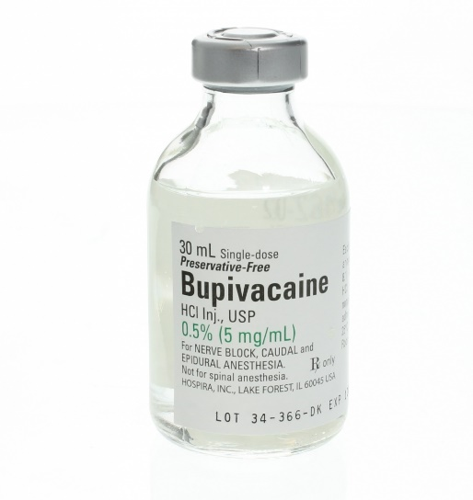
AGENT: Bupivacaine HCL
TRADE NAME: Marcaine
CHEMICAL NAME: 1-butyl-2’,6’ pipecoloxylidide-HCL
ONSET: 10-30 minutes (depends on route of
administration)
DURATION: 180-480 minutes
INDICATIONS:
Bupivacaine is a potent local anesthetic used in equine medicine. It is used to induce regional anesthesia for humane relief of pain, because it provides anesthesia that lasts 4–6 hr. The long duration of action of this drug renders it less suitable for diagnostic nerve blocks, but often more suitable for peri-operative analgesia of the distal limb. More proximal nerve blockade, however can compromise recovery quality because the patient effectively has a ‘dead leg’.

Slide 10
DOSAGE:
For peripheral nerve blocks and caudal epidural anesthesia are in the range 0.05-0.08 mg/kg (i.e. 5-8ml of the 0.5% solution in an average adult horse).
CONTRAINDICATIONS:
More cardiotoxic than Lidocaine

Slide 11
THE END.

