Slide 1
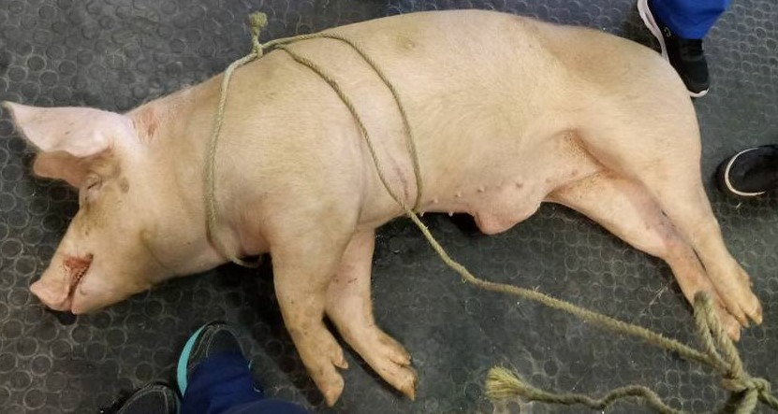
OBSERVATION POST-OP on Big Joe

Slide 2
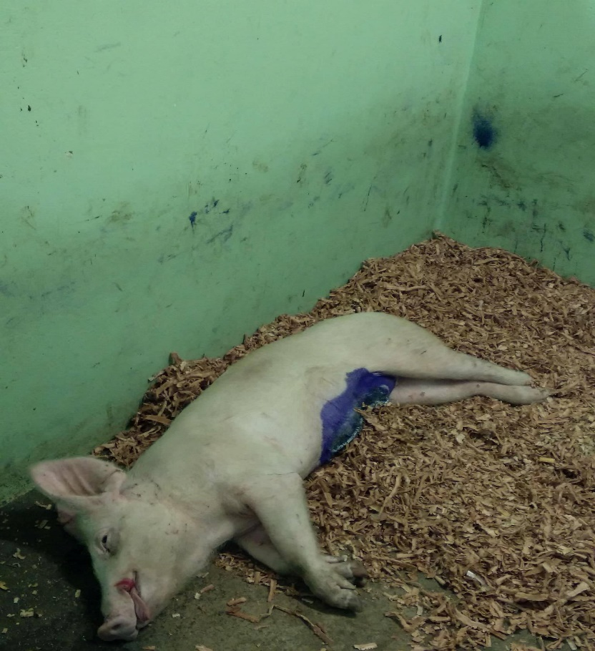
Big Joe immediately after surgery
Parameters of Big Joe immediately after surgery
Temperature: 37.2°C
Pulse : 94 beats/min
Respiration: 40 breaths/min

Slide 3
Treatment post-op
1. For the next 7 days the pig will be assessed by a distance exam and physical exam.
Heart rate, Breathing rate and Temperature, Mucous membrane colour, Capillary refill time, Rumen contractions, Hydration level, Faeces appearance and quantity, Appetite and Activity/Demeanour will be monitored.
The incision site would be monitored for signs of Pain upon touch, Fly strike, Discharges, Haemorrhage, Swelling and Abnormal heat/coldness.
Tetravet aerosol (topical antibiotic) and Larvicid aerosol (larvicide repellent) would be applied daily.
The SOAP form would be updated daily.
2. Administer Penicillin-Streptomycin as before every 3 days for 2 doses/times.

Slide 4
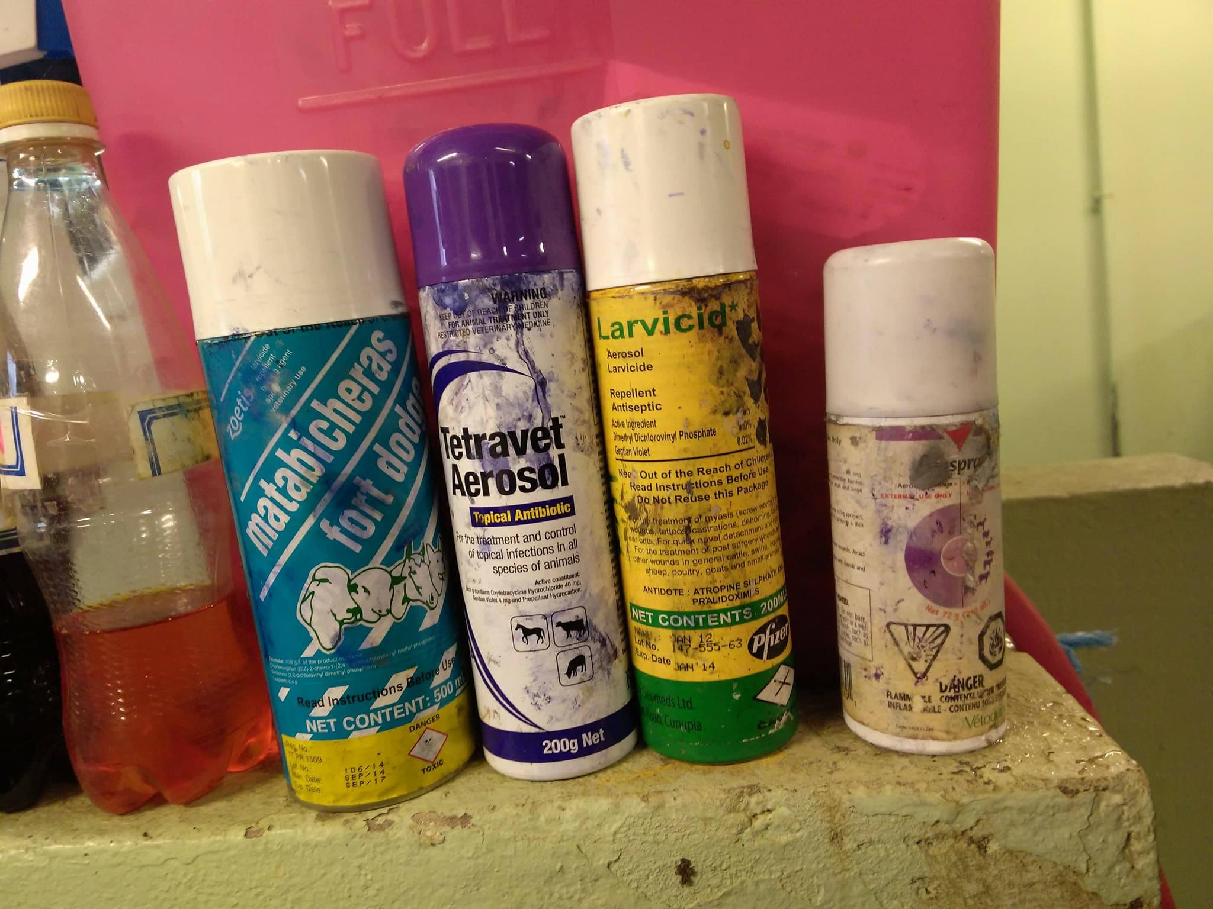
Sprays used after surgery
1. Antibiotic spray was applied directly to the wound; Tetravet https://www.drugs.com/pro/tetravet.html
2. Aluminium powder barrier was applied directly to the wound; Alu spray http://www.vetpharmacy.co.uk/equine-first-aid/vetoquinol/aluspray-210ml-aluminium-spray-pd-1172.html
3. Larvicide/Screw worm spray was applied around the wound; Metabicheras fort dodge https://ar.zoetis.com/products/bovinos/matabichera-fd.aspx

Slide 5
Day 1 Post Operation
Upon distance examinations of Big Joe appeared bright, alert and responsive with normal parameters.
Parameters of pig 1 day Post Op:
Temperature: 39.3°C
Pulse: 80 beats/min
Respiration 56 breaths/min
Immediately after surgery Big Joe was placed in lateral recumbency on an electric heating mat due his low body temperature. He was observed for 2 hours until he moved into sternal recumbency.
There was no vocalization which indicated no pain was felt from affected areas.
There was no abnormal behaviour which indicated the surgical procedure affected the animal negatively.
There was no haemorrhage or abnormal discharge. However due to the location of the hernia the preputial area was palpated to express urine and to ensure the urethra is not blocked. This would be continued daily for 1 week.
There were no flies present on or around the surgical site which indicated there was proper post-op management and the screw worm spray worked effectively.

Slide 6
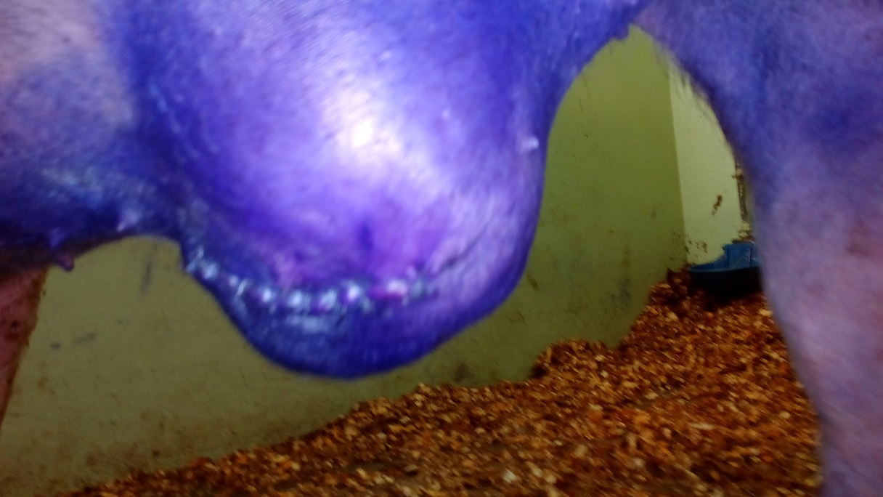
Wound 1 day post op after spray

Slide 7
Day 3 Post Operation
Upon distance examinations of Big Joe appeared bright, alert and responsive with normal parameters.
Parameters of pig day 3 Post Op:
Temperature: 99.3 °C
Pulse: 72 beats/min
Respiration: 40 breaths/min
There was no vocalization which indicated no pain was felt from affected areas.
There was no abnormal behaviour which indicated the surgical procedure affected the animal negatively.
There was no haemorrhage, abnormal discharge and the swollen preputial area was expressed. A small amount of urine was present.
There were no flies present on or around the surgical site which indicated there was proper post-op management and the screw worm spray worked effectively.
Stool sample of normal consistency was observed which indicated the animal is eating and drinking habits were returning to normal.

Slide 8
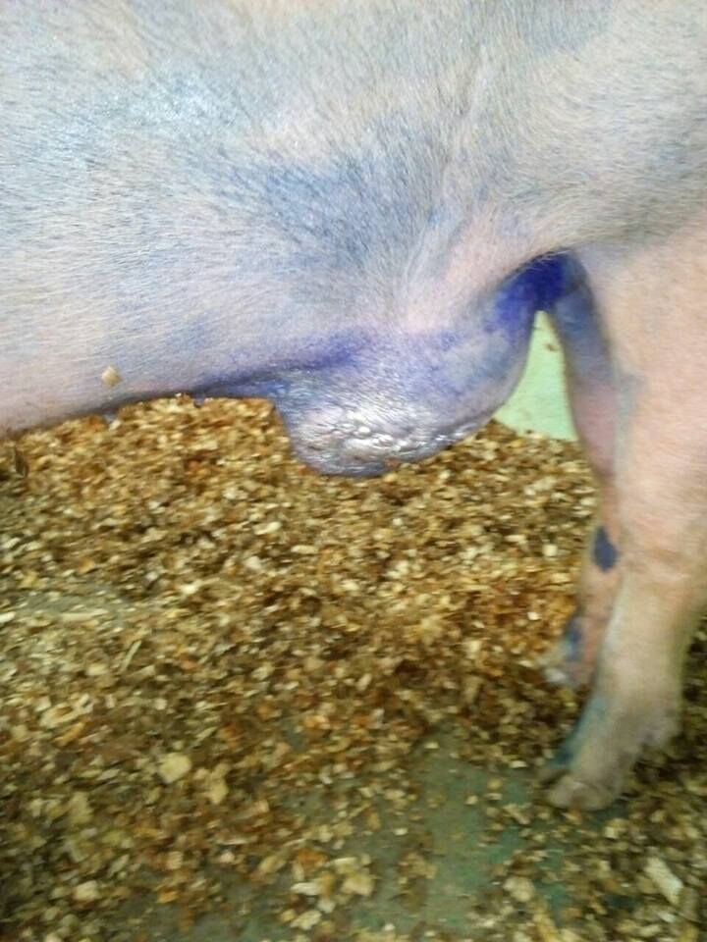
Wound 3 day post op before spray

Slide 9
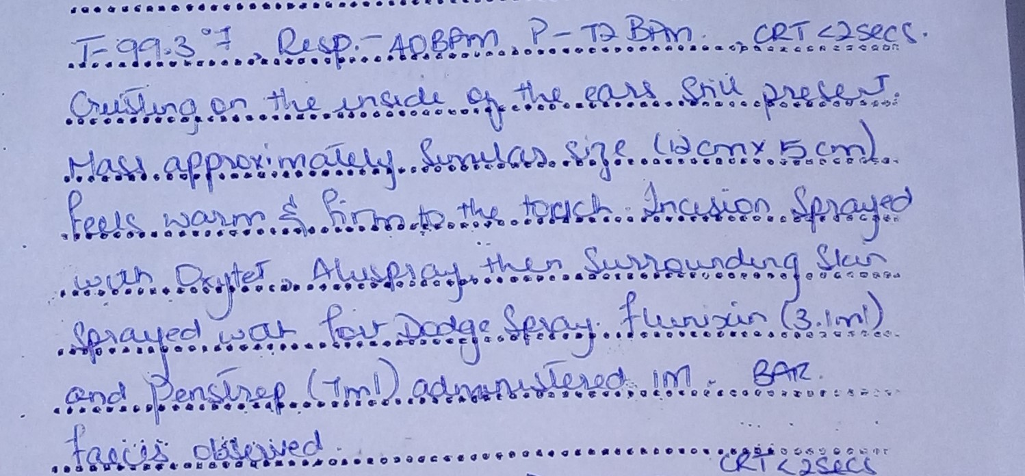
SOAP: up to 3 day post op. Overall, the swollen incision site is slowly decreasing and this will be continually monitored by the students. The preputial area will be expressed for a few more days. Topical larvicide and antibiotic will be applied daily. If there is any indications of pain the animal would be treated accordingly to his records. Stitches should removed with the next 2 weeks.

Slide 10
Big Joe 3 day post op

