Slide 1
Foot and Claw Surgery
Lab 12

Slide 2
Anatomy of the Hoof

Slide 3
Anatomy of the Hoof

Slide 4
Anatomy of the Hoof

Slide 5
Anatomy of the Hoof

Slide 6
Anatomy of the Hoof

Slide 7
Anatomy of the Hoof

Slide 8
Anatomy of the Hoof

Slide 9
Economic Importance
Hoof lameness is one of the top three reasons that can cause economic lost to a farmer.
Hoof lameness problems include:
Infertility (inability to breed), prolongs calving intervals
replacement cost of a cow/bull
culling losses
Reduced milk yield: discarded milk due to antibiotic use
Veterinary expanses
Labour

Slide 10
Important Conditions of Bovine Digit

Slide 11
Important Conditions of Bovine Digit

Slide 12
Bovine Lameness Scoring Chart

Slide 14
Common Types of Hoof Problems

Slide 15
Foot Rot
Caused: Fusiformis necrophorus.
Location: High in between the claws/toes.
Presentation:
Foul Odour
Usually lameness in one leg.
The foot swells above the coronet and the toe spreads.
Can progress into the joint space or tendon sheath producing permanent damage.

Slide 16
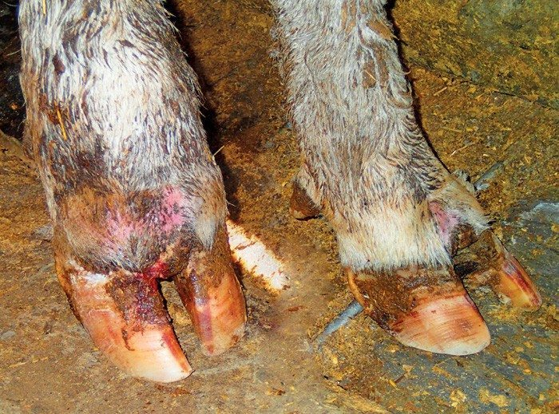
Foot Rot

Slide 17
Heel Erosions
Cause: Overgrown hooves shift the weight toward the heels, exposing the heels to erosion. Most likely Heel erosions star seen in the hind limb.
At the bulb of the heel as pits on the surface that can develop into parallel grooves that get filled with bacteria. A new sole developed underneath and material becomes packed in between the two layers.

Slide 18
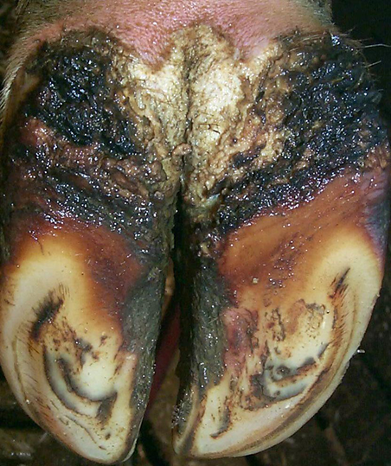
Heel Erosions

Slide 19
Laminitis
Cause: overgrown and deformed feet or toes.
Hemorrhages, abscesses or ulcers may occur when material enters places where the wall and sole have separated.
Predisposing factors: nutritional management (rumen acidosis), metabolic and digestive disorder, hormonal change and environmental aspect (bedding, hard surfaces0
Animal may appear lame or stiff and have difficulty in getting up or down.
Usually seen during the first 100 days postpartum.

Slide 20
Laminitis
Rumen acidosis: as the rumen decreases below 5, the lactic acid production is elevated. The increase in acidity causes stasis of fermentation.
Endotoxins can be produced and released which can trigger histamine release. Thus causing vasoconstriction, dilation, laminar destruction, hoof deterioration and laminitis process develops.

Slide 21
Laminitis
Acute laminitis: Systematic ill cow with clinical signs such as intense pain including swelling and temperatures above the coronary band.
Subclinical laminitis: can be a long and slow process. Clinical signs: sole hemorrhage and yellow discolourations.
Chronic laminitis: No therapy. The growth pattern of the keratinized horn is disrupted and the shape of the digits altered, becoming more elongated and flattened. Dis shape appearance tot eh front of the hoof is seen. Internally the coffin bone has been separated from the front of the wall.

Slide 22
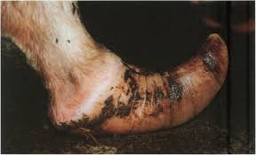
Laminitis/ Founder

Slide 23
Sole ulcers
Predisposing factors: moisture, excessive wear and poor hoof trimming. Usually associated with the clinical manifestation of laminitis.
Rule of thumb: if 10% of the hers had sole ulcers, the herd should be suspected for laminitis.
Location:
normally seen in both hind limbs
Sole ulcers are raw sores usually occurring on the inner side of the outside claw.
Presentation: A bulge of granular-like tissue sticking through the sole.

Slide 24
Sole ulcers

Slide 25
Indications

Slide 26
Hoof Trimming
Hoof trimming is essentially the maintenance of healthy normal feet.
This simple management technique can save the farmer having severe monetary loses in his farm.
The hoofs should be trimmed at least every 6 months.

Slide 27
Hoof Trimming
Indications:
Return hooves to ideal shape so that they are balanced and capable of supporting the cow’s weight.
Removing dead and disease horn, promotes growth of new tissues ad reduces pain.

Slide 28
Hoof Trimming
Manual Trimming
Mechanical Trimming
Advantages:
Precision
TLC for each animal
Disadvantages
Time consuming
Requires a skills
Expensive labour
Advantages
Large number of animals can be done quickly
Save the farmer money.
Disadvantages:
Mistakes are easily made with a machine.
Life threating damage in occur to the operator.

Slide 29
Arthrodesis of the Distal Interphalangeal (DIP) Joint.
This choice of technique based on the anatomic structure infected and the location of existing draining tracts.
The advantages of ankylosis of the DIP joint in comparison to digit amputation are:
The cattle will have a longer production life
The outcome is superior for a heavy animal or when the hind lateral or the front medial digit is affected.
Healing is more cosmetic and mechanically stable.

Slide 30
Arthrodesis of the Distal Interphalangeal (DIP) Joint.
Disadvantages are:
More expensive
More postop care
Slowly return to the production line up.

Slide 31
Arthrodesis of the DIP joint by a Dorsal Approach
Indication: if the distal sesamoid bone and the tendinous portion of the DDF tendon are not affected. If it is use the Solar Approach.
Easier to perform and is less invasive.
This also provides more stability to the joint because the tendinous portion of the DDF muscle is not disrupted.
Contraindications:
Limited visibility of the joint, hence difficulty in debridement.
Drainage is less efficient with the solar approach.

Slide 32
Digit Amputation
The removal of the digit is based on:
Severe Foot Rot unresponsive to antibiotics and complicated by osteomyelitis
Abscess formation with osteoarthritis of the DIP joint.
Infectious arthritis/ tenosynovitis
Dislocation of the phalangeal joints.

Slide 33
Digit Amputation
Prognosis is good.
Advantages:
The cattle normally return the production line up quickly.
Prolongs life (even though if it’s for a short period)
Disadvantages:
Survival period is not favorable. Culled earlier then herd-mates
Complication due to heavy weight of the cattle
Sepsis of the fetlock joint

Slide 34
Resection of deep tendons and sheaths
Indication: septic tenosynovitis complicating digital sepsis.
Sometimes the removal of the deep digital tendon is adequate. Other possible procedures are removal of deep and superficial tendons with or without partial or total removal of digital sheath.

