Slide 1
Intra-Operation
Hoof Trimming

Slide 2
Hoof Trimming: Manually
After restraining the animal in a chute and securing the leg. It was then cleaned of any debris.
The length/ height of the dorsal wall was measured to 7.5 cm and marked off. Then the excess was removed using a hoof cutter.
The effect was a square toe about 11mm. This was then trimmed down to 6mm using a hoof knife. Small pieces were removed at a time.

Slide 3
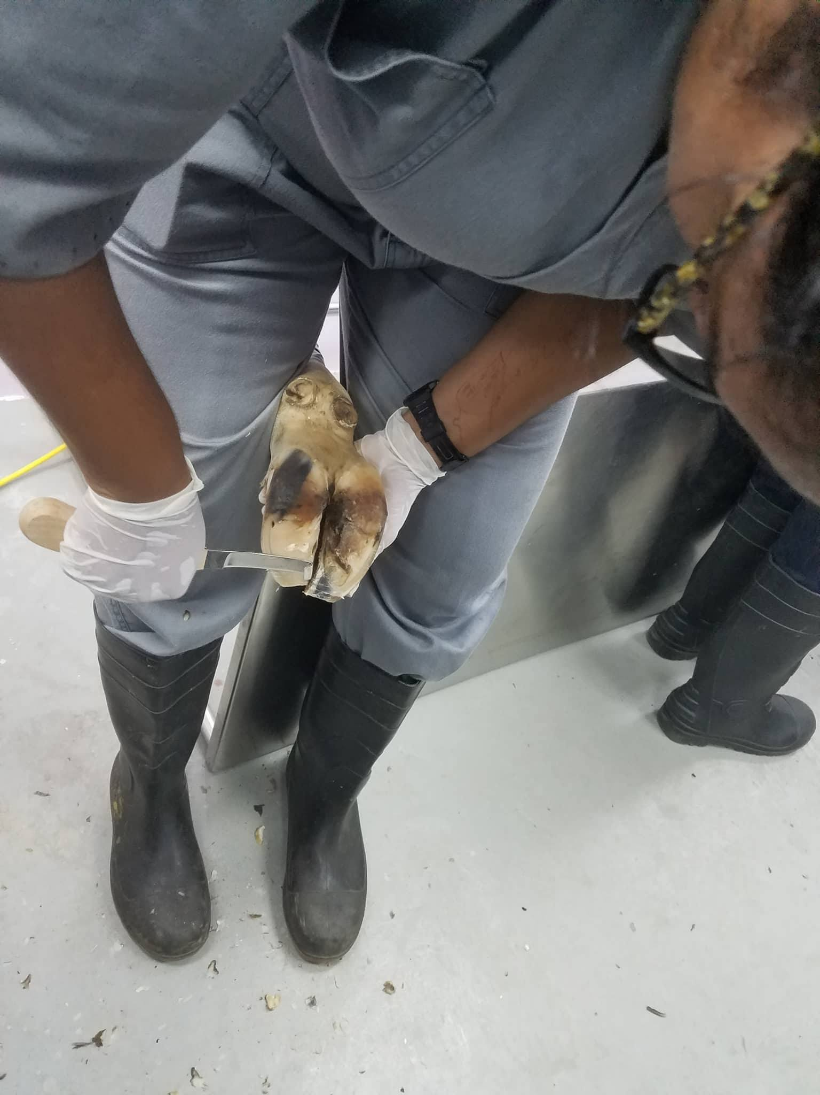
Hoof Trimming: Manually

Slide 4
Hoof Trimming: Manually
Still within the upper 1/3 of the hoof, any excess was removed from the axial (inner) and abaxial (outer) surface.
Note that caution was taken by constantly checking the sole surface and white line for any granulation tissue.
Then the lateral aspect (upper 2/3) of the sole was blended with the first 1/3 of the hoof.

Slide 5
Hoof Trimming: Manually
The steps mentioned above was repeated for the next claw.
Next the heel (lower 1/3) of the claw was trimmed, to blend in with the next 2/3. Caution was taken to not over trim this area and removed too much of the heel. This was also repeated for the next claw.
After which the toes were opened. Near the interdigital space, the sole was trimmed in a dish/concave manner. This permits a self cleaning mechanism which allows for easy removal of the debris. This was done on the opposite claw.

Slide 6
Hoof Trimming: Manually
Please look this video. I think every farmer should invest in this.
https://www.youtube.com/watch?v=6qGL5XoBAyQ
The below video shows manual videos techniques.
https://www.youtube.com/watch?v=BxvuXyJ4nrs
https://www.youtube.com/watch?v=YKD_3aSpIa0

Slide 7
Hoof Trimming: Mechanically
The same principles were applied but this time grinders were used.
This video shows in depth technique and safety. Don’t worry its only 7 minutes.
https://www.youtube.com/watch?v=OR6B9i18xMY

