Slide 1
BOVINE FOOT AND CLAW SURGERY
Pre-Operative Management

Slide 2
SIGNALMENT
NAME: PEGGY ASA GRADE: 2
SEX: FEMALE
AGE: >4 YEARS
SPECIES: BOVINE
BREED: HOLSTEIN MIX
WEIGHT: 500KG

Slide 3
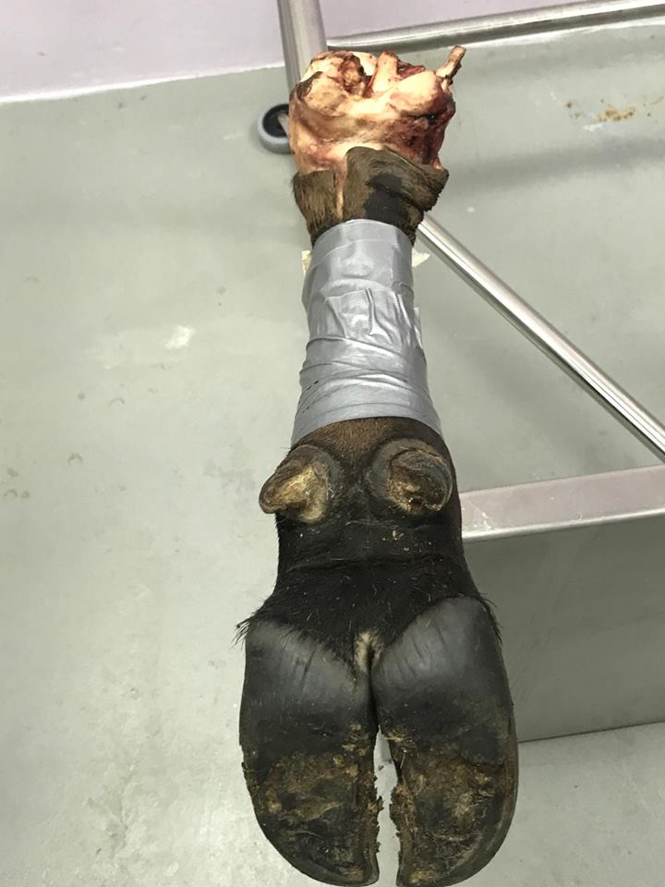
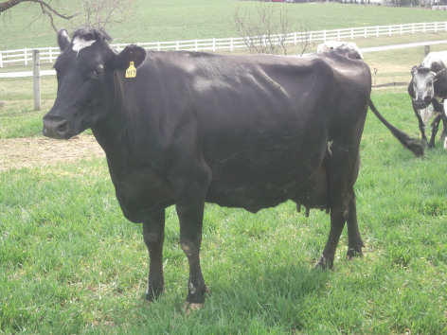
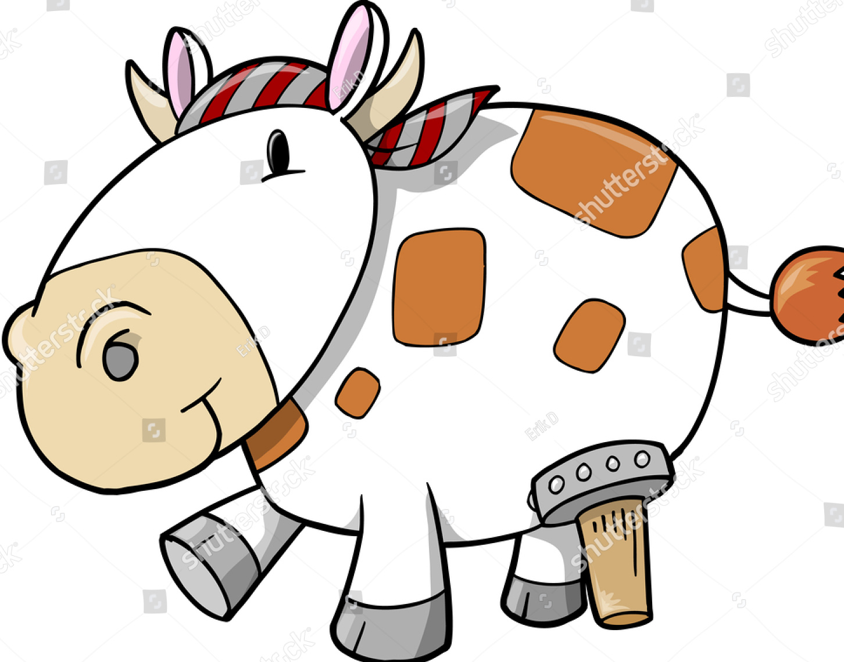
Before she was LEGGY
Then she became PEGGY

Slide 4
DISTANCE EXAMINATION OF THE LAME COW- HISTORY
DEFINING THE PROBLEM
Date of onset, duration and signs observed should be obtained.
Individual problem or herd problem? Conditions such as digital dermatitis and foul are usually herd problems whereas cases of septic arthritis are sporadic.
Acute or chronic? Injuries such as fractures usually appear suddenly, whilst problems such a degenerative joint disease may have a more chronic history.
Mild or severe condition? Bruising may produce a mild lameness, whist solar ulcers often produce severe lameness.
Static or progressive? Animals with infections such as septic arthritis usually deteriorate rapidly. Traumatic injuries such as bruising may improve rapidly. Animals with chronic arthritis may show no change over time.

Slide 5
PHYSICAL EXAMINATION OF THE LAME COW
Please look at the following video for details on how to examine and assess a lame cow:
https://www.youtube.com/watch?v=F8vetrDq2LQ

Slide 6
INDICATIONS OF HOOF TRIMMING
Hoof growth -- and thus, the need for hoof trimming -- is affected by many factors, including breed and genetics, soil moisture and characteristics, management and nutrition.
Animals grazed on rocky, dry soil may not require the extent of hoof care as animals that are maintained on soil that is free of rocks and higher in moisture content.
Animals in high rainfall areas will need to have their hooves inspected more regularly than those on dry ground.
Housed animals usually require more hoof trimming than pastured animals.
Animals on a higher plane of nutrition usually require more frequent hoof trimming.

Slide 7
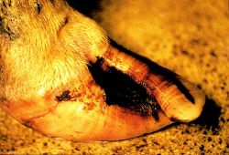
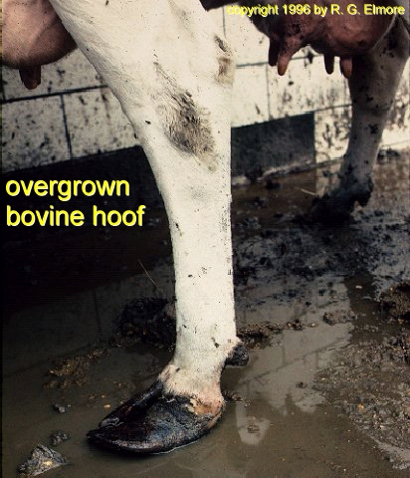
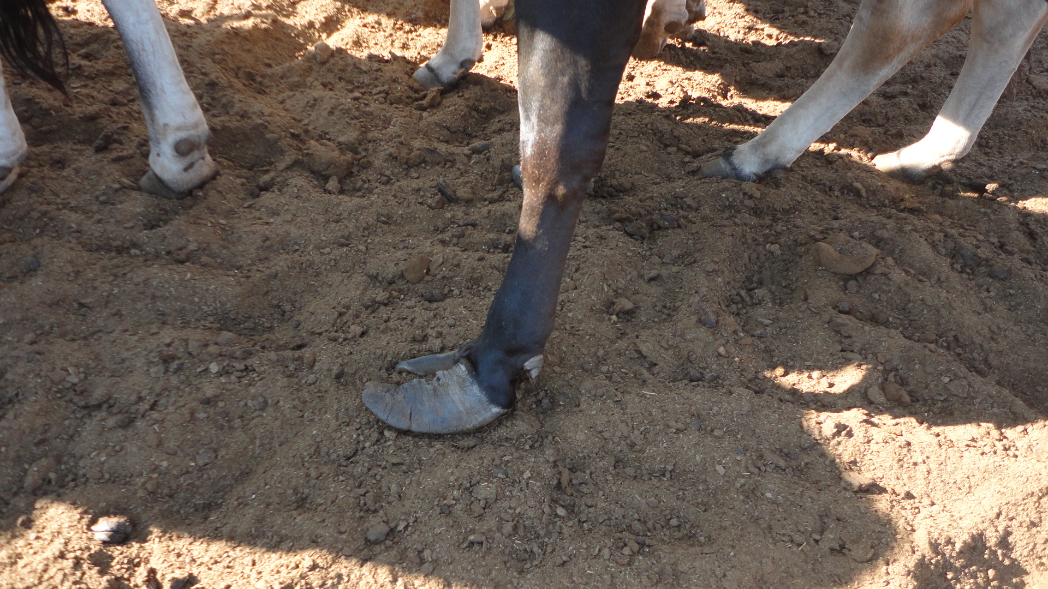
INDICATIONS OF
HOOF TRIMMING

Slide 8
INDICATIONS OF FOOT AND CLAW SURGERY
Surgical digital diseases include:
vertical cracks
Septic arthritis of the distal and proximal interphalangeal joints
Tenosynovitis and flexor tendon necrosis
Pedal osteomyelitis
Interdigital hyperplasia
Phalangeal luxation
Distal phalanx fracture
Degenerative joint diseases of the coffin joint

Slide 9
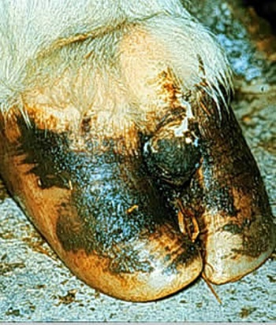
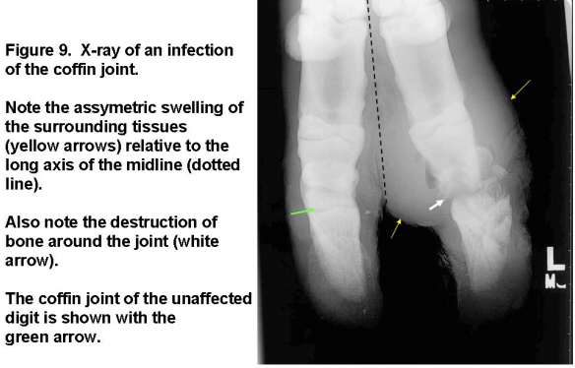
INDICATIONS OF FOOT AND CLAW SURGERY
Interdigital Hyperplasia

Slide 10
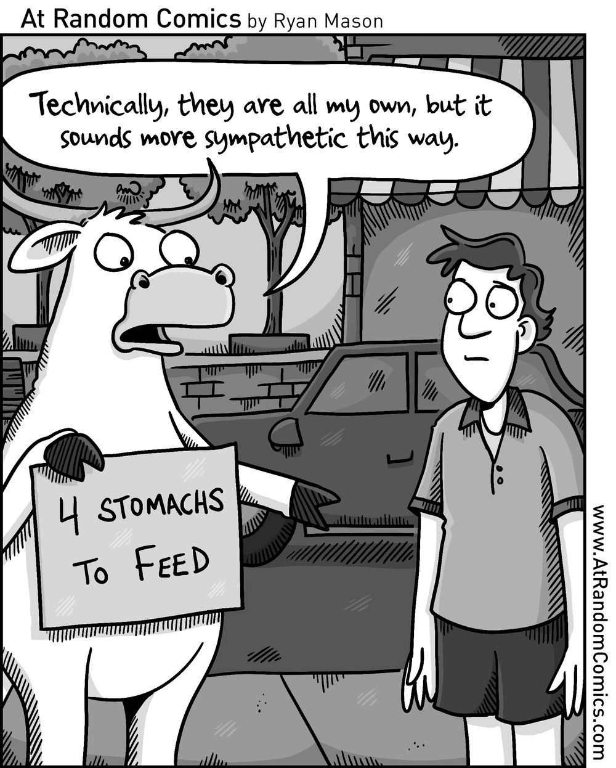
FASTING
In adult cattle undergoing elective procedures, feed should be withheld for 24 to 48 hours, and water for 12 to 18 hours, depending on the size of the animal and the procedure to be performed.
Small ruminants are generally not fasted longer than 24 hours and water is not withheld for more than 12 hours.
Excessive fasting should be avoided as it may result in a change in ruminal flora and predispose the animal to ketosis. In addition to decreasing the likelihood of regurgitation, fasting by decreasing the mass of the contents, will ameliorate the effects of compression by the rumen on respiratory and cardiovascular function in the recumbent animal.

Slide 11
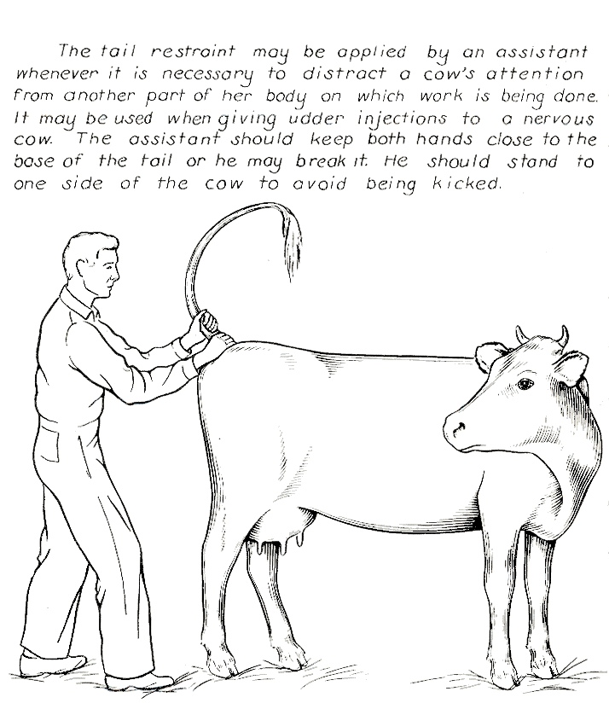
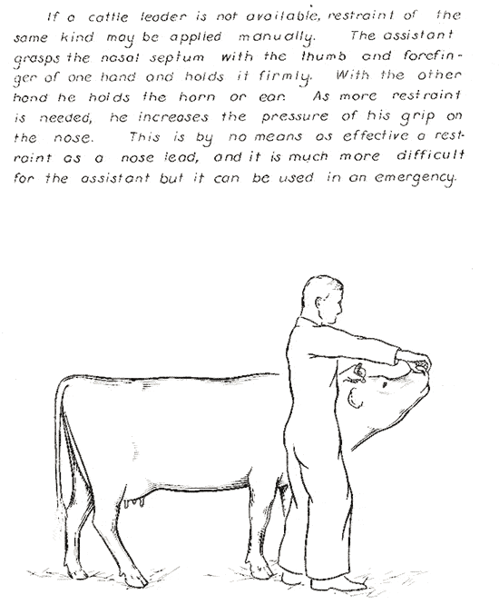
MANUAL RESTRAINT OF PATIENT
Tail Jack
Nose Pinch

Slide 12
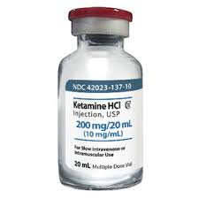
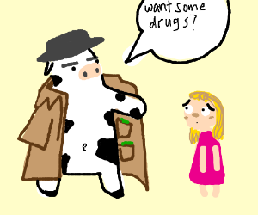
CHEMICAL RESTRAINT OF PATIENT
Xylazine used for sedation. Given intramuscularly
Ketamine used for sedation. Given intramuscularly

Slide 13
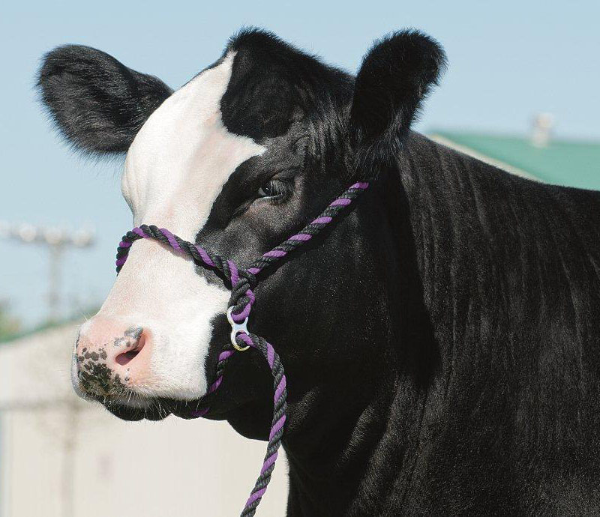
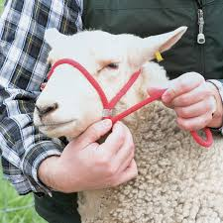
PHYSICAL RESTRAINT OF PATIENT- HALTER

Slide 14
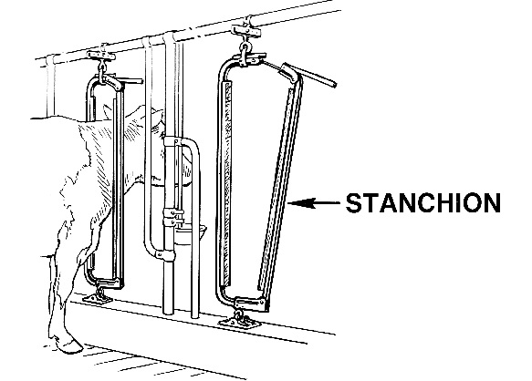
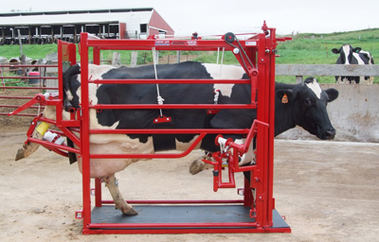
PHYSICAL RESTRAINT OF PATIENT- STANCHIONS

Slide 15
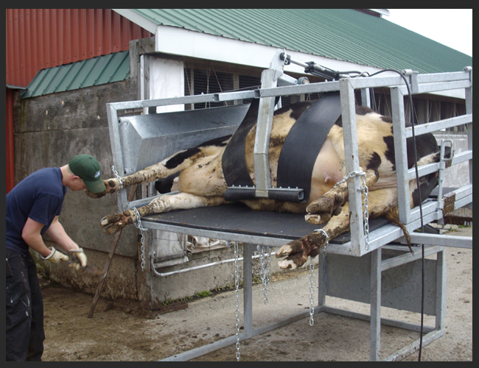
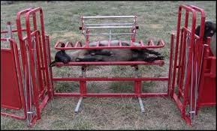
PHYSICAL RESTRAINT OF PATIENT- TILT TABLES
Tilt Table for Cattle
Tilt Table for Small Ruminants

Slide 16
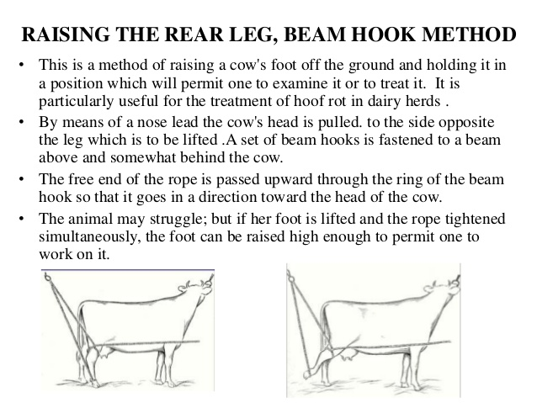
PHYSICAL RESTRAINT OF PATIENT- LEG ROPE TIE

Slide 17
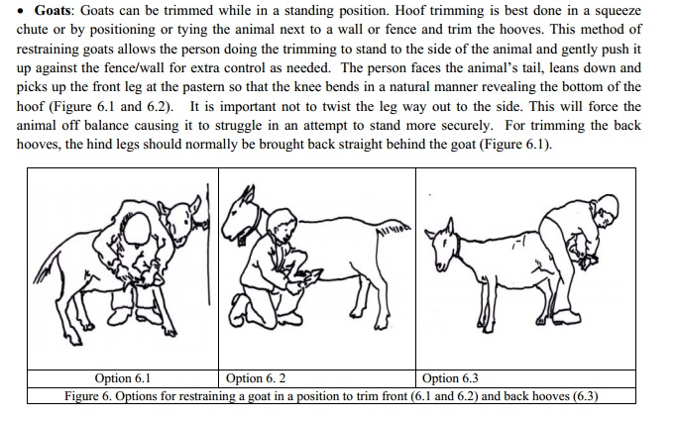
PHYSICAL RESTRAINT OF PATIENT- LEG LIFT IN SMALL RUMINANTS

Slide 18
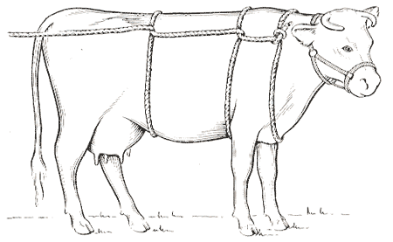
PHYSICAL RESTRAINT OF PATIENT- CASTING
Burley’s Method of Casting
Double Half Hitch Casting Method

Slide 19
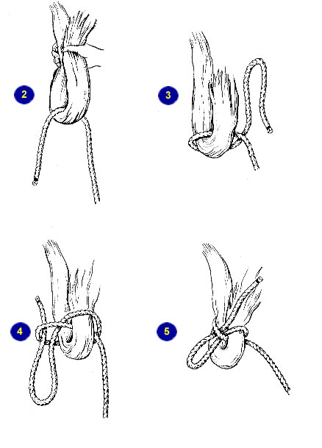
PHYSICAL RESTRAINT OF PATIENT- TAIL TIE

Slide 20
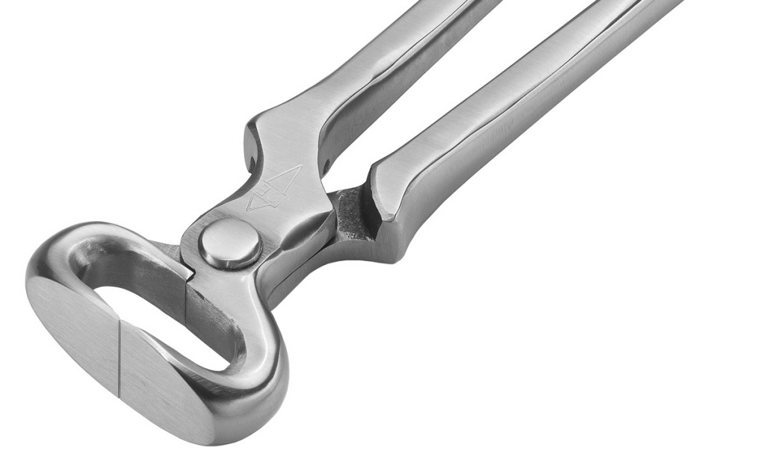
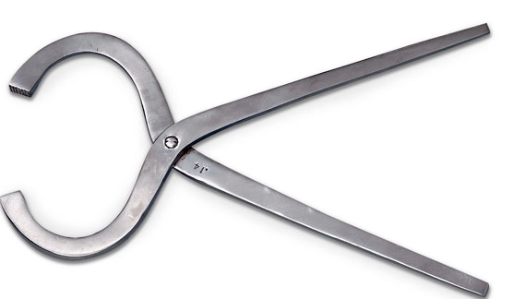
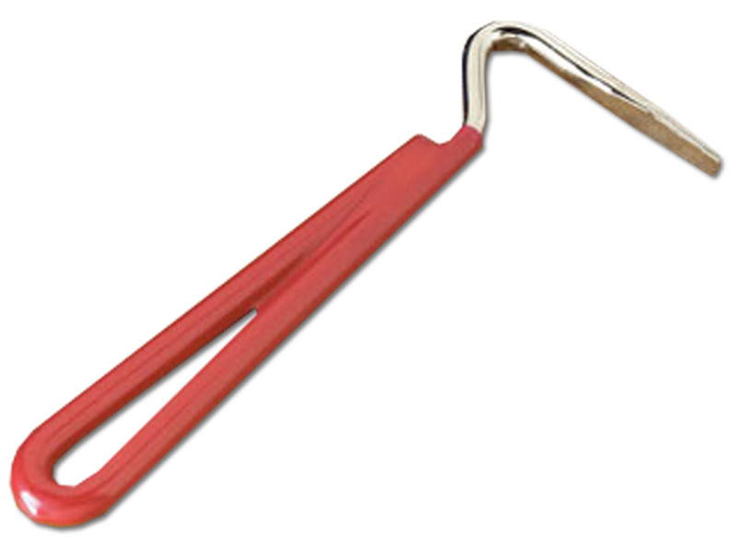
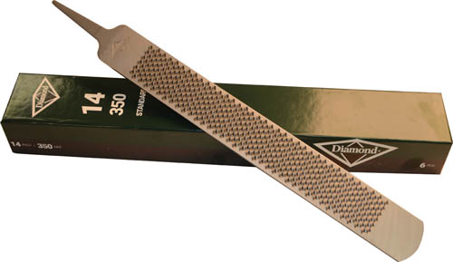
MANUAL EQUIPMENT USED IN HOOF TRIMMING
Hoof Knife
Hoof Tester
Hoof Nipper
Hoof shears
Hoof pick
Rasp

Slide 21
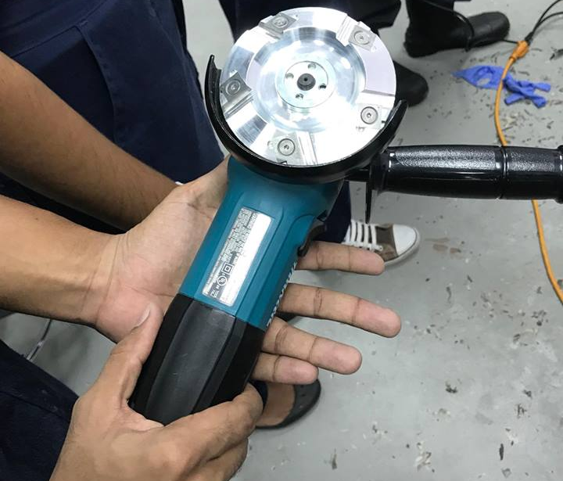
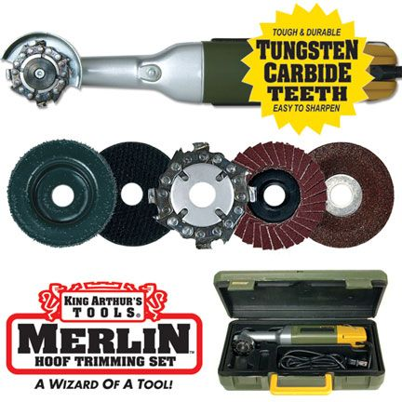
ELECTRICAL EQUIPMENT USED IN HOOF TRIMMING
Hoof Grinder
Hoof Trimmer
Hand Model: Jeremy “Rico Suave” Mungal

Slide 22
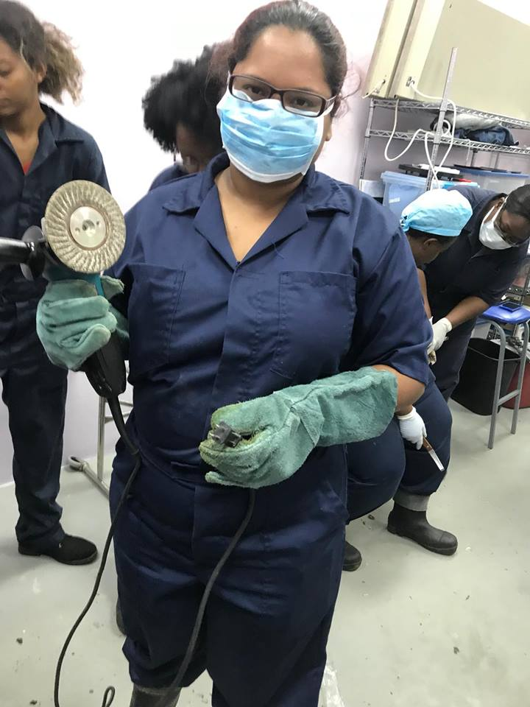
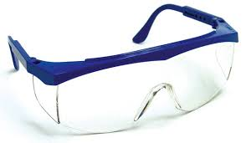
SAFETY EQUIPMENT USED IN HOOF TRIMMING
Protective Eyewear
Face Mask
Protective Coveralls
Safety Gloves
Model” Jaime “Sugar Apple” Dowlath
Protective Footwear

Slide 23
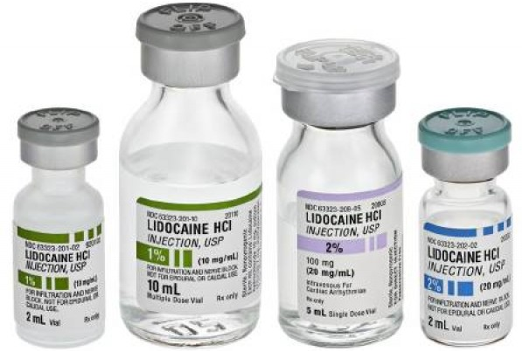
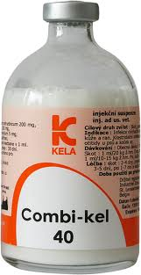
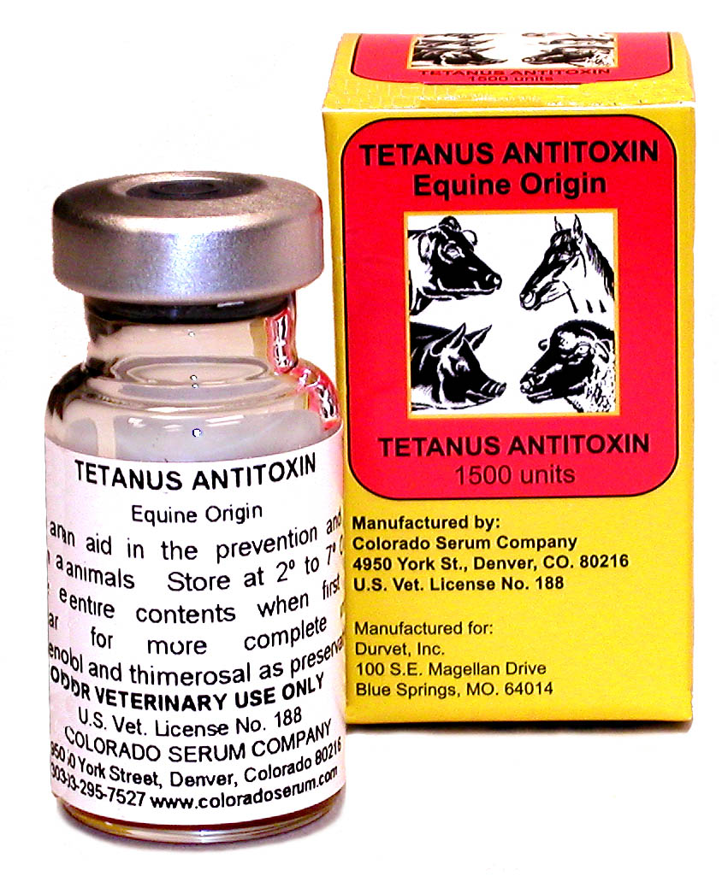
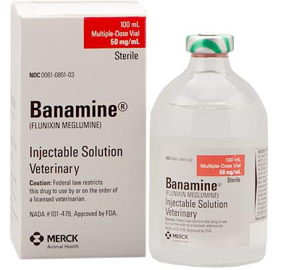
DRUGS REQUIRED FOR FOOT AND CLAW PROCEDURES
Kindly see “Peggy’s Pharmacy” for drug concentration calculations.

Slide 24
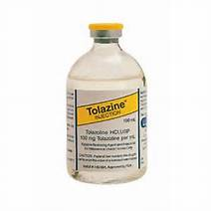
DRUGS REQUIRED FOR FOOT AND CLAW PROCEDURES- REVERSAL DRUGS

Slide 25
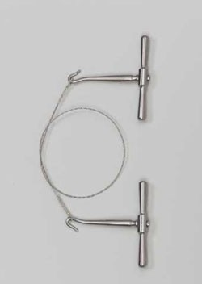
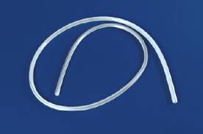
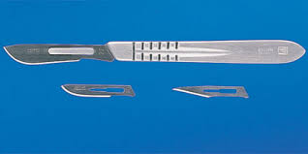
EQUIPMENT REQUIRED FOR SURGERY
GIGLI WIRE
DRAINAGE TUBE
SCALPEL HOLDER WITTH BLADES

Slide 26
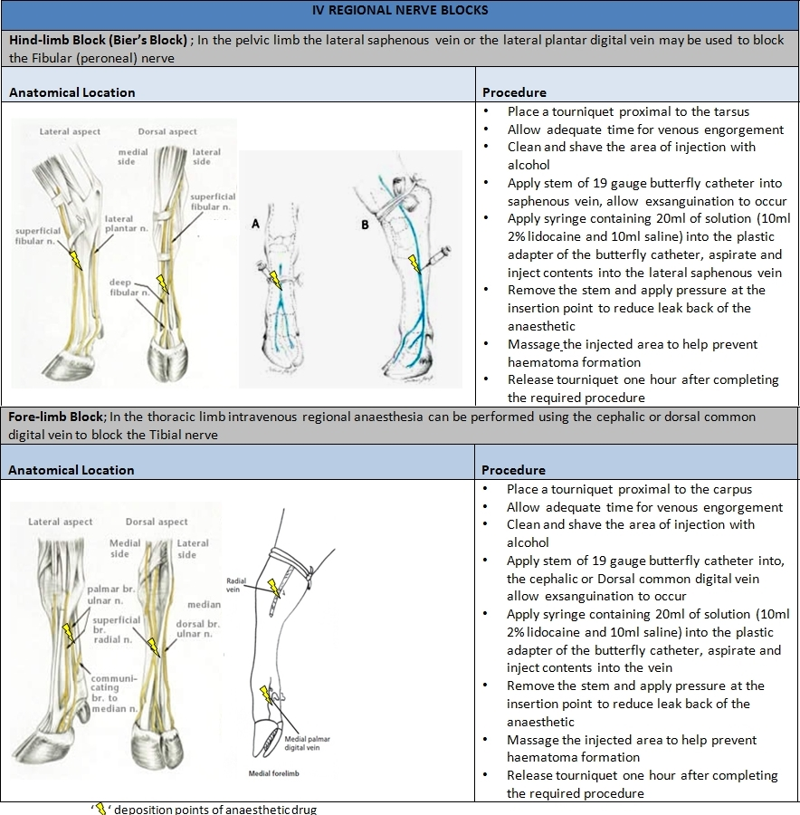
IV REGIONAL NERVE BLOCKS

Slide 27
IV REGIONAL NERVE BLOCKS
Tightly apply a rubber tube tourniquet on the upper part of the limb-above the metatarsophalangeal/metacarpophalangeal joint of limb- to stop blood flow.
Isolate any prominent superficial vein below the tourniquet, preferably the dorsal digital vein and insert needle.
Inject 2% lidocaine into vein.
Disadvantages include:
Rupture of muscles due to decreased oxygen
Persistent lameness if tourniquet is kept on too long.

Slide 28
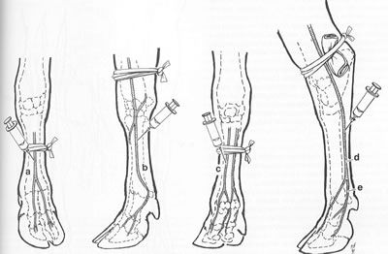
IV REGIONAL NERVE BLOCKS
How to utilize tourniquets
https://www.youtube.com/watch?v=vlVpxJwlB7k

Slide 29
BANDAGE LAYERS AND THEIR FUNCTIONS
Simply put, using bandages is a way of protecting a wound, to avoid further contamination. However, bandages have several other key functions. They control or limit hemorrhage and infection, immobilize the area surrounding the wound, prevent wound desiccation, absorb exudate, and help in the debridement of the wound. Bandages are typically suitably padded, i.e. consisting of three layers (primary, secondary, and tertiary), and applied consistent with the wound, avoiding any trauma to the newly-formed epithelium.

Slide 30
BANDAGE LAYERS AND THEIR FUNCTIONS- PRIMARY LAYER
The primary layer makes direct contact with the wound, which allows tissue fluid to go through to the secondary layer. This layer can be either adherent or non-adherent. An adherent bandage consists of a mesh material that incorporates itself with the tissue and debris around the wound. This type of bandage aids with tissue debridement, as the tissue and debris are removed with bandage changes. This bandage comes in three different types: dry-to-dry, dry gauze is applied to the wound; wet-to-dry, gauze with saline is placed on the wound; and wet-to-wet, damage is usually caused to the tissue bed because the area is too moist. On the other hand, a non-adherent bandage consists of a non-stick, foam material that lays on top of the wound, preventing further trauma and protrudes when the healthy epithelium is formed.

Slide 31
BANDAGE LAYERS AND THEIR FUNCTIONS- SECONDARY LAYER
The secondary layer, often consists of rolled cotton or cast padding. This layer absorbs the tissue fluid, as well as pads the wound and immobilizes the limb.

Slide 32
BANDAGE LAYERS AND THEIR FUNCTIONS- TERTIARY LAYER
The tertiary layer is usually made of an adhesive tape or elastic wrap. It holds both the primary and secondary layers in place, provides pressure to the wound and protects the inner layers from the environment.

Slide 33
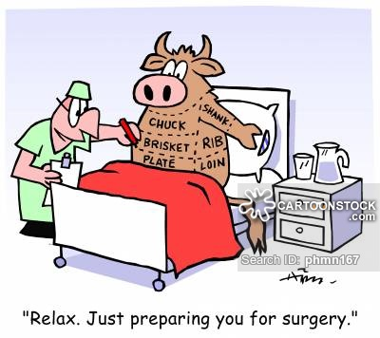
SURGICAL SITE PREPARATION
The surgical site is clipped widely. Fresh wounds are cleaned and debrided until the operative field is clean. Old wounds should display a cherry red granulating surface. After the leg is hung in a vertical position, the surgical site is prepped for aseptic surgery. The entire leg is draped to permit free manipulation. If there is an open infected wound distal to the amputation site, a water-impermeable wrap is used.

