Slide 1
Cattle Hoof and Digit Care
A visual flow of the procedure

Slide 2
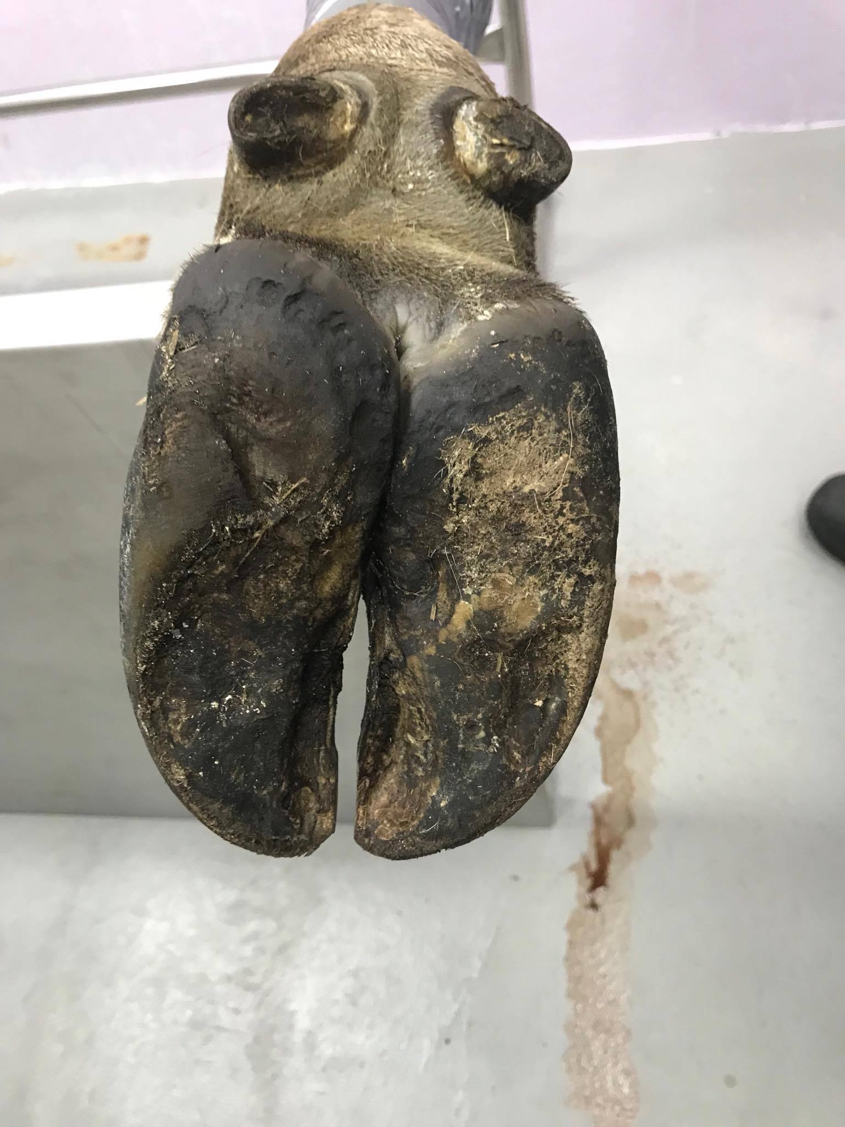
Manual Hoof Trimming

Slide 3
Manual Hoof Trimming- Complete Guide Video

Slide 4
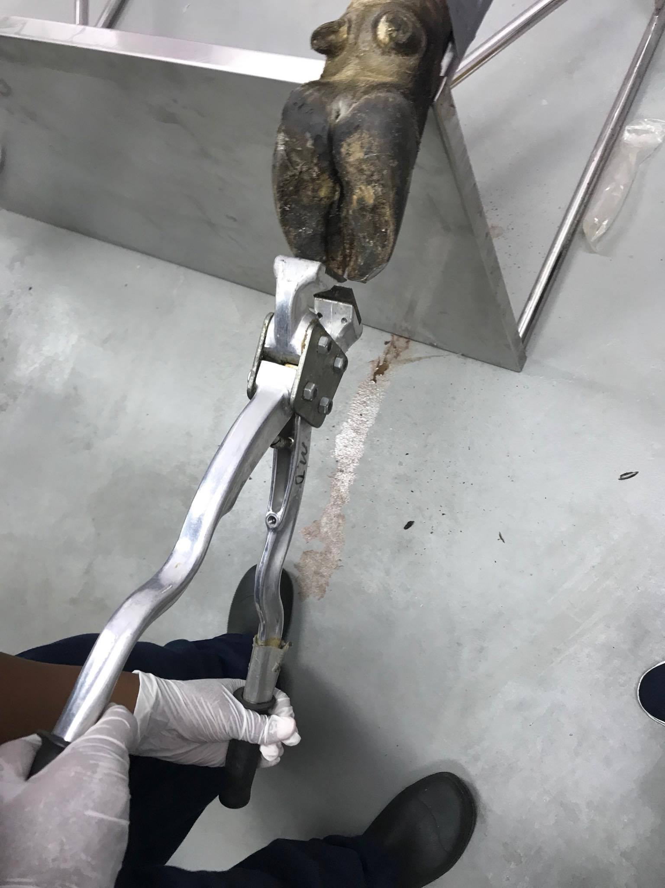
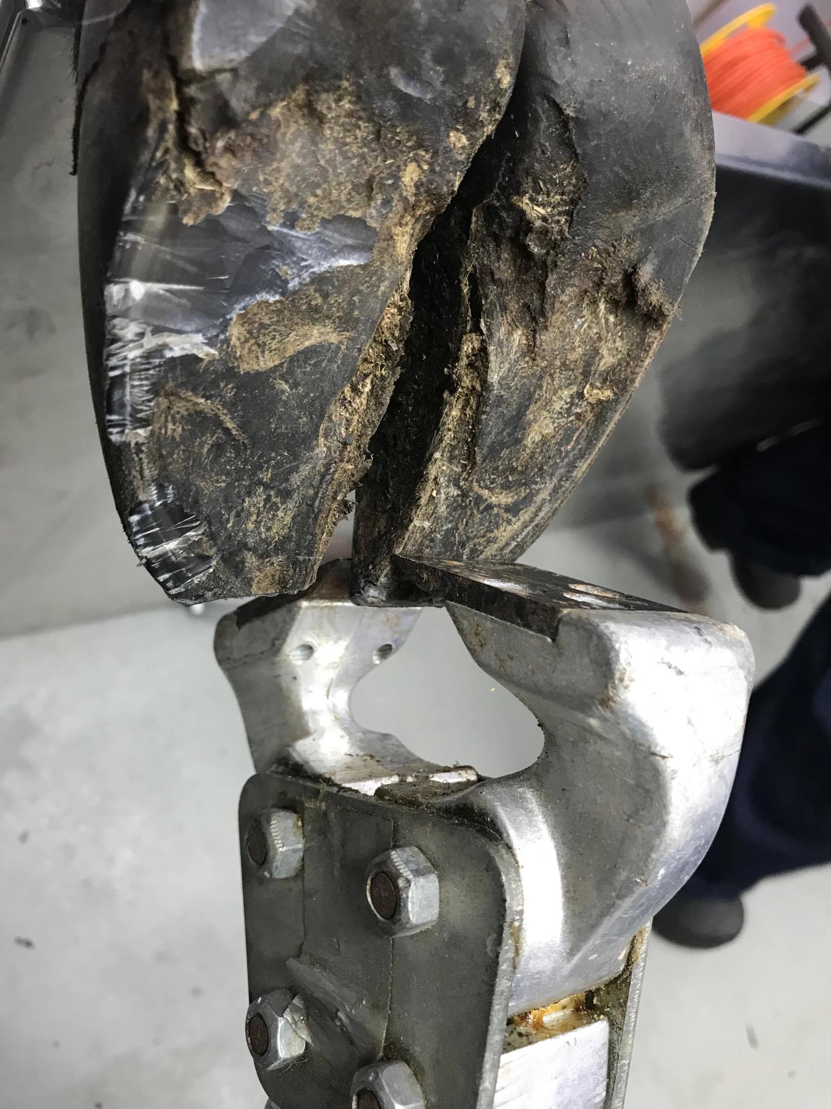
Manual Hoof Trimming- Using Hoof Nippers to cut toe

Slide 5
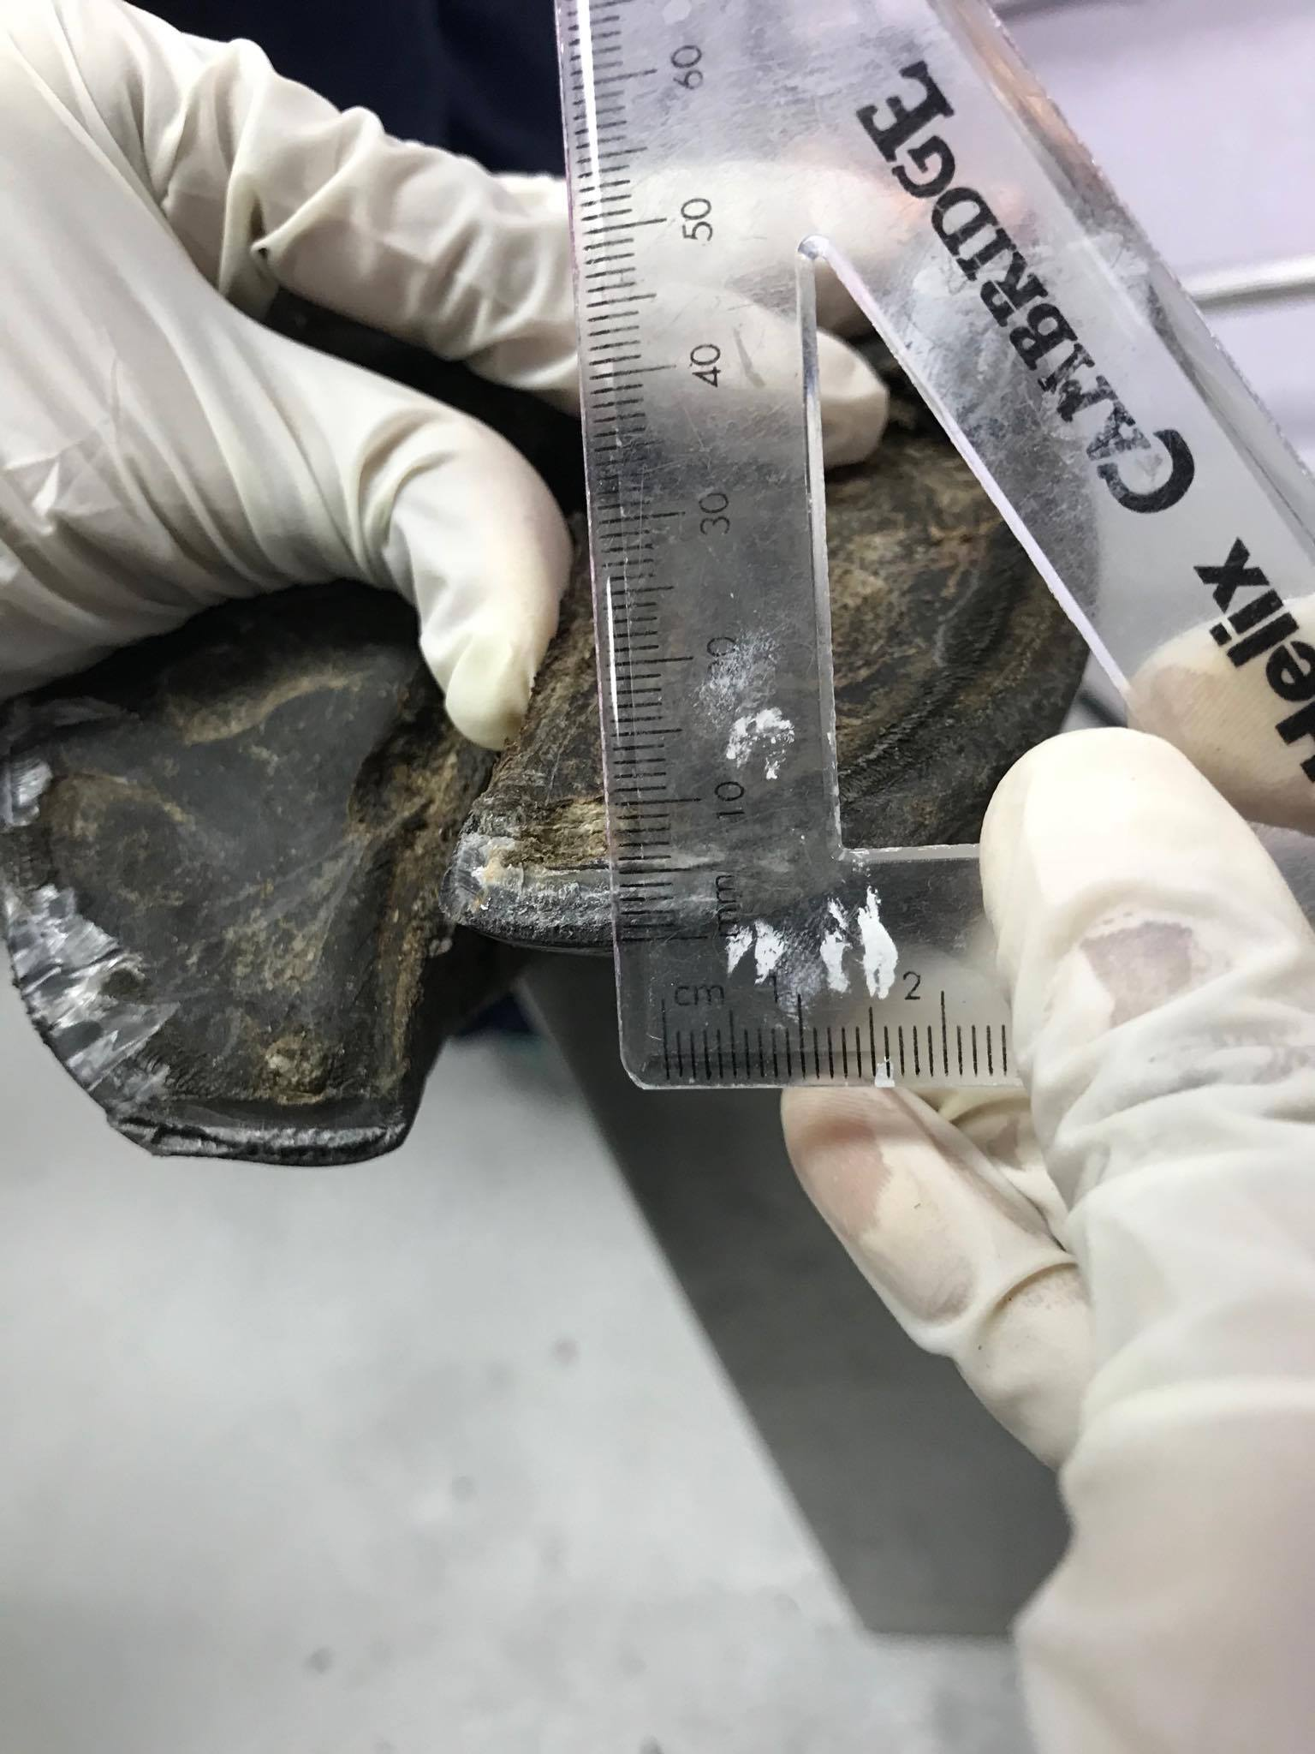
Manual Hoof Trimming- Using ruler to measure toe height of 5-8 mm ideally

Slide 6
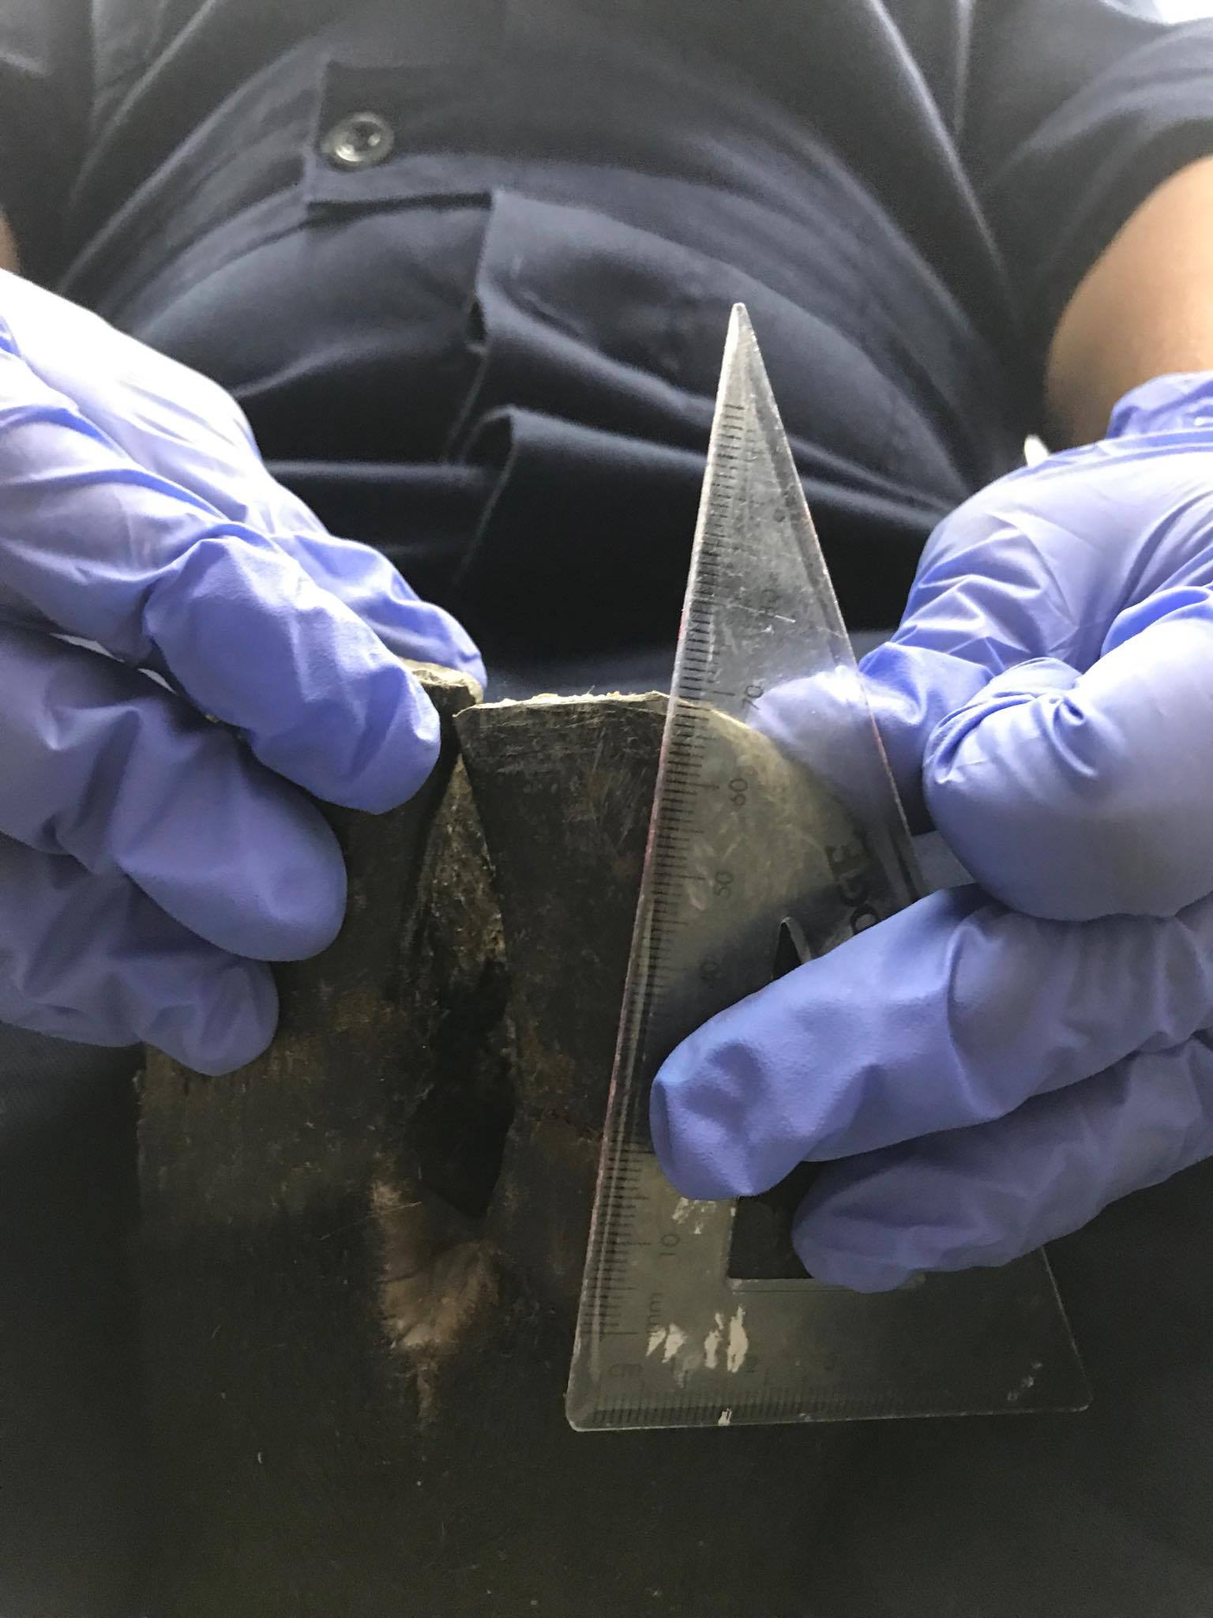
Manual Hoof Trimming- Using ruler to measure Dorsal hoof wall length of 6-7 cm ideally

Slide 7
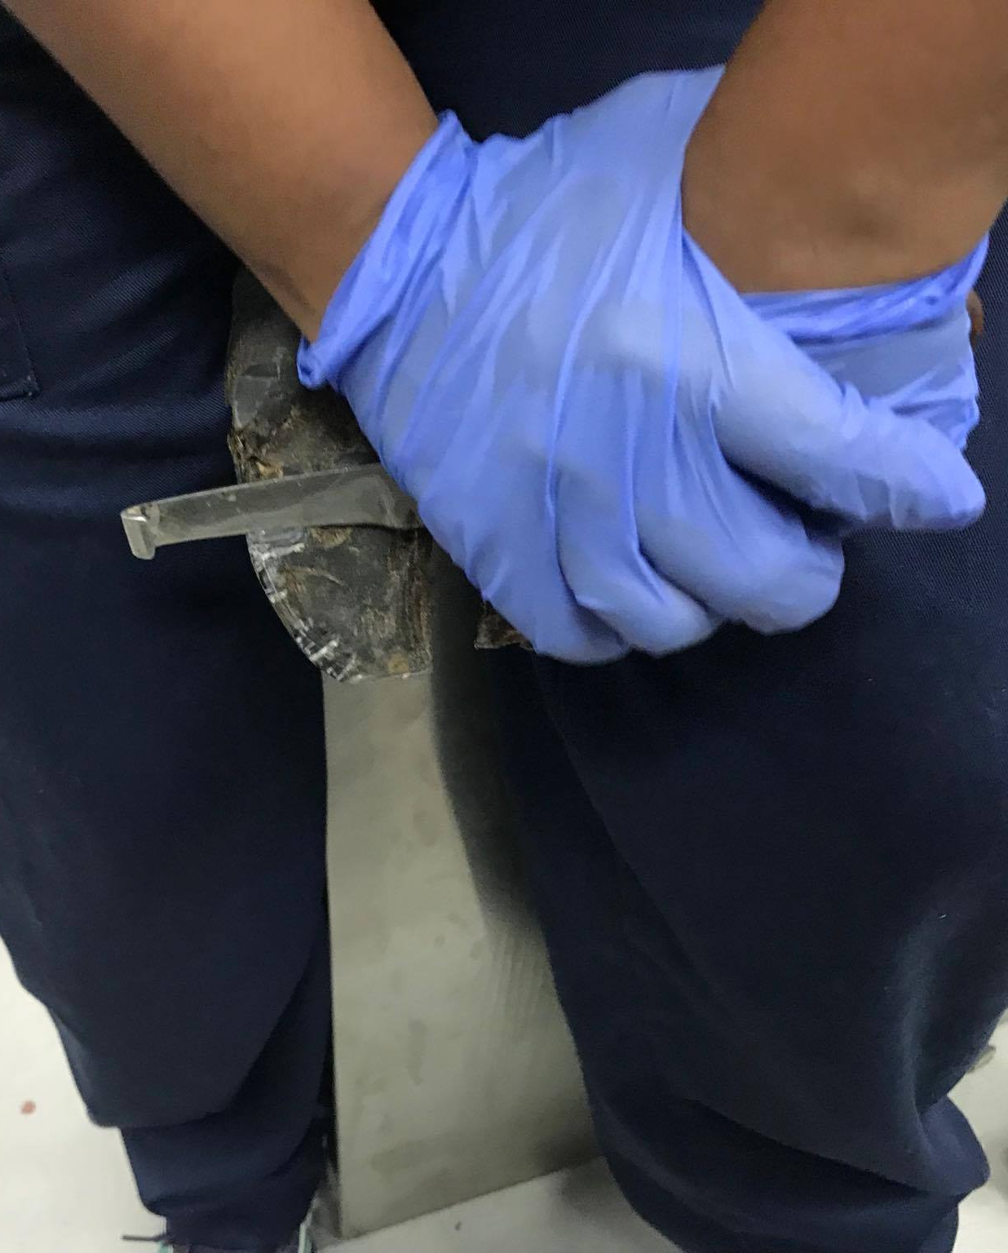
Manual Hoof Trimming- Using hoof knife

Slide 8
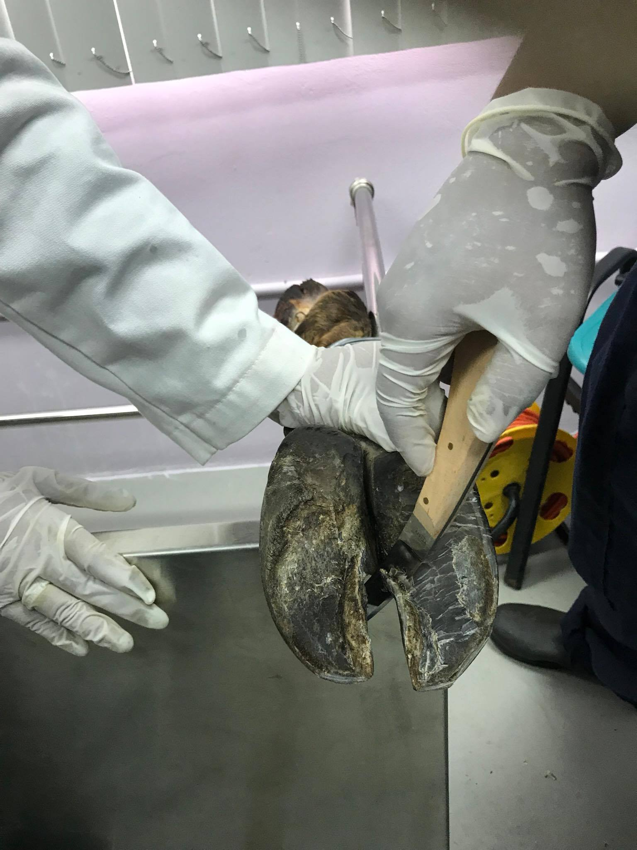
Manual Hoof Trimming- Using hoof knife of Middle Inner claw, should be done last

Slide 9
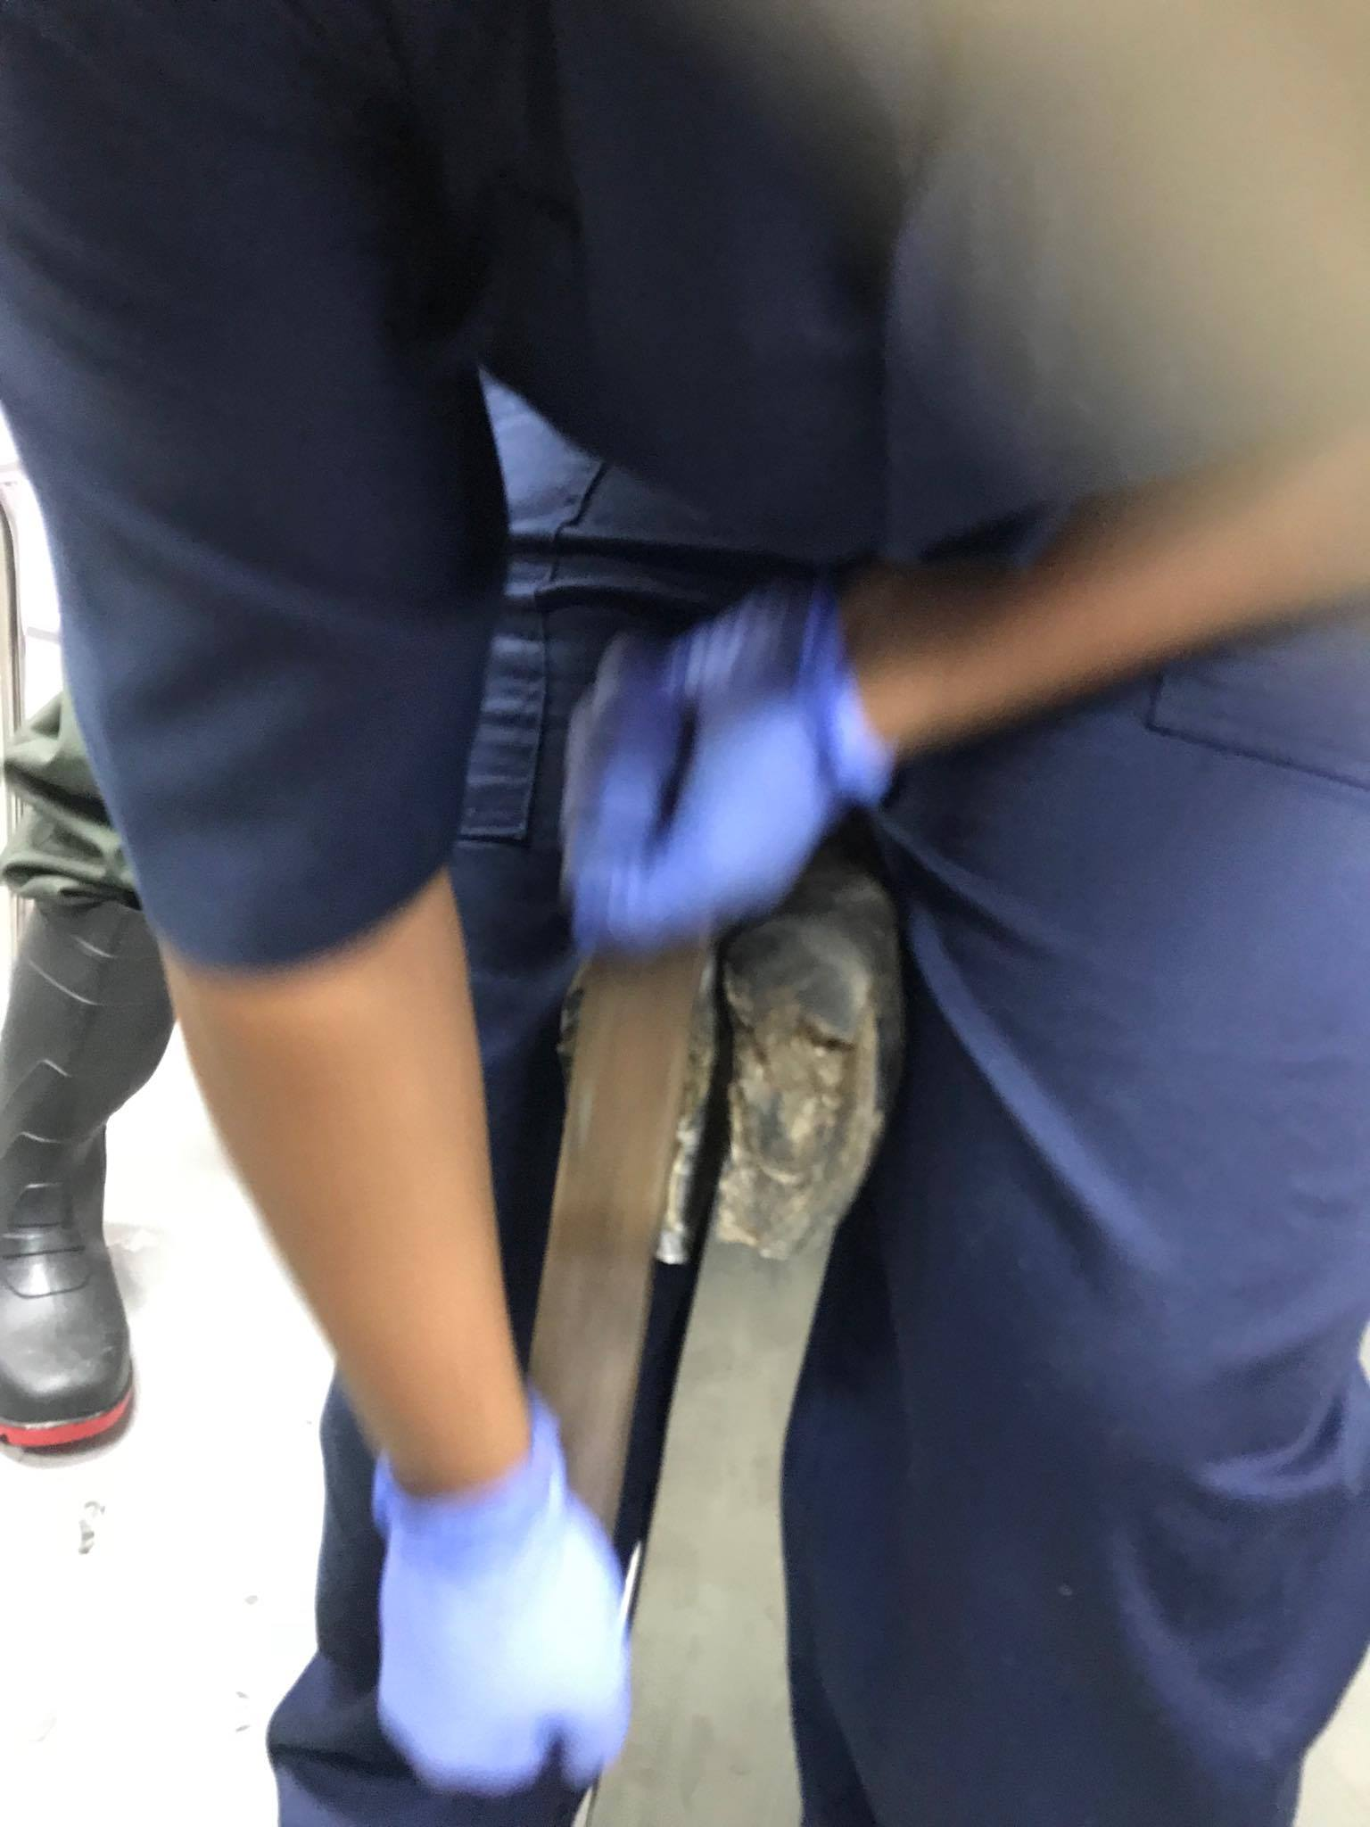
Manual Hoof Trimming- Rasping

Slide 10
Manual Hoof Trimming- Using hoof knife assessing potential lesions Video

Slide 11
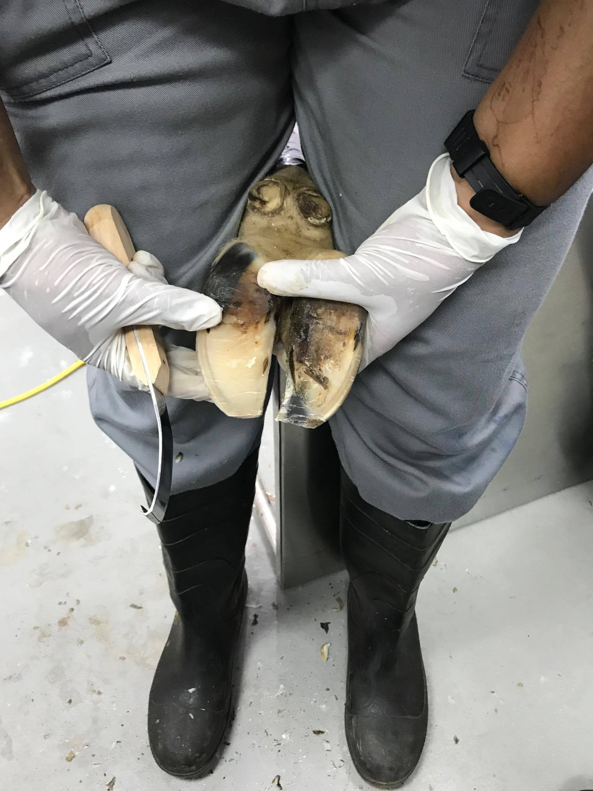
Manual Hoof Trimming- At end, looking good, Observe the curve of the Hoof knife

Slide 12
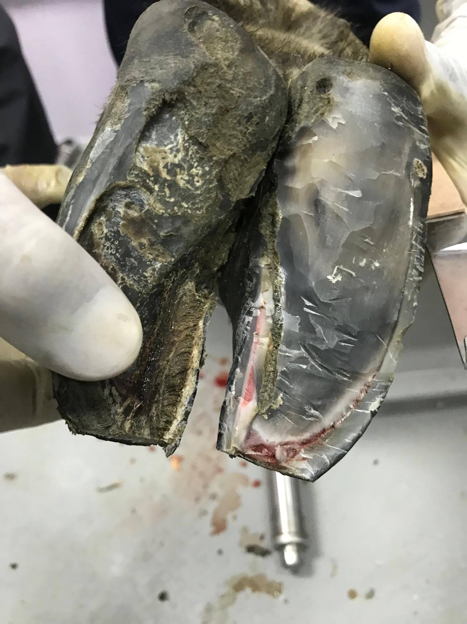
Manual Hoof Trimming- A bit too much removed at toe through the white line

Slide 13
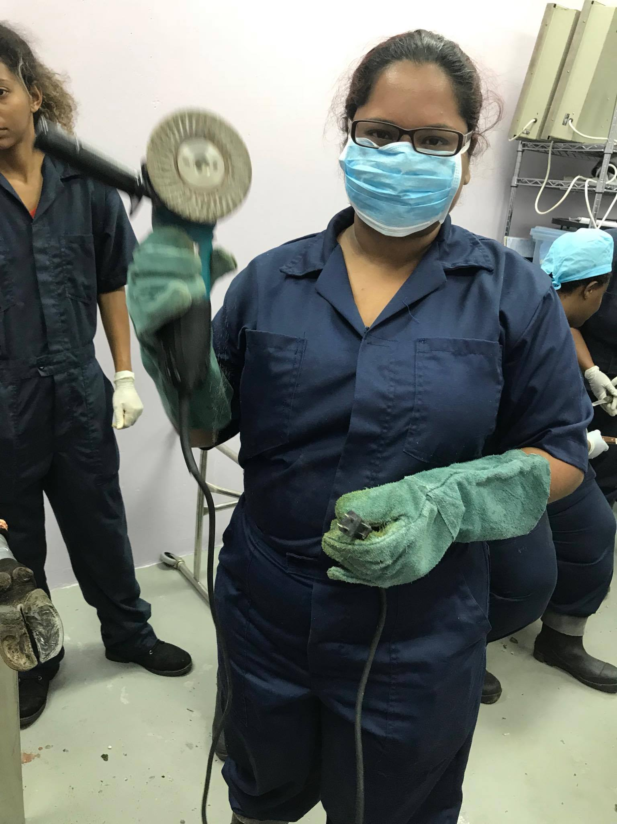
Power tool Hoof trimming- Tool and Protective wear

Slide 14
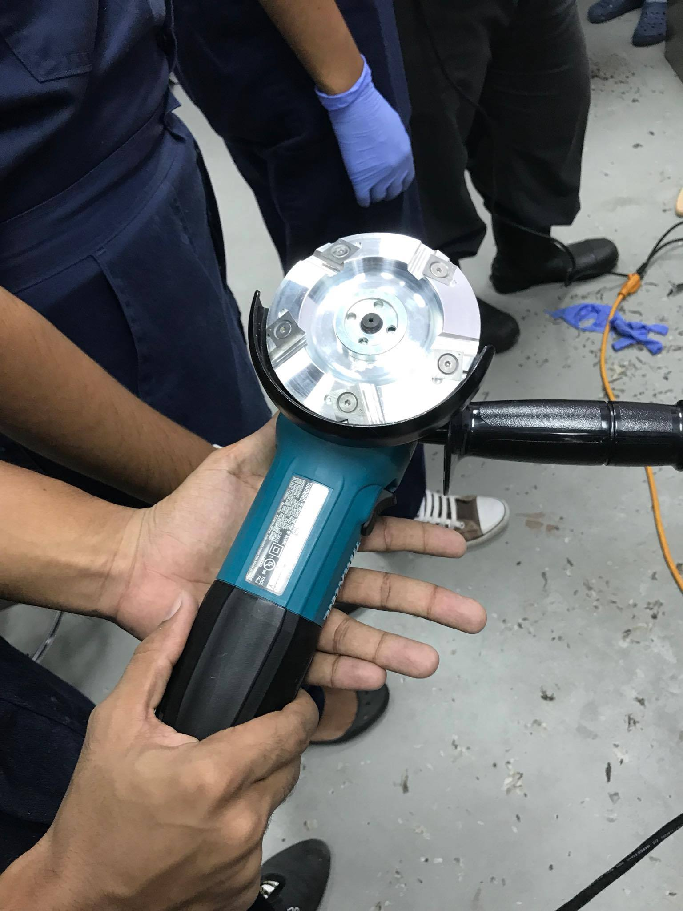
Power tool Hoof trimming- 4-sided blade Tool which requires slight pressure

Slide 15
Power tool Hoof trimming- 4 sided Blade uses part 1 Video

Slide 16
Power tool Hoof trimming- 4 sided Blade uses part 2 Video

Slide 17
Power tool Hoof trimming- 4 sided Blade uses part 3 Video -Do not go too steep

Slide 18
Power tool Hoof trimming- Merlin uses part 1 Video

Slide 19
Power tool Hoof trimming- Merlin in use part 2 Video

Slide 20
Power tool Hoof trimming- Merlin

Slide 21
Power tool Hoof trimming- Assessing Flat soles

Slide 22
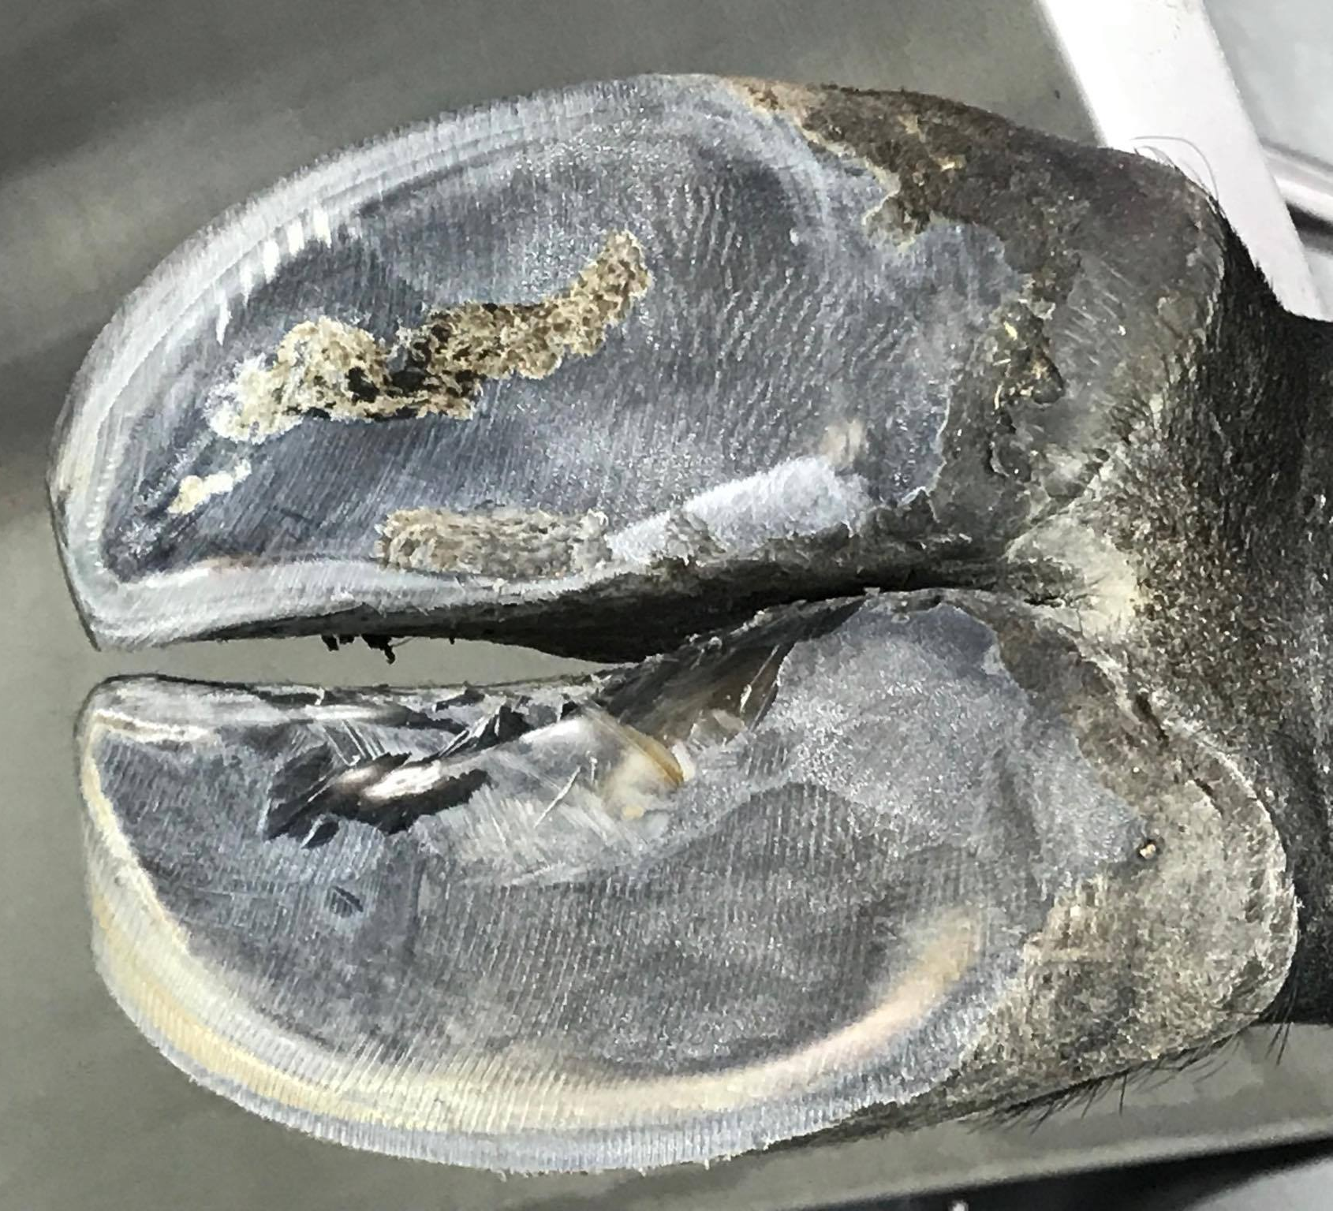
Power tool Hoof trimming- On border of heel, sole and horn of heel

Slide 23
Disarticulation of Proximal Interphalangeal joint

Slide 24
Disarticulation of Proximal Interphalangeal joint- Location Video

Slide 25
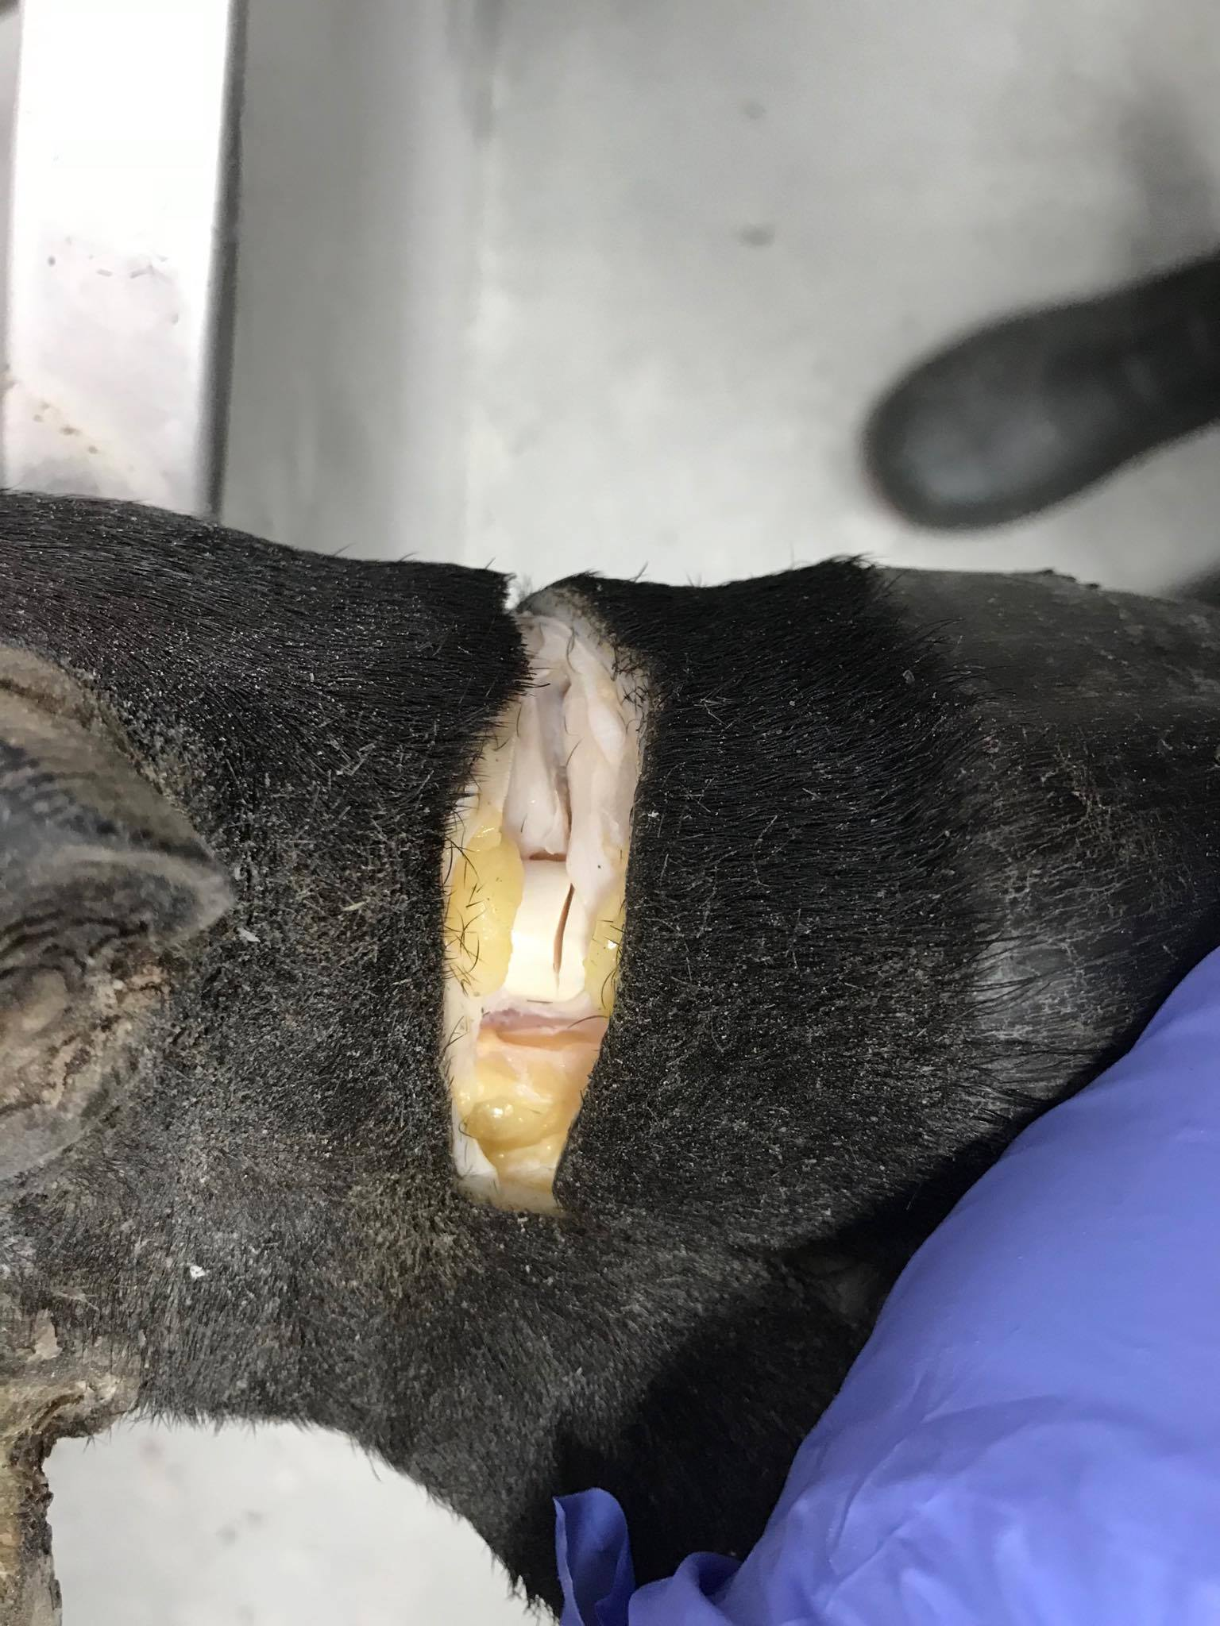
Disarticulation of Proximal Interphalangeal joint- Cutting through Digital Flexor tendon

Slide 26
Disarticulation of Proximal Interphalangeal joint-Through joint capsule

Slide 27
Disarticulation of Proximal Interphalangeal joint-Cutting along Coronary band laterally

Slide 28
Disarticulation of Proximal Interphalangeal joint-Through joint

Slide 29
Disarticulation of Proximal Interphalangeal joint- Articulating surface of distal P 1

Slide 30
Disarticulation of Proximal Interphalangeal joint- Articulating surface of Digit removed, proximal P 2

Slide 31
Disarticulation of Proximal Interphalangeal joint-Digit removed

Slide 32
Digital Flexor Tendon Removal

Slide 33
Digital Flexor tendon removal- Location, from mid dew claw towards mid metatarsal

Slide 34
Digital Flexor tendon removal- Push distally to isolate Deep Digital flexor tendon Video

Slide 35
Digital Flexor tendon removal- Tying and inserting Drain using Buhner needle part 1 Video

Slide 36
Digital Flexor tendon removal- inserting Drain using Buhner needle part 2 Video

Slide 37
Digital Flexor tendon removal- inserting Drain using Buhner needle and rubber tubing (ideally)

Slide 38
Digital Flexor tendon removal- Tied Drain Typically the Digital Flexor Tendon is cut off/resected before the needle is inserted and tubing tied.

Slide 39
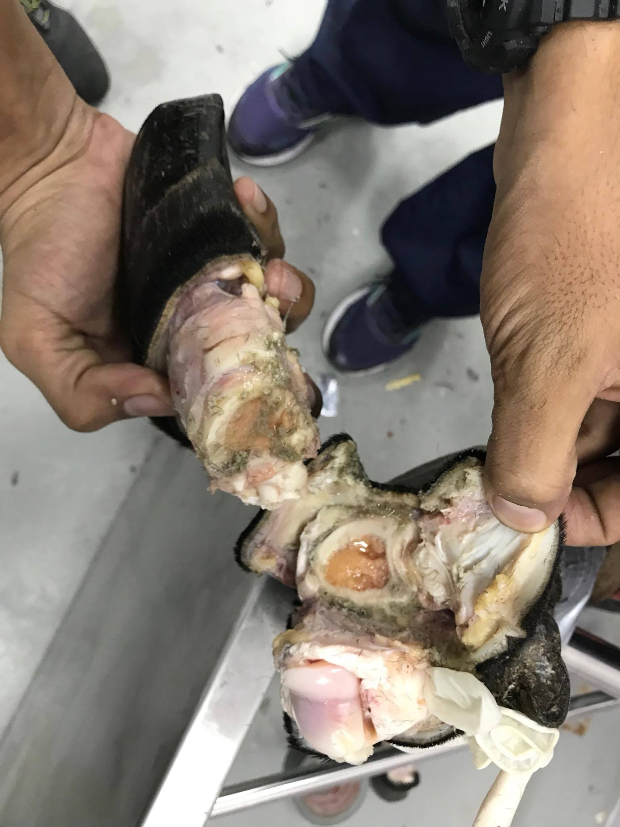
Gigli Digit amputation of Distal P 1

Slide 40
Gigli Digit amputation-Location Distal third P 1 Video

Slide 41
Gigli Digit amputation of Distal P 1- Cutting above the coronary band leaving skin for suturing after the procedure, Video

Slide 42
Gigli Digit amputation of Distal P1– Undermining to the dewclaw and Cutting above the coronary band leaving skin for suturing after, Video

Slide 43
Gigli Digit amputation of Distal P 1- Undermining skin for suturing

Slide 44
Gigli Digit amputation of Distal P 1-Location and setting Gigli wire Video

Slide 45
Gigli Digit amputation of Distal P1- Using Gigli wire Video

Slide 46
Gigli Digit amputation of Distal P 1-Using Gigli wire

Slide 47
Gigli Digit amputation of Distal P 1- Using Gigli wire with Adjusted position This was necessary as the angle was not initially 45 degrees to the proximal digit abaxially but was directed towards the dew claws.

Slide 48
Gigli Digit amputation-Cut through P 1

Slide 49
The end!

