Slide 1
Semi-closed castration
In a stallion

Slide 2
General information
Semi-closed castration is also known as the modified closed castration method
It is done under general anesthesia
Opening of the vaginal tunic allows for observation of enclosed structures such as the spermatic vessels, epididymis and ductus deferens.
3 major ligaments (remnants of the Gubernaculum) need to be ruptured:
The proper ligament of the testes
The ligament of the tail of the epididymis
Scrotal ligament
The use of ligatures can be applied for mature stallions

Slide 3
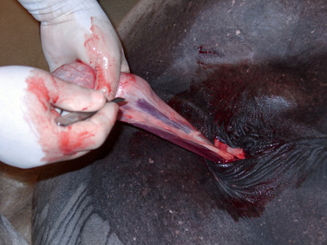
Steps involved
Blunt dissection of the spermatic sac by cutting through the skin, tunica dartos and the spermatic facia using a scalpel
Tense the median raphe and pull the cranial end of the sheath in a forward and upward direction.
A longitudinal incision is made roughly 4 cm from the median raphe
The vaginal process is separated from the skin by tearing the scrotal ligament using your fingers
The vaginal process is incised in a manner that is cranial to and just above the testicles
Image 1: Longitudinal incision being made

Slide 4
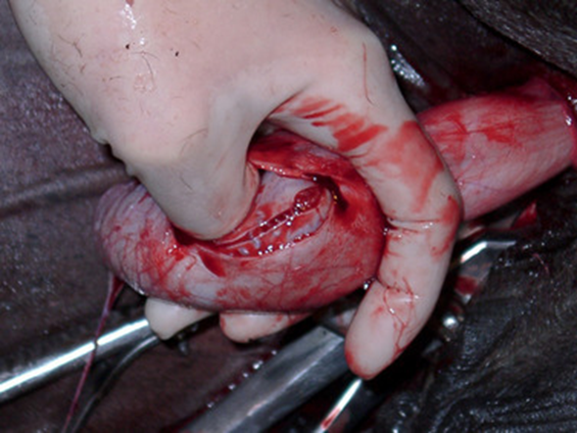
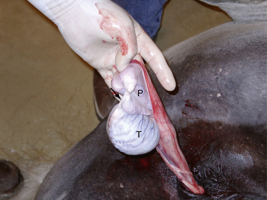
Extrude the testicles and epididymis through the incision. The fundus becomes inverted and exits through the incision because the fundus of the vaginal tunic is affixed by the ligament of the tail of the epididymis to the epididymis and testis
Tension is maintained on the vaginal tunic while traction is applied to the spermatic cord using the thumb
The spermatic blood vessels are ligated and divided
The entire vaginal process is ligated
Blunt dissection of the spermatic cord and cremaster muscle from the scrotal facia is performed and transaction near the superficial inguinal ring is applied using an emasculator
ABOVE: Image 2: Insertion of thumb into incision of the parietal tunic and into vaginal cavity
BELOW: Image 3: Exteriorization of parietal tunic (P) and testis (T)

Slide 5
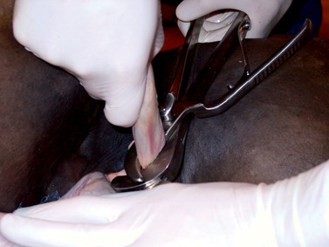
Emasculation is performed to remove the distal vaginal process which contains the testicle and epididymis
The Emasculator is placed in a “nut to nut” position
It must be ensured that it is positioned in a transverse direction and reduce the entanglement of any skin between the emasculator
Once the emasculator is closed, crushing occurs for 30 seconds to 1 minute
Image 4: Placement of the emasculator

Slide 6
references
Themes UFO. 16. Surgery of the Stallion Reproductive Tract [Internet]. Veterian Key. 2016 [cited 2020Oct17]. Available from: https://veteriankey.com/16-surgery-of-the-stallion-reproductive-tract/
Kilcoyne I. Equine castration: A review of techniques, complications and their management [Internet]. UC Davis. British Equine Veterinary Association; [cited 2020Oct17]. Available from: https://ucdavis.pure.elsevier.com/en/publications/equine-castration-a-review-of-techniques-complications-and-their-

