Slide 1
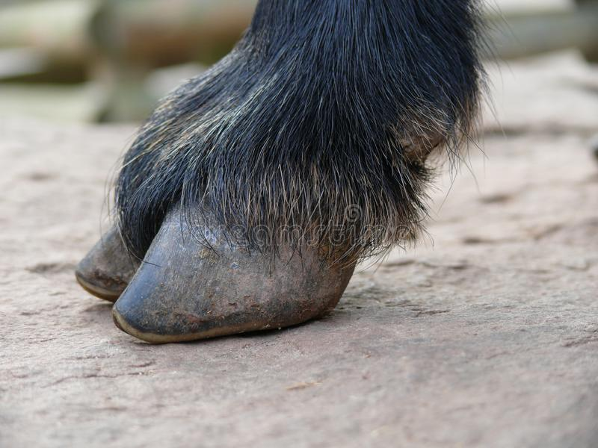
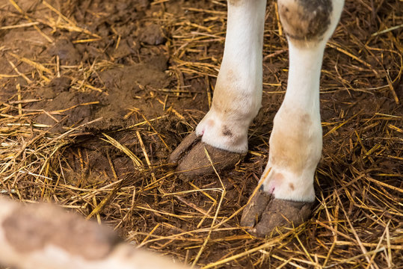
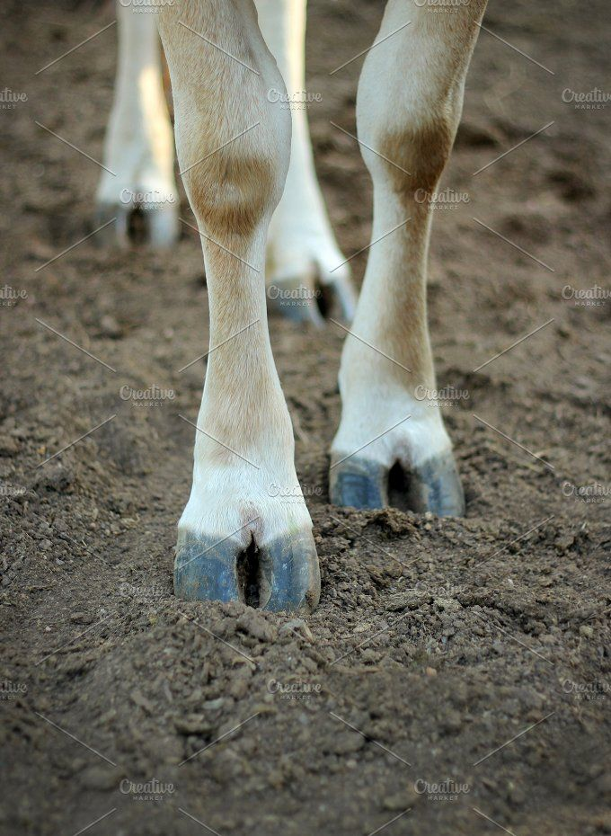
Foot & Hoof Anatomy of Ruminants
Bones, Joints, Ligaments, Tendons, Nerves and Blood Vessels + Hoof Anatomy

Slide 2
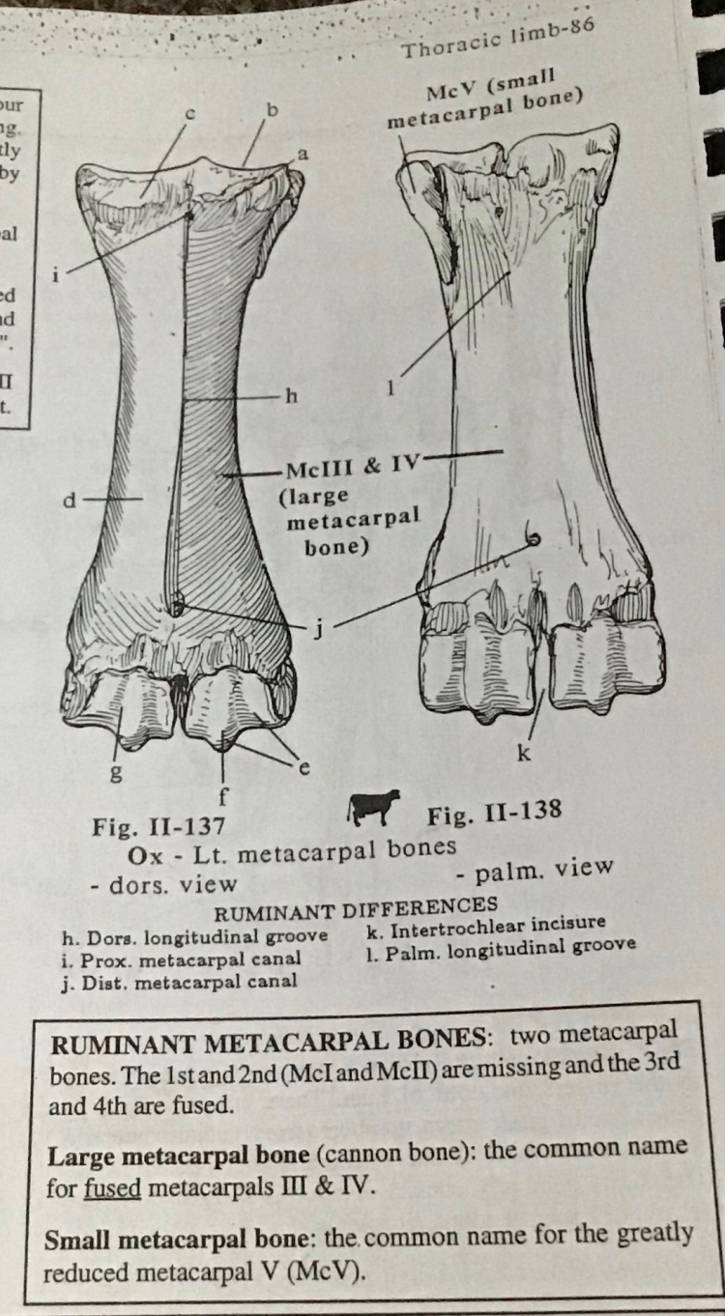
Bones of the foot:
The Metatarsal Bones- 3 bones
Made up of fused metacarpal/metatarsal bones III & IV
The digits- II - V
II & V- vestegial and non-weight bearing
III & IV – developed and weight bearing
Each digit is made up of 3 phalanges:
Proximal
Middle
Distal (also called coffin or pedal bone)
Each digit has 3 sesamoid bones
2 proximally
1 distally (navicular)

Slide 3
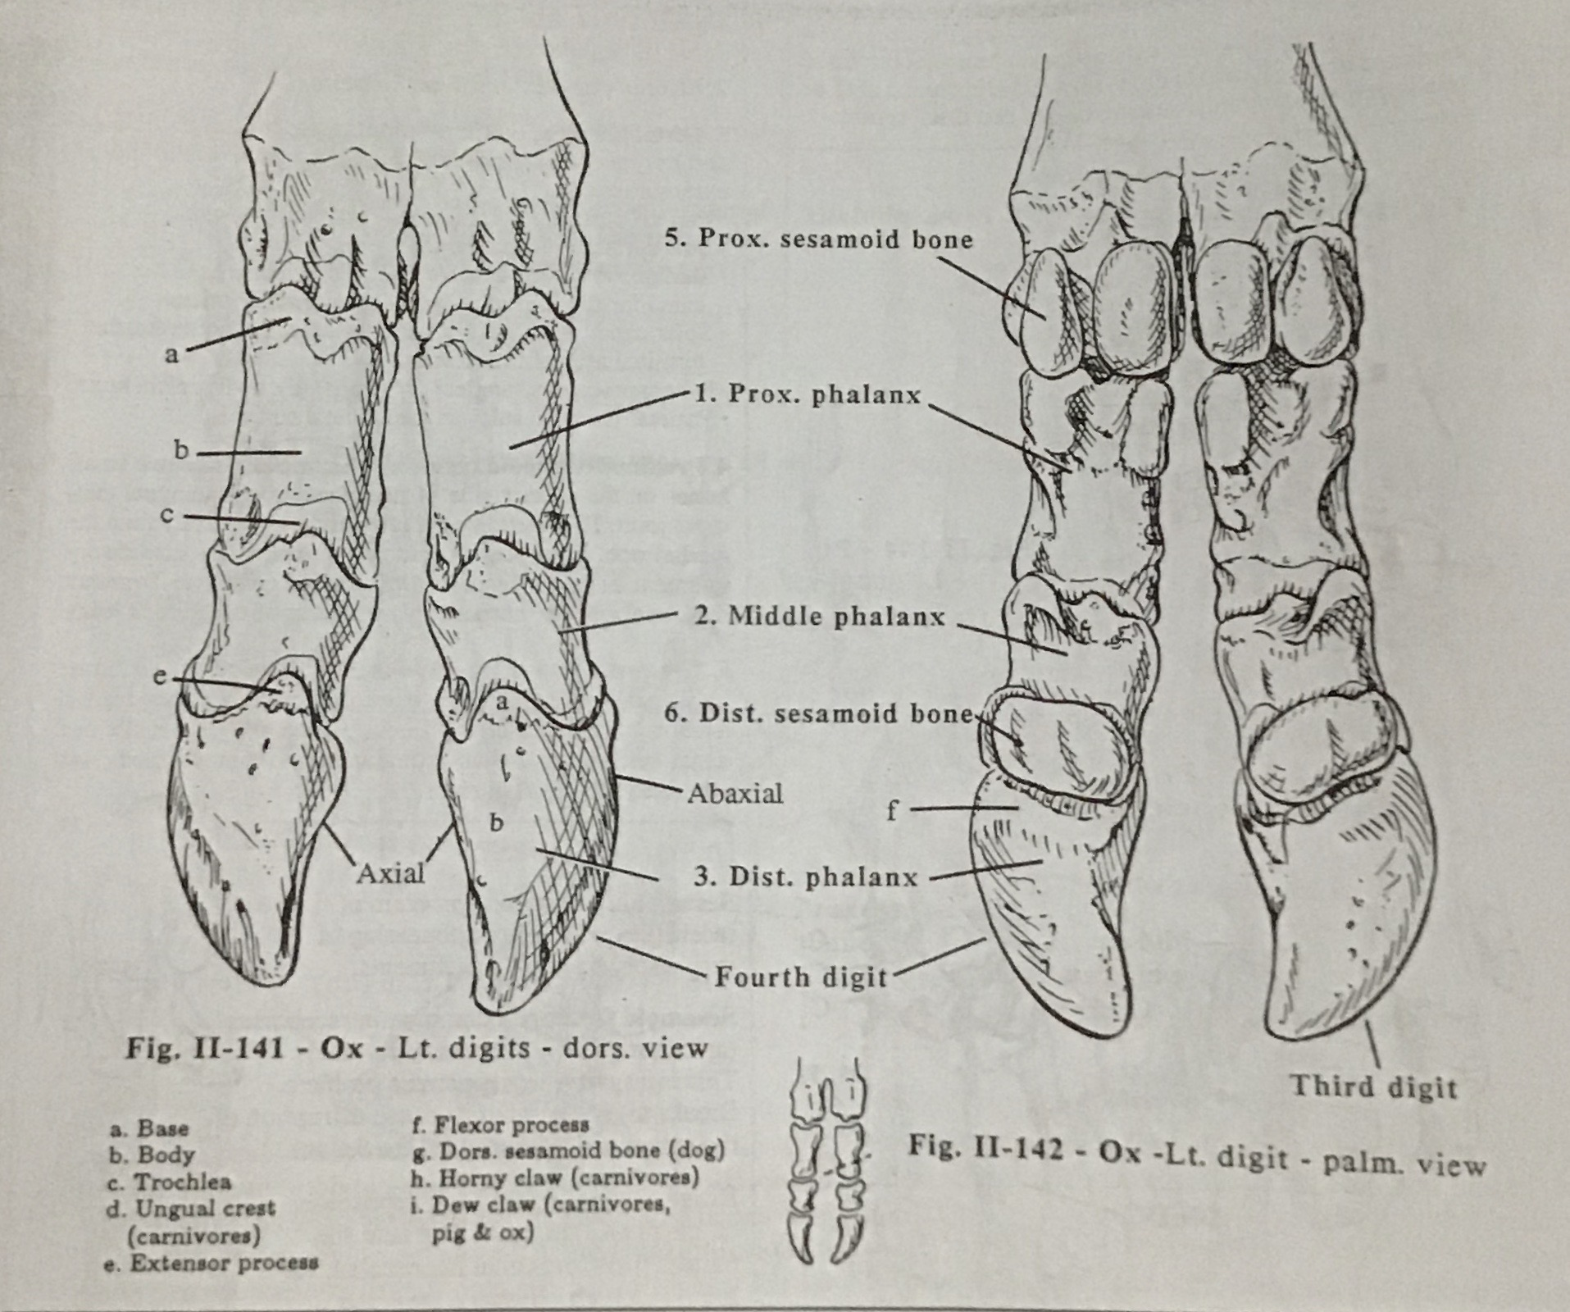

Slide 4
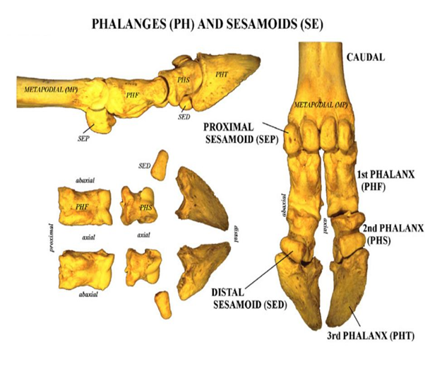

Slide 5
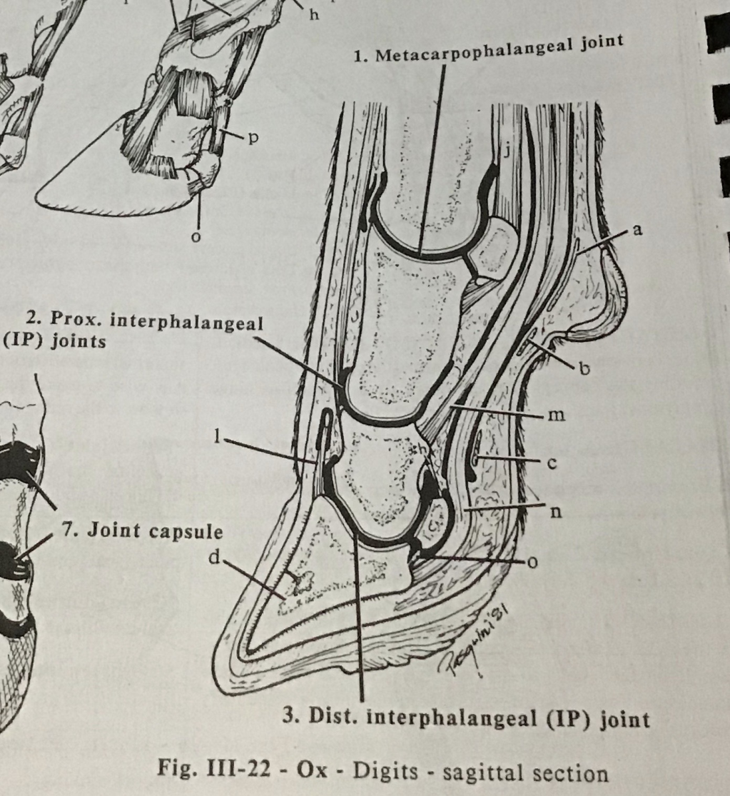
Joints of the foot:
3 joints:
1. Metacarpophalangeal joint
FETLOCK
2. Proximal interphalangeal joint
PASTERN
3. Distal interphalangeal joint
COFFIN/PEDAL

Slide 6
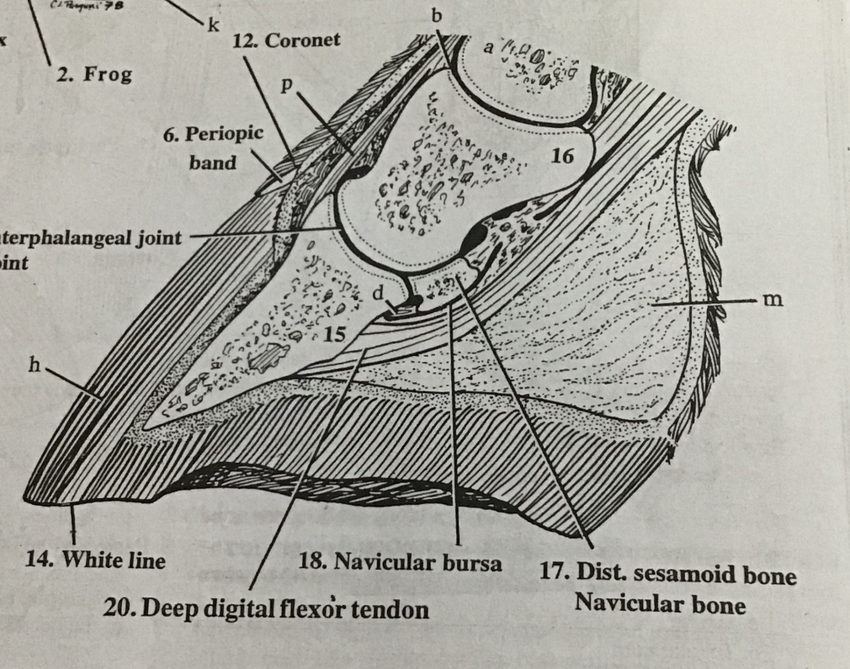
The Navicular bursa is a structure located between the deep digital flexor tendon and the distal (navicular) sesamoid bone
Purpose is to reduce the friction between the two structures

Slide 7
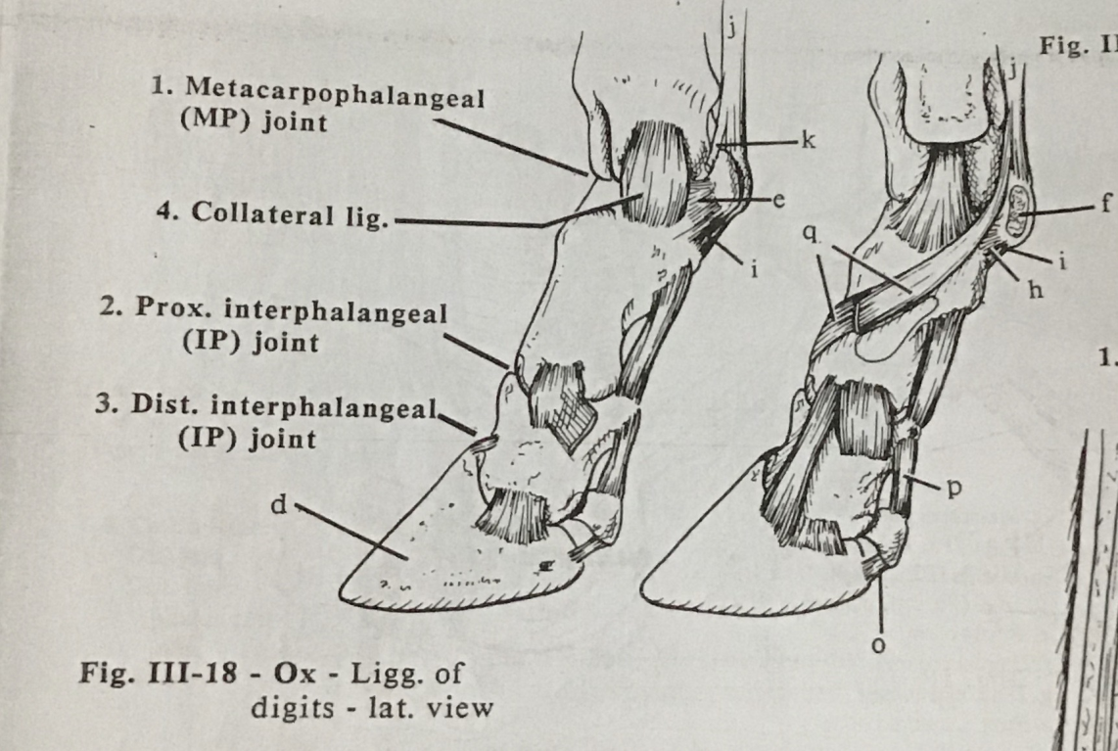
Ligaments of the foot:
Collateral sesmoidean lig. (e)
Intersesmoidean lig. (f)
Middle (oblique) sesmoidean lig. (h)
Deep (cruciate) lig. (i)
Suspensory lig. (j)
Extensor branch (k)
Middle branch (q)
Suspensory navicular lig. (p)

Slide 8
Ligaments continued….
Palmar anular lig. (a)
Proximal digital anular lig. (b)
Distal digital anular lig. (c)
Distal sesmoidean impar (navicular) lig. (o)

Slide 9
Tendons of the Foot:
Common digital extensor ten. (l)
Superficial digital flexor ten. (m)
Deep digital flexor ten. (n)

Slide 10
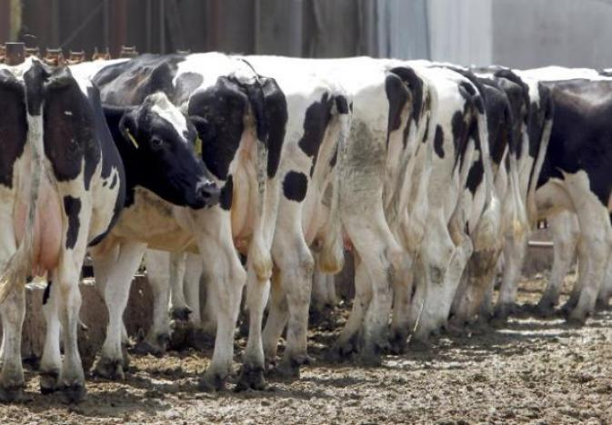
Blood SUPPLY TO the foot
Forelimb and Hindlimb

Slide 11
Forelimb:

Slide 12
Hindlimb:

Slide 13
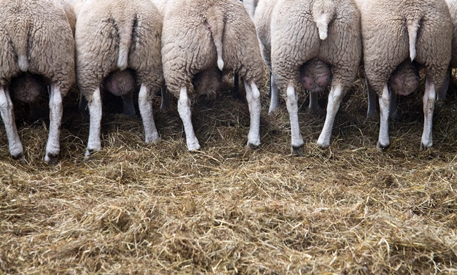
NERVE SUPPLY TO the foot
Forelimb and Hindlimb

Slide 14
Forelimb:

Slide 15
Hindlimb:

Slide 17
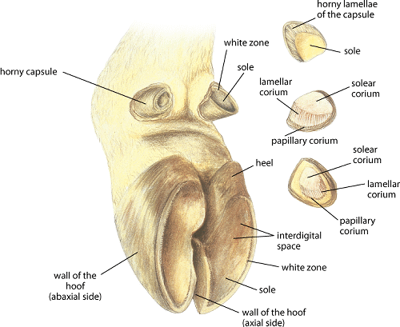
The HOOF
And its structures….

Slide 18
Hoof:
The hoof refers to the modified form of the integument (skin) that covers the foot. It consists of the:
Epidermis
Dermis or Corium
NB: The hoof of the horse and ruminant are anatomically the same EXCEPT horse have bars, a frog and secondary laminae while ruminants do not AND horses bear weight on one toe while ruminants bear weight on two toes

Slide 19
The Epidermis:
The part of the integument that overlies the dermis
Consists of different layers:
Perioplic epidermis
Coronary epidermis
Laminar epidermis
Sole epidermis
The Dermis/Corium
The vascular layer underlying the dermis
Consists of different layers:
Perioplic corium
Coronary corium
Laminar corium
Corium of the sole
Bulb dermis

Slide 20
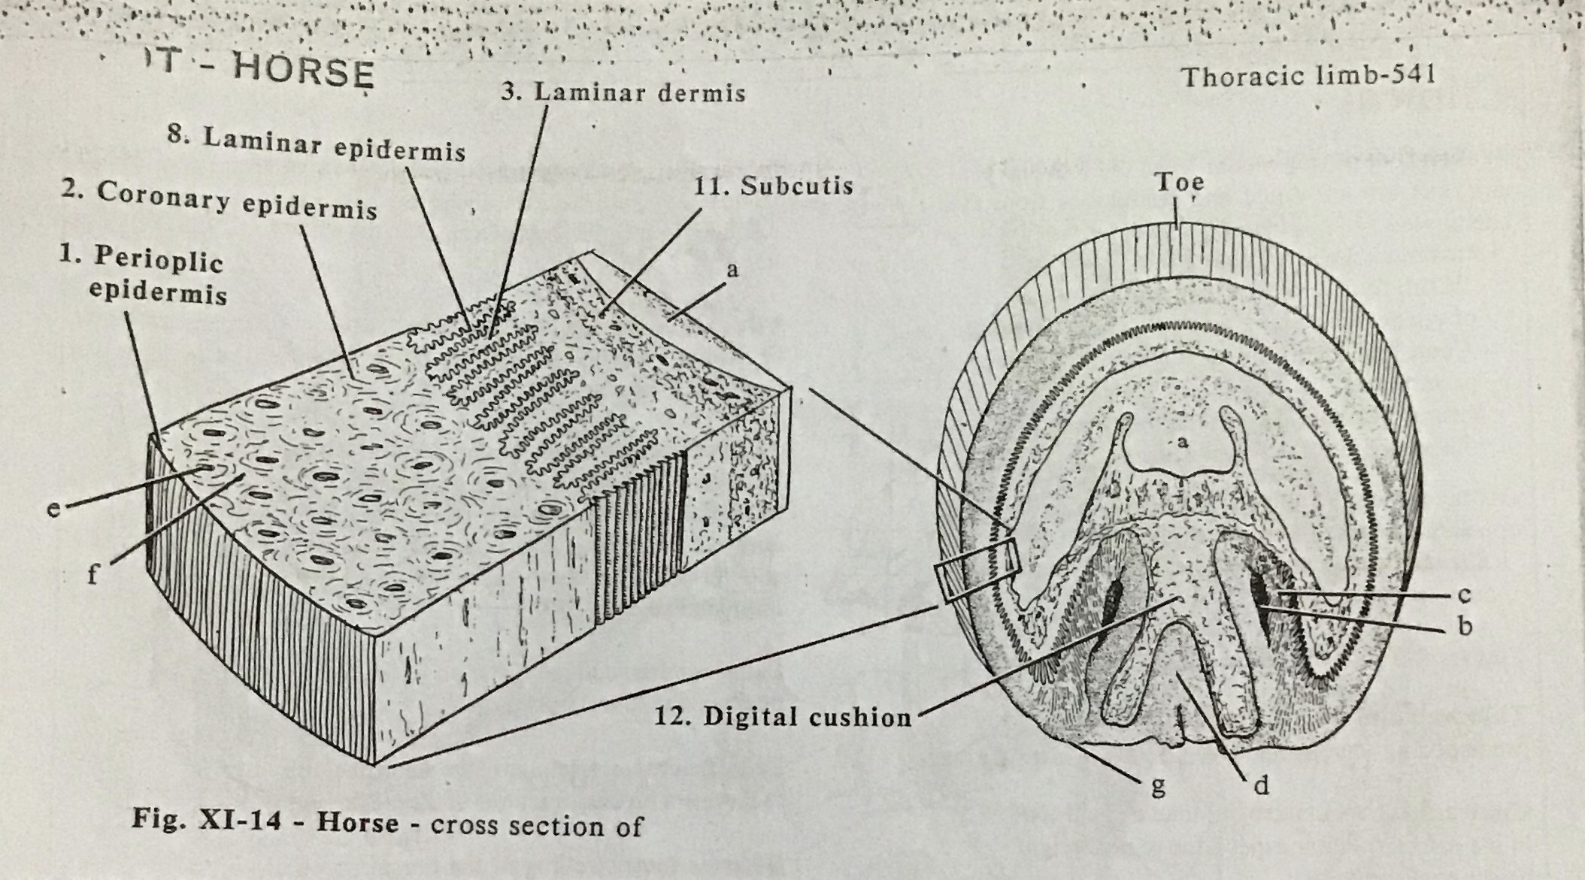
The Subcutis is a layer of connective tissue that joins the dermis to the coffin bone.

Slide 21
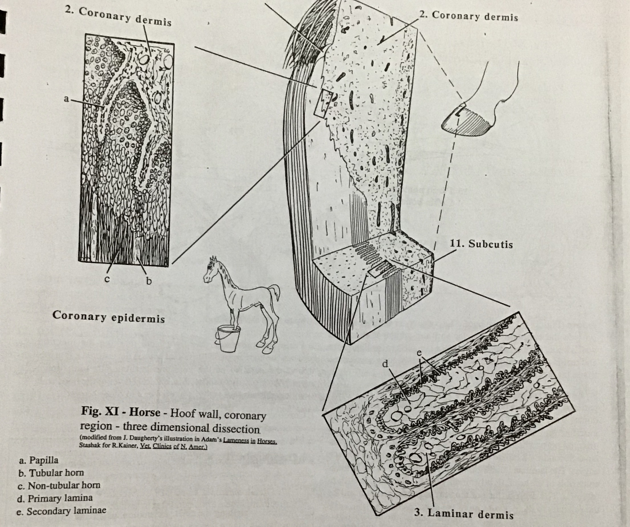

Slide 22
External structures of the hoof: The wall
Toe- dorsal part of the wall
Heel- plantar aspect of the wall
Quarter- medial/lateral parts of the wall
Coronet- junction of the hoof (periople) & the skin
Periople- outer, shiny layer of the hoof
Perioplic band- soft horn adjacent to the coronet

Slide 23
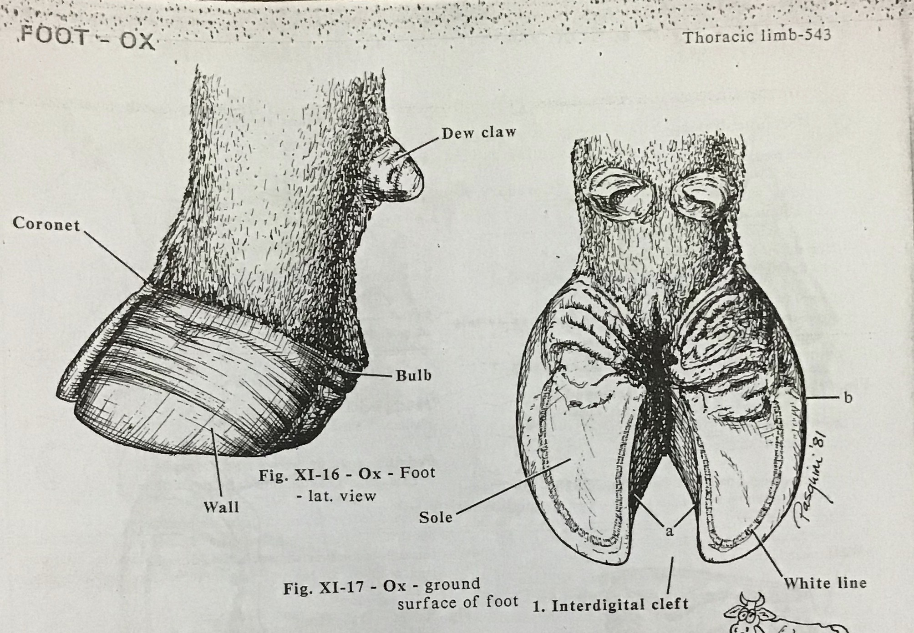
Bulb- upward thickening of the heel
Sole- concave surface facing the ground below the heel
Interdigital cleft- space between the two hooves

Slide 24
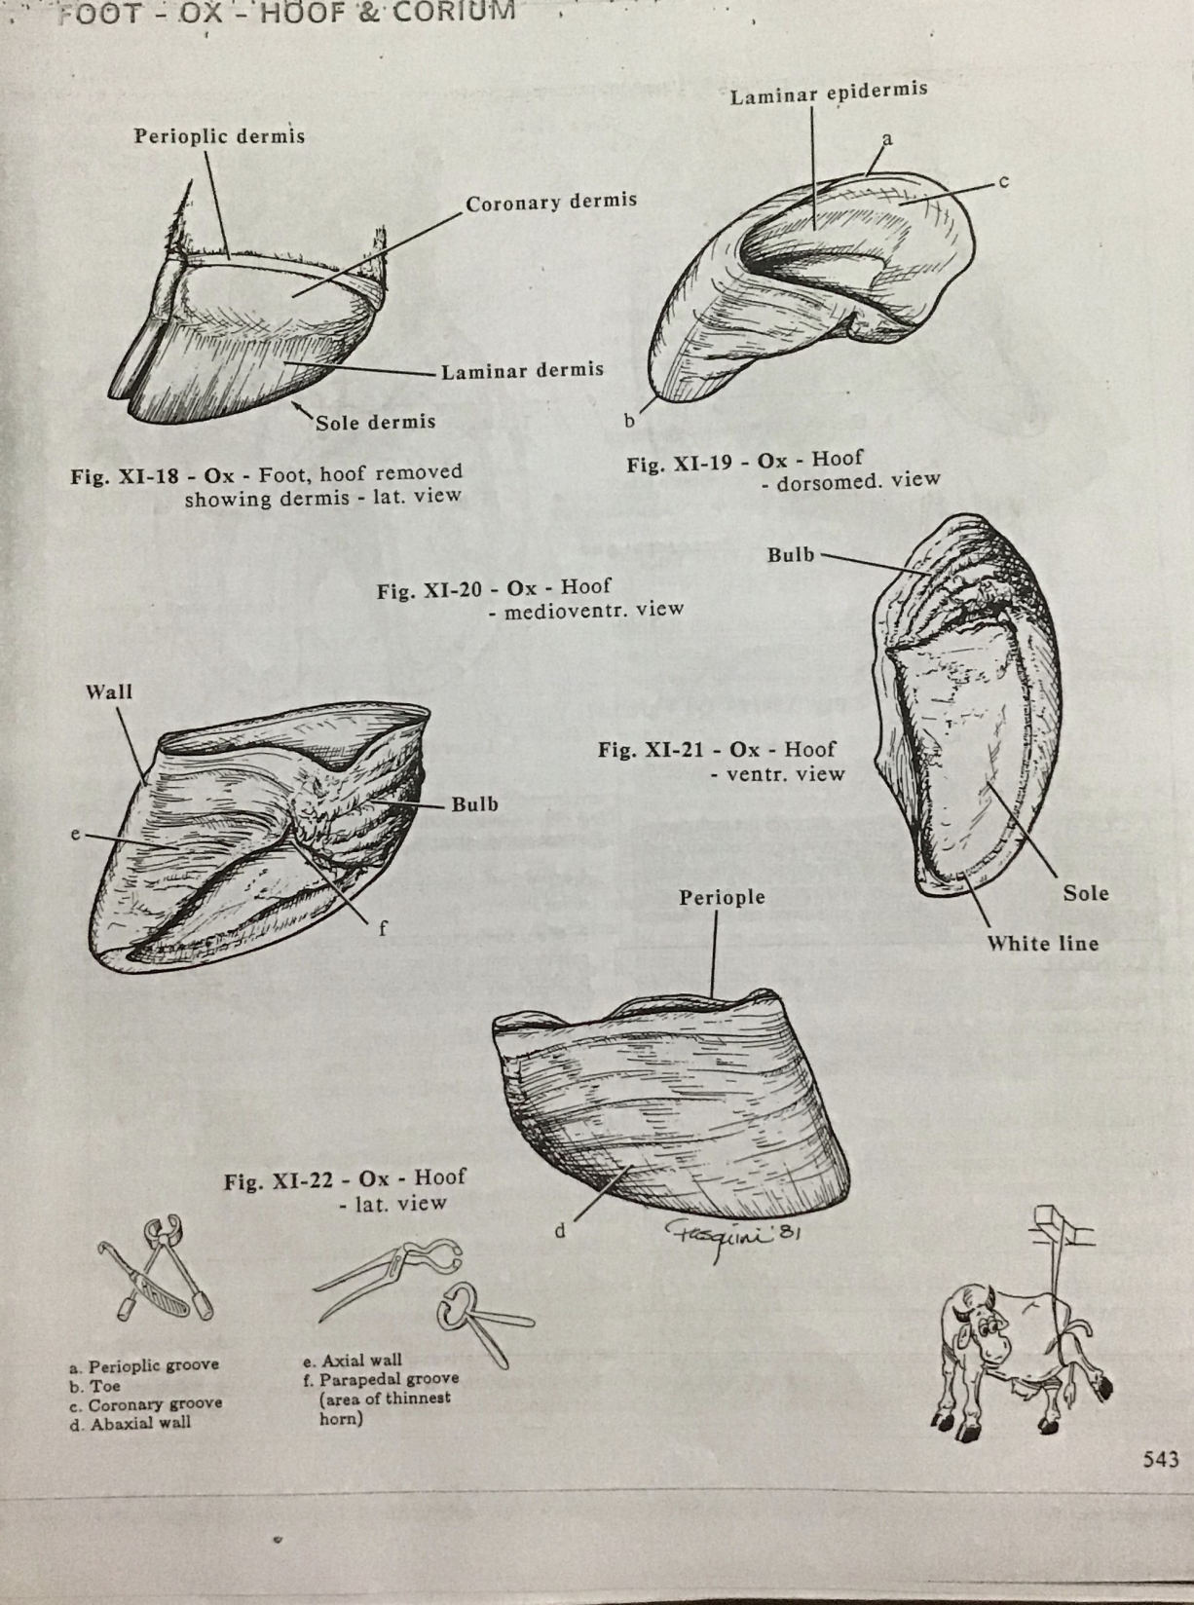
White line- the junction between the wall & the sole. It serves as an external indication of the sensitive internal structures of the hoof

Slide 25
The End ☺
References:
Pasquini C, Spurgeon T, Pasquini S. Anatomy of domestic animals. Systemic and Regional Approach.. 7th ed. Pilot Point, TX: Sudz Publishing; 2007.

