Slide 1
Radical Mastectomy
In Goats

Slide 2
Bilateral Mastectomy

Slide 3
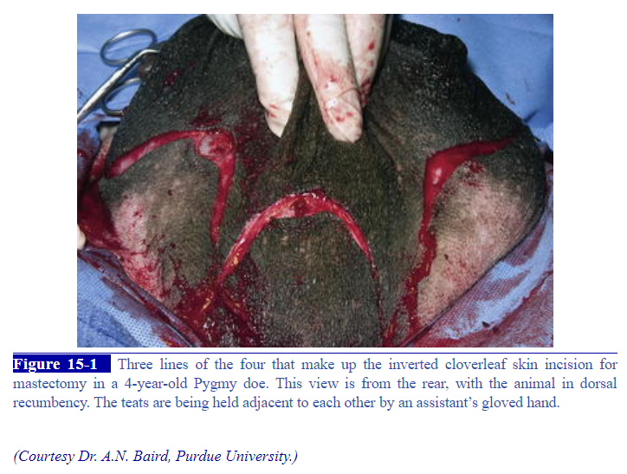
An inverted cloverleaf skin incision is made
This is a series of four curvilinear incisions with the convex side toward the teats making cranial, caudal, and two lateral skin flaps respectively.

Slide 4
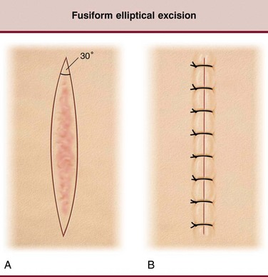
NB: an elliptical incision around the base of the udder can also be done

Slide 5
Lift the glandular tissue of the udder off the body wall.
Identify the pudendal blood vessels, the perineal blood vessels and the caudal epigastric vein and ligate using a miller’s knot + transfixation ligation. Double ligate.
Video demonstration on this ligation method:
https://www.youtube.com/watch?v=St_7BTWDaZ8

Slide 6
Once, no major bleeding occurs, the skin is then closed.
Suture subcutaneous fat using absorbable monofilament suture materials such as 4-0 VICRYL or PDS II in a simple interrupted pattern.
Suture the skin in an ‘X’ pattern using Horizontal Mattress sutures. Same kind of suture material can be used as with the subcut suturing.
A Penrose drain should be included under the skin closure and anchored with suture material
Video demonstrating how to anchor a drain: https://www.youtube.com/watch?v=8fOYfTl3S18

Slide 7
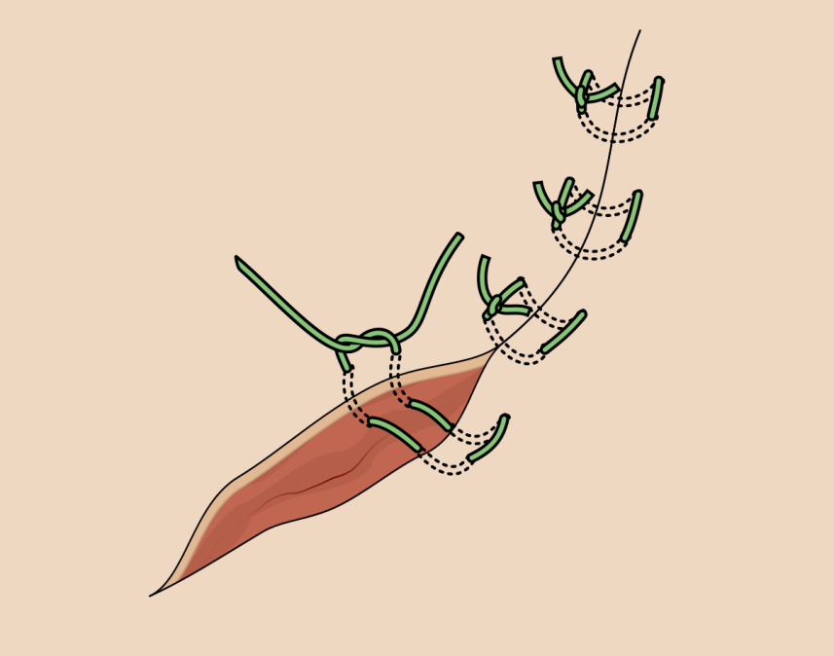

Slide 8
Where closure cannot be done, tack the deeper tissues to the external rectus using an interrupted suture pattern and leave the wound open to heal via second intention (with the relevant post-op care)
A rolled towel can be sutured to the wound to apply pressure and minimize seroma formation.

Slide 9
Unilateral Mastectomy

Slide 10
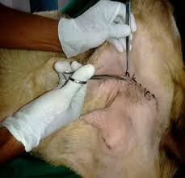
Done the same as in a Bilateral Mastectomy except that only one half of the udder is removed.
An eliptical incision is made at the base of the half to be removed, leaving enough skin to be sutured during closure.

Slide 11
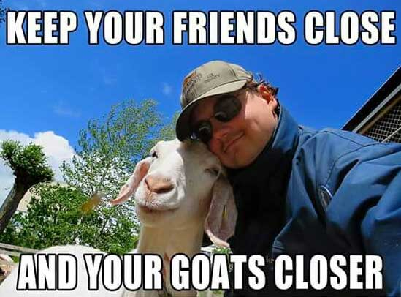
References:
How to- Goat Mastectomy: https://open.lib.umn.edu/largeanimalsurgery/chapter/how-to-mastectomy/#:~:text=Surgical%20procedure,long%20axis%20of%20the%20patient.&text=The%20skin%20is%20dissected%20off,are%20double%20ligated%20as%20identified.
Diseases of the Mammary Gland: https://veteriankey.com/diseases-of-the-mammary-gland/
El-Maghraby HM. Comparison of two surgical techniques for mastectomy of goats. Small Ruminant Research. 2001 Jun 1;40(3):215-21.
Turner A, McIlwraith C, Hull B. Techniques in large animal surgery. 4th ed. Philadelphia (Pa.): Lippincott Williams & Wilkins; 2013.

