Slide 1
ACS 560 Microblog 911 Project Status
Kassie M. Bowman
October 25, 2011

Slide 2
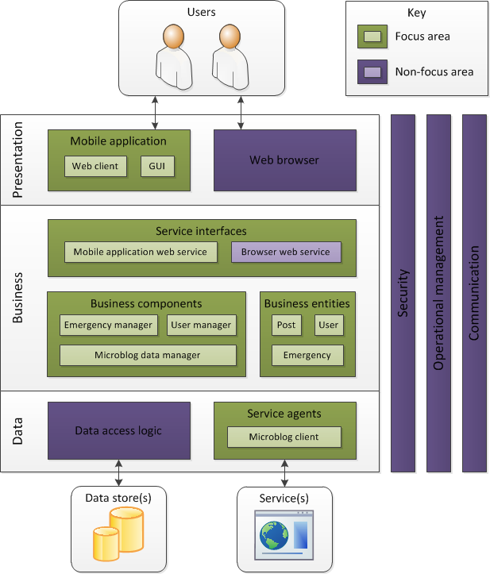
Application Architecture

Slide 3
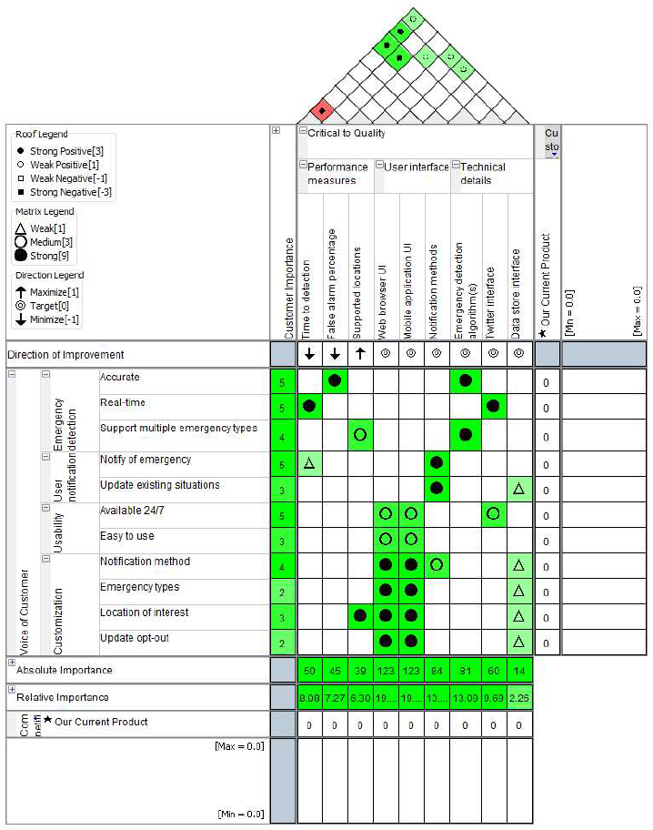
Axiomatic Design
House of Quality

Slide 4
Status Summary
Inception
Vision Document (v1)
Application Architecture (v2)
Schedule (v1)
FMEA (v1)
Design Matrix (v1)
Design Structure Matrix (v1)
SRS (v3)
Elaboration
PMP (v3)
QFD House of Quality (v1)
Ready to Begin UML

Slide 5
Thank You.
Any questions?

