Slide 1
Diego Valencia
Bitacora 1

Slide 2
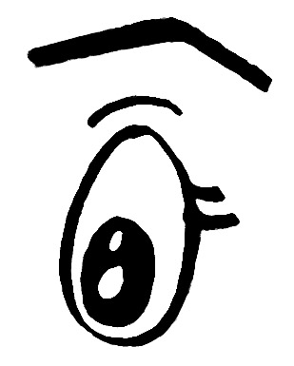
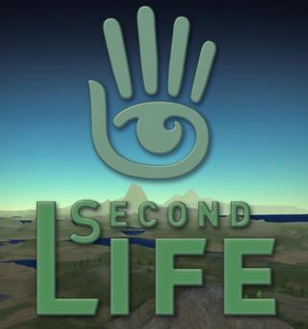
My experience in second life was fine; to begin with, I couldn´t go to class because I was sick, so I had some troubles with this process of creating my avatar.
Then, I had to work on my own and finally I created my avatar (Diox007) and I started checking the thing I could do there. Moreover, I had some problems with the computer due to the resolution the program requires but finally I could fly and have one conversation with 2 people. In addition, I realized that this game or program is very interesting for learning and meeting people from other countries; we can share information and learn more vocabulary with native speakers all over the world.
Also, I learned some things such as how to change his clothes, how to fly and how see other places.

Slide 3
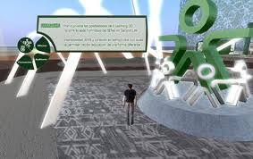
Moreover, I realized that students were very excited with this activity and their performance was good; as in a normal classroom, few students did not follow instructions and sometimes were confused or lost but they could find a solution with the team´s help. Indeed, it was nice to see the conversations and notice the positive things we can do with technology (in this case, Second Life).
During the activity in second life as a group, I was with the teacher observing the virtual class because I couldn´t get online; I saw the activity as a teacher which was very interesting because I could see the organization and the way students should follow in order to get the goals. This platform of SENA is a great tool for learning and it proves that students really can learn and interact together , promoting cooperation and teamwork .

Slide 4
I think it is nice to use Second Life and technology in general to improve our skills and to experience our knowledge in a real context. However, I consider that we cannot depend always from technology because some people could be addicted to it and be unable to remember real life, (forgetting friends and family )I have seen some cases.

