Slide 1
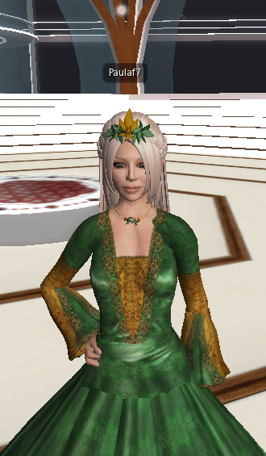
Bitácora 1
Seminario Pedagogía y Didáctica 1
Paula Fernanda Molano C.

Slide 2
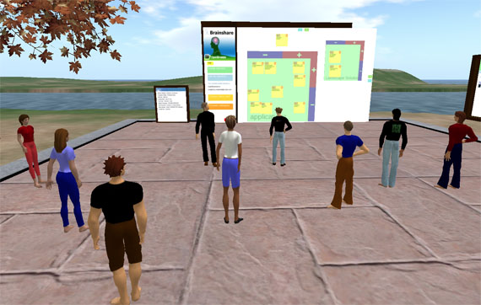
My First Experience in SL…
When I first entered to Second Life, I felt confused because I did not know how to use the program. However, I was very surprised when I began to use it and to find out thinks like, how to change the avatar, how to travel to other places, find other people and so on. I did not imagine that you could do things you would like to do in reality, but in an imaginary world where you can be whoever you want to be.

Slide 3
First Virtual Class…
When we had our first virtual class in Second Life, I first could do it well because of the lack of experience with the program; nevertheless, my classmates helped me to fin the SENA Island and to get involved in the dynamic of the class. I found interesting the way Harold managed the class, because he was always controlling everybody and following the process of each group during the activity.
What called my attention the most, was the cooperation, negotiation and team work that we did, helping our classmates and doing the activities of each station.

