Slide 1
Bitácora 0
Seminario Pedagogía y Didáctica 1
Paula Fernanda Molano C.

Slide 2
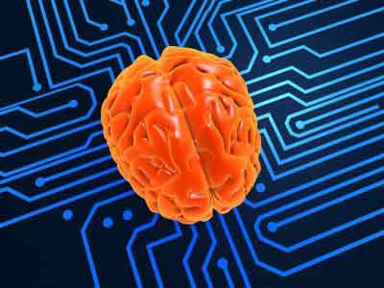
My Expectations
I expect from this class to get as many tools as possible to be a good teacher and to encourage my students to learn a language. In addition, nowadays, it is important to have a guide and to be updated about the new techniques and methodologies that are being used to teach a second language. Some teachers think they know how to use technology just because they know how to use a computer; nevertheless, they do not know how to take the maximum advantage of it. That is why, I expect to learn how to use it in the right way.

Slide 3
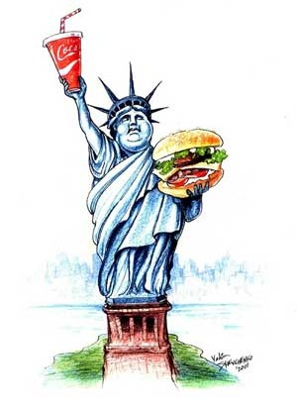
Experiences With ICT’s
I have been teaching English giving particular classes. During my experience, I have almost always used ICT’s. I find them very useful at the moment of calling the attention of the student when explaining topics and showing them examples of the use of the language in real contexts.

