Slide 1
Use Case Modeling
Chapter 7
Part of Requirements Modeling
Designing Concurrent, Distributed, and Real-Time Applications with UML
Hassan Gomaa (2001)

Slide 2
Use Case Model (7.1)
A use casediagram consists of actors and use cases.
  Actors are external users of the system.
  Use cases are the things actors use the system for.
    A sequence of interactions between one or more actors and the system.
The Use Case Model shows the functional requirements of a system with use case diagrams.

Slide 3
Actors (7.2)
Represents a class of external user of the system.
  Primary Actors initiate use cases.
  Secondary Actors may also participate.
Actors are not limited to humans
  Any I/O device that connects to a system is an actor.
    E.g. Sensors, timers, etc.
  When the I/O is initiated or received by a human, the human is considered the actor.
    E.g. keyboards, displays, etc.

Slide 4
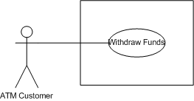
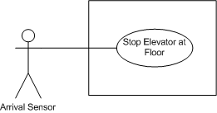
Actor Examples (7.2)
Human Actor
Non-Human Actor

Slide 5
Actors, Roles, and Users (7.3)
Actors are used to represent a role played by a user.
  Actors model types of users.
Users are instances of a particular type
  E.g. Driver, Navigator, Engineer, etc.
A user can have multiple types.
An actor can have multiple users.

Slide 6
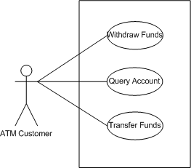
Identifying Use Cases (7.4)
Input from an actor are the starting places for use cases.
  Start by considering the inputs to the system, and the sequences of events they will begin.
Consider the ATM Customer, who may want to:
  Withdraw funds
  Query for account balances
  Transfer funds from one account to another

Slide 7
Use Case Documentation (7.5)
In addition to the diagram, each use case should have a description consisting of:
  Use Case Name
  Summary
  Dependency
  Actors
  Preconditions
  Description
  Alternatives
  Post-condition
  Outstanding Questions

Slide 8

Use Case Relationships – Extend (7.7.1)
Used to show alternative routes.
The primary sequence of events is abstracted into a base use case, and extension use cases show the alternate routes.

Slide 9
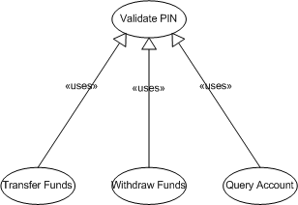
Use Case Relationships – Include (7.7.2)
Used to abstract common functionality among several use cases.
Caution should be exercised: Abstract use cases should be used infrequently.
  The goal is to model requirements, not functionally decompose the problem
Called “uses” in VISIO

Slide 10
Use Case Packages (7.8)
Like everything else in UML, use cases may be divided into packages.
In COMET, use cases are grouped into packages by a common major actor, and the package is named after that actor.
  E.g. FactoryOperatorUseCasePackage would contain use cases in which the factory operator was a major actor.

Slide 11
Summary (7.9)
Use Cases are used to document functional requirements in COMET.
Use Case Diagrams consist of Actors and Use Cases
Each use case should have a use case description
Use Cases can extend and include one another.

