Slide 1
Finite State Machines and Statecharts
Chapter 10
Part of Analysis Modeling
Designing Concurrent, Distributed, and Real-Time Applications with UML
Hassan Gomaa (2001)

Slide 2
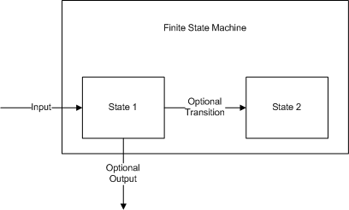
Finite State Machines
Finite state machines are conceptual machines with a finite number of states.
State transitions are changes in from one of these states to another.

Slide 3
Finite State Machines (cont)
State Machines consist of two basic elements:
Events: occurrences at a point in time.
States: recognizable situations that exist over an interval of time.
The dynamic aspects of the problem domain are modeled using finite state machines.
Typically one Object encapsulates one state machine.

Slide 4
Statecharts
In UML, state machines are represented in Statecharts.
Statecharts may be flat or hierarchical, and can depict a wealth of information regarding the expected operation of a system.

Slide 5
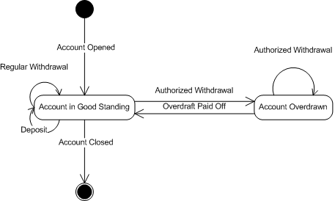
Statechart Examples

Slide 6
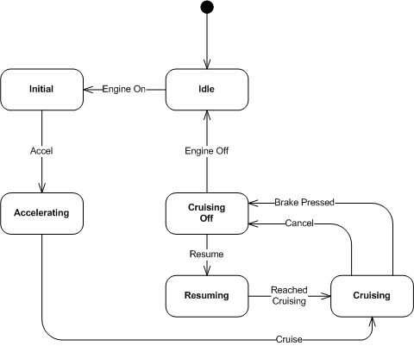
Statechart Examples (cont)

Slide 7
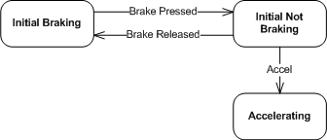
Statechart Examples (cont)

Slide 8
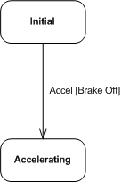
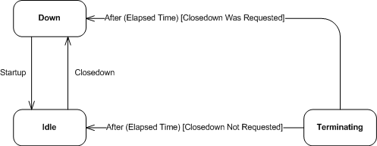
Conditions
Conditions are represented after an event with square brackets
Conditions determine which, if any, state the event transitions to.

Slide 9
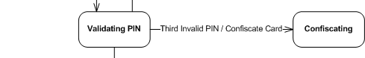
Actions
Actions associated with a state transition are shown after the event causing that transition, separated by a “/”.

Slide 10
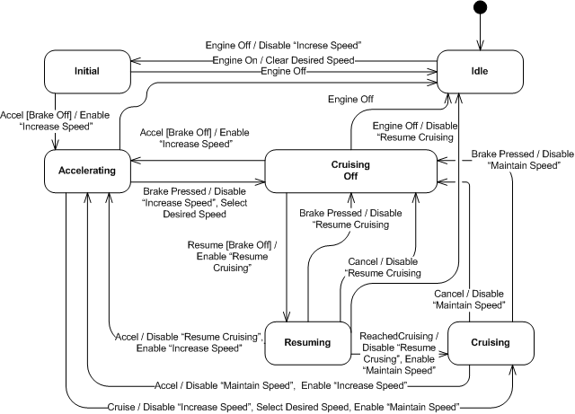
Too Many Actions Clutter Diagrams

Slide 11
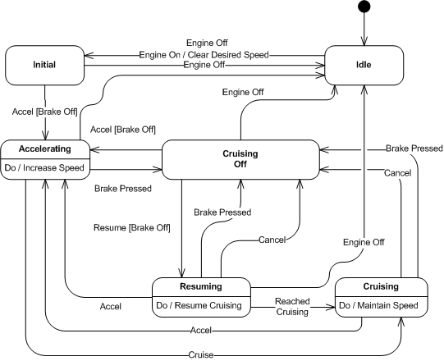
Activities
Activities actions appear on a states block using the “Do / Activity” notation.
Clean up the event transitions
Prevent unnecessary repetition

Slide 12
Activities Example

Slide 13
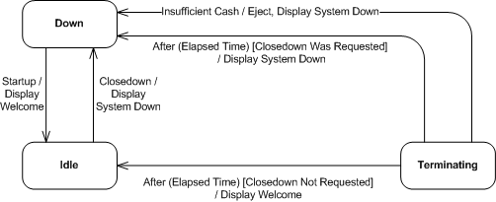
Entry and Exit Actions
Entry and Exit actions occur upon entering or leaving a state.

Slide 14
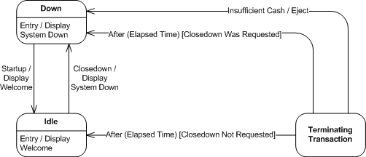
Entry and Exit Actions (cont)
Entry and exit actions can also be displayed as activities.

Slide 15
Hierarchical Statecharts
Hierarchies are used to simplify state charts.
Each sub-state gains the transitions of the super-state.
Being in the super-state means being in one and only one of the sub-states.
Common transitions can be aggregated to the super-state

Slide 16
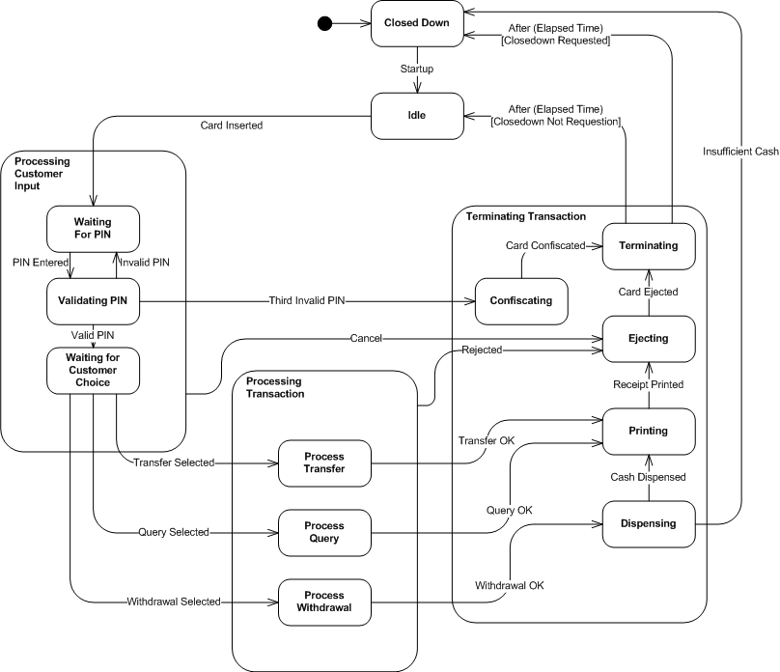
Hierarchical Statecharts Example

Slide 17
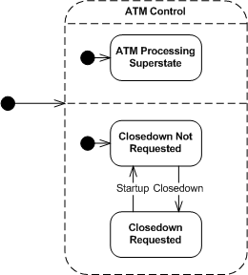
Concurrent Statecharts
When multiple sub-states must be active simultaneously, a concurrent statechart is used.

Slide 18
Statechart Guidelines
States must represent identifiable situations or intervals of time.
Each state should have
A unique name.
An exit.
On flat statecharts, only one state at a time should be active.

Slide 19
Statechart Guidelines (cont)
Events and Actions are distinct:
Events are the cause of transitions
Something that happens.
Actions are the effect of transitions
A command.
Conditions are boolean values – they must evaluate to “true” or “false”
Actions, Activities, and Conditions are optional; use only where necessary.

Slide 20
Developing Statecharts from use Cases
Collect the actions, conditions and results from a use case description.
Develop a preliminary statechart with those actions and conditions as the events and the results and the states.
Consider any alternative external events not in the use case.
Develop hierarchical and concurrent statecharts as necessary.

Slide 21
Summary
Finite state machines are used to model the dynamic aspects of the problem domain using statecharts.
Statecharts consist of Transitions and States
Events cause Transitions (possibly based on a condition)
Actions or activities are caused by transitions.
Statecharts may be flat, hierarchical, or concurrent.

