Slide 1
Using COMET with Visio
Visio UML Modeling

Slide 2
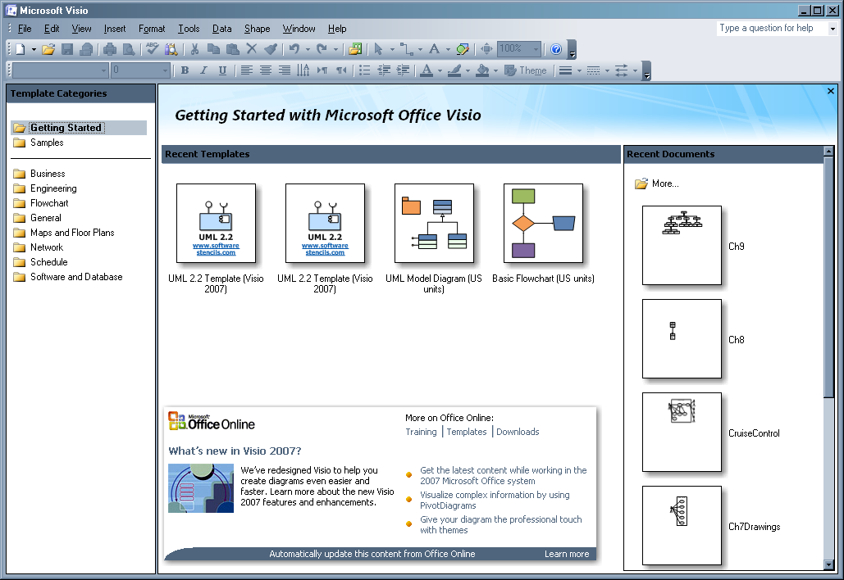
Creating a Drawing
After opening Visio, you will see a list of templates available.

Slide 3
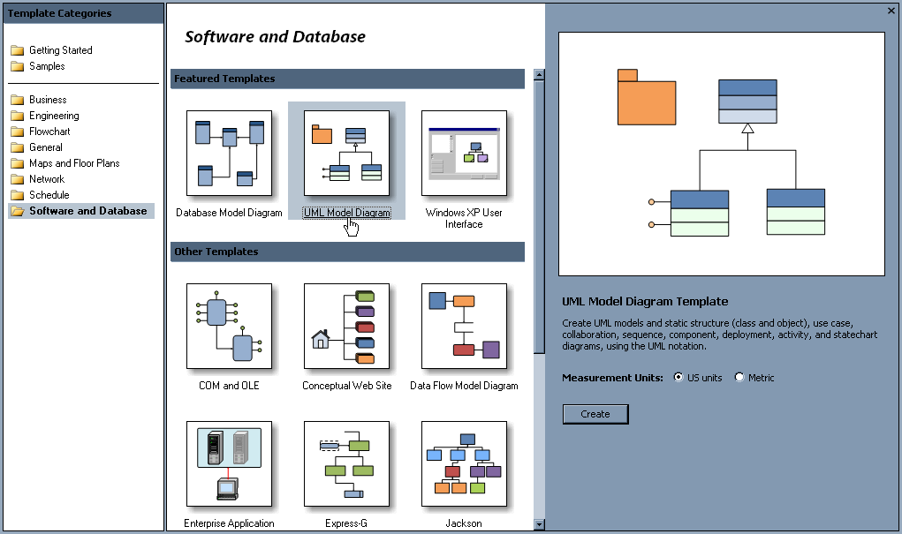
Create a Drawing (cont)
Under the Software Engineering folder, select UML Model Diagram
After choosing your units, select “Create”

Slide 4
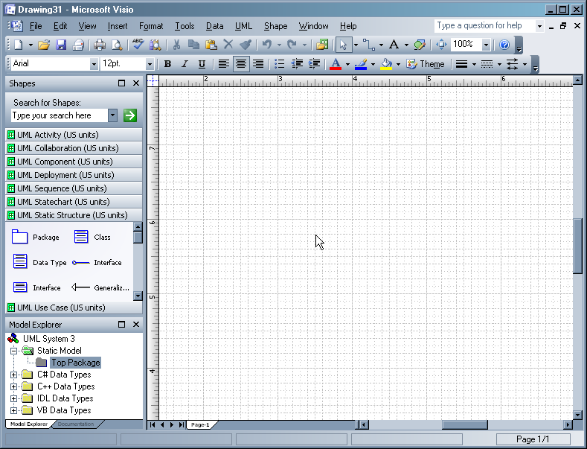
Create a Drawing (cont)
You will be taken to a new drawing with the UML shapes and Model Explorer visible.

Slide 5
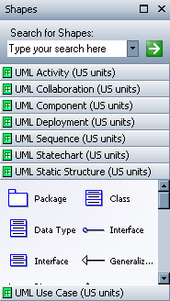
Shapes Library
The Shapes Library is on the left hand side.
Shapes are organized by the kind of UML diagram they appear on.

Slide 6
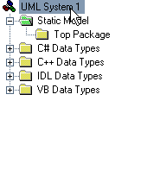
Model Explorer
The Model Explorer is also on the left hand side.
All the objects you create will be shown here in a hierarchy for easy access.

Slide 7
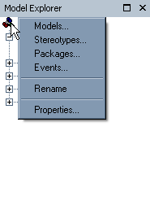
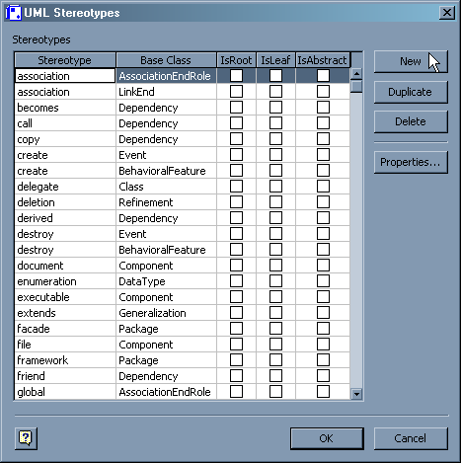
Adding Stereotypes
To add stereotypes, right click on the system in the Model Explorer
Select “Stereotypes…” and the Stereotypes dialog will appear.

Slide 8
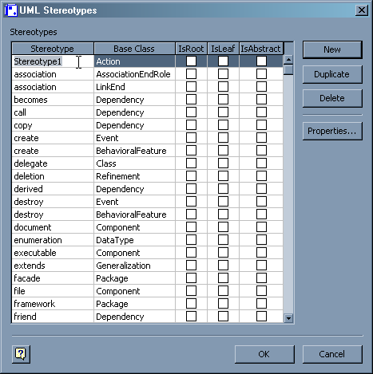
Adding Stereotypes (cont)
Click “New” to create a new stereotype
You can specify the name, and the base class the stereotype applies to.

Slide 9
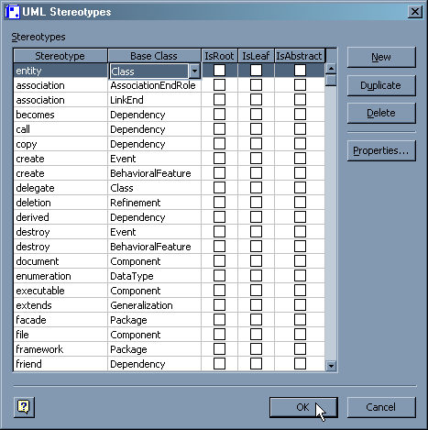
Adding Stereotypes (cont)
Lets make the entity stereotype for classes. Click OK to finish.

Slide 10
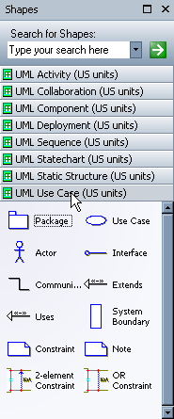
Use Case Diagrams
First, select the UML Use Case section of the shapes library

Slide 11
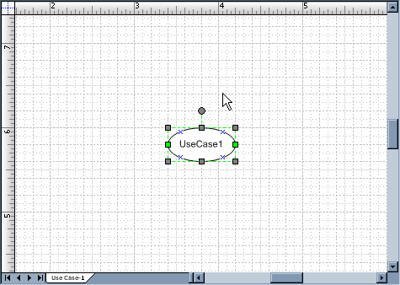
Use Case Diagrams (cont)
Drag a use case onto the drawing.

Slide 12
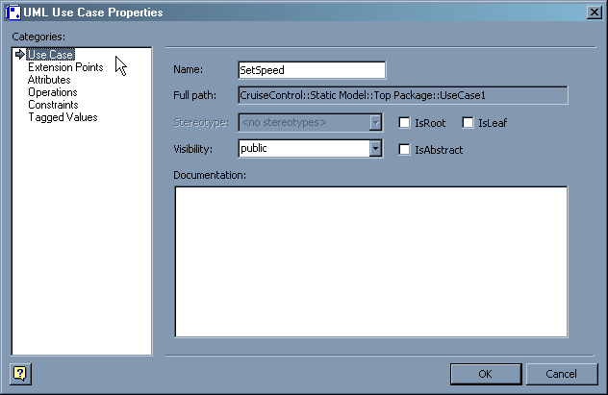
Use Case Diagrams (cont)
Double-click the Use Case to open its properties dialog, and give it a name.

Slide 13

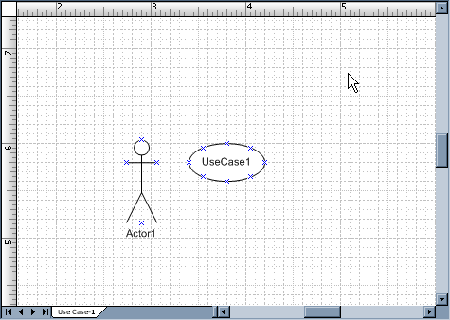
Use Case Diagrams (cont)
Repeat this process with an Actor

Slide 14
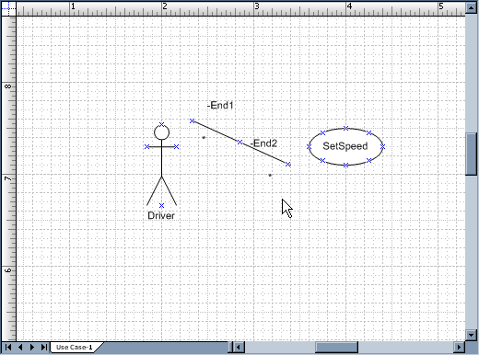
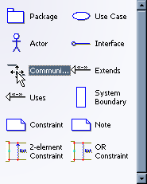
Use Case Diagrams (cont)
Find the Communications Connector in the UML Use Case shapes, and drag it onto the drawing..

Slide 15
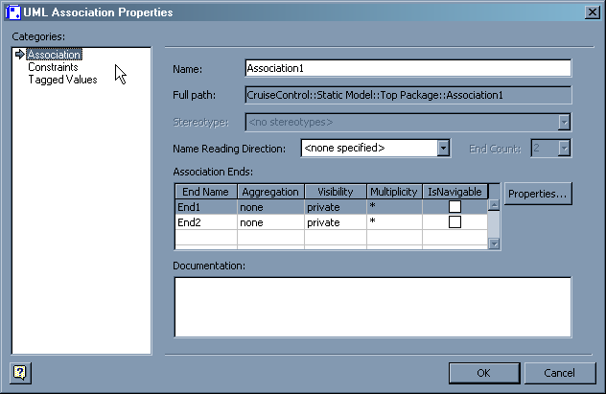
Use Case Diagrams (cont)
After linking the Actor and Use case, double-click the Communication Connector to open its properties.

Slide 16
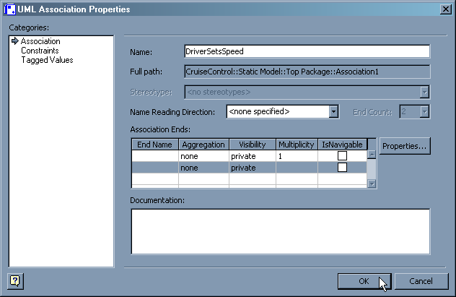
Use Case Diagrams (cont)
Note you can change the end names and multiplicities.
Blank all but a multiplicity of 1 for the Driver.

Slide 17
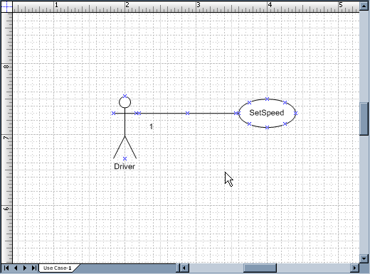
Use Case Diagrams (cont)
The Use Case is now Finished.

Slide 18
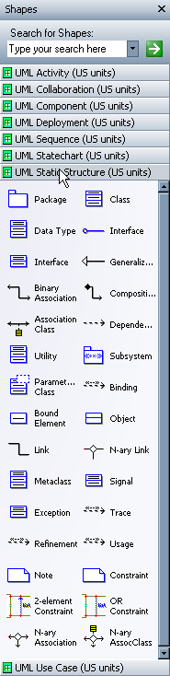
Class Diagrams
In a new drawing, select the UML Static Structure shapes.

Slide 19
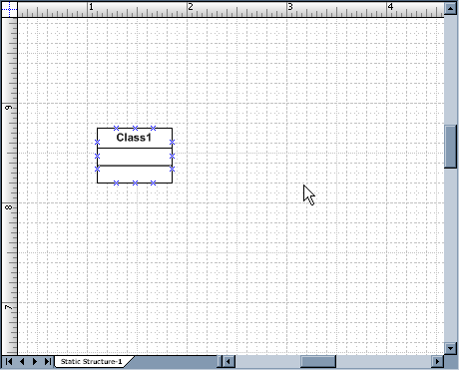
Class Diagrams (cont)
Drag a Class onto the drawing.

Slide 20
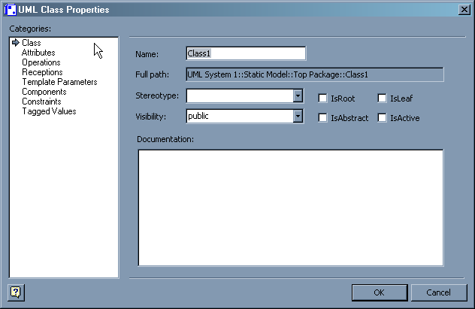
Class Diagrams (cont)
Double Click on the new class to open its properties, where you can change its name.

Slide 21
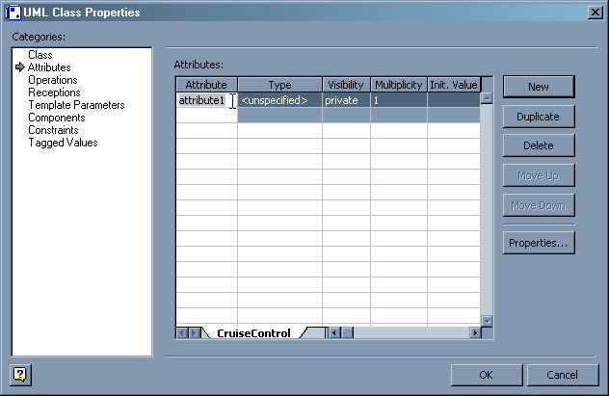
Class Diagrams (cont)
You can also add attributes and operations to the class.

Slide 22
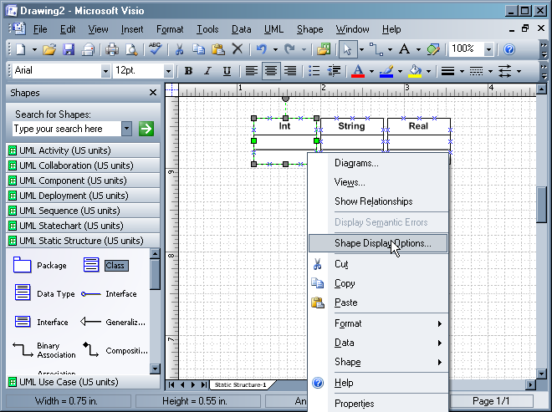
Class Diagrams (cont)
After creating several basic classes, right-click on one and select “Shape Display Options”

Slide 23
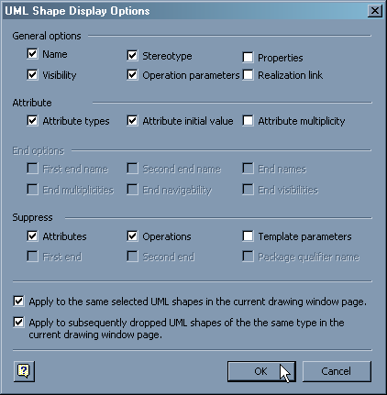
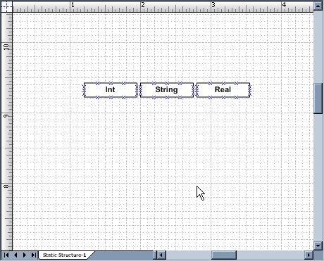
Class Diagrams (cont)
Note that you can suppress the visibility of the Attributes and Operations fields.

Slide 24
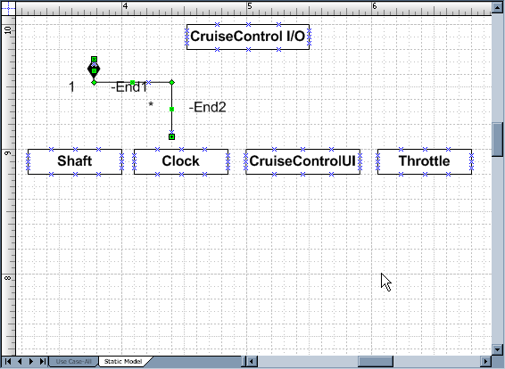
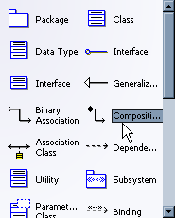
Class Diagrams (cont)
To define a composition or aggregation relationship, use the Composition connector.

Slide 25
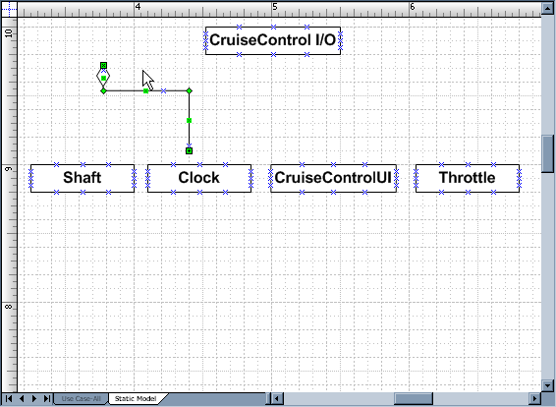
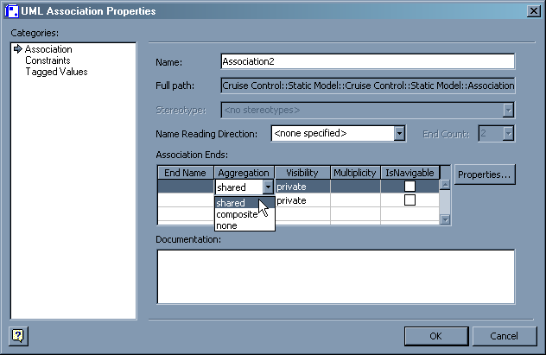
Class Diagrams (cont)
Changing the Aggregation to “shared” replaces the solid diamond with a transparent one.

Slide 26
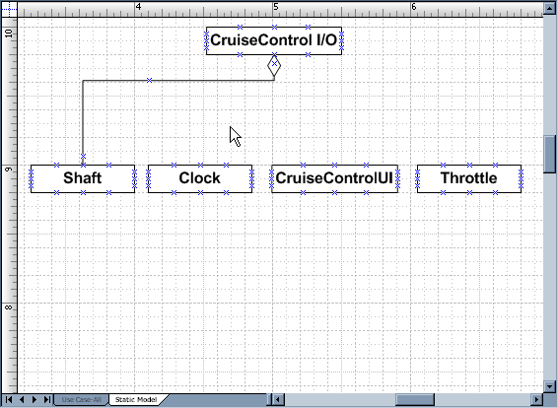
Class Diagrams (cont)
After editing the properties of the Composition connector, connect its ends to the appropriate objects.

Slide 27
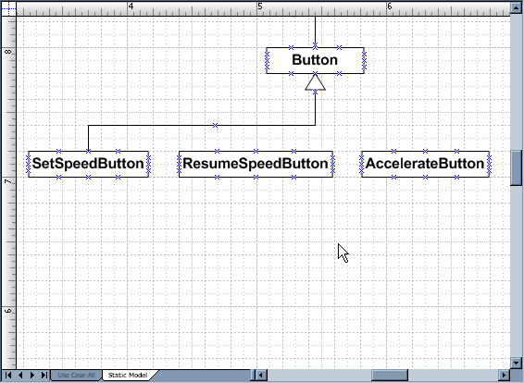
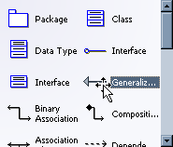
Class Diagrams (cont)
Similarly, generalization relationships are shown with a Generalization connector.

