Slide 1
Static Modeling
Chapter 8
Part of Requirements Modeling
Designing Concurrent, Distributed, and Real-Time Applications with UML
Hassan Gomaa (2001)

Slide 2
Static Modeling
Static Models describe the structural aspects of a problem.
  The real-world entities involved.
  These are less likely to change than functional requirements, are are hence called static.
Static Models are depicted with UML’s class diagrams in COMET.

Slide 3
Static Model Relationships (8.1)
Association
  Denotes a static structural relationship.
Composition and Aggregation
  Denotes a made-up-of relationship.
  Offers two strengths of relationship.
Generalization and Specialization
  Denotes an is-a relationship
  Creates a hierarchy.

Slide 4

Association (8.1.1)
Shown by an arc connecting two classes.
Can demonstrate
  Nature of the relationship.
  Multiplicity at both ends.

Slide 5




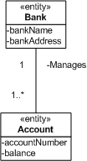
Multiplicity Examples (8.1.2)
One-to-One
One-to-Many
Numerically
Specified
Optional - One
Optional - Many
Many-to-Many

Slide 6
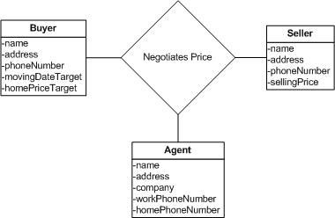
Link Attributes (8.1.4)
Enable complex relationships
Useful for many-to-many relationships
  Allows attributes on the association itself.

Slide 7
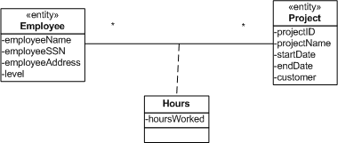
Association Classes (8.1.5)
An alternative to Link Attributes
Allows a full class (not just attributes) to model the relationship between two other classes

Slide 8
Composition and Aggregation (8.2)
Composition
  Parts of a composition can only belong to a whole.
  All the parts live and die together, with the whole.
  Marked by a shaded diamond on the connector.
Aggregation
  Parts can be added and removed.
  Typically more conceptual than compositions.
  Marked by a clear diamond on the connector.

Slide 9
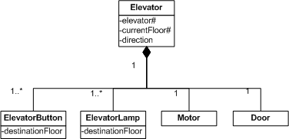
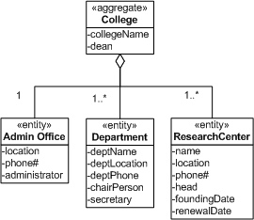
Composition and Aggregation Examples (8.2)
Composition
Aggregation

Slide 10
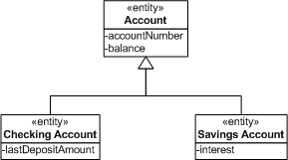
Generalization and Specialization (8.3)
Used to show similarities between classes
  The similarities are abstracted into a generalization class.
  Depicts an is-a relationship.
Superclass
Subclass
Subclass

Slide 11
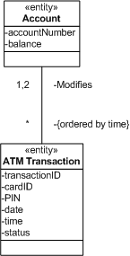

Constraints (8.4)
Specify conditions or restrictions that must be true.
Can constrain attributes or associations.

Slide 12
Static Modeling – Problem Domain (8.5)
COMET initially emphasizes modeling:
  Physical Classes
    Have physical characteristics (i.e. real-world objects)
    Include devices, users, external systems, and timers
  Entity Classes
    Long-lived, conceptual, data-intensive classes.
    In a banking example, this would include things like accounts and transactions.

Slide 13
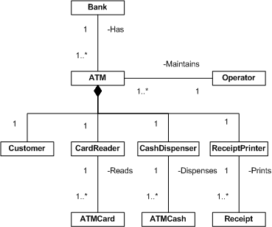
Physical Classes Example (8.5)

Slide 14
Static Modeling – System Context (8.6)
Depicts the relationship between the system and it’s environment.
Can be developed using actors or inputs and outputs.
Use UML Stereotypes to model:
  <<system>> for the system.
  <<external…>> for classes in the context.
    IO
    Timer
    System
    User

Slide 15
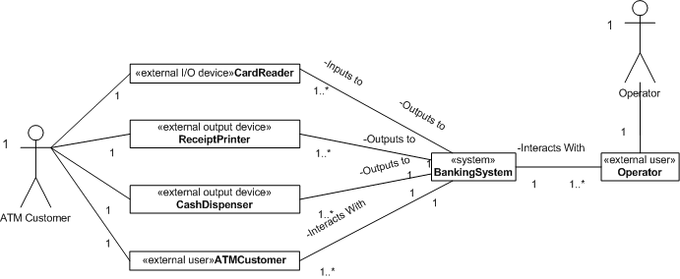
System Context Example (8.6)

Slide 16
Static Modeling – Entity Classes (8.7)
Entity Classes are long-lived, data-intensive classes.
Store persistent data that is used by multiple use-cases.
Often mapped to database and storage mechanisms in the design phase.

Slide 17
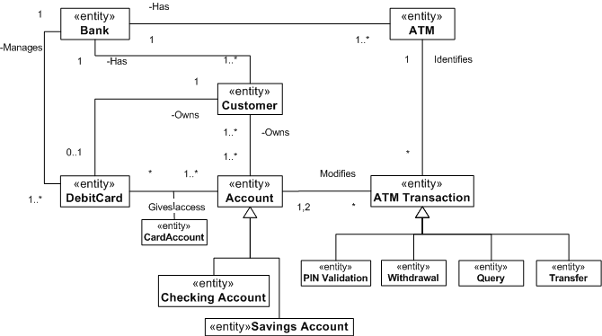
Entity Classes Example (8.7)

Slide 18
Summary (8.8)
Static Models are depicted on class diagrams.
Classes may be related by:
  Association
  Aggregation/Composition
  Generalization/Specialization
COMET Emphasizes modeling:
  Physical classes
  System context
  Entity classes

