Slide 1
Dynamic Modeling
Chapter 11
Part of Analysis Modeling
Designing Concurrent, Distributed, and Real-Time Applications with UML
Hassan Gomaa (2001)

Slide 2
Dynamic Modeling
Addresses the dynamic, or behavioral, aspects of a system.
Both Inter- and Intra- object interactions are considered.
Intra-object Statecharts.
Inter-object Interaction Diagrams
Produces a Dynamic Model

Slide 3
Dynamic Model
Includes:
Interaction Diagrams
Collaboration Diagrams
Sequence Diagrams
Message Sequence Description
Statechart Diagrams (if needed)

Slide 4
Overview of Dynamic Modeling
Review of Interaction Modeling
What the different types of interaction diagrams look like
How to choose which to use.
How to perform Dynamic Analysis in COMET
Determining which objects to include in the dynamic model.
Comparison of state vs. non-state oriented dynamic analysis.

Slide 5
Object Interaction Modeling
Objects and Messages are represented on an Interaction Diagram
Objects are instances of classes
Messages consist Events coupled with the data that accompanies them, or their attributes.
message = event (attributes)
e.g.: ATM Card Inserted (Card ID, Expiration Date)
Messages represent data passed from one object to another.
Messages may or may not trigger actions

Slide 6
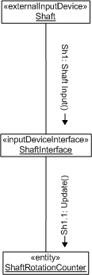
Collaboration Diagrams
Collaboration diagrams depict messages going from one object to another.
Messages should have sequence numbers to indicate order.

Slide 7
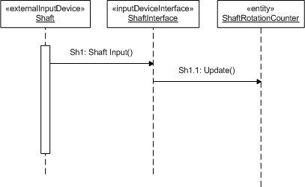
Sequence Diagrams
Sequence Diagrams capture time sequence of interactions between objects.
Because the diagram depicts the time sequence, message sequence numbers are not necessary, but my be included.
Note that the lifelines are dashed – we do not determine object lifecycles in the analysis modeling phase.

Slide 8
Collaboration vs. Squence
Only one or the other is needed.
COMET prescribes a slight preference for collaboration diagrams.
An important part of design modeling is synthesizing the collaboration diagrams – hence collaboration diagrams must be created for all sequence diagrams anyways.
During the analysis modeling, COMET emphasizes capturing the information passed from one object to another, rather than the action taken when a message arrives.

Slide 9
What Interaction Diagrams Show
Scenarios of Use Cases
A Scenario is a particular path through a Use Case.
Alternative paths may be selected based on conditions.
Generic interaction diagrams show all scenarios.
Instance interaction diagrams show a single scenario.

Slide 10
Message Labels
Message labels take the following form:
sequence expression: message name (attributes)
Sequence Expressions may include:
Message Sequence Number
Recurrence
Iteration
Condition
Attributes are arguments, data, or parameters sent with the message
e.g.: 2.6 [Valid]: Valid PIN

Slide 11
Message Sequence Numbering
Message sequence numbers in COMET consist of:
[first optional letter sequence] [numeric sequence] [second optional letter sequence]
e.g.:
A1
1a
Use1.3invalid

Slide 12
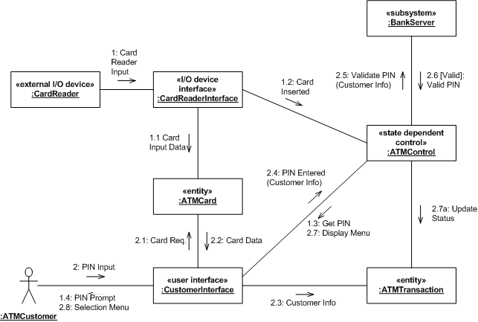
Message Labeling (example)

Slide 13
Message Sequence Description
The message sequence description is a narrative describing the interactions on an interaction diagram.
Typically used to provide additional information that is not easy or appropriate to represent on the interaction diagrams.

Slide 14
Dynamic Analysis
Determines how analysis model objects interact with each other.
Begins with a Use Case
The sequence of internal interactions started by external inputs defined in a Use Case are “followed” through the system to eventual system output.
Is Iterative.
First objects associated with a use case are identified.
Then their interactions are considered and re-considered.

Slide 15
Non-State Dependent Dynamic Analysis
Determine interface object(s).
Determine internal objects.
Determine object collaboration.
Consider alternative sequences.
Notes:
Determine interface object(s).
How do the actor(s) involved interact with the system?
Determine internal objects.
What parts of the system need to be a part of this interaction?
Determine object collaboration.
How do all the objects interact with each other to accomplish the use case?
Consider alternative sequences.
What other ways might the objects interact if the input varies?

Slide 16
Non-State Dependent Dynamic Analysis (example)
Use Case Name: View Workstation Status
Actor: Factory Operator
Summary: Factory operator views the status of one or more workstations
Precondition: Factory operator is logged in.
Description: Factory operator requests view of the status of one or more factory workstations. The request may be made on demand, or by subscription to receive notification of status changes.
Alternatives: Factory workstation is down. Warning message is displayed.
Postcondition: Workstation status has been displayed.

Slide 17
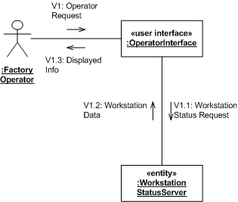
Non-State Dependent Dynamic Analysis (example, cont)

Slide 18
State-Dependant Dynamic Analysis
Determine Objects and Interactions.
Determine the interface object(s).
Determine the state-dependant control object(s).
Determine other internal objects.
Determine object collaboration.
Execute the Statechart.
Consider Alternative Sequences.

Slide 19
Executing the Statechart
For each state transition caused by a message, determine all the actions that result from the change in state and the objects that execute the identified actions and activities.
For each triggered or enabled object, determine the messages generated and their destinations.
Show the determined internal and external messages on both the statechart and the interaction diagram.

Slide 20
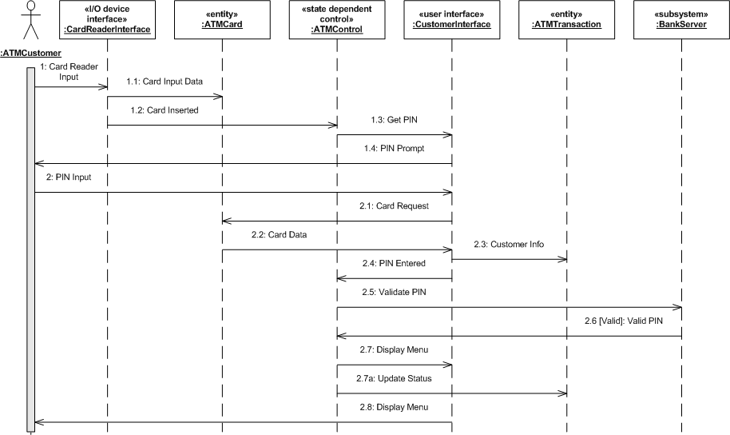
State-Dependant Dynamic Analysis (banking example)
Determine the main sequence:

Slide 21
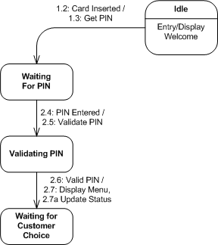
State-Dependant Dynamic Analysis (banking example, cont)
Execute the statechart

Slide 22
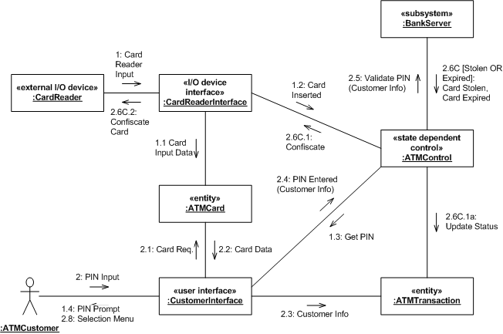
State-Dependant Dynamic Analysis (banking example)
Determine Alternative Sequences

Slide 23
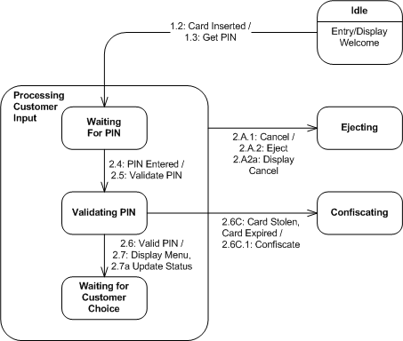
State-Dependant Dynamic Analysis (banking example)
Refine the statechart to include alternative sequences.

Slide 24
Summary
Dynamic Analysis determines how objects interact to accomplish Use Cases.
The Dynamic Model consists of:
Interaction Diagrams (Collaboration or Sequence)
Statechart Diagrams (if necessary)
Message Sequence Descriptions

Slide 25
Summary (cont)
Dynamic Analysis can be state or non-state dependent.
Dynamic Analysis consists of:
Determining external and internal objects.
Determining object collaborations.
Considering alternative sequences.

