Slide 1
Object and Class Structuring
Chapter 9
Part of Analysis Modeling
Designing Concurrent, Distributed, and Real-Time Applications with UML
Hassan Gomaa (2001)

Slide 2
Object and Class Structuring
First attempt at determining the software objects in the system.
Emphasis on objects modeling real-world and entity objects
Determines and Categorizes the software interfaces to the objects developed in the Static Modeling phase.
The beginnings of the Dynamic Model

Slide 3
Object Structuring Criteria
No uniquely correct decompositions of a system.
Analytical Judgment
Problem Characteristics
Problem Domain
Provide guidance for structural decisions.

Slide 4
Categorizing Application Classes
Recall that objects are instances of classes.
Interface Objects
Represent connections to the external environment of the system.
Device Interface Objects connect to a hardware I/O device.
User Interface Objects provide for human user interaction.
System Interface Objects represent external systems or subsystems.
Entity Objects
Long living information stores.

Slide 5
Categorizing Application Classes (cont)
Control Objects
Provide coordination for other objects
State-dependant Control Objects
Timer Control Objects
Coordinator Objects
Application Logic Objects
Contain application details
Business Logic Objects represent the general logic of the system.
Algorithm Objects encapsulate any special algorithms that may be used by the system.

Slide 6
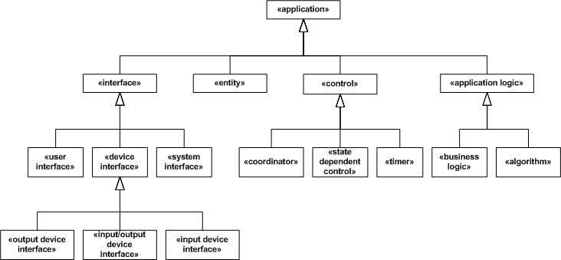
Categorizing Application Classes (cont)

Slide 7
External and Interface Classes
External classes represent objects outside the system.
Interface classes represent the connection between external classes and the system.
Interface classes are part of the system; External classes are not.

Slide 8
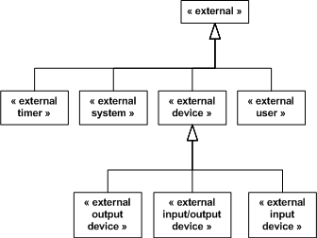
Categorizing External Classes
Timers
Devices
Input
Output
Input/Output
Systems
Users

Slide 9
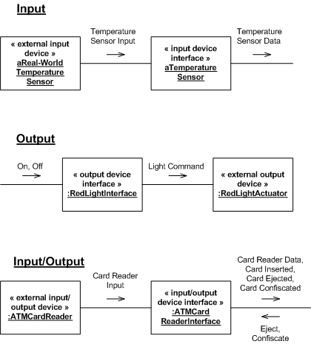
Device Interface Objects
Represent external sensors, actuators, etc.

Slide 10

User Interface Objects
Generally assume the presence of standard I/O objects controlled by the operating system.
May be complex GUI’s or simple CLI’s
May be a composite of many smaller smaller user interfaces.

Slide 11

System Interface Objects
Represent connections to other systems:
External Systems
Subsystems

Slide 12
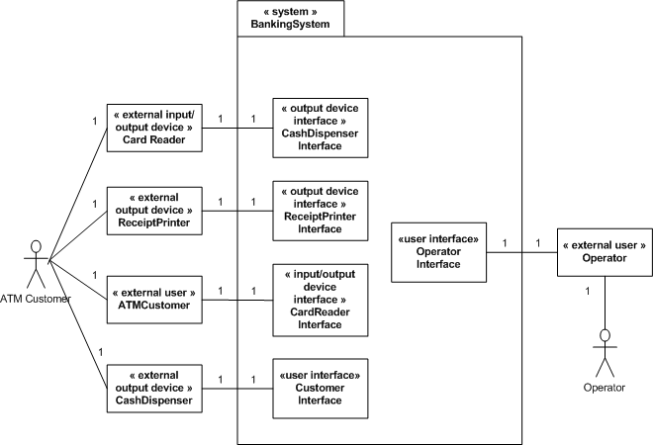
Interface and External Objects

Slide 13
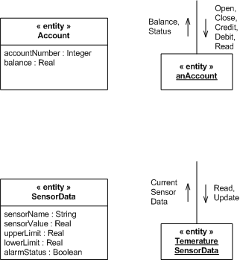
Entity Objects
Recall that Entity Objects are long living.
Used by many use cases.
Store information that persists across use cases.
Entity objects are instances of the entity classes developed in the Static Modeling phase.
Encapsulate data to limit access.

Slide 14
Coordinator Control Objects
Make decisions regarding overall sequencing for a collection of objects.
Coordinate the actions required for a use case.
Decides purely on the input given.
i.e. not a state machine.

Slide 15
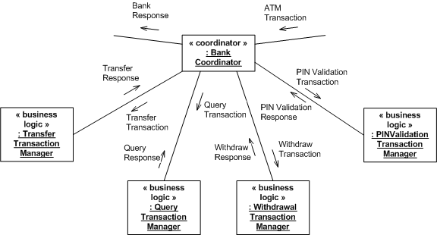
Coordinator Control Objects (example)

Slide 16
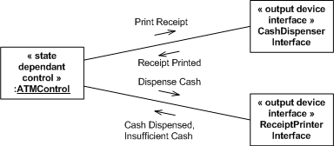
State-Dependant Control Objects
Make decisions based on both inputs at current state.
The behavior changes based on the state of the control object.

Slide 17
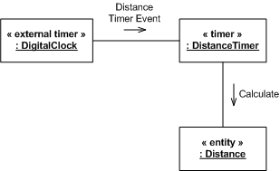
Timer Control Objects
Timer Control Objects are activated by external timers.
Timer Control Objects either perform an action themselves, or activate another object to perform the action.

Slide 18
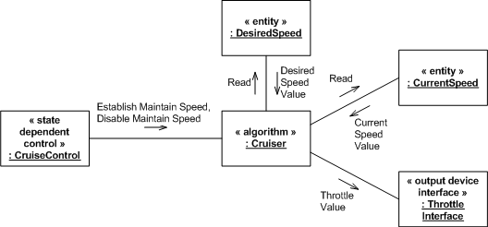
Application Logic Objects
Business Logic Objects
Not always necessary for very simple business logic.
Algorithm Objects
Encapsulates special algorithms
Allows the algorithm to change with minimal effort if needed.

Slide 19
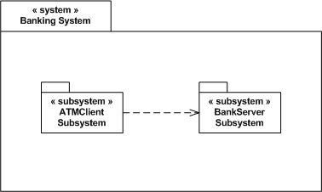
Subsystems
Objects that share functional dependencies are best placed in a subsystem.
The Use Cases can be a good place to start if the subsystem divisions are not obvious.
In COMET, packages are used to show subsystems.

Slide 20
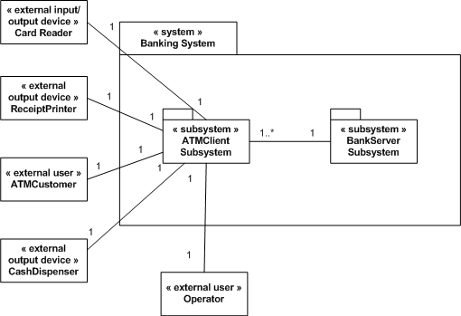
Subsystems Example

Slide 21
Summary
Application Classes can be categorized into 4 broad categories:
Interfaces
Entities
Controls
Application Logic
The relationship between application classes can be represented using collaboration diagrams

Slide 22
Summary (cont)
Subsystems can be used to group objects for increased abstraction.
Objects can be separated into packages by Use Case if no other divisions are readily available.

