Slide 1
COMET Overview
Chapter 6
Designing Concurrent, Distributed, and Real-Time Applications with UML
Hassan Gomaa (2001)

Slide 2
What is COMET?
Concurrent Object Modeling and architectural design mEThod
COMET is a design method
For concurrent applications
Especially real-time and distributed applications
The COMET software life cycle is compatible with USDP (Unified Software Development Process)

Slide 3
COMET Software Lifecycle (6.1)
A highly iterative process
Focuses on the use case concept
Functional requirements are recorded in terms of actors and their use of the system, collected into use cases.
A use case is a series of interactions between one or more actors and the system

Slide 4
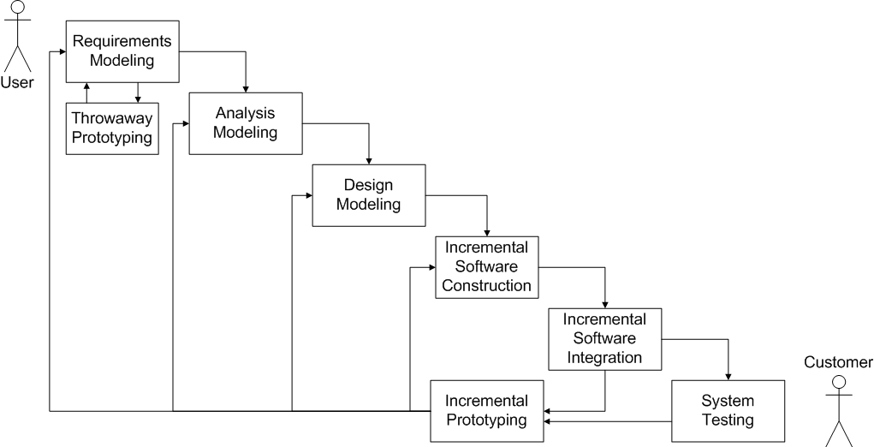
COMET Software Lifecycle (6.1)

Slide 5
COMET Modeling (6.1.1-2)
Requirements Modeling
Use cases are generated, and serve as the requirements for the system.
Throwaway prototypes can help to clarify the requirements.
Analysis Modeling
Static Models
Class Diagrams show the classes of the problem domain.
Dynamic Models
Show the problem domain objects participating in use cases.

Slide 6
COMET Modeling (cont.; 6.1.3)
Design Modeling
Design of the software architecture
Problem Domain is mapped to Solution Domain
Subsystems are identified and designed
Emphasis is on distributed subsystems that communicate with each other via messages.
Concurrent tasking concepts have to be taken into account, in addition to Object Oriented concepts.

Slide 7
Incremental Prototyping (6.1.4-5)
After modeling, the software subsystems are incrementally constructed and integrated into incremental prototypes.
A phased, iterative approach
Build and test a little at a time.
If significant problems are testing, a return to the modeling phases is in order.

Slide 8
System Testing (6.1.5)
When the incremental prototype is to be turned over to the customer, it must first undergo system testing.
The use cases of the requirements model are tested black box, ensuring the software meets specifications.

Slide 9
COMET vs. USDP (6.2.1)
Directly compatible with COMET
The first three phases even have same names!
USDP’s Testing phase is broken into COMET’s Incremental Integration and System Testing phases
These activities should be performed by separate teams.
Incremental Integration -> Development Team
System Testing -> Testing Team

Slide 10
COMET vs. Spiral Method (6.2.2)
The technical activity (third) quadrant of the Spiral Method can be either:
Requirements Modeling
Analysis Modeling
Design Modeling
Incremental Software Construction
Incremental Software Integration

Slide 11
Modeling Activities in COMET
COMET defines the modeling phases thus:
Requirements: defining the function of the system.
Analysis: Decomposing the the problem for better understanding.
Design: Synthesizing the solution into a complete system.

Slide 12
Requirements Modeling Activities (6.3.1)
Developing black-box use cases

Slide 13
Analysis Modeling Activities (6.3.2)
Static Modeling
Object Structuring
Finite State Machine Modeling
Dynamic Modeling

Slide 14
Design Modeling Activities (6.3.3)
Consolidate object collaboration diagrams.
Decide the subsystems and their relationships.
Decide the distribution of subsystems.
Characterize the objects as active (tasks) or passive.
Structure subsystems into concurrent tasks.

Slide 15
Design Modeling Activities (cont.; 6.3.3)
Determine if messages should be asynchronous or synchronous.
Determine the class interfaces.
Including information that will be hidden
Develop a detailed design of the software.
Task synchronization and communication
Internal design of the concurrent tasks

Slide 16
COMET in a Nutshell (6.4.1-2)
Develop Requirements Model
Develop use case model
Develop use case diagrams depicting the actors and use cases, and define the relationships between them. Packages may be used to group functional areas.
Document each use case with a use case description (i.e. a narrative description of the use case)
Develop Analysis Model
Develop static model of problem domain using classes, relationships, and attributes
Develop a static model class diagrams showing the physical classes in the problem and their relationships.
Develop a system context model class diagrams showing the external I/O of the system.
Develop a static model of the entity, or data-oriented, classes in the problem.
Define all classes in the class dictionary, which describes classes and attributes.

Slide 17
COMET in a Nutshell (cont; 6.4.2)
Optionally structure the system into additional classes and objects.
Develop a dynamic model, linking objects to use cases. For each use case:
Determine the models that participate in the use case.
Develop a collaboration or sequence diagram showing the interactions between the participating objects, analyzing the sequence of and information passed by the interactions.
Develop a state-chart for any state dependent objects.
Develop message descriptions for each interaction diagram.

Slide 18
COMET in a Nutshell (cont ; 6.4.3)
Develop Design Model
Synthesize artifacts from the analysis model into an initial software architecture. If problems are found, iterate through step 2 again
Synthesize state-charts
Synthesize a collaboration model
Synthesize a static model
Design overall software architecture
Design distributed component-based architecture
Design concurrent task architecture for each subsystem

Slide 19
COMET in a Nutshell (cont ; 6.4.3)
Design the concurrent task architecture for each subsystem
Structure subsystems into concurrent tasks.
Define the tasks and their interfaces.
Develop concurrent collaboration diagrams for each subsystem.
Document the design of each task in a task behavior specification.
Analyze the real-time performance of the design.
Design the classes in each subsystem.
Develop

Slide 20
COMET in a Nutshell (cont ; 6.4.3)
Develop the detailed design of each subsystem.
Design the internals of composite tasks.
Design the details of task synchronization.
Design the connector classes for inter-class communication.
Design and document each task’s internal event sequencing logic.
Analyze the performance of the real-time design for each subsystem in greater detail (optional).

Slide 21
Summary (6.5)
COMET is a software design lifecycle and methodology.
COMET is highly iterative
The basic phases of COMET are:
Requirements Modeling
Analysis Modeling
Design Modeling
Incremental Software Construction
Incremental Software Design
System Testing

