Slide 1
Software Architecture Design
Chapter 12
Part of Design Analysis
Designing Concurrent, Distributed, and Real-Time Applications with UML
Hassan Gomaa (2001)

Slide 2
Software Architecture Design
Software Architecture refers to the decomposition of a system into subsystems
This is necessary for large-scale and complex software systems.

Slide 3
Software Architectural Styles
Software Architectural styles are recurring architectures used in a variety of applications.
  Client/Server Architecture
  Layers of Abstraction Architecture
  Communicating Tasks Architecture
The styles may be blended as necessary. They are not mutually exclusive!

Slide 4
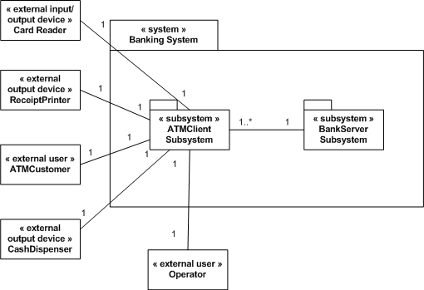
Client/Server Architecture
Sever provides services
Client consumes services
Widely used in distributed applications.

Slide 5
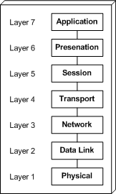
Layers of Abstraction Architecture
Each layer communicates only with the layers directly above and below itself.
  Each layer solves only part of a given problem.
E.g. Operating Systems, Database Management systems, and Network Systems

Slide 6
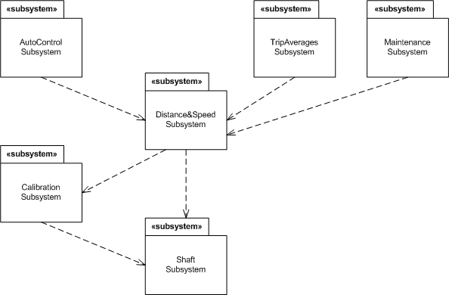
Communicating Tasks Architecture
Network of Concurrent tasks with separate threads of control.
With or without shared memory.
May or may not be on the same computational node.
Common in real-time systems.

Slide 7
System Decomposition Issues and Guidelines
Subsystems should be externally lowly-coupled and internally highly-coupled.
  This can help to determine which objects belong in which subsystem.
Separation of Concerns is the fundamental principle guiding decomposition.
Subsystems provide lower-resolution information hiding than objects.
If no obvious decompositions appear, consider the Use Cases.

Slide 8
Subsystem Decomposition Issues and Guidelines (cont)
Things to consider during separation of concern decomposing:
  Aggregate/Composite objects
  Geographical locations
  Clients and servers
  User interface
  External object interfaces
  Scope of control
  Entity objects

Slide 9
Consolidated Collaboration Diagrams
To begin the system decomposition process, and to transition from analysis to design, construct a consolidated collaboration diagram.
The consolidated collaboration diagram synthesizes all the collaboration diagrams used to support the use cases
  Message sequencing numbers are omitted to reduce clutter
  If the diagram is still too cluttered, multiple messages can be aggregated into one name.

Slide 10
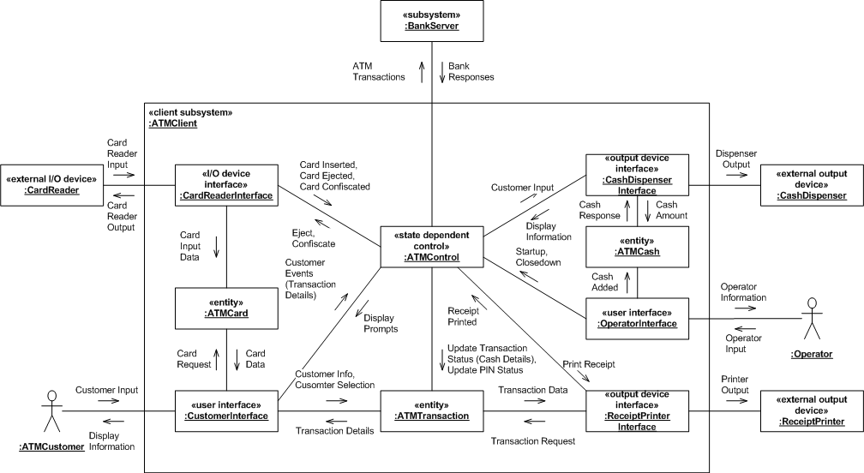
Consolidate Collaboration Diagram (example)

Slide 11
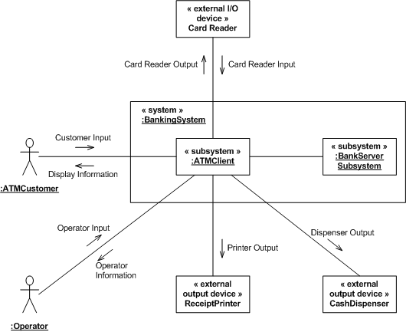
Subsystem Software Architecture
Subsystems may also be shown on subsystem collaboration diagrams.
This provides a high-level view of the collaborations within a system.

Slide 12
Subsystems in Concurrent, Real-time, and Distributed Applications
Concurrent, real-time, and distributed applications frequently have the following types of subsystems:
  Control
  Coordinator
  Data Collection
  Data Analysis
  Server
  User Interface
  I/O Subsystem
  System Services

Slide 13
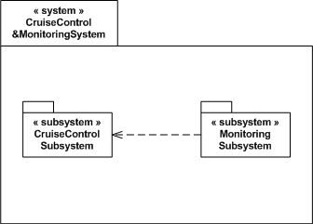
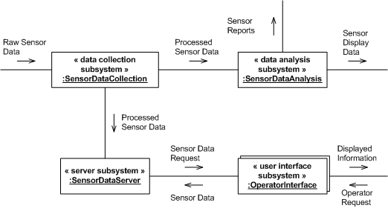
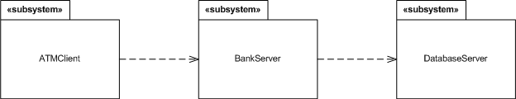
Subsystems in Concurrent, Real-time, and Distributed Applications (examples)

Slide 14
Design Analysis Static Modeling
A more detailed model is developed as part of solution design.
This static model may either refine the conceptual static model developed in the analysis modeling phase, or may be developed from the consolidated collaboration diagrams.
Further refinement considers the directional nature of class relationships.

Slide 15
Summary
Software Architectural Styles may be blended
  Client/Server
  Layered
  Communicating Tasks
Complex systems may be decomposed into subsystems with loose external coupling and high internal coupling.
Multiple criteria exist for subsystem decomposition.

