Slide 1
Electron Transport Chain
ETC

Slide 2
ETC
Consists of four protein-lipid complexes located in the inner membrane of the mitochondrion.
These complexes aid in the transfer of electrons to oxygen.
Electrons are most commonly transferred in association with hydrogen atoms or hydride (H-) ions.

Slide 3
Goal of the ETC
Reducing equivalents containing a high-energy hydrogen and electron pair gain entry to the beginning of the chain.
The hydrogen and electron then move from areas of electronegativity (NAD+) towards areas of electropositivity (atomic oxygen).
Produce ATP

Slide 4
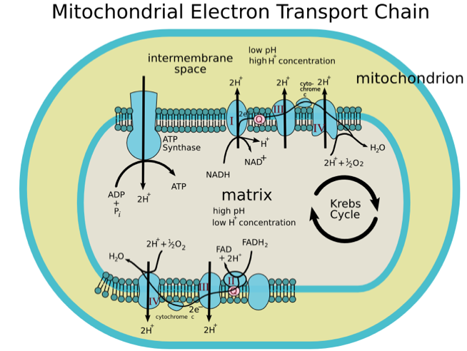
ETC
Notes:
Complex I NADH Dehydrogenase: electrons transferred from NADH through complex I to coenzyme Q result in proton pumping. Proton pumping means that the protons are transported across the inner membrane against both an electrical and a concentration gradient.
Complex II Succinate Dehydrogenase: removes electrons from succinate and transfers them to ubiquinone via FAD.
Complex III Q-Cytochrome c oxidoreductase: transfers electrons from reduced coenzyme Q (QH2) to cytochrome c.
Complex IV Cytochrome c Oxidase: removes two electrons from the two molecules of cytochrome c and transfers them to molecular oxygen, producing water.

Slide 5
ATP and the ETC
2 ATP are produced per glucose molecule in the cytoplasm.
For every molecule of NADH, 3 ATP are produced. For every molecule of FADH, 2 ATP are produced.
Glycolysis yields 4-6 ATP’s in the mitochondria in addition to the two formed in the cytoplasm.
Together with the ATP formed in the TCA cycle and the ATP produced as the result of reducing equivalents donated from the TCA cycle to the ETC, the ATP yield per glucose is 36 to 38 molecules of ATP.
Notes:
Remember 2 ATP’s go into glycolysis and 4 ATP’s are produced in glycolysis. (-2+4=2 total from glycolysis)

Slide 6
Summary of Cellular Respiration
Net number produced (+) or consumed (-) by each reaction | Glycolysis | Pyruvate decarb-oxylation | Beta-oxidation (ex: 16-C Palmitic Acid) | TCA cycle | Electron Transport Chain | Total
ATP | +2 | 0 | -2 | +2 | +34 | +38/ 96
Glucose | -1 | 0 | 0 | 0 | 0 | -1
NADH | +2 | +2 | +7 | +6 | -10/-17 | 0
Acetyle- CoA | 0 | +2 | +8 | -2/-10 | 0 | 0
CO₂ | 0 | +2 | +2 | +4 | 0 | +6
Pyruvate | +2 | -2 | 0 | 0 | 0 | 0
FADH₂ | 0 | 0 | +7 | +2 | -2/-9 | 0
O₂ | 0 | 0 | 0 | 0 | -6 | -6
Notes:
Pyruvate decarboxylation: pyruvate is actively transported from the cytosol into the mitochondrial matrix for decarboxylation. Pyruvate decarboxylation is catalyzed by the mitochondrial enzyme, Pyruvate dehydrogenase (PDH)
The Amount of energy from beta oxidation is dependent upon the fatty acid. For example, from the 16-carbon palmitic acid, the yield is 8 acetyl CoA, 7 FADHs, and 7 NADH. If you do an ATP yield analysis from the oxidation of a fatty acid, remember to account for the fact that formation of fatty acyl CoA cost the equivalent of two ATP. Palmitic acid could produce up to 96 ATPs, a TG made from three palmitic acids could produce 3 times this many (not including the ATP yield from glycerol molecule.) (Professor Linton, 2008)
How many ATP are produced is dependent upon the fatty acid, more energy in fat molecule than glucose.

