Slide 1
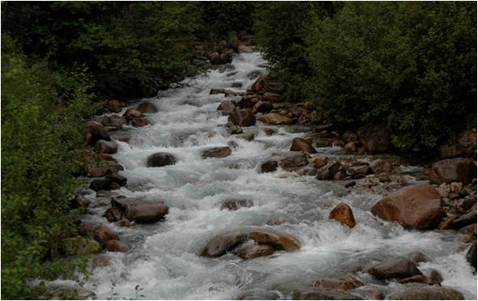

Agricultural Affect on Our Streams
Liz Lauer
Devon Fore
Melanie Bias

Slide 2
What is agriculture?
Agriculture is the practice of cultivating the land and raising live stock, both of which affect the watershed.

Slide 3
What is watershed?
Watershed is the entire geographical area drained by a river and its tributaries.

Slide 4
How do they affect each other?
Watershed and agriculture affect each other greatly. The health of a watershed can be dependent on agriculture.
The chemical levels of a watershed can be raised or lowered because of agriculture. The animals on the farm can affect watershed so can how often the land is harvested and whether or not the farm has a riparian buffer and is keeping it in good healthy shape

Slide 5
How do they affect each other cont.
The chemical levels of a watershed can be raised or lowered because of agriculture. The animals on the farm can affect watershed so can how often the land is harvested and whether or not the farm has a riparian buffer and is keeping it in good healthy shape.
Notes:
.

Slide 6

Manure Management
Manure run-off in streams can affect the clarity of the water.
Pathogens-can make water unsafe to drink
Manure “soup” can cause Algae Blooms
Affect the underwater habitat for fish and MBI’s
Can cause illnesses in animals

Slide 7
Manure Management Cont
Contamination of the water plants can occur
E. Coli can be found in the water
Cryptosporidium is a single celled organism that is found in manure that may end up in the water

Slide 8
Manure Management Cont.
To help the amount of run-off farmers are taking to a plan of how much nutrients their giving their livestock.
To reduce the amount of phosphorus in the manure farmers are changing the supplements in the feed

Slide 9
Pollution
Everyday activities can generate pollutants. Examples besides agriculture are construction sites, septic systems and roadways.
Sediments, oils, salt organic matter, pesticides, and fertilizers ( from the stores and even cows) can run off into nearby rivers or streams.

Slide 10
Pollution
The biological balance of the watershed can be negatively affected by these pollutants. It can cause cloudy water, weed growth, and increases in algae.

Slide 11
How to help solve this pollutant problem.
The term Riparian Buffer is used to describe lands adjacent to streams where vegetation is strongly influenced by the presence of water.
Agriculture can lead to a large amount of run off, which is why a riparian buffer can help keep a stream healthy.
They help prevent harmful sediments from manure ( E Coli) that the cows can produce.

Slide 12
How to help solve this pollution problem cont.
Besides the cow’s fertilizers, and the run off being a problem for our watersheds there is also a problem with farms destroying things that keep the rivers safe.
When farmers expand land the can take away natural buffers that are very important to the farm.

Slide 13
How to solve the pollution problem cont.
Farming can use up a good part of the watersheds and the areas around its nutrients. The soil is important and over faming can be harmful to the land and streams.
Another way to help maintain healthy streams are contour farming.

Slide 14
How to solve the pollution problem cont.
Contour farming is the practice of preparing land, planting crops, and cultivating them on a level or nearly level contour around a slope.
By practicing this type of farming you can cut run of harmful chemicals by 50 %.
Agriculture is a big part of West Virginia, it affects everything from watershed to development.

Slide 15
Mill Creek Data
Temperature: 5.5 Celsius
pH: 7.5
Conductivity: 680 us
Dissolved Oxygen: 10 ppm
Nitrate/Nitrite: 0 ppm
Alkalinity: 275 ppm
Turbidity: 0 JTU
Bacteria (Fecal/E-coli): na/na
Phosphate: 1 ppm
Phosphates, DO , and bacteria levels are affected by cemeteries and agriculture.

Slide 16
Physical Conditions
Water Level: normal
  Water clarity: clear
  Water color: none
  Water odor: none
  Sediment odor: na
  Stream bed color: brown
  Surface foam: slight
  Algae color: light green/ brown
  Algae abundance: moderate
  Algae texture: even coating
  The algae hasn’t been affected by the cemeteries at all.

Slide 17
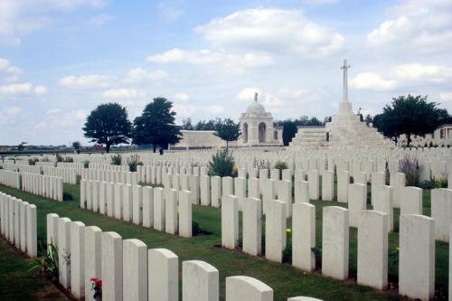
Cemeteries
Before and in the early 1920s the deceased were buried in wooden caskets. In the late 1900s they started to bury people in metal caskets.
The coffins that were made of wood would slowly start to decay. And the bodies are leaking phosphates out into the ground.
When they leak the phosphates it goes into the groundwater and causes algal blooms.

Slide 18
Cemeteries
The kind of algae that comes from the leaking phosphates is fast growing and blue green.
The blue green algae is not nutricous for the BMI and out-competes and replaces green algae and diatoms which are better food sources for the BMI and fish.

Slide 19
When the dark blue algae covers the surface it makes it impossible for the sunlight to get through to the plants on the bottom and then they die. If the plants die fish lose their source of food and shelter.

Slide 20
Cemeteries
Another problem that arises is the blue green algae becomes so numerous that it eventually dies and sinks to the bottom of the river. Bacteria decomposes the algae at the bottom of the river and takes the oxygen out of the water. Which is bad for the all of the aquatic animals and the DO levels.

Slide 21
Cemeteries cont
Cemeteries and agriculture can effect a river greatly it eventually along with over use of a river can lead to eutrophication.
Eutrophication is the natural process that occurs in an aging lake or pond. It can build up the nutrients in a lake to much.

Slide 22
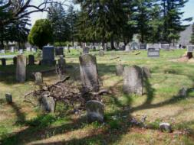
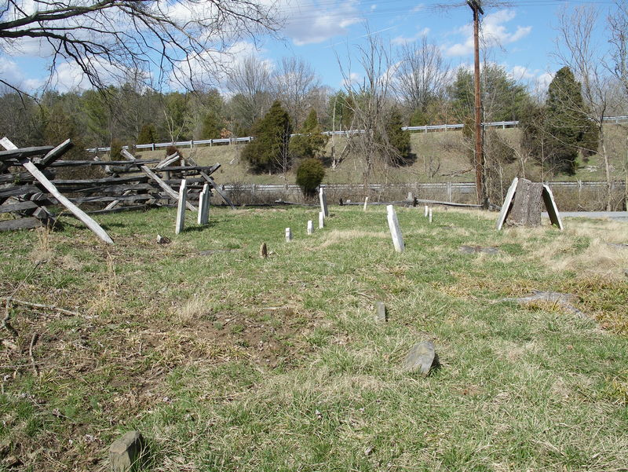
Pictures
This picture is Gerrardstown Presbyterian Church Graveyard.
This is a picture of a older cemetery .

Slide 23
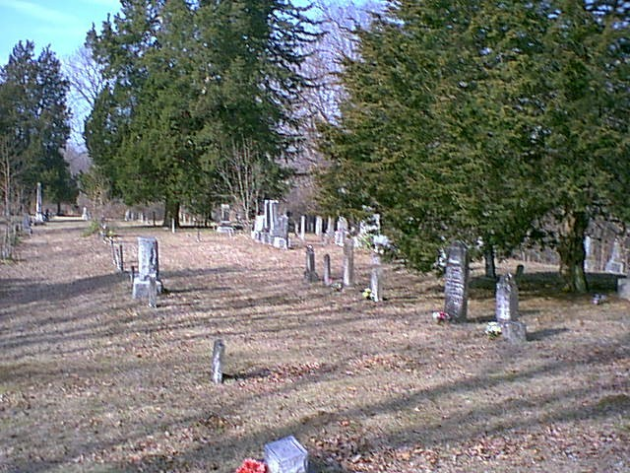
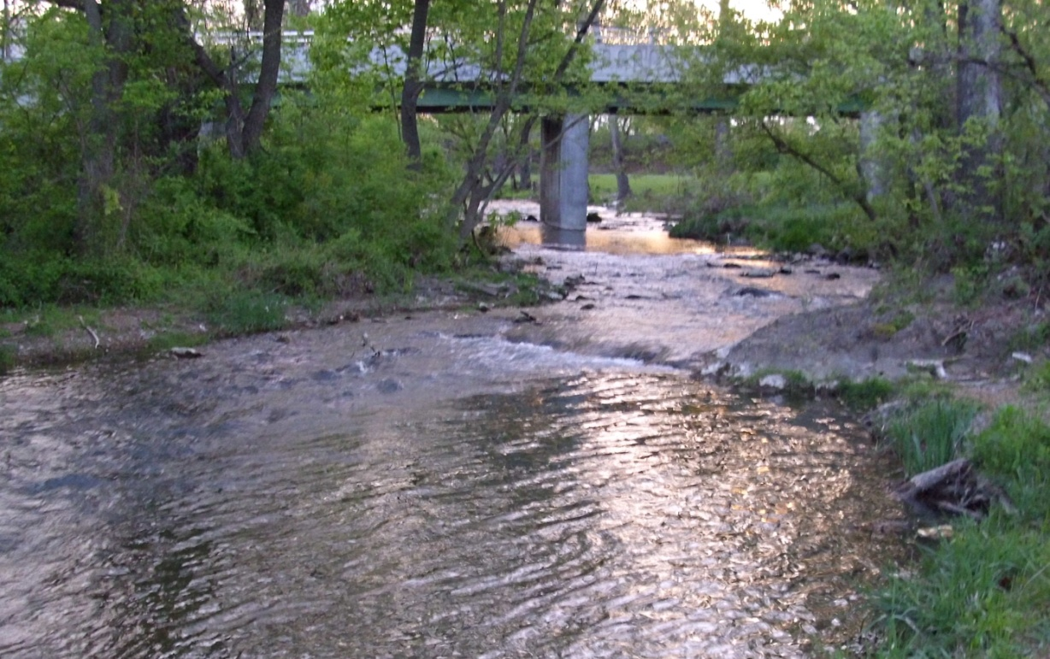
This is an older cemetery where erosion has taken place.
This is the Mill Creek River

Slide 24
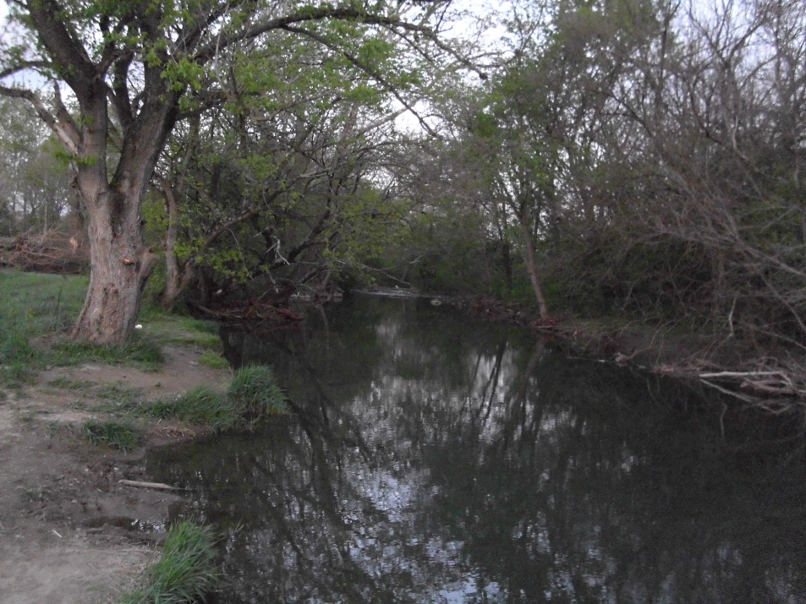
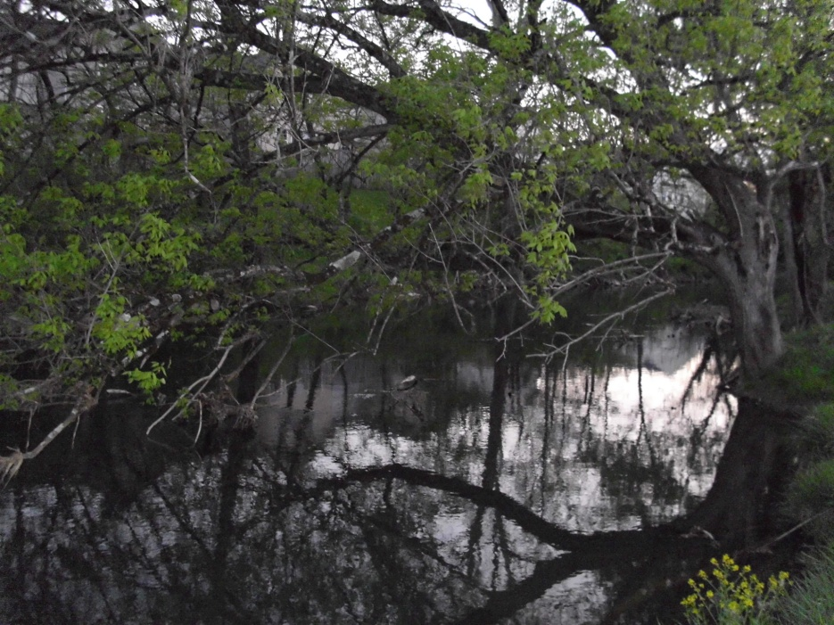
This is Mill Creek River watersheds where we planted trees.

Slide 25
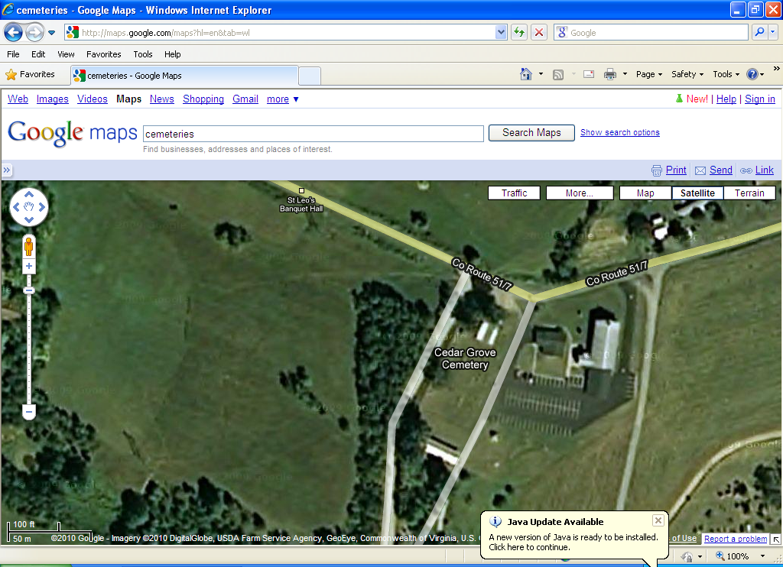
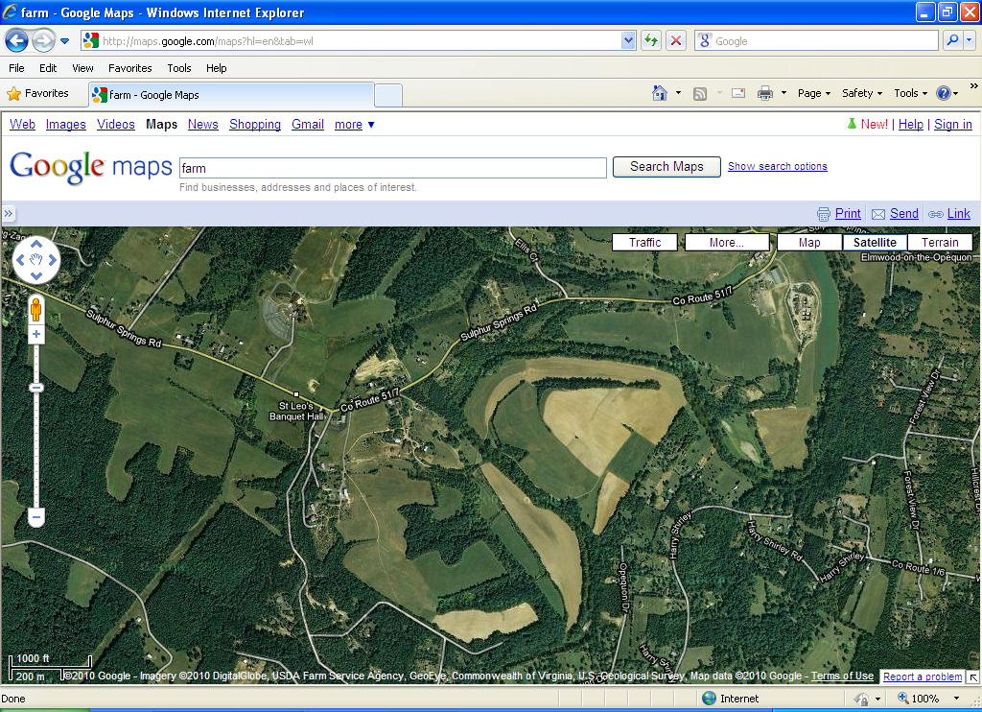
This picture is of a cemetery on Sulphur Springs Road, Cedar Grove Cemetery.
The second picture is on Sulphur Springs road. The farm is Sulphur Springs Stables.

Slide 26
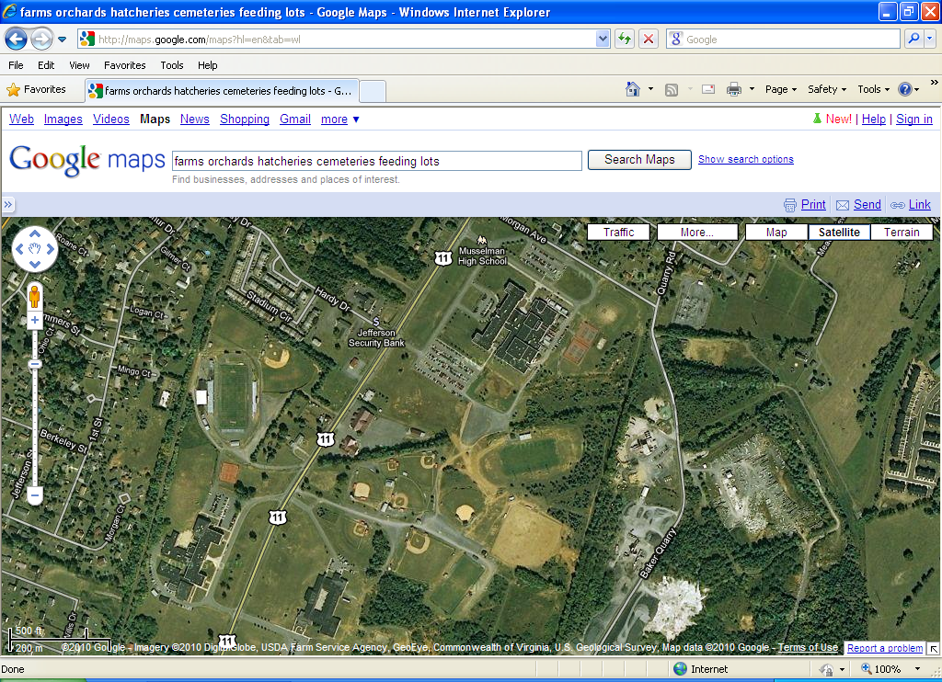
This is an satellite view of MHS and the surrounding areas, including some
of the farm areas. The picture also includes Jefferson Security Bank and
Other housing developments.

Slide 27
My World Information:
Area computed km2: 62,854.2358
Name: West Virginia
FIPS: 54
Farms:17,237
Average Farm (acre): 196
Total Cropland (acre):1,285,786
Sales per farm: 15,701
Population (humans): 1,808,344

Slide 28
Conclusion
As a group we were assigned to find out how agriculture and cemeteries affect watershed in our local areas such as Mill Creek and Opequon streams. Agriculture can have a big affect on all watersheds. Farmers can over farm their land which takes valuable nutrients out of the land that the streams need. To solve this problem farmers can spread out their harvesting or farm on hills. Another problem that farms can present is the chemicals that they use to kill weeds. these chemicals can get into run off and to the streams. Also cows on farms can spread diseases through their manure like E Coli. The nitrate, dissolved oxygen, and phosphate levels can be greatly affected by this. Another thing that isn’t often thought of that affects watershed and rivers chemical levels are cemeteries. Bodies used to be buried in wood caskets.

Slide 29
In older cemeteries bodies start to decompose and phosphates from the caskets seep into the ground water and into rivers. Older and bigger farms often have their own private cemeteries and the streams can have higher phosphate levels then public streams. Our Mill Creek and Opequen streams don’t seem to be greatly affected by agriculture and cemeteries but streams on farms and near older cemeteries are more at risk.

Slide 30
Bibliography
Cloern, J.E. 2001 “ Our evolving conceptual model of the coastal eutrophication problem: Marine Ecology Process Series v. 210
Marylin Gouge http://www.rootsweb.ancestry.com/~wvberkel/cemetery.html Berkely County West Virginia Cemetery List updated 2010
No author listed http://www.sciencebuzz.org Phosphorous in the River 2008
Connie Reeves, Chad Behrendt, Crystal Floyd http://www.extension.umn.edu/yardandgarden/ygbriefs/p443wooddecay.html “Plant Pathology” 2009
http://northmoutain.org/pictures March 28, 2010
Google Maps- Saint Leo the Great Cemetery 2109 Sulphur Springs Road, Ranson West Virginia, Sulphur Springs Stable, and Cedar Gove Cemetery.

