Slide 1
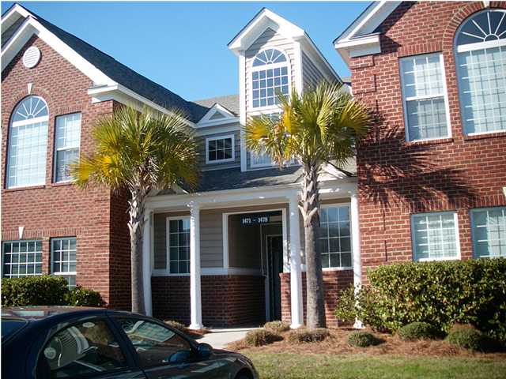
HOME
1. HDB Homes are more expensive than Condo.
YES
NO
2.Condo have the following Facilities: Swimming Pool, tennis court etc.
YES
NO

Slide 2
HOME
You`re Right

Slide 3
HOME
Wrong

