Slide 1
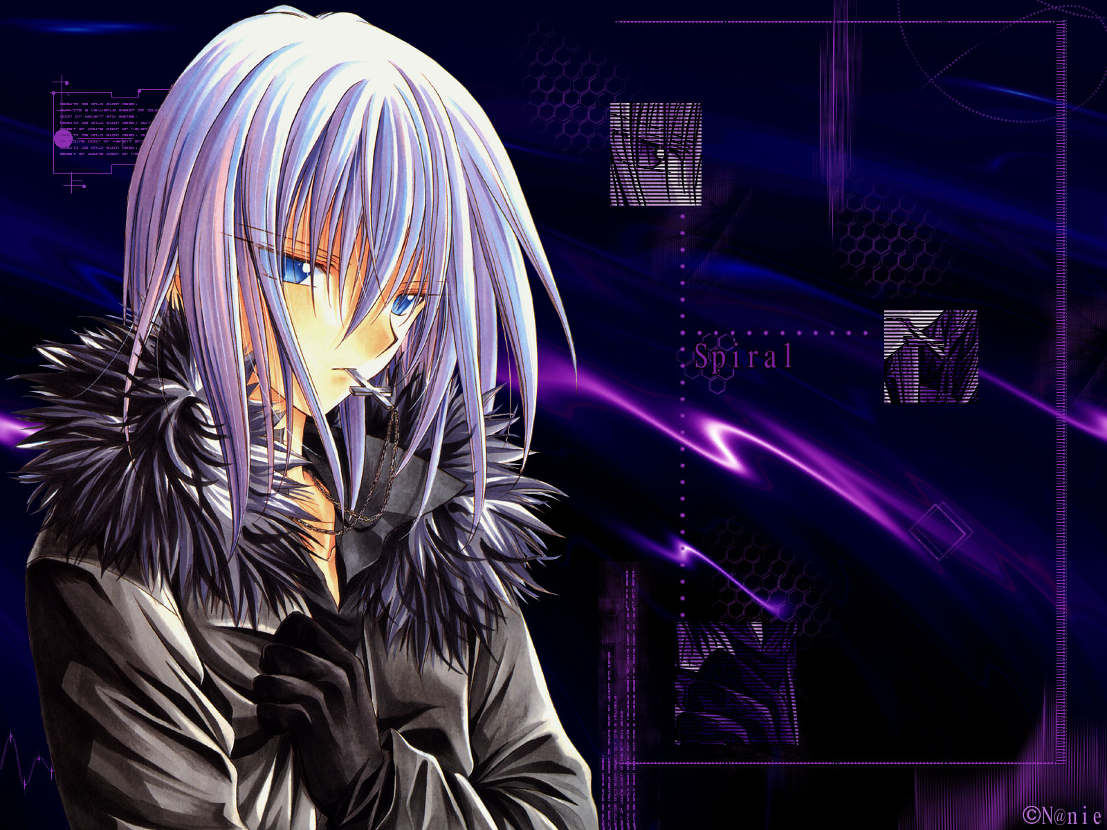
ANIME QUIZ
How Good are you?

Slide 2
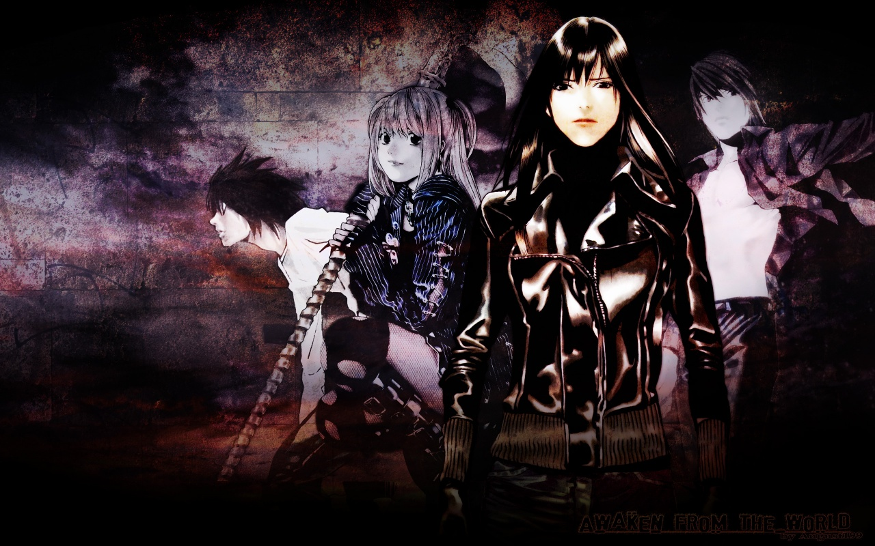
1. Death Note: Who is Misa in love with?
A : L
B : Light
C : W
D : Rem

Slide 3
CORRECT !!!!!!!!!!!! WELL DONE !!!!!!!

Slide 4
WRONG !!! PLEASE READ MORE !!!

Slide 5
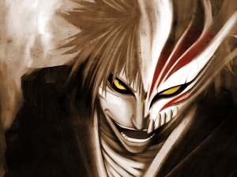
2. YU YU Hakusho: What is Kurama's
favorite weapon made from?
A : A Lily
B : A Yellow Rose
C : A Red Rose
D : A Cherry Blossom

Slide 6
CORRECT !!!!!!!!!!!! WELL DONE !!!!!!!

Slide 7
WRONG !!! PLEASE READ MORE !!!

Slide 8

3. Initial D: How many members of the
Red Suns did Tak defeat?
A : 6
B : 2
C : 3
D : 4

Slide 9
CORRECT !!!!!!!!!!!! WELL DONE !!!!!!!

Slide 10
WRONG !!! PLEASE READ MORE !!!

Slide 11
End Of Quiz!!
WELL DONE ALL!!

