Slide 1

Contemporary Research Design
A fresh look at new and traditional educational issues
Jolene Fitch, Brian Hart,
and Elijah Carter

Slide 2
Introduction
Review of the Research Design
Literature Review and Conceptual Framework
Method of Structured Inquiry
Sampling Plan and Frame
Review of Goals
Next Steps

Slide 3
RETURN TO CMAP

Slide 4
Comparing Methods
Experimental
Advantage:
Testing causal relationships
Disadvantage:
Often includes deception
Difficult to isolate variables in this instance
Survey
Advantage:
Ability to survey large groups economically and strong on reliability
Disadvantage:
Potential to be superficial and inflexible and weak on validity
(Babbie, 2011)
Qualitative
Advantage:
Focus group is somewhat systematic like a survey but benefiting from interviewing, high face validity, captures real-life data, helps generate subsequent survey questionnaires
Disadvantage:
Skilled moderators, amassing students, and locations

Slide 5
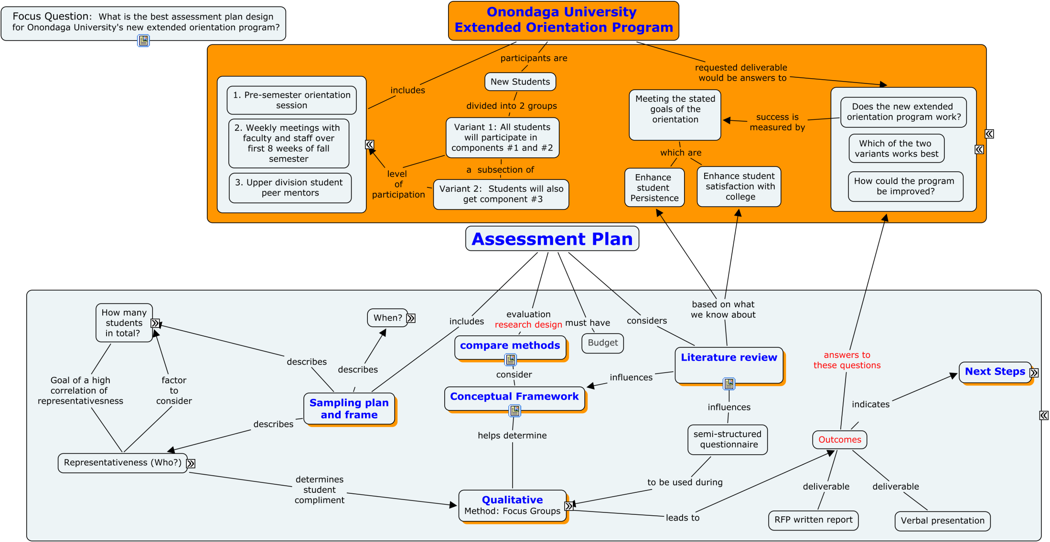

Slide 6
Literature Review
Student Satisfaction
  Pacarella and Terenzini (1991)
  Academic achievement, Persistence, and
  Satisfaction is:
  Correlated to time and energy students apply to learning and engagement

Slide 7
Literature Review
Student Persistence
Tinto (1975, 1987, 1993)
  Social and Academic integration
Astin (1993)
  Student Involvement
    Academics,
    relationships with faculty, and
    Interactions with student peer groups

Slide 8
Literature Review
Varied Pathways to Persistence
Diverse student populations (Tinto, 1993)
Traditional students find making friends most threatening (Terenzini, 1994)
Non-traditional students tend to delay involvement until secured in academics
(Terenzini, 1994)
Non-traditional students were motivated by validation from internal or external sources
(Rendon, 1994)

Slide 9
Literature Review
Varied Pathways to Persistence
“The overall level of student satisfaction
. . . And adjustment differed significantly
by race/ethnicity” (Laanan, 1996, 1998)

Slide 10
Literature Review
Tinto (1993)
  Different institutional rates of departure
    Structure of institutional academics and social systems
    Individual students are responsible for departure

Slide 11
Literature Review
Rendon, Jalomo, and Nora (2011)
Practitioners have focused on offering programs to get more students involved
Instead of
On what motivates students to get involved

Slide 13
Conceptual Framework
Our Research Plan Influenced by:
The structured inquiry of Tinto, Pascarella and Terenzini and others
Our Constructivist Perspective

Slide 14
Conceptual Framework
Constructivism
“all knowledge . . . Is contingent upon human practices being constructed in and out of interactions between human beings and their world . . . Theory and practice inform one another in a mutually shaping manner”.
(Broido & Manning, 2002, p. 436)

Slide 15
Conceptual Framework
Postmoderism (constructivist theory)
Lead to more complex understanding of college students.
Seek to describe the depth and diversity of students and their perspectives rather than the norm.
(Broido & Manning, 2002)

Slide 16
Conceptual Framework
“Knowledge claims must be set within the conditions of the world today and in the multiple perspectives of class, race, gender, and other group affiliations” (Creswell, 2008 as covered by Broido & Manning, 2002, p.438)

Slide 17
Conceptual Framework
Consistent with this paradigm
Our method will be qualitative research
  Provides more flexibility
  Deeper understanding

