Slide 1

Contemporary Research Design
A fresh look at new and traditional educational issues
Jolene Fitch, Brian Hart, and Elijah Carter

Slide 2
Overview
Review of the Research Design
Methods of Structured Inquiry
Literature Review and Conceptual Framework
Sampling Plan and Frame
Review of Goals
Next Steps

Slide 3
Our Understanding of the Program
Introduction to our Concept Map

Slide 4
Comparing Research Methods
Experimental
Advantage:
Testing causal relationships
Disadvantage:
Often includes deception
Difficult to isolate variables
Quantitative -Survey
Advantage:
Ability to survey large groups economically
Strong on reliability
Disadvantage:
Potential to be superficial
Potential to be inflexible
Weak on validity
Lower return rates
Qualitative
Advantage:
Focus group is somewhat systematic like a survey but flexible
High face validity, captures real-life data,
helps generate subsequent survey questionnaires
Speedy results
Disadvantage:
Skilled moderators
amassing students and locations
Difficult to analyze

Slide 5
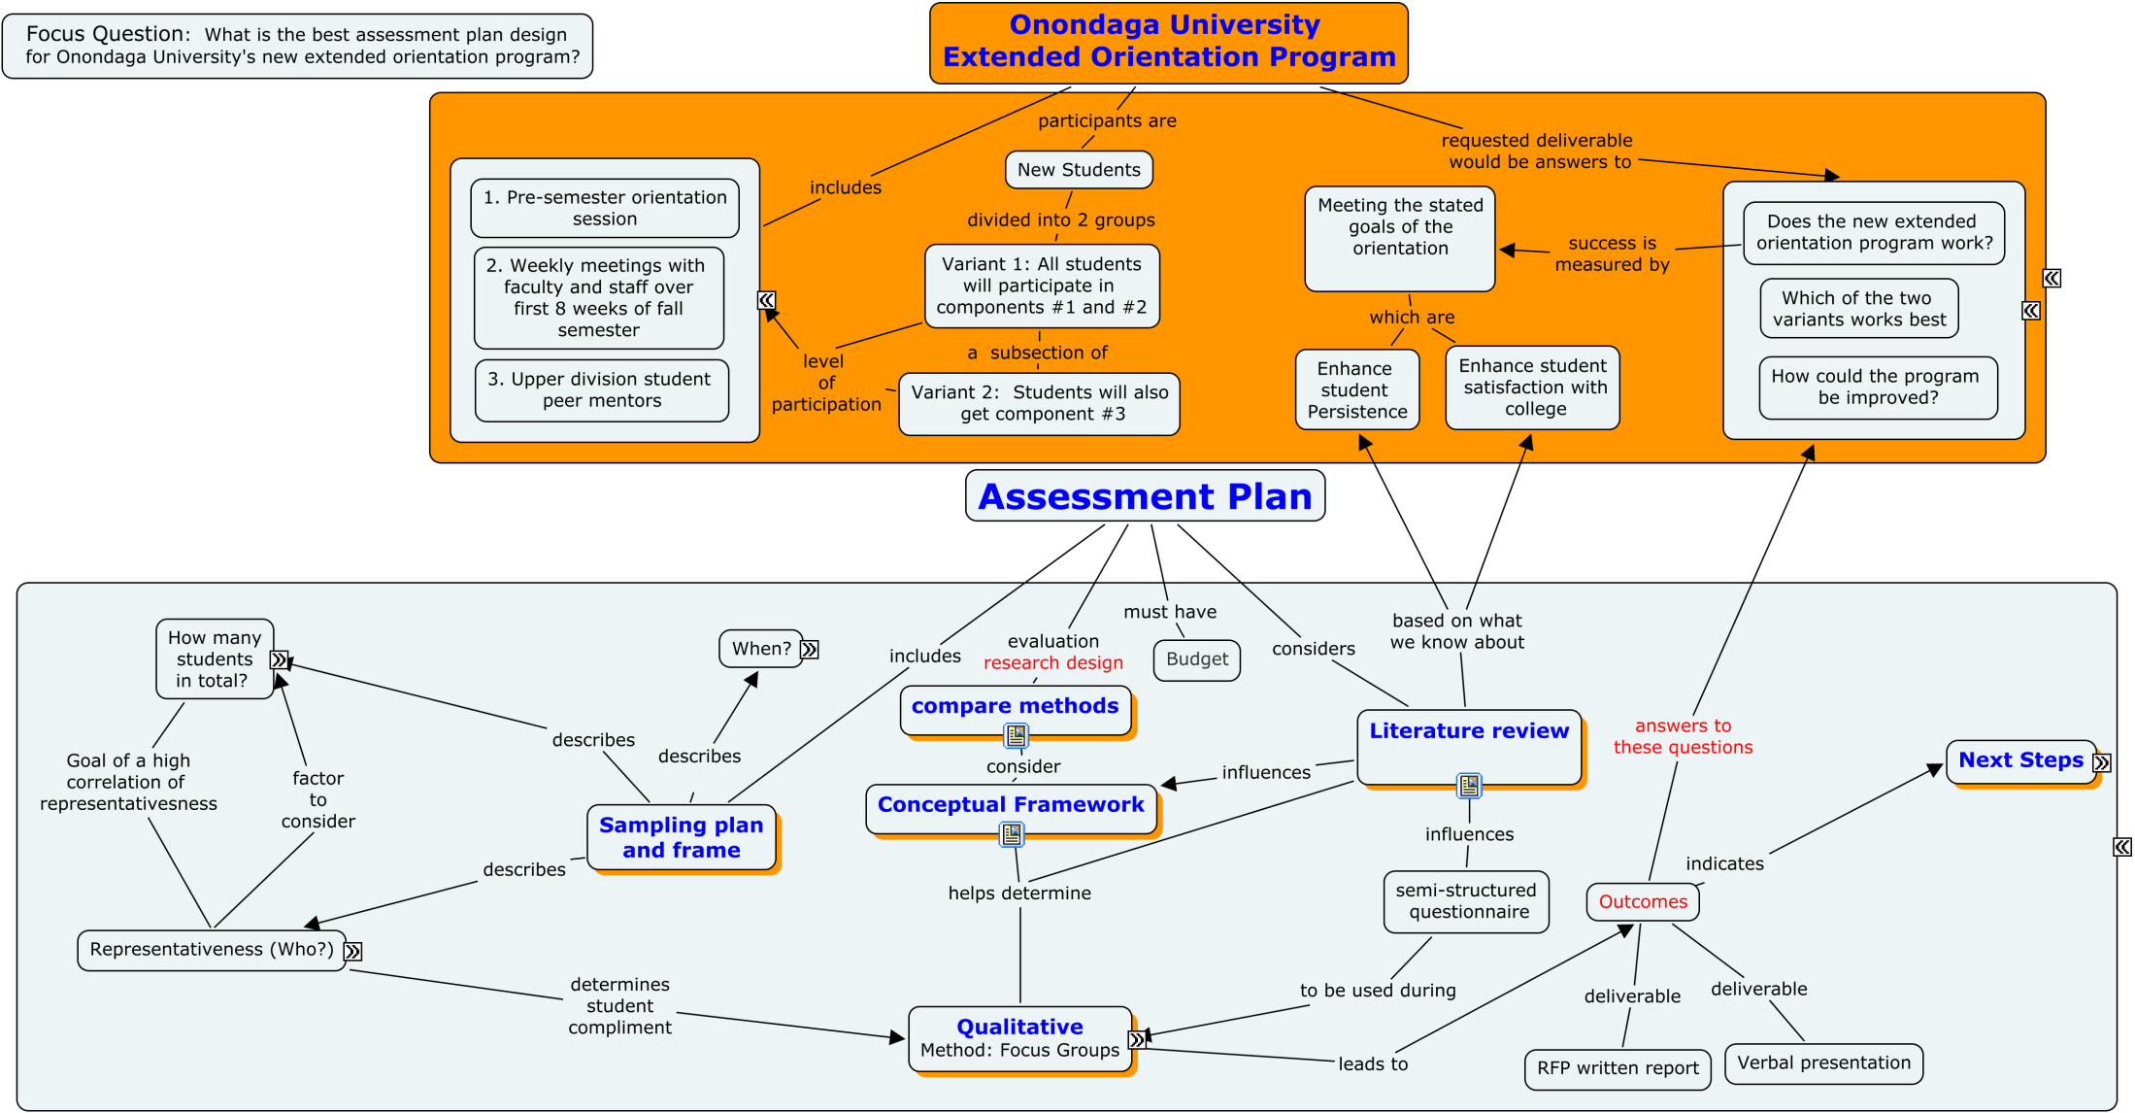

Slide 6
Literature Review
Student Persistence
Interactionist Theory - Tinto (1975, 1987, 1993)
  Social and Academic integration
Student Involvement - Astin (1993)
  Academics,
  relationships with faculty, and
  Interactions with student peer groups

Slide 7
Literature Review
  Academic achievement, Persistence, and Satisfaction is:
  Correlated to time and energy students apply to learning and engagement
  Pacarella and Terenzini (1991)

Slide 8
Literature Review
Varied Pathways to Persistence (Tinto, 1993)
Diverse student populations (Tinto, 1993)
Traditional students find making friends most threatening (Terenzini, 1994)
Non-traditional students tend to delay involvement until secured in academics (Terenzini, 1994)
Non-traditional students were motivated by validation from internal or external sources (Rendon, 1994)

Slide 9
Literature Review
Varied Pathways to Persistence
“The overall level of student satisfaction
. . . And adjustment differed significantly
by race/ethnicity” (Laanan, 1996, 1998)

Slide 10
Literature Review
Tinto (1993)
  Different institutional rates of departure
    Structure of institutional academics and social systems
    Individual students are responsible for departure

Slide 11
Literature Review
Rendon, Jalomo, and Nora (2011)
Practitioners have focused on offering programs to get more students involved
Instead of
On what motivates students to get involved

Slide 12
Most desirable student learning outcomes:
Student perceptions of the learning climate are positive
Students’ basic psychological needs are met by the learning institution
When students use more self determined form of motivation.
(Copland & Levesque-Bristol, 2011)

Slide 14
Conceptual Framework
Our Research Plan Influenced by:
The structured inquiry of Tinto, Pascarella and Terenzini and others
Our Constructivist Perspective

Slide 15
Conceptual Framework
Constructivism
“all knowledge . . . Is contingent upon human practices being constructed in and out of interactions between human beings and their world . . . Theory and practice inform one another in a mutually shaping manner”.
(Broido & Manning, 2002, p. 436)

Slide 16
Conceptual Framework
Postmoderism (constructivist theory)
Lead to more complex understanding of college students.
Seek to describe the depth and diversity of students and their perspectives rather than the norm.
(Broido & Manning, 2002)

Slide 17
Conceptual Framework
“Knowledge claims must be set within the
conditions of the world today and in the multiple
perspectives of class, race, gender, and other group
affiliations”. (Creswell, 2008 as covered by Broido & Manning, 2002, p.438)

Slide 18
Conceptual Framework
Consistent with this paradigm
Our method will be qualitative research in the form of Focus Groups
  Provides more flexibility
  Deeper understanding

Slide 19
Sampling Plan and Frame
To our Concept Map

